Slide 1


SUSTAINABLE
LEARNING
ECOSYSTEMS
Yuliia Fedorova
Oleksii Ilchenko
Denys Kovalenko
Juraj Mikuš
for Human-Centered AI in
Intergenerational Digital Workspaces
Comenius University Bratislava
V. N. Karazin Kharkiv National University
Bridging Technology and Humanity in
Intergenerational Workplaces
the learning ideas conference 2026 | Sustainable Learning Ecosystems
Notes:
Slide 1 — Title Slide
Time: approximately 45 seconds
Good afternoon, distinguished colleagues and conference participants.
My name is Oleksii Ilchenko, and on behalf of our research team — Yuliia Fedorova, Denys Kovalenko, Juraj Mikuš, and myself — I am pleased to present our study entitled “Sustainable Learning Ecosystems for Human-Centered AI in Intergenerational Digital Workspaces.”
Our research focuses on an important question: as artificial intelligence increasingly transforms work, how can we ensure that people continue to learn, collaborate, and make responsible decisions together with AI systems?
We propose a conceptual framework that connects human-centered AI, continuous learning, emotional intelligence, intergenerational collaboration, higher education, and workplace processes.

Slide 2

PRESENTATION ROADMAP
From motivation to conceptual framework and implementation.
01. Why the topic matters
02. Research problem and Aim
03. Conceptual foundation
04. What Is a Sustainable Learning Ecosystem?
05. SLE architecture
06. Core Components in Practice
07. Intergenerational collaboration
08. Higher education and workplace bridge
09. Methodological Approach
10. Six-Stage Implementation Approach
11. Expected Outcomes and Main Contributions
12. Conclusion
Notes:
Slide 2 — Presentation Roadmap
Time: approximately 35 seconds
I will begin by explaining why this topic matters and what research problem we address.
Then I will introduce the conceptual foundations and define the Sustainable Learning Ecosystem framework.
After presenting its architecture, I will discuss its practical components, the role of intergenerational collaboration, and the connection between universities and workplaces.
Finally, I will describe our methodology, implementation approach, principal contributions, and future research directions.

Slide 3

01. Why the topic matters
AI Changes Work, But Learning Often Stays Separate
The central challenge is how people learn with AI while working.
AI-Augmented Work
Fragmented Learning
Diverse workforce
Decision support
Analytics
Automation
Short Courses
Tool Training
Low Continuity
Digital Fluency
Experience
Trust differences
Key Ideas:
01
02
03
Continuous learning
Human-centered AI
Ecosystem view
Learning must be embedded directly in digital work processes, not limited to isolated training sessions.
AI should support understanding, reflection, autonomy, and professional judgment and be regulated by EI.
Universities, organizations, AI tools, and human reflection must be connected by feedback loops.
Notes:
Slide 3 — Why the Topic Matters
Time: approximately 1 minute 20 seconds
Artificial intelligence is already changing how organizations work.
AI supports decision-making, analytics, automation, knowledge management, and workflow optimisation. Employees increasingly work alongside intelligent systems rather than using only traditional digital tools.
However, learning often does not develop at the same speed. In many cases, organizations still rely on isolated training sessions or short courses focused on particular tools. Employees may learn how to operate a system, but not necessarily how to interpret AI recommendations, question automated outputs, or combine them with professional judgment.
This creates a gap between AI-augmented work and workplace learning.
The challenge is also intergenerational. Younger professionals may be more comfortable with digital experimentation and new AI tools. Experienced employees often contribute deep contextual knowledge, professional judgment, and organizational memory.
Our central argument is that sustainable AI adoption requires learning to be integrated directly into work processes. People should learn with AI while they work, reflect, collaborate, and make decisions.
Therefore, we need an ecosystem approach connecting AI tools, people, organizations, universities, and continuous feedback.

Slide 4

02. Research problem and Aim
Observed problem
Research gap
AI tools are adopted unevenly
Training is often isolated from workflows
Learning focuses on tools, not capabilities
AI feedback can be opaque or emotionally difficult to interpret
Limited integration of AI-supported learning, intergenerational collaboration, emotional intelligence, and workplace process integration into one sustainable framework.
To present a conceptual framework for Sustainable Learning Ecosystems (SLE) for Human-Centered AI across higher education and AI-augmented workplace contexts.
RESEARCH AIM
RQ1
RQ2
RQ3
Integration
Design
Implementation
How can human-centered AI, workplace learning and Emotional Intelligence be combined?
What components support transparency, reflection, skill evolution and lifelong learning?
How can universities and organizations operationalize feedback loops?
Notes:
Slide 4 — Research Problem and Aim
Time: approximately 1 minute 25 seconds
The problem behind our research consists of several related challenges.
First, AI tools are adopted unevenly. Different employees and organizations demonstrate different levels of readiness, confidence, and trust.
Second, training is often separated from real workflows. People receive instruction, but not always support when they must apply AI in a real professional situation.
Third, much learning remains tool-oriented rather than capability-oriented. Responsible AI collaboration requires transparency, reflection, digital literacy, communication, and professional autonomy.
Finally, AI-generated feedback can be difficult to interpret, particularly when it affects decisions, performance, or professional confidence.
This leads to our identified research gap: there is limited integration of AI-supported learning, human-centered design, emotional intelligence, intergenerational collaboration, higher education, and workplace processes within one sustainable framework.
Therefore, our research aim is to present a conceptual framework for Sustainable Learning Ecosystems for Human-Centered AI.
We address three questions: how these domains can be integrated, which components enable sustainable learning, and how universities and organizations can create effective feedback loops.

Slide 5





03. Conceptual Foundation
Human-Centered AI
AI-Augmented Learning
Transparency, explainability, accountability, empowerment and human control.
Adaptive learning, learning analytics, intelligent tutoring and simulation.
Workplace Learning & BMP
Emotional Intelligence
Learning embedded in business processes, monitoring, feedback and optimization.
Trust, reflection, communication and responsible human-AI interaction.
Notes:
Slide 5 — Conceptual Foundation
Time: approximately 1 minute 25 seconds
Our study is theoretical in nature and integrates scientific contributions from multiple disciplines.
The main research methods applied in this work are literature analysis and conceptual synthesis. Literature analysis allowed us to examine existing scientific perspectives on how artificial intelligence influences learning, work, collaboration, and decision-making.
The conceptual synthesis method then enabled us to combine insights from different research fields in order to develop a unified theoretical framework.
More specifically, our framework builds on five interconnected areas.
The first is artificial intelligence research, especially the principles of human-centered AI, including transparency, explainability, accountability, user empowerment, and human control.
The second is learning sciences, particularly AI-augmented and adaptive learning, where intelligent technologies support feedback, simulation, and continuous competence development.
The third is organizational behavior, which helps us understand collaboration, knowledge sharing, trust, and adaptation within digital workplaces.
The fourth is emotional intelligence research, which is important for interpreting AI-generated feedback, managing uncertainty, communicating effectively, and supporting responsible human-AI interaction.
The fifth is Business Process Management, which provides the perspective of integrating learning and AI support directly into organizational workflows, monitoring, and continuous process improvement.
Finally, based on this interdisciplinary synthesis, we propose the Sustainable Learning Ecosystem framework, which connects people, AI technologies, education, and workplace processes through continuous feedback loops.

Slide 6





04. What Is a Sustainable Learning Ecosystem?
"A Sustainable Learning Ecosystem is a socio-technical system where people, AI, and processes co-evolve through continuous feedback loops to ensure resilient professional growth."
Adaptive
Embedded
Human-Centered
Intergenerational
Feedback-Driven
Learners and AI systems adjust to new knowledge needs.
Learning takes place inside workflows, not only in classrooms.
AI supports understanding, autonomy and responsible decisions.
Generations exchange digital skills, judgment and experience.
Content, AI models and practices improve over time.
Notes:
Slide 6 — What Is a Sustainable Learning Ecosystem?
Time: approximately 1 minute 5 seconds
We define a Sustainable Learning Ecosystem as a socio-technical system where people, AI, and processes co-evolve through continuous feedback loops in order to support resilient professional growth.
This ecosystem is adaptive because it responds to changing skills and technologies.
It is embedded because learning happens inside workflows, not only in separate courses.
It is human-centered because AI should support understanding, autonomy, and responsible decisions.
It is intergenerational because different generations exchange digital capabilities, experience, contextual knowledge, and professional judgment.
Finally, it is feedback-driven because learning materials, AI tools, and organizational practices should improve over time.
So, an SLE is not simply a platform or a training programme. It is a long-term learning environment linking people, intelligent technologies, education, and work.

Slide 7

05. SLE architecture
A conceptual framework for Sustainable Learning Ecosystems
Human-Centered AI
Intergenerational Collaboration
Transparency & Explainability
User Empowerment
Emotional Intelligence
Knowledge sharing
Innovation and problem-solving
Trust and Adaptability
REAL-TIME
FEEDBACK
ADAPTIVE
LEARNING
Sustainable Learning Ecosystem
Higher Education Bridge
Workplace Integration
PREDICTIVE
ANALYTICS
University Programs
Simulated Environments
AI-Driven workflow
On-the-Job Learning
Lifelong skill evolution through continuous feedback loops
The architecture connects higher education, workplace processes, and intergenerational collaboration through continuous feedback loops.
Notes:
Slide 7 — Sustainable Learning Ecosystem Architecture
Time: approximately 2 minutes
This slide presents the central architecture of our conceptual framework.
At its centre is the Sustainable Learning Ecosystem. It is supported by three mechanisms: adaptive learning, predictive analytics, and real-time feedback.
Adaptive learning helps individuals and organizations respond to changing knowledge requirements.
Predictive analytics can identify patterns in organizational data and anticipate future learning or decision-support needs.
Real-time feedback allows learning to happen while tasks are being performed, not only after the process is complete.
Around the centre, the framework includes four supporting domains.
The first is Human-Centered AI, which focuses on transparency, explainability, user empowerment, and emotional intelligence. AI recommendations should be understandable and remain subject to human evaluation.
The second is Intergenerational Collaboration. Younger professionals may contribute digital fluency and rapid experimentation, while experienced professionals contribute contextual expertise, critical judgment, and organizational memory.
The third is the Higher Education Bridge. Universities prepare people for AI-supported work through applied curricula, simulations, digital laboratories, and research cooperation.
The fourth is Workplace Integration. Here, AI-supported learning becomes part of real business processes, workflow analytics, and on-the-job development.
The architecture therefore connects technology, human capabilities, educational preparation, and organizational practice through continuous feedback loops.

Slide 8
06. Core Components in Practice
From principles to everyday organizational learning.
01
02
03
AI-augmented workflow core
Human reflection interface
Emotional intelligence layer
AI supports knowledge processing and decision-making inside business processes.
Employees interpret AI outputs, evaluate recommendations and exercise agency.
Supports feedback interpretation, trust, communication and responsible interaction.
04
05
06
Collaboration mechanisms
Higher education-workplace bridge
Sustainability feedback loops
Implement continuous sustainability loops where content, models, and practices co-evolve over time.
Mentoring and knowledge exchange across generations.
Universities prepare; organizations continue learning inside real work.
Notes:
Slide 8 — Core Components in Practice
Time: approximately 1 minute 15 seconds
To move from architecture to practice, our framework identifies six core components.
First, an AI-augmented workflow core, where AI supports real decisions, knowledge processing, and process activities.
Second, a human reflection interface, where employees interpret AI recommendations and use professional judgment.
Third, an emotional intelligence layer, which supports trust, communication, feedback interpretation, and responsible interaction.
Fourth, collaboration mechanisms, such as mentoring, knowledge exchange, mixed-generation teams, and collaborative problem-solving.
Fifth, a higher education–workplace bridge, ensuring that universities prepare learners for real AI-augmented environments and organizations continue the learning process.
Finally, sustainability feedback loops, where process data, user experience, learning outcomes, and AI performance contribute to continuous improvement.
These components provide a practical structure for designing learning environments around responsible human-AI cooperation.

Slide 9






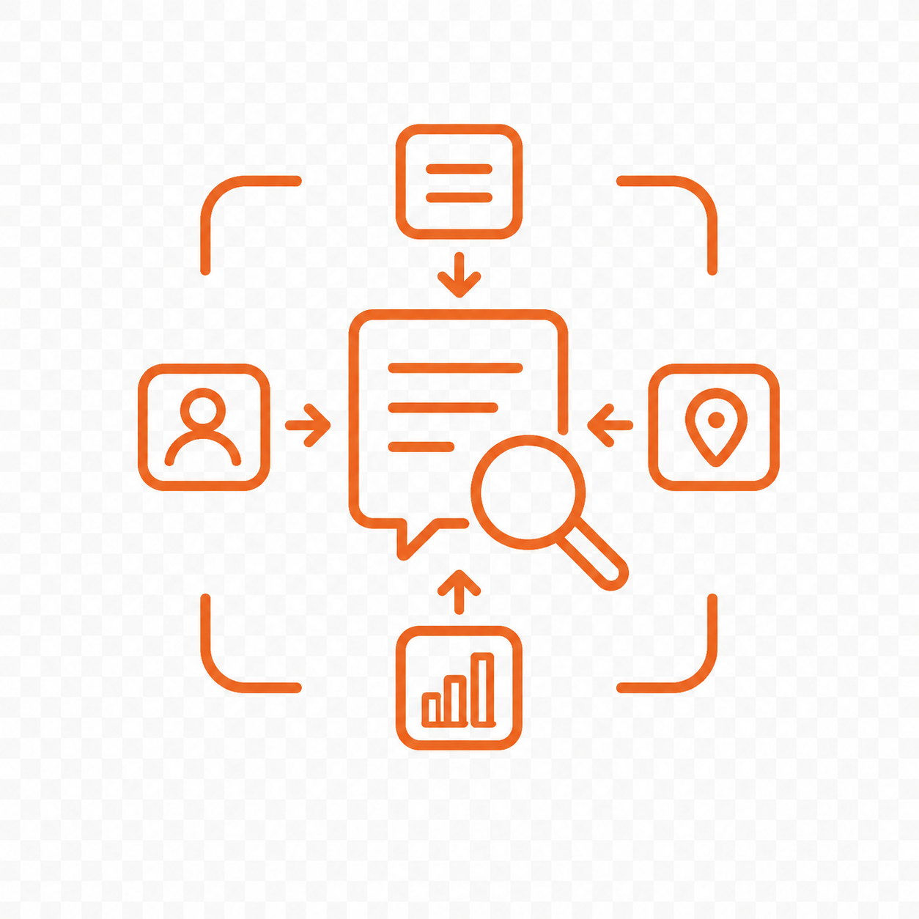
07. Intergenerational collaboration
Generational diversity becomes a source of resilience and knowledge exchange.
Younger Professional
Experienced Employees
High Digital Fluency
Deep Domain Expertise
Rapid Tool Experimentation
Professional Judgment
Experimentation with AI
AI-supported
knowledge
exchange
Organizational Memory
New forms of collaboration
Contextual Interpretation
"The SLE framework bridges technical agility with contextual wisdom, fostering a mutual exchange where AI-supported knowledge sharing creates a more resilient workforce."
Goal:
Combine Digital skills, experience, Emotional Intelligence and reflective Decision-Making.
Notes:
Slide 9 — Intergenerational Collaboration
Time: approximately 1 minute 25 seconds
Intergenerational collaboration is a central part of our framework.
Workplaces increasingly combine employees with different professional histories, digital experience, and expectations regarding AI.
Younger professionals often contribute digital fluency, openness to experimentation, and rapid adoption of new tools.
Experienced employees contribute deep domain expertise, contextual interpretation, professional judgment, and organizational memory.
Rather than viewing these differences as barriers, our framework treats them as complementary strengths.
For example, a younger professional may quickly explore how an AI system can analyse information or automate a task. An experienced colleague may evaluate whether the recommendation is practically meaningful, ethically acceptable, or consistent with organizational reality.
AI-supported knowledge exchange can make this cooperation more systematic. However, technology alone is not enough. Trust, communication, emotional intelligence, and mutual respect are essential.
The goal is to combine digital agility with contextual wisdom and reflective decision-making, creating a more adaptive and resilient workforce.

Slide 10






08. Higher education and workplace bridge
Universities prepare people for AI-augmented work; organizations continue learning inside work.
Higher Education
two-way exchange
• data
• feedback
• competencies
• research cooperation
Organizations
Applied Curricula
BPM Integration
Simulation Labs
Workflow Analytics
Research Cooperation
On-the-Job Learning
CONTINUOUS
FEEDBACK
Work Execution
Process Data
AI Analytics
Human Reflection
Improvement
Notes:
Slide 10 — Higher Education and Workplace Bridge
Time: approximately 1 minute 20 seconds
Universities have an important role in preparing people for AI-augmented workplaces.
Students should learn not only how to use AI tools, but also how to interpret AI outputs, work with data, question recommendations, collaborate responsibly, and understand the human and ethical dimensions of intelligent technologies.
This can be supported through applied curricula, simulation labs, project-based learning, industry cases, and research cooperation.
At the same time, organizations provide valuable feedback to universities. Real workplace processes generate data, practical challenges, competence requirements, and new research questions.
Therefore, the relationship should be two-directional.
Universities prepare professionals for AI-supported work, while organizations continue their learning through workflow analytics, on-the-job development, and human reflection.
This feedback cycle connects work execution, process data, AI analytics, human interpretation, and continuous improvement.
Such a bridge is important because AI-related competencies must evolve throughout professional life.

Slide 11
09. Methodological Approach
Conceptual interdisciplinary synthesis rather than primary empirical data collection.
01
02
03
04
Literature analysis
Conceptual synthesis
Framework development
Future validation
AI adoption, AI in education, workplace learning, human-centered AI, BPM and EI.
Integration of technology, learning sciences and organizational behavior.
Components, relationships, feedback loops and implementation stages.
Empirical testing in real universities and organizations.
Important clarification
The contribution is framework-building and synthesis. Empirical validation is positioned as the next research stage.
Notes:
Slide 11 — Methodological Approach
Time: approximately 55 seconds
Our research is conceptual and interdisciplinary.
We do not present results from a completed empirical experiment. Instead, we synthesise existing research from several fields: AI adoption, AI in education, workplace learning, human-centered AI, emotional intelligence, intergenerational collaboration, and Business Process Management.
Based on this literature analysis, we developed the Sustainable Learning Ecosystem framework, identified its main components, and proposed an implementation path.
This is important to clarify because our contribution is currently framework-building.
The next research stage will involve empirical validation in real educational and organizational settings, where the influence of the ecosystem on learning, collaboration, trust, and workplace outcomes can be measured.

Slide 12
10. Six-Stage Implementation Approach
How the conceptual model can move into practice.
01
02
03
Assess Environment
Integrate Processes
Establish Interfaces
Evaluate current digital learning infrastructure and identify gaps in human-AI collaboration readiness.
Embed AI-augmented learning directly into core business workflows to ensure context-aware skill development.
Design human-centered reflection interfaces that support transparency and professional autonomy.
04
05
06
Support Exchange
Bridge HE & Work
Create Feedback Loops
Foster intergenerational knowledge sharing through AI-supported mentoring and collaborative problem-solving.
Connect higher education curricula with workplace reality through simulation labs and industry data exchange.
Implement continuous sustainability loops where content, models, and practices co-evolve over time.
Notes:
Slide 12 — Six-Stage Implementation Approach
Time: approximately 1 minute 50 seconds
To make the conceptual model more practical, we propose a six-stage implementation approach.
The first stage is Assess Environment. Organizations or universities should evaluate their existing digital tools, learning practices, AI readiness, and collaboration challenges.
The second stage is Integrate Processes. AI-supported learning should become part of real workflows rather than remain an isolated technical solution.
The third stage is Establish Interfaces. Employees need transparent, human-centered ways to interpret AI recommendations, understand context, provide feedback, and exercise professional judgment.
The fourth stage is Support Exchange. Organizations should create opportunities for intergenerational mentoring, knowledge sharing, collaborative problem-solving, and reflective learning.
The fifth stage is Bridge Higher Education and Work. Universities and organizations can cooperate through simulations, applied courses, joint research, industry datasets, and real professional cases.
The sixth stage is Create Feedback Loops. Information from learning analytics, employee experience, organizational data, and AI outputs should improve processes, learning content, and intelligent systems over time.
These stages provide a flexible pathway. They are not necessarily linear, because sustainable ecosystems should continuously adapt to changing technologies and human needs.

Slide 13

11. Expected Outcomes and Main Contributions
For Learners
For employees
For organizations
For universities
For society
Adaptive, contextual and reflective learning experiences.
Higher AI literacy, resilience and confidence.
Adaptive, contextual and reflective learning experiences.
Stronger alignment with workplace needs.
Inclusive lifelong learning.
MAIN CONTRIBUTIONS
01
02
03
Integrative framework
Shift in learning logic
Practical path
Connects human-centered AI, learning sciences, EI, intergenerational collaboration and BPM.
Moves from isolated training toward continuous learning embedded in digital work processes.
Provides a six-stage approach for universities and organizations.
Notes:
Slide 13 — Expected Outcomes and Main Contributions
Time: approximately 1 minute 10 seconds
The proposed framework can create value for several groups.
For learners, it supports adaptive and reflective learning connected with real professional contexts.
For employees, it can strengthen AI literacy, confidence, resilience, and the ability to work responsibly with intelligent systems.
For organizations, it supports continuous learning integrated into processes and improves the potential for knowledge sharing and adaptation.
For universities, it strengthens alignment between educational programmes and workplace requirements.
For society, it supports inclusive lifelong learning during digital transformation.
Our framework makes three main contributions.
First, it integrates human-centered AI, emotional intelligence, intergenerational collaboration, learning sciences, and BPM within one model.
Second, it shifts the focus from isolated tool training toward learning embedded in everyday digital work.
Third, it offers a practical six-stage implementation approach for universities and organizations.

Slide 14







12. Conclusion
The future of AI in work is not only about smarter algorithms. It is about designing ecosystems where people, organizations and intelligent systems learn together.
Key Takeaways
Next Steps
SLE moves beyond tool training to a human-centered ecosystem.
Empirical validation in real-world organizational settings.
Refine AI-augmented feedback for deeper human reflection.
Continuous feedback links academic preparation with workplace reality.
Develop standardized metrics for ecosystem sustainability.
Intergenerational synergy turns diversity into resilience.
Notes:
Slide 14 — Conclusion
Time: approximately 55 seconds
To conclude, the future of artificial intelligence in the workplace is not only about developing smarter algorithms.
It is about designing environments where people, organizations, and intelligent systems can learn together.
Our framework positions learning, human reflection, emotional intelligence, and intergenerational collaboration at the centre of AI adoption.
It also highlights the need for continuous cooperation between universities and organizations, because professional competencies must evolve together with technology.
Intergenerational diversity should not be treated as an obstacle. When digital agility is combined with experience, contextual judgment, and responsible decision-making, it becomes a source of organizational resilience.
The next step is to validate this framework empirically in real educational and workplace contexts.

Slide 15
Thank you for your attention.
Sustainable Learning Ecosystems
for Human-Centered AI
in Intergenerational Digital Workspaces
Yuliia Fedorova
Oleksii Ilchenko
Denys Kovalenko
Juraj Mikuš
For any additional questions or opportunities for further collaboration, please feel free to contact me by email: yuliia.fedorova@fm.uniba.sk
Comenius University Bratislava
V. N. Karazin Kharkiv National University
the learning ideas conference 2026 | Sustainable Learning Ecosystems
Notes:
Slide 15 — Thank You Slide
Time: approximately 15 seconds
Thank you very much for your attention.
On behalf of our research team, I would also like to thank the conference organizers for the opportunity to present this work.
For any additional questions or opportunities for future collaboration, please feel free to contact us by email.

Slide 16
Questions and discussion are welcome.
Sustainable Learning Ecosystems
for Human-Centered AI
in Intergenerational Digital Workspaces
Yuliia Fedorova
Oleksii Ilchenko
Denys Kovalenko
Juraj Mikuš
For any additional questions or opportunities for further collaboration, please feel free to contact me by email: yuliia.fedorova@fm.uniba.sk
Comenius University Bratislava
V. N. Karazin Kharkiv National University
the learning ideas conference 2026 | Sustainable Learning Ecosystems
Notes:
Slide 16 — Questions and Discussion
Time: approximately 5 seconds
Thank you once again. I will be pleased to answer your questions.

