Slide 1

Social Media Addiction and Academic Attainment in an Underrepresented Student Population
Prince Mohammad bin Fahd University
Maryam BoJulaia*, Renad Alshaykhahmed, Beshaier Alqahtaniand, and Maura Pilotti

Slide 2
Adaptation
A positive response to environmental change
A characteristic of learning
A key outcome of the learning process
Adaptation to social media can be ambiguous
Evident of social media use

Slide 3

Maladaptive Social Media Use
Excessive concern about social media
Lack of self-regulatory control
It takes different forms
User purpose
Context of use

Slide 4
Maladaptive Social Media Use
Spending a lot of time and energy on social media applications
Personal relationships
Academic performance and learning
Work productivity
Overall well being
It has both positive and negative impacts on users
Excessive use classified as addictive behavior

Slide 5
Social Media
Salience: Social media becoming the most important activity
Tolerance: The need for increasing amounts of time spent on social media
Mood modification: Cope with undesirable mental states
Relapse: Occurs when the activity is no longer under control
Withdrawal: Unpleasant mental states and physical
Conflict: Neglecting responsibilities and relationships due to SMA

Slide 6

Social Media Use in Saudi Arabia
Maladaptive social media use is a social and health issue
Users unaware of negative effects
Literature highlighted mixed findings:
Higher social media use often linked to lower GPA
Students don’t recognize the the negative impact
Reported positive attitudes
Social media addiction and academic procrastination

Slide 7
Social Media Use in Saudi Arabia
No direct relationship between time spent on social media and GPA
Key to academic impact is distraction, not time spent

Slide 8

Cognitive Load Theory
Distraction reduces working memory capacity
Limited-capacity system process information
Engaging in demanding learning tasks
Distractions reduce mental resources for learning
Reduce understanding and compromised learning

Slide 9
Cognitive Load Theory
Multitasking with media impairs learning
Attention switching
Tasks coordination
Integration information & long-term memory
Addictive social media use:
Significant diversion
Impairment in performance

Slide 10
Cognitive Load Theory
Link between addiction and impaired task performance
Literature’s evidence:
Media multitasking affects learning performance
Background media reduce activities’ quality

Slide 11

Prospective and Retrospective Memory
Few studies examine long-term memory systems:
Prospective memory: remembering intentions
Retrospective memory: recalling past information
Social media addiction may impair both memory type
Awareness of memory failures

Slide 12

Self-Efficacy
Confidence in one’s ability influences academic performance
Social media use can reduce interest in studies
Positive self-efficacy may offset negative effects of social media
Mixed evidence of self-efficacy

Slide 13
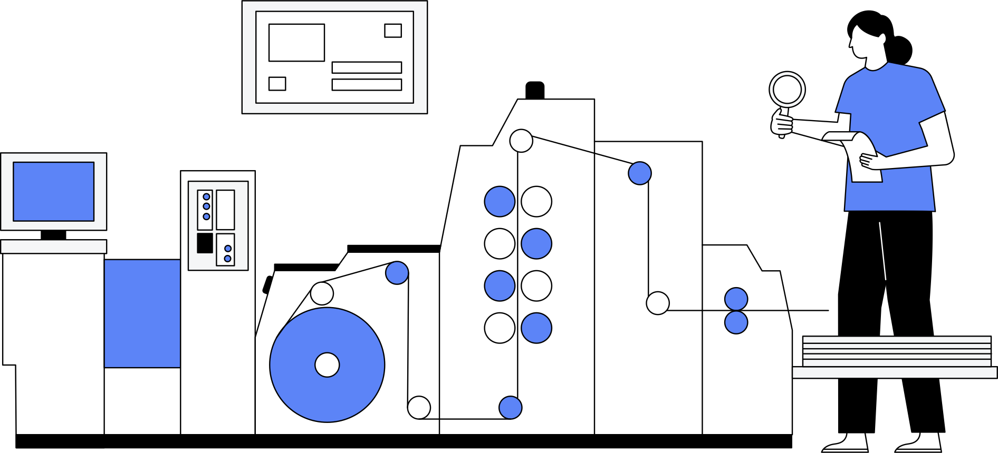
Research Purpose
Investigate if social media addiction predicts academic attainment
Social media addiction measured by (BSMAS)
Academic attainment (GPA)
Memory concerns (prospective & retrospective )
Self-efficacy

Slide 14

Research Hypotheses
GPA inversely related to social media addiction and memory concerns and positively related to self-efficacy
Self-efficacy emerge as the best predictor of GPA
High and low-performing students differ in use, memory, and efficacy

Slide 15
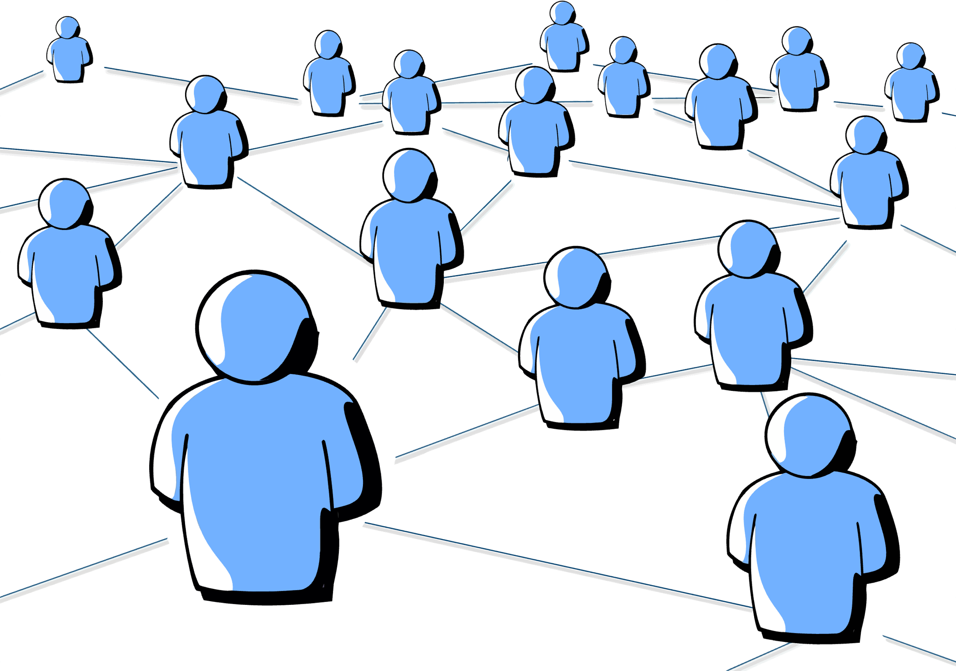
Methods: Participants
Purposive sampling
356 female undergraduate students
199 students in STEM fields
157 students in non-STEM fields
Ages: 18–28
Language
First Language: Arabic
Second language: English

Slide 16
Methods: Instructional Context
Courses:
Intro to Psychology
Critical Thinking
Written Communication
English-medium university in Saudi Arabia
The participation 96%

Slide 17

Methods: Materials and Procedure
Data collected during high academic pressure period
Social media as technological applications to share content
A self-reflection
Three scales:
Bergen Social Media Addiction Scale (BSMAS)
Prospective and Retrospective Memory Questionnaire (PRMQ)
Self-Efficacy Scale (SES)

Slide 18

Bergen Social Media Addiction Scale (BSMAS)
Measures addictive social media behavior
Six components of addiction:
Salience
Tolerance
Mood modification
Relapse
Withdrawal
Conflict
Rated on 5-point Likert scale

Slide 19
Prospective and Retrospective Memory Questionnaire (PRMQ)
Captures holistic memory concerns
Prospective
Retrospective
16 statements, rated 5-point Likert scale

Slide 20
Self-Efficacy Scale (SES)
Assesses self-efficacy
8 statements of confidence rated 1–5

Slide 21

Cognitive Functioning
GPA used as measure of cognitive functioning
End-of-first-year data collected from registrar
Links with memory, self-efficacy, and social media use

Slide 22
Results
Lower GPA → Higher social media addiction
Lower GPA → Higher prospective memory concerns
Lower GPA → Higher retrospective memory concerns
Higher GPA → Higher self-efficacy

Slide 23
Results
Table 1. Regression Analysis with GPA as the outcome variable
 | B | SE b | Beta | t | p
Constant | 4.035 | 0.198
BSMAS * | -0.393 | 0.029 | -0.576 | -13.438 | < 0.001
PRMQ-Pro. Mem. | -0.049 | 0.034 | -0.065 | -1.454 | ns
SES * | 0.087 | 0.026 | 0.151 | 3.407 | = 0.001

Slide 24
Results
Table 2. Regression Analysis with GPA as the outcome variable
 | B | SE b | Beta | t | P
Constant | 4.060 | 0.174 |  | 23.399
BSMAS * | -0.395 | 0.029 | -0.579 | -13.839 | < 0.001
PRMQ-Retro. Mem. * | -0.065 | 0.028 | -0.099 | -2.282 | = 0.023
SES * | 0.080 | 0.026 | 0.138 | 3.125 | = 0.002

Slide 25
Results
Table 3. Descriptive statistics
Performance Category | Under Perf. Mean | SD | High Perf. Mean | SD
BSMAS | 3.31 | 0.77 | 2.76 | 0.77
PRMQ-Prospective Mem. | 4.18 | 0.54 | 3.11 | 0.48
PRMQ-Retrospective Mem. | 3.26 | 0.63 | 2.03 | 0.56
SES | 3.18 | 0.95 | 4.34 | 0.57
GPA | 2.79 | 0.55 | 3.19 | 0.50

Slide 26

Results
High performers (n=163)
Lower addictive social media use and fewer memory concerns
Higher self-efficacy and grades
Under-performers (n=193)
Higher addictive social media use and more memory concerns
Lower self-efficacy and grades
High- and low-performing students differ in social media use, memory concerns, and self-efficacy

Slide 27

Discussion
Targeting social media addiction may improve GPA
Public awareness campaigns through:
Individualized training
Screening tools (e.g., BSMAS)
Screen-time monitoring applications
Promote students’ psychological well-being

Slide 28
Discussion
Workshops to enhance students' confidence
Training in organizational strategies and memory aids
Quality of attention is the primary driver of academic success
Educating students on how multitasking might prevents the deep processing required for complex learning

Slide 29

Future Work
Generalizability to other populations
Male students in Saudi Arabia may differ in outcomes
Targeting specific major groups
Further research needed on gendered educational contexts

Slide 30
Authors Contact Information
Maryam BoJulaia Renad Alshaykhahmed
mbojulaia@pmu.edu.sa 202200373@pmu.edu.sa
Beshaier Alqahtani Maura Pilotti
balqahtani@pmu.edu.sa mpilotti@pmu.edu.sa

