Slide 1

New Directions in Assessment: Societal Impact and Artificial Intelligence
Kent Seaver​
University of Texas at Dallas – Naveen
Jindal School of Management​
Kenton.Seaver@utdallas.edu​

Slide 2

Key Takeaways
Indirect Measures are the best way to determine the overall success of a school’s mission.
AI can be used to improve learning outcomes for students, as well as programs.
Societal Impact is a critical component of assessment; schools can use data to tell their story in ways that stakeholders can understand.

Slide 3
Why Assessment?
Accreditation leads to assessment​.
Accreditation serves as both a quality assurance and accountability mechanism for our learning institutions. ​
Creates a living document where evidence is collected, and changes can be documented. ¹
¹ Blaine T. Garfolo, Northwestern Polytechnic University, United States and Barbara L’Huillier, Prince Mohammad Bin Fahd University, Saudi Arabia​ Demystifying Assessment: The Road To Accreditation​ Journal of College Teaching & Learning – Third Quarter 2015
Notes:
AoL

Slide 4
Jindal School Breakdown
Almost 10,000 students (BS, MS, MBA, PhD, Cert. EXEC ED).
210 assessed courses across 82-degree programs; approximately 85 different coordinators.
Some UGRD classes have 20+ sections.
Courses taught in four different modalities (synchronous, online synchronous, asynchronous online, hybrid).

Slide 5
Indirect Measures of One College
Advisory Boards ​
Alumni/Exit Surveys​
Career Fair Evaluations
​
Competitions/Cases​
Student Organizations

Slide 6
Purpose of Indirect Measures
Assessing whether a curriculum is accomplishing desired objectives​
May have a more comprehensive impact than direct measures​
A school’s mission, expected outcomes, and strategies are used in combination to determine measures​.¹
¹ 2020 Interpretive Guidance for AACSB Business Accreditation 2023 Update

Slide 7
Indirect Measures, Societal Impact, and AI
A better understanding of curriculum’s impact on external stakeholders can be illustrated via indirect measures.
Indirect measures (i.e., community hours and school outreach) are sustainable, replicable, and promote mindfulness. ​
Sustainable development and advancement of societal goals can be aided by using AI solutions.²
​
² AI for social good: unlocking the opportunity for positive impact, 2020

Slide 8

Higher Education and Societal Impact
Societal impact encompasses all areas of teaching, research, and service. ​
One vision of societal impact is that business schools contribute expertise to help mitigate some of society’s most pressing economic, social, human, and environmental problems.¹ ​
¹ AACSB and Societal Impact​
Aligning With the AACSB 2020 Business Accreditation Standards​
February 2023

Slide 9

Incorporating AI into Program Assessment
Take SLO and use Co-pilot for new measures/examples.
Use existing measures and SLO's to improve success via Co-pilot suggestions.
AI can lead to better understanding of Sustainable Coursework; create cases and ideas.²
²AI and Assessment: Where We Are Now, AACSB, 4/15/24

Slide 10
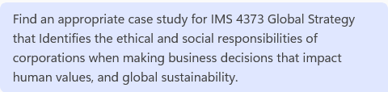
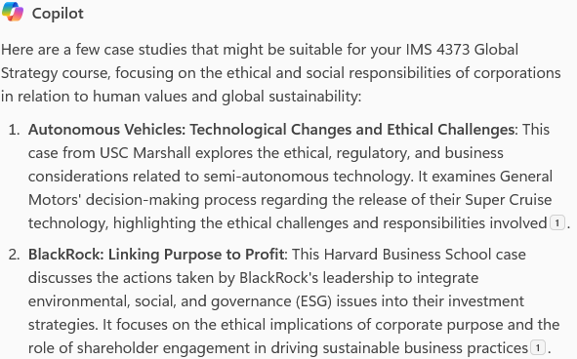

Slide 11
IMS 4373 Global Strategy
CSLO 1 | Students will be able to analyze a case study and provide strategy recommendations for a multinational corporation in a foreign market | Students were expected to analyze a business case based on a business problem of a multinational corporation. Based on their analysis students were asked to provide a set of recommendations. | 80% of students will score at least 80% on the measures used Course is offered every spring semester | 40 students participated in this course in AY 24-25. 85% of the students were able to score 90% and above when making strategy recommendations for a multinational corporation in a foreign market. | Every semester the instructor tries to improve the delivery of the course by bringing more industry speakers who led strategic transformation of their companies and are well versed in the subject matter. The format of this course includes a number of discussions, activities, speakers and case studies. The course is based on the Ethical Justice models of case study and seems to be gaining interest among students. The instructor will try to cover more material during the upcoming semester to ensure wider coverage of the topic.

Slide 12
AI Needed for Student Organizations
Lack of metrics is a common problem that student organizations face when attempting to assess effectiveness and engagement of student-organized activities.
Language and sentiment-based frameworks can be used by student organizations that are looking for an alternative to assess the effectiveness of student activities.⁴
⁴Quantifying the Effectiveness of Student Organization Activities using Natural Language Processing, 2024.
Notes:
Engagement outside of the classroom is critical.​
​
Student Organizations are perfectly suited to handle this task.​
21 Organizations (519 students, over 7700 hours) engaged the community.​
​
Indirect measures (community hours and school outreach) are sustainable, replicable, and promote mindfulness. ​
​

Slide 13
Societal Impact Template: Curriculum and Indirect Measures Meet Students Organizations….with AI

Slide 14
Conclusions/Analysis
Indirect measures can help with curriculum changes.
Indirect measures coupled with AI can create a stronger focus on academic assessment.
Societal Impact works in this settings because approaches that brings together parties with complementary skill sets can collectively address complex issues.

Slide 15
Why need AI
1. Not hitting mark
2. Hit mark all the time... not AoL
3. Need help with AoL...creativity...want to try
Critical Thinking and mindfulness...it equals mindfulness
Bigger slide for 3350 vita-separate onto another slide
What goes into the exit survey.... did you learn the skill in class? Employer feedback
Alumni survey...societal impact....nonprofit focus....outreach.

