Slide 1
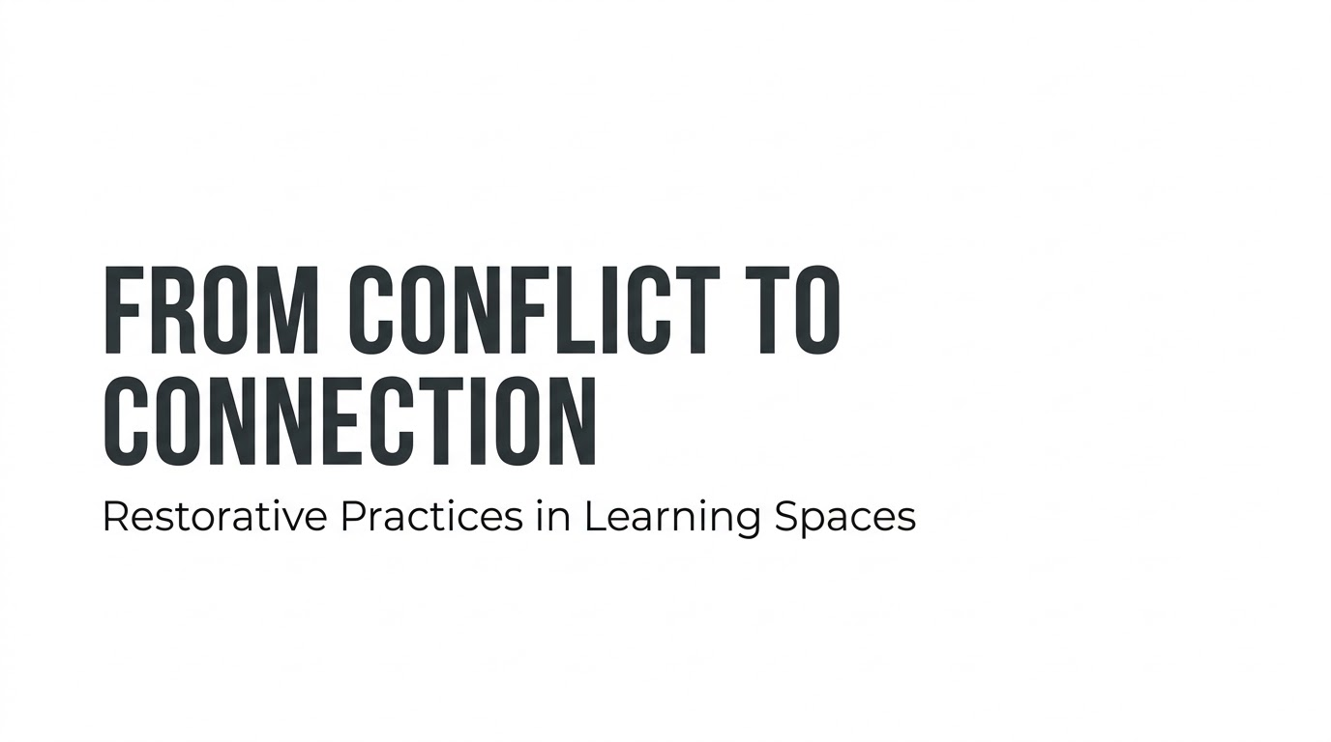

Slide 2
Participant Outcomes
By the end of this session, you will have:
A clear framework for restorative practice
Four practical tools you can use immediately
A repeatable facilitation sequence
Indicators that help you document relational and cultural change

Slide 3
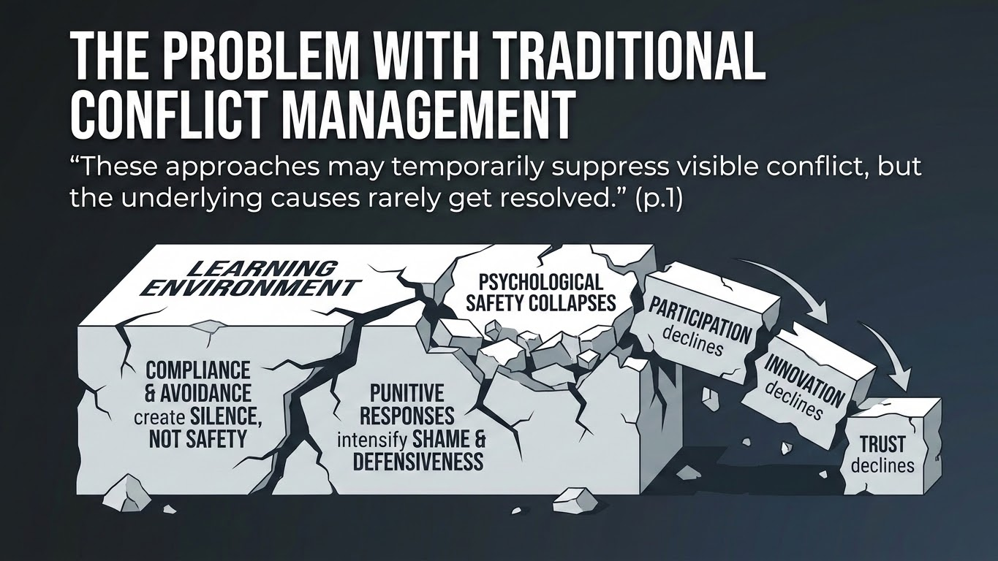

Slide 4
Most institutions default to three predictable patterns:
Compliance
Avoidance
Punishment
“prioritize control and order over humanity.”
They create a fragile calm — a quiet built on fear, not trust.

Slide 5
“These behaviors leave relational harm unaddressed
and lead to disengagement.”

Slide 6
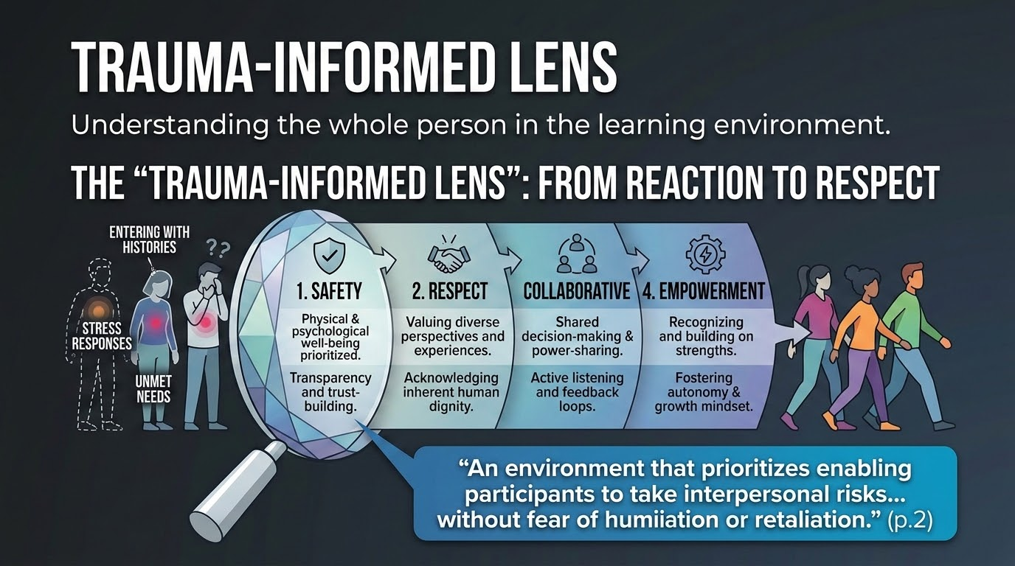

Slide 7
Restorative work succeeds only when grounded in a trauma‑informed lens.
People enter learning spaces with:
Histories
Stress responses
Unmet needs
SAMHSA’s principles: safety, respect, collaboration, empowerment
align directly with restorative practice.

Slide 8
effective environments:
“enable participants to take interpersonal risks without fear of humiliation or retaliation.”

Slide 9
And facilitators support this through:
“consistent facilitation patterns, transparent communication, and opportunities for learner choice and agency.”

Slide 10
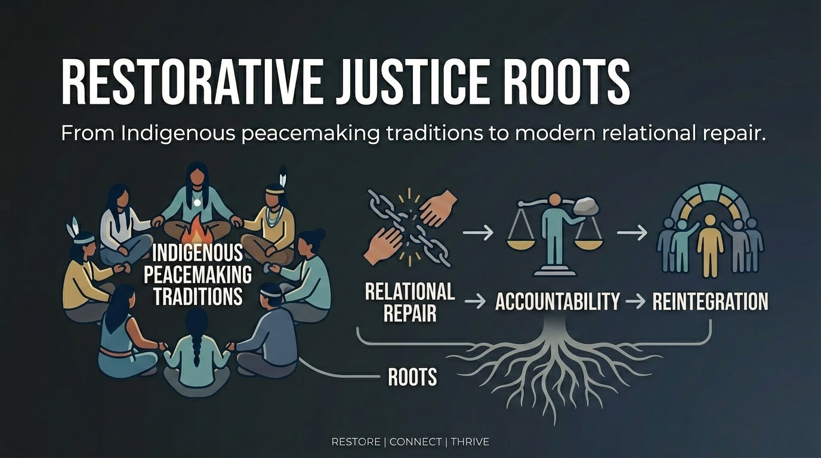

Slide 11
Restorative practice is grounded in Indigenous peacemaking traditions that center:
Relational repair
Accountability
Reintegration
Modern frameworks build on these traditions, but the heart remains the same:
Restore. Connect. Thrive.

Slide 12
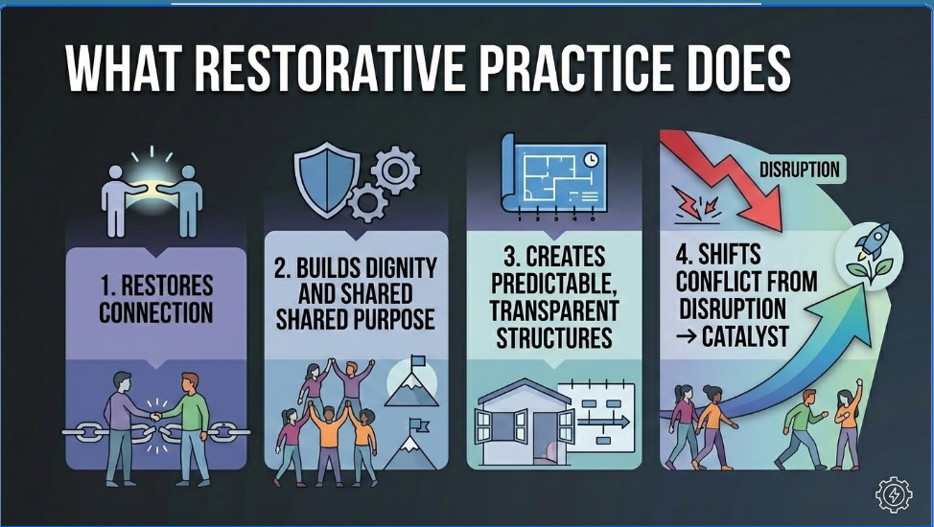

Slide 13
Restorative practice:
Restores connection
Builds dignity and shared purpose
Creates predictable, transparent structures
Shifts conflict from disruption → catalyst
As the paper states:
“Conflict becomes a catalyst for engagement rather than disruption.”

Slide 14
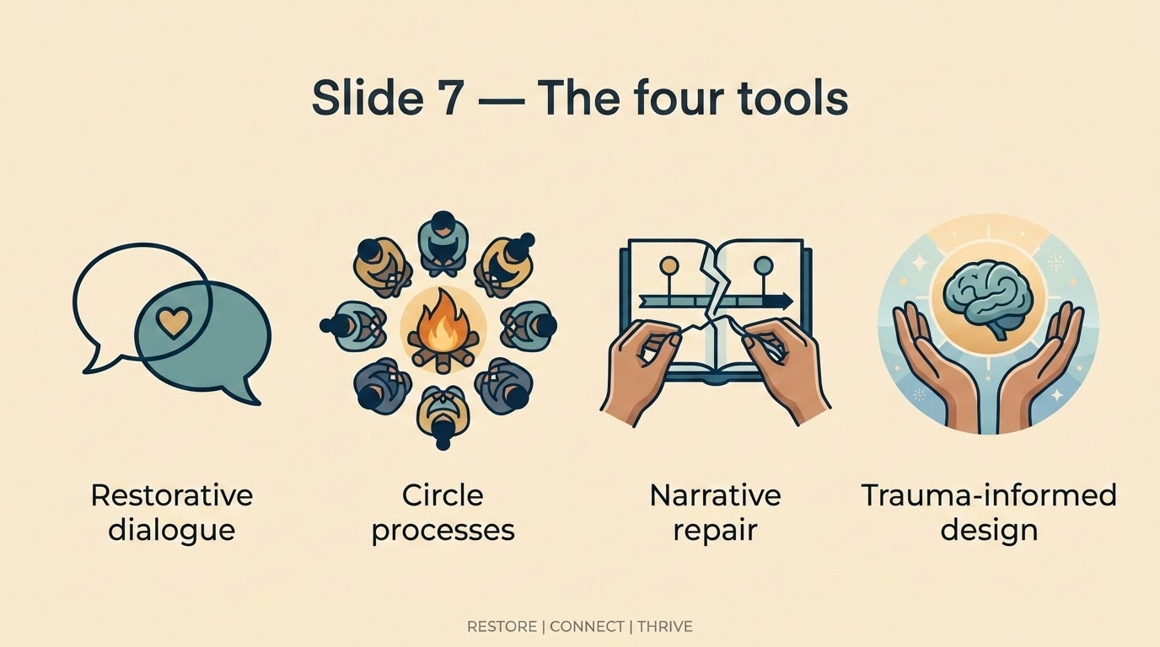
Each tool is effective on its own and transformative when used together.

Slide 15
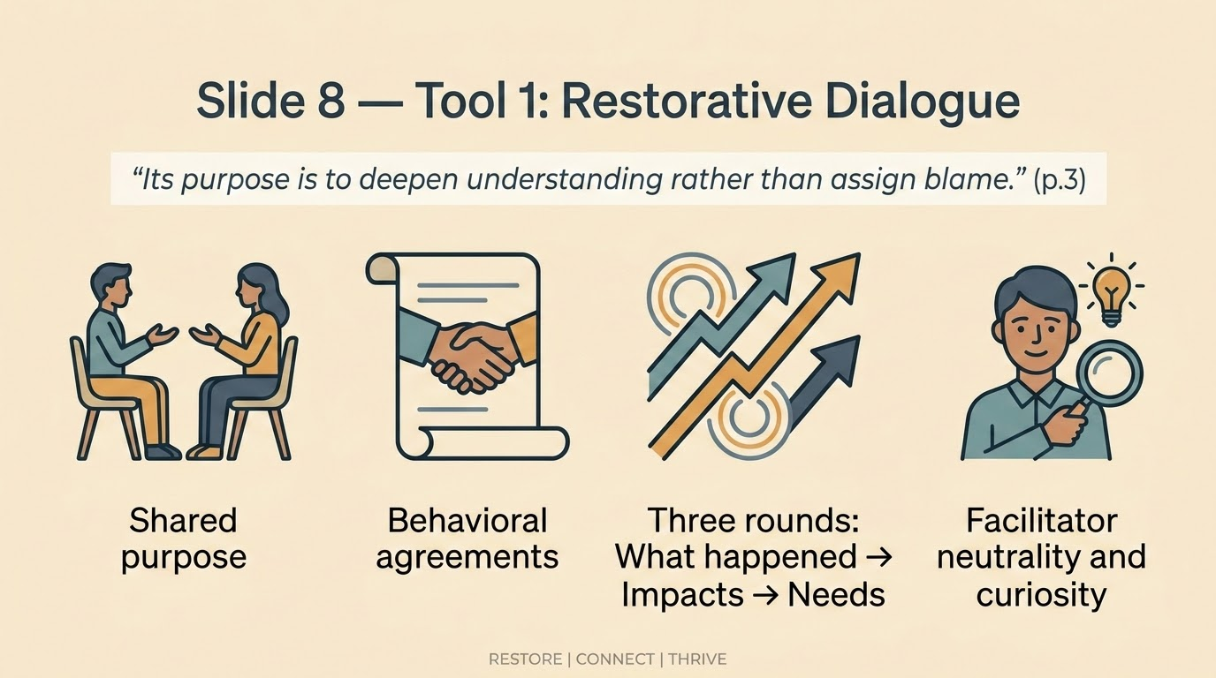

Slide 16
Restorative dialogue is structured, intentional conversation designed:
“to deepen understanding rather than assign blame.”
It includes:
A shared purpose
Behavioral agreements
Three predictable rounds:
  What happened
  Impacts
  Needs and commitments
Facilitator neutrality and curiosity

Slide 17
“This structure is predictable, repeatable, and supports emotional and cognitive behavior change.”

Slide 18
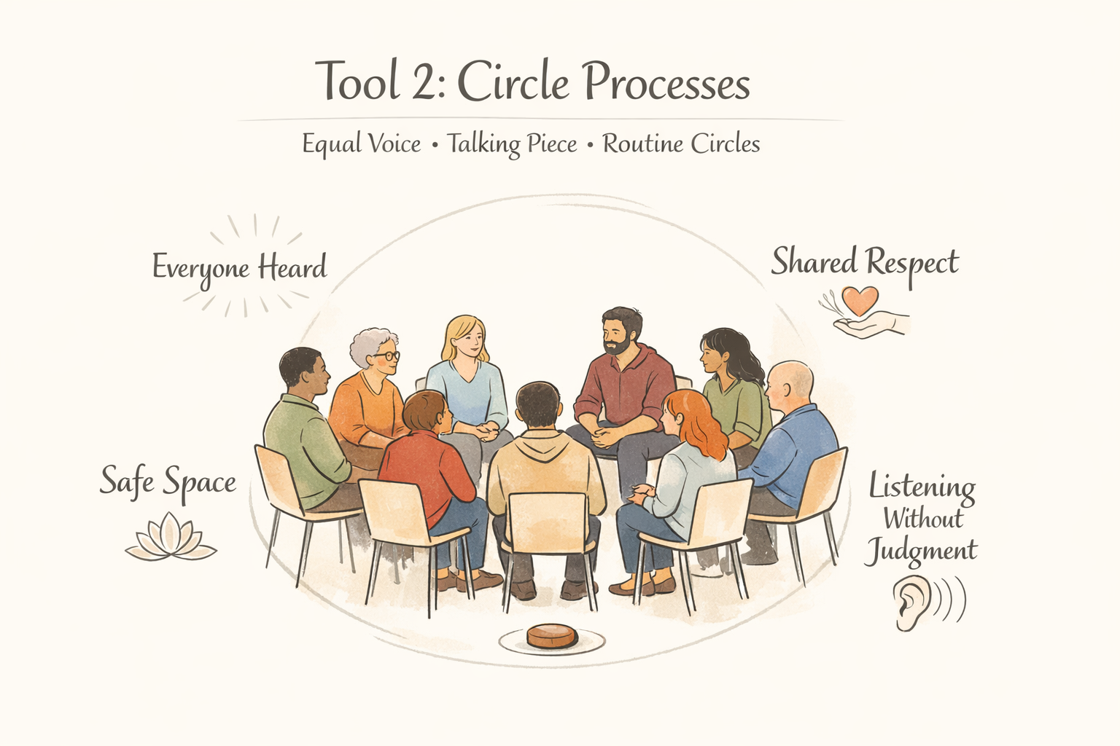

Slide 19
Circle processes build community before conflict arises.
Key elements:
Equal voice
A talking piece
Listening without judgment
Routine circles that normalize reflection

Slide 20
“Scheduling weekly circles… transforms relationships from transactional to restorative.”

Slide 21
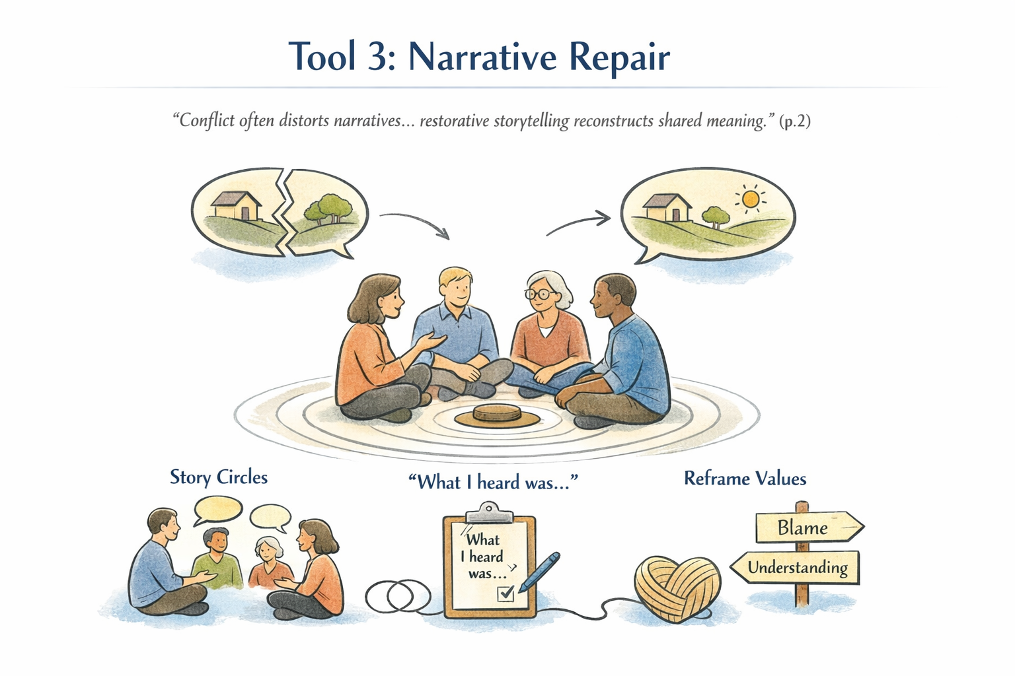

Slide 22
Conflict distorts the stories we hold about ourselves and each other.
Narrative repair helps participants:
Externalize the problem
Share experiences safely
Reconstruct shared meaning
Use acknowledgment statements like “What I heard was…”

Slide 23
“Conflict often distorts these narratives, shaping perceptions of belonging, fairness, and identity.”

Slide 24
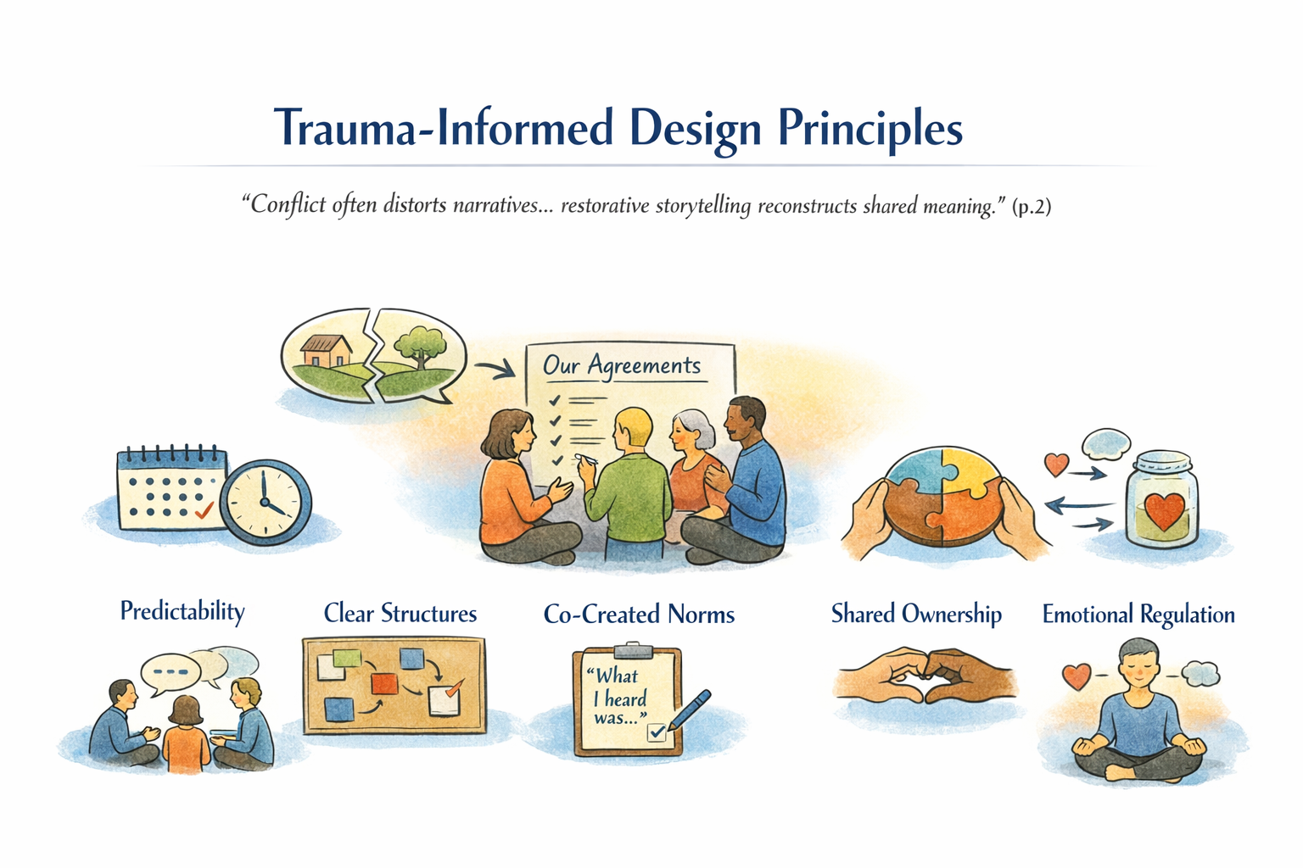

Slide 25
“Creating and maintaining clear structures, open communication, and co‑created norms is imperative.”

Slide 26
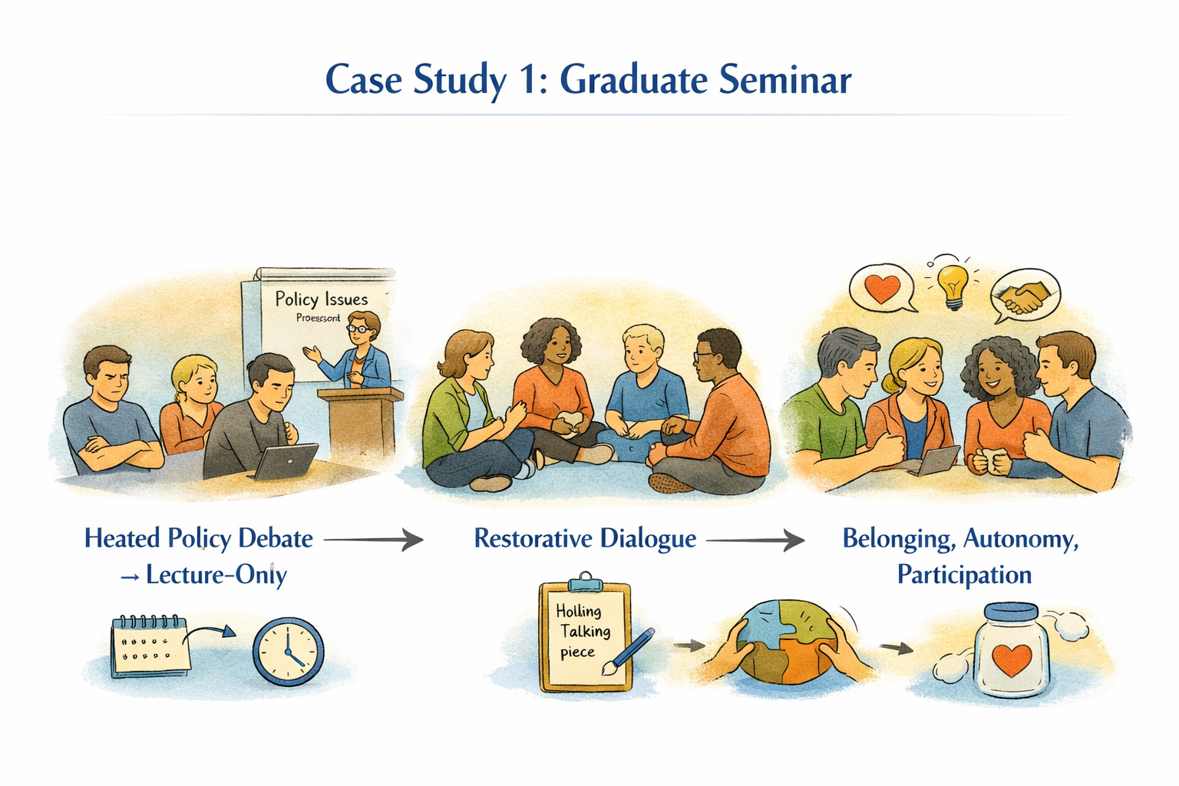
“fear of retribution and retaliation”
“participation has declined sharply”

Slide 27
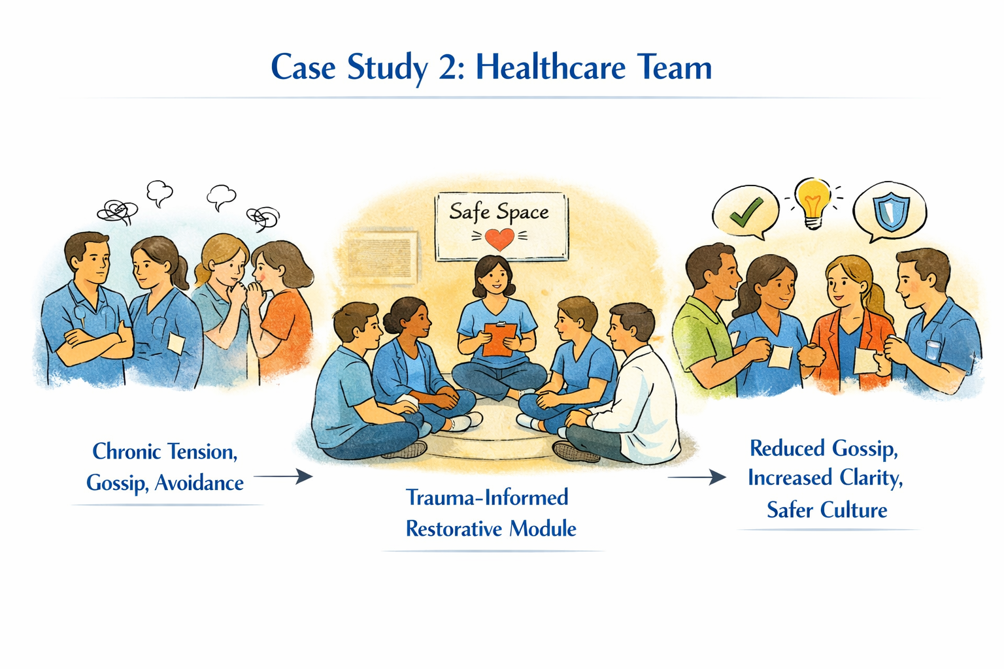
“tense, avoidant, and emotionally draining”
“reinforcing the harm”

Slide 28
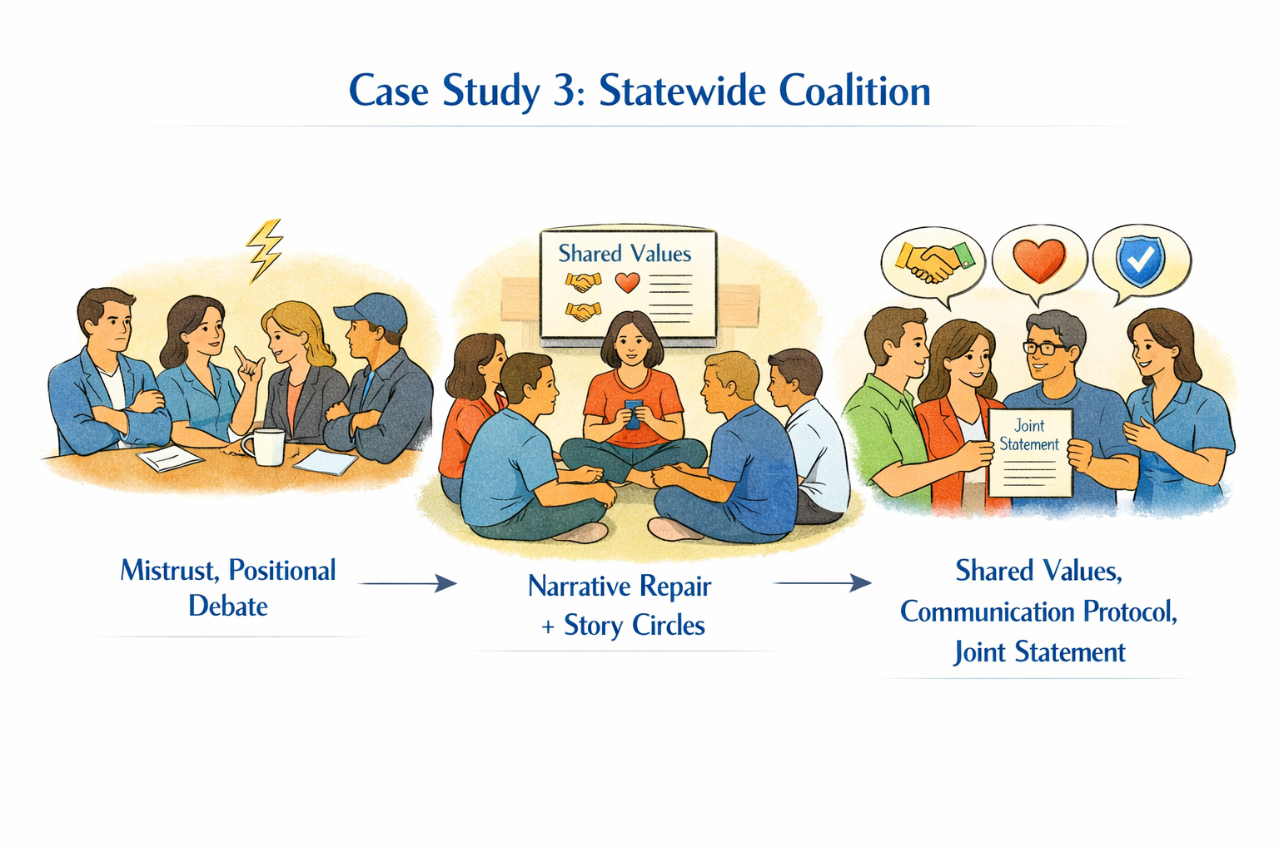
“strong personalities, differing priorities, histories of mistrust”

Slide 29
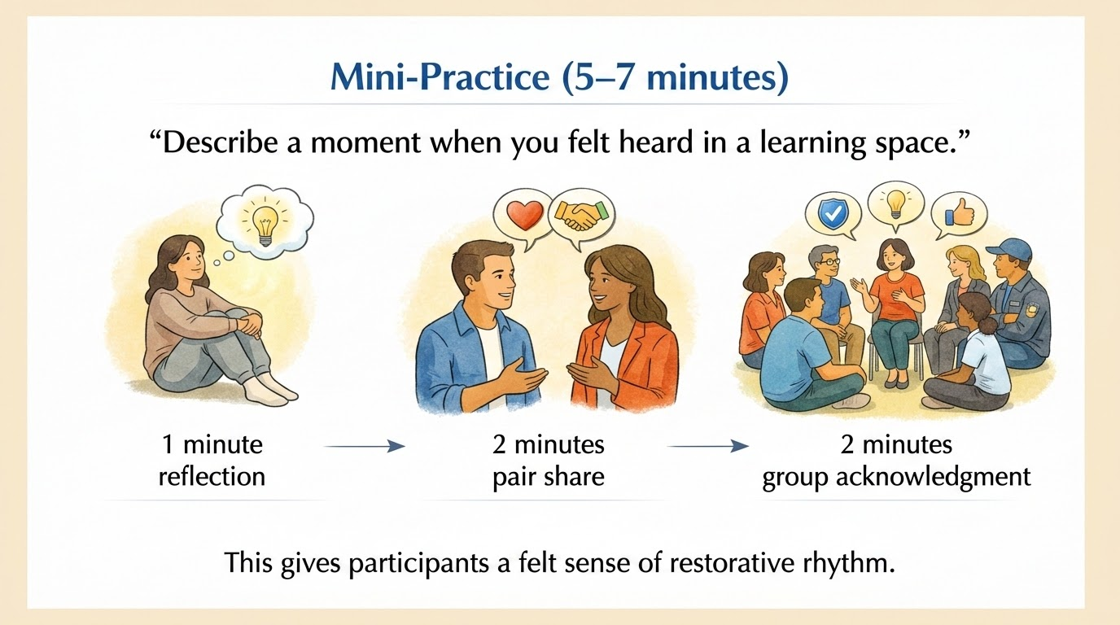
“Opportunities for voice and choice encourage participants to engage more honestly and collaboratively.”

Slide 30
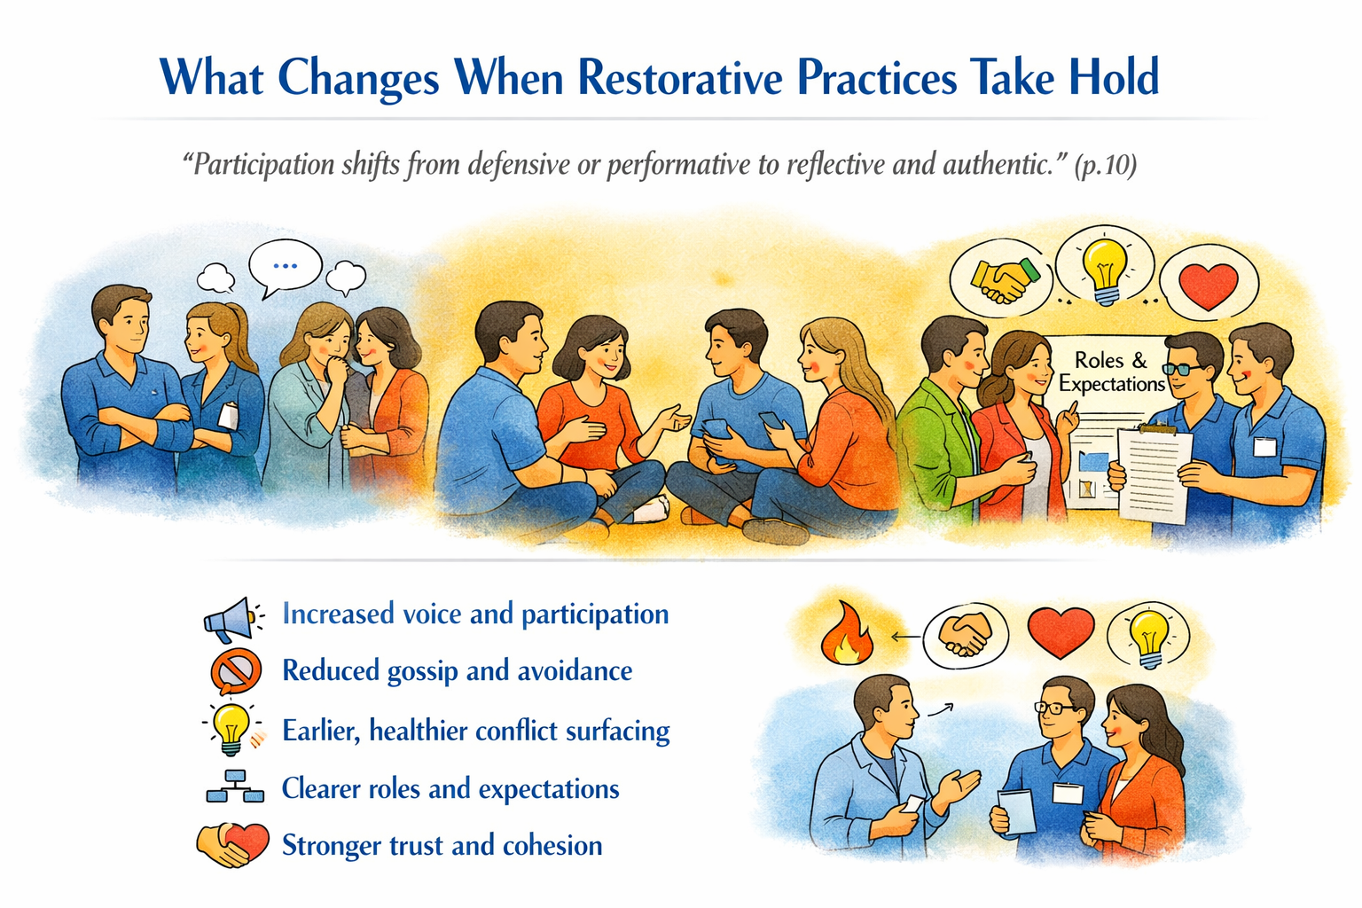

Slide 31
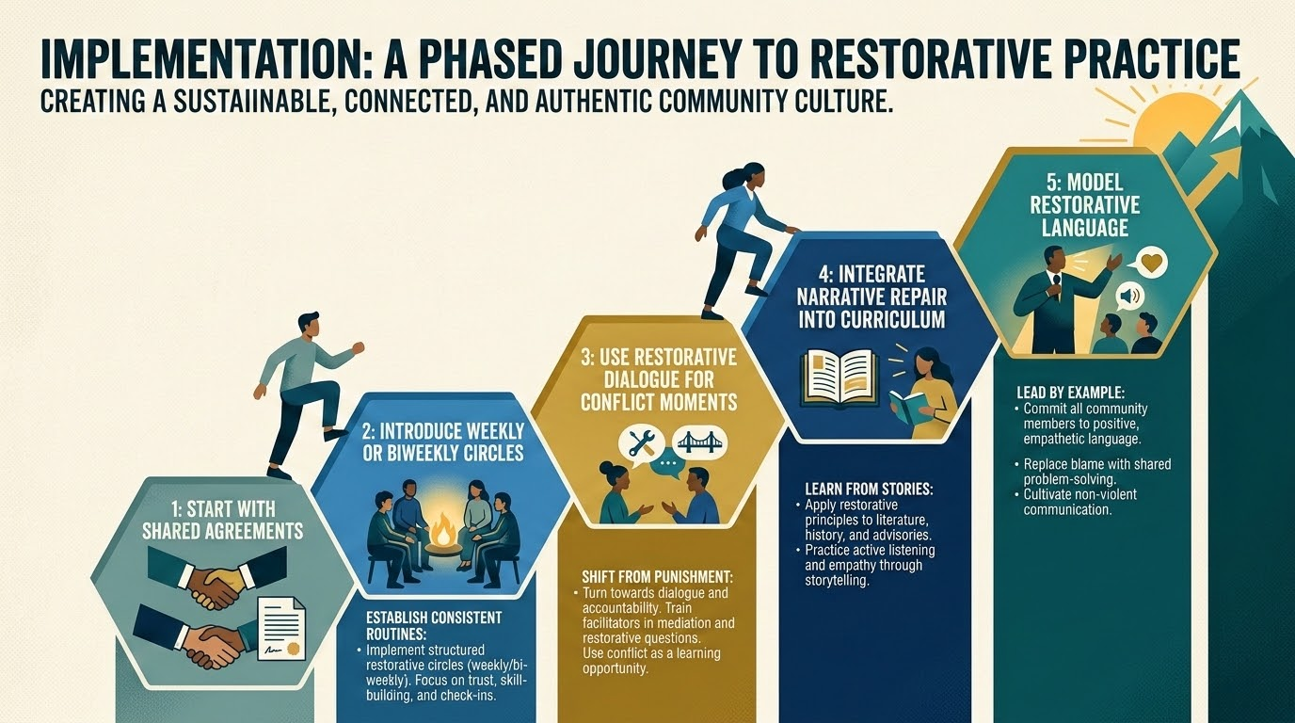

Slide 32
“Capacity is strengthened through facilitator training, regular restorative check‑ins, and integrating restorative approaches into HR and conflict resolution pathways.”

Slide 33
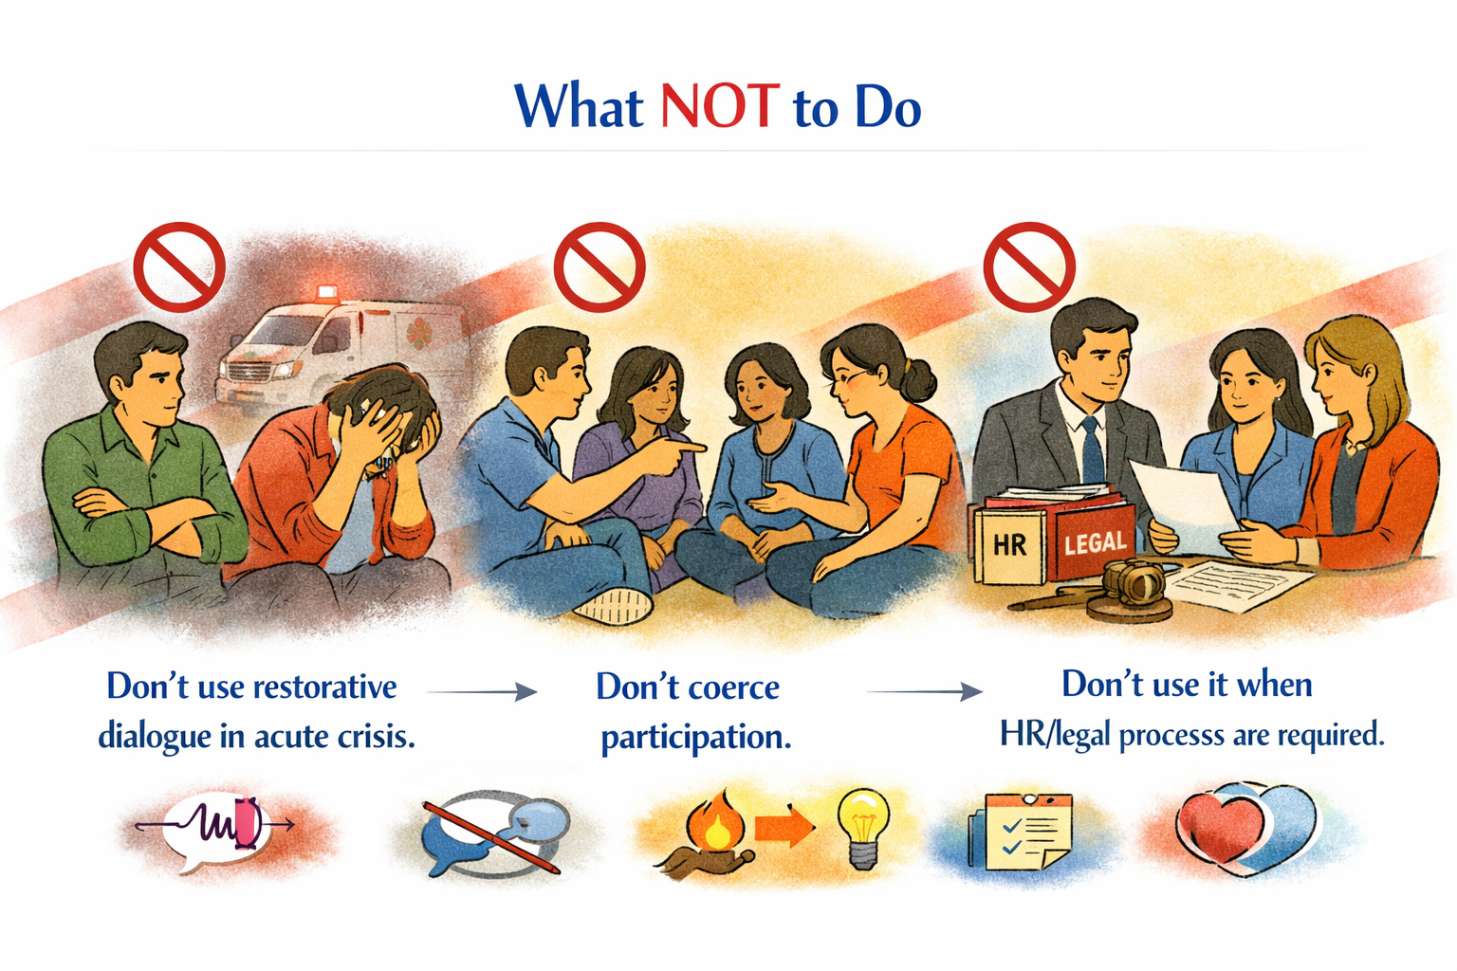

Slide 34
“Restorative practice is not a technique—it’s a culture.”
“When we restore connection, we restore possibility.”

Slide 35
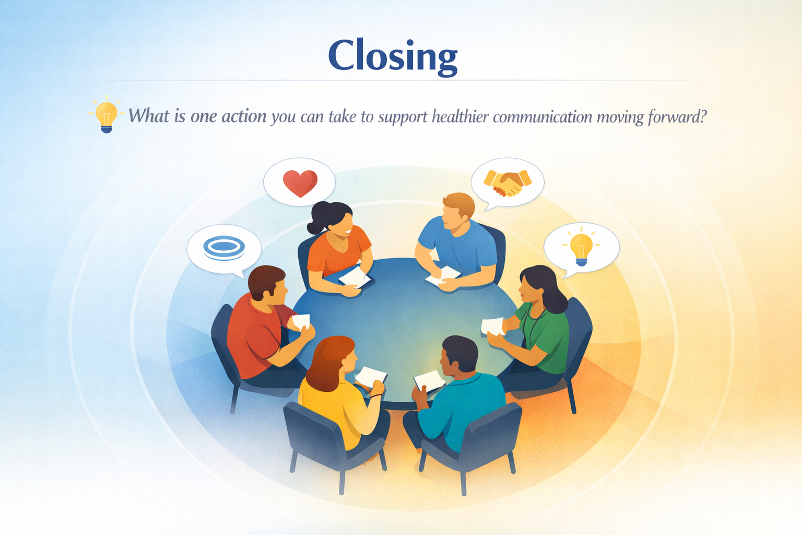
“Restorative practice is not a technique;
it’s a culture.”
“When we restore connection, we restore possibility.”

Slide 36


