Slide 1

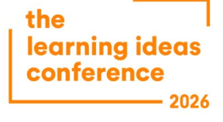


Learning Ideas Conference 2026
Sponsored by
Using Problem-Based Learning
Embedded in a Collaborative
Online International Learning
Experience
David Antonio Buentello-Montoya | david.buentello@tec.mx | Tecnológico de Monterrey, Mexico
Camila Andrea Cifuentes-Castro | camila.Cifuentes@udalba.cl | Universidad del Alba, Chile

Slide 2
Contents
01
Background & Motivation
02
COIL and our case study
03
Research questions and impact measurement
04
Results
05
Conclusions

Slide 3
How many of our students will ever work internationally?
Most of them — but only a small fraction will get an international mobility experience.
The World
The Gap
The Risk
Globalized
~5%
Left Behind
Engineers today work in multinational teams, with global supply chains and international standards (from day one of their careers).
Roughly 5% of higher education students in Latin America participate in traditional study-abroad or mobility programs. The rest graduate without the experience.
Students who never collaborate across cultures are less prepared for 21st-century workplaces demanding adaptability and global awareness.

Slide 4
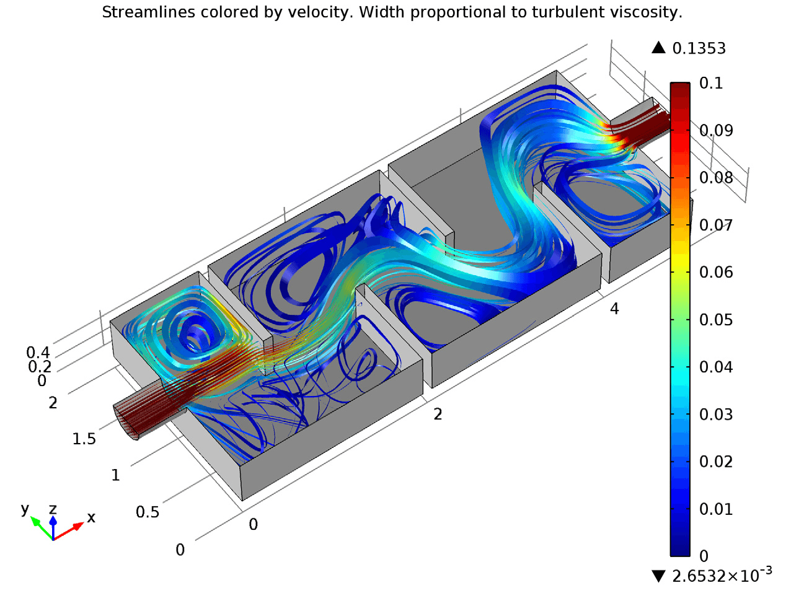
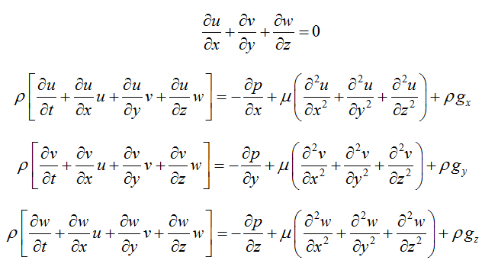

Transport Phenomena: Beautiful, Abstract, and Hard
What Is Transport Phenomena?
The mathematical framework governing how momentum, heat, and mass move through matter.

Slide 5
Transport Phenomena: Beautiful, Abstract, and Hard
Why students struggle to engage?
High mathematical demand: Coupled PDEs with no closed-form solutions — numerical methods required
Highly abstract: Governing equations describe invisible (or different scale) phenomena; difficult to visualize without context
“Why does it matter?”: Topics feel disconnected from real engineering problems students care about
Motivation gap: Without autonomy or relevance, engagement and deeper learning suffer

Slide 6
Motivation + Solution
1
Only a small
fraction of students
access international mobility
2
Employers demand intercultural & global competencies from graduates
3
Transport phenomena and other core topics are difficult to engage students with
▼ Our Approach
Integrate COIL + PBL in a Chemical Engineering transport phenomena course
to develop intercultural competencies AND improve disciplinary learning.

Slide 7
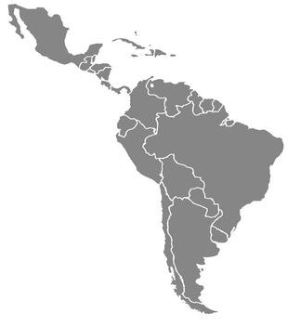
Our COIL: Mexico and Chile
Two hours difference: Antofagasta (Chile) is two hours ahead of Guadalajara (Mexico).
Distance: Around 6100 km (3750 miles).
Faculty hadn’t met prior the COIL interaction (thus were study subjects too!)

Slide 8
Participants & Course Design
26
15
~90
Chemical Engineering
Students (Mexico)
Weeks total
Course Duration
Total Hours
(60 classroom + 30 outside)
Course Timeline (15 Weeks)
PBL (~10 weeks)
COIL (4 weeks)
Wk 1
Wk 5
Wk 9
Wk 11
Wk 15
Course Grading Breakdown
Exams (3 × 15pts) – 45%
PBL Case Report – 15%
Homework & Activities – 25%
COIL Interactions – 15%

Slide 9
Research questions
Does COIL increase student engagement in a transport phenomena course?
Does PBL increase student engagement in a transport phenomena course?
How do the two methodologies compare, in terms of student acceptance?

Slide 10
Impact measurement
Surveys (with a scale from 1 to 5) were conducted at different moments.
COIL experience and whether or not they felt engaged by it
PBL activities and problem solving moments
Overall course grading

Slide 11
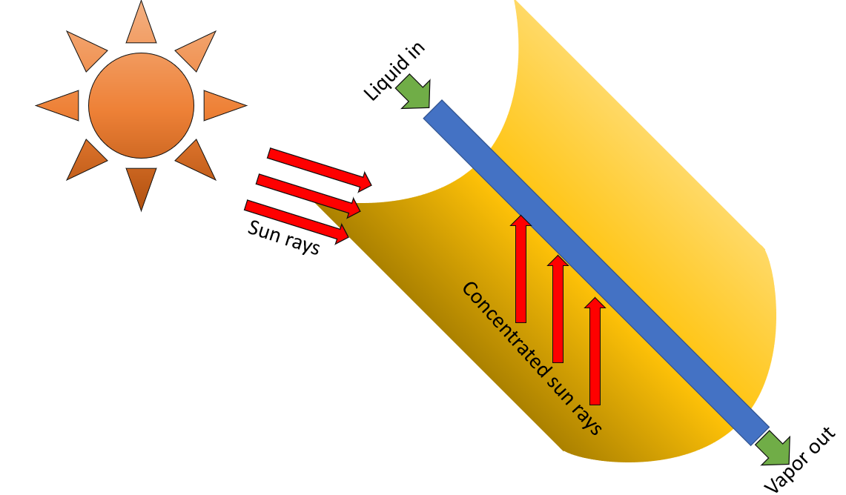
Problem-Based Learning — The Solar Energy Challenge
The problem
Can a Parabolic Trough Collector (PTC) be an adequate technology to harness solar thermal energy in Mexico and Chile, given local weather conditions, energy needs and socioeconomic aspects?
Student tasks
Understand governing equations (Navier-Stokes, heat, continuity)
Model solar irradiation potential (Global Solar Atlas data)
Calculate energy that could be harvested from PTCs
Propose socioeconomic and environmental analysis for Mexico & Chile
Write a peer-reviewed journal-style report

Slide 12
Results: COIL Experience
Engagement & overall COIL experience scored well (3.7–3.9 / 5)
Cross-institutional collaboration was the lowest-rated element (3.1 / 5)
Students said "Different expectations, working styles and academic rigor between institutions are an important challenge“
Survey scale: 1 (lowest) to 5 (highest)
n = 26 students · 100% response rate

Slide 13
Results: COIL Experience
Question number | Graded aspect | Mean | Standard deviation
1a | Interaction with local students | 4.28 | 0.678
2a | Interaction with students outside of the university | 3.76 | 1.090
3a | Engagement | 4.20 | 0.645
4a | Overall experience | 4.28 | 0.541

Slide 14
Results: PBL
PBL experience scored well (4.6/ 5)
Students said "PBL added relevance and helped make abstract concepts tangible"
Students would rather engage with PBL than COIL
Survey scale: 1 (lowest) to 5 (highest)
n = 26 students · 100% response rate

Slide 15
Results: PBL
Question number | Graded aspect | Mean | Standard deviation
1b | The problem was challenging to solve | 3.8 | 0.936
2b | The methodology helped understand abstract concepts in the course | 4.8 | 0.447
3b | I felt engaged by the problem | 4.6 | 0.894
4b | The methodology motivated me to study additional hours | 4.6 | 0.548
5b | Overall, I liked the problem-based learning methodology | 4.6 | 0.893
6b | I prefer PBL over COIL as a learning methodology | 4.2 | 0.836

Slide 16
Results: Overall course evaluation
"The course was challenging, but PBL helped make otherwise abstract concepts tangible."
Students expressed interest in taking further “advanced” topics such as Computational Fluid Dynamics courses
Eager to learn more about renewable energy mechanisms and sustainability
Would like PBL in future courses with greater level of technical detail
Course Rating
9.04
out of 10
σ = 1.43

Slide 17
Conclusions
PBL significantly improved learning of abstract transport phenomena concepts — students valued the real-world context it provided.
COIL was positively received overall, but cross-institutional collaboration was challenging due to differences in academic expectations and working styles.
Students were inspired to pursue further study in CFD, numerical methods, and renewable energy — evidence of deep engagement.
Study limitation: single cohort (n=26), data from Mexican students only — bilateral COIL assessment is needed in future work.

Slide 18
References
J. Rubin, “Embedding Collaborative Online International Learning (COIL) at Higher Education Institutions An Evolutionary Overview with Exemplars,” 2000. [Online]. Available: www.handbook-internationalisation.com.
S. Hackett, J. Janssen, P. Beach, M. Perreault, J. Beelen, and J. van Tartwijk, “The effectiveness of Collaborative Online International Learning (COIL) on intercultural competence development in higher education,” International Journal of Educational Technology in Higher Education, vol. 20, no. 1, Dec. 2023, doi: 10.1186/s41239-022-00373-3.
Radical solutions and E-learning. Practical innovations and online educational. SPRINGER Verlag, SINGAPOR, 2020.
R. Swain-Oropeza and J. A. Renteria-Salcedo, “Tec21 Can Be an Educational Model for a VUCA World,” Proceedings of the 2019 IEEE 11th International Conference on Engineering Education, ICEED 2019, pp. 147–152, 2019, doi: 10.1109/ICEED47294.2019.8994923.
A. Steinemann, “Implementing sustainable development through problem-based learning: Pedagogy and practice,” Journal of Professional Issues in Engineering Education and Practice, vol. 129, no. 4, pp. 216–224, 2003, doi: 10.1061/(ASCE)1052-3928(2003)129:4(216).
R. W. Jones, “Education and Training Problem-based Learning: Description, Advantages, Disadvantages, Scenarios and Facilitation,” 2006.
M. D. Saputra, S. Joyoatmojo, D. K. Wardani, and K. B. Sangka, “Developing critical-thinking skills through the collaboration of Jigsaw model with problem-based learning model,” International Journal of Instruction, vol. 12, no. 1, pp. 1077–1094, 2019, doi: 10.29333/iji.2019.12169a.
T. P. Yildirim, L. Shuman, and M. Besterfield-Sacre, “Model-eliciting activities: Assessing engineering student problem solving and skill integration process,” International Journal of Engineering Education, vol. 26, no. 4, pp. 831–845, 2010.
“Global Solar Atlas.” [Online]. Available: https://globalsolaratlas.info/detail?c=28.971803,-110.99762,11&s=29.098177,-110.954361&m=site
R. M. Ryan and E. Deci, “Self-determination theory and the facilitation of intrinsic motivation, social development, and well-being.,” American Psychologist, vol. 55, no. 1, pp. 68–78, 2000.

