Slide 1


Slide 2

JORDAN HU COLLEGE OF SCIENCE & LIBERAL ARTS

Slide 3



Transforming Engineering Education with Mini Role-Playing Simulations: Experiential Learning for Leadership and Interdisciplinary Teamwork
Cristo Leon, Ph.D.
New Jersey Institute of Technology, New Jersey, USA.
Ricardo Morales Carbajal, Ph.D.
Universidad Autónoma de Baja California, Baja California, México
Francisco Fernando Gallego Escobar, Med.
Institución Universitaria Pascual Bravo, Medellín, Antioquia, Colombia
James Lipuma, Ph.D.
New Jersey Institute of Technology, New Jersey, USA.
June 11th, 2026

Slide 4

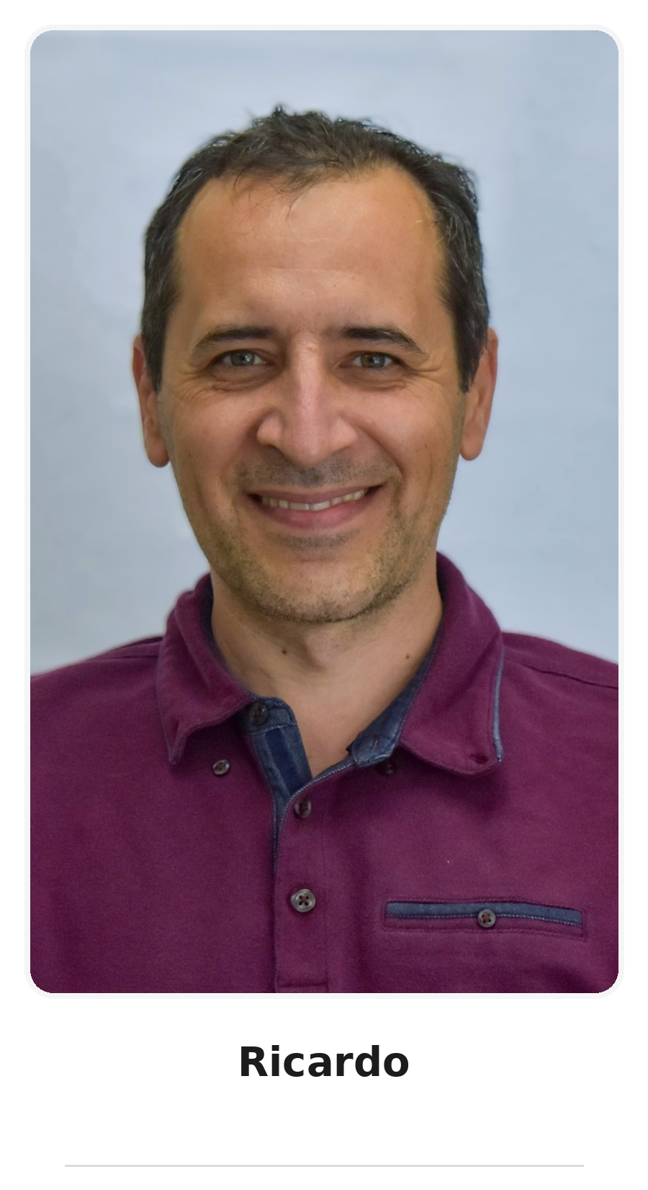
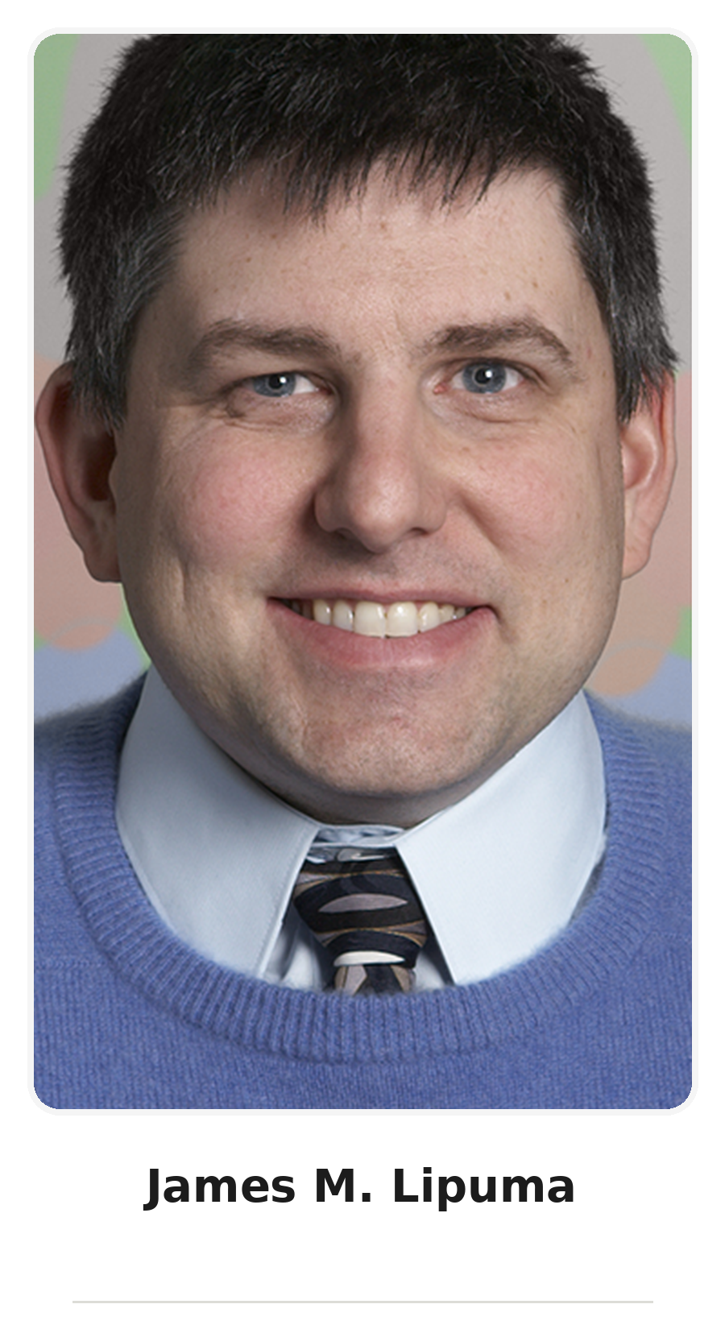
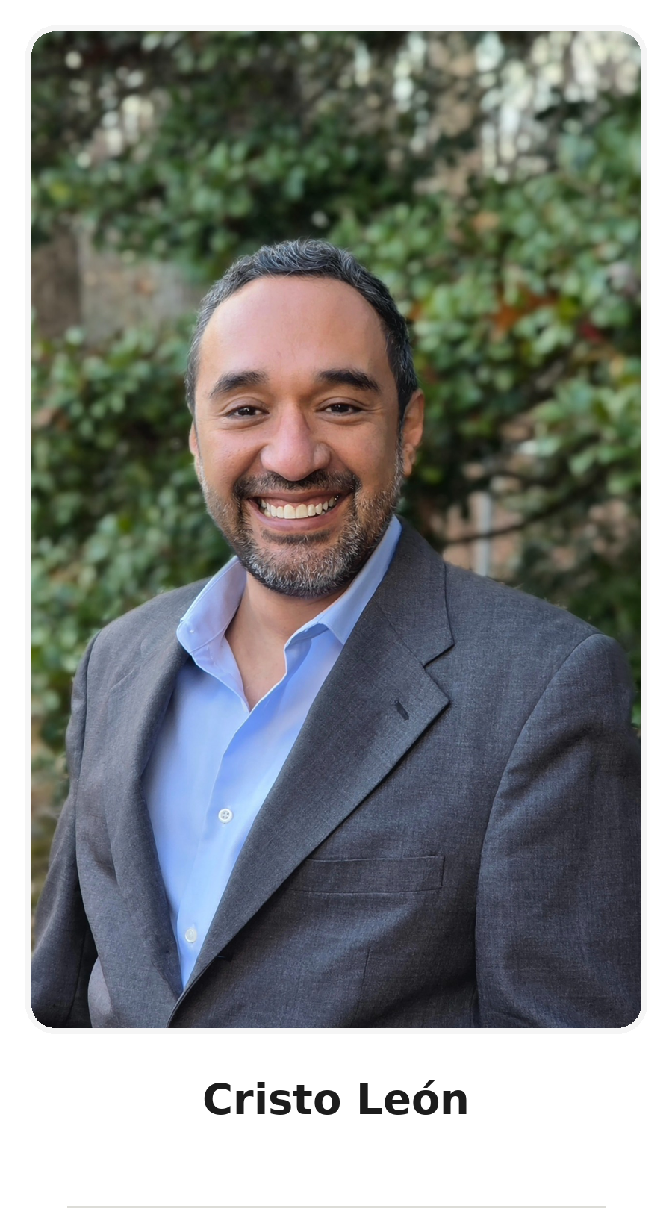
The Team
Francisco
Ricardo
James
Cristo

Slide 5
Beta Testers
Susana Rojas Torres
Alec Andrés Echavarría Sierra
María José Guerrero Zerpa
Carolina López Sánchez
Elian Cuesta
Mateo Santamaría Rojas
Juan José Patiño Cano
Mateo Ramírez García
Nichole Andrade
Katherine Lipuma
Daniela Aguirre Luque
Edgar Javier Ontiveros Lopez
Glauber Abril Arce
Lizeth Nayely Álvarez Villegas
Monserrat Estela García Gallardo
Yahir Joel Montaño López
Jose Ernesto Malpica Rosendo
Edgar Meritano
Julián Marconi
Marcos O. Cabobianco

Slide 6
Why We Built This Simulation
Career Exploration Gap
Collaboration Gap
Engineering identity and interdisciplinary understanding

Slide 7
The Reality of Engineering Practice
Real-world engineering problems are solved by teams, not individuals.

Slide 8
Order and Chaos: A Pedagogical Metaphor
ORDER = Technical Skills
CHAOS = Human Skills

Slide 9
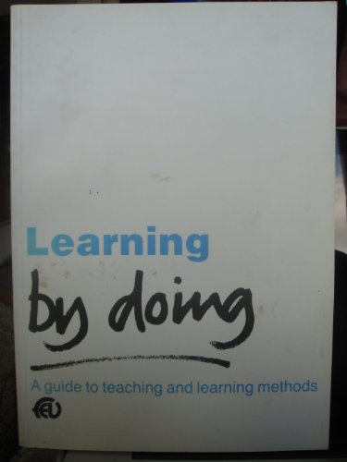
Experiential Learning Through Role-Playing
Learning by Doing: A Guide to Teaching and Learning Methods
Gibbs, G. (1988). Learning by Doing: A Guide to Teaching and Learning Methods (1st ed.). Further Education Unit (FEU).

Slide 10
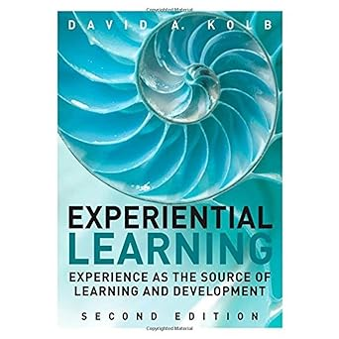
Experiential Learning Through Role-Playing
Experiential Learning: Experience as the Source of Learning and Development, Second Edition
Kolb, D. (2014). Experiential Learning: Experience as the Source of Learning and Development, Second Edition (2nd ed.). Pearson FT Press.

Slide 11
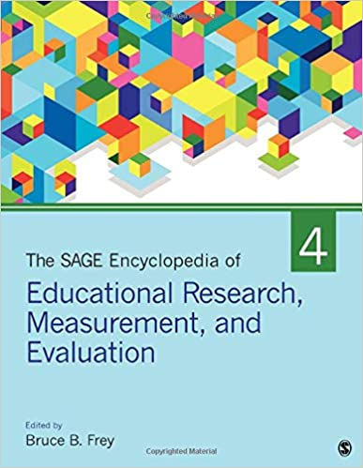
Experiential Learning Through Role-Playing
The SAGE Encyclopedia of Educational Research, Measurement, and Evaluation
Frey, B. B. (2018). The SAGE Encyclopedia of Educational Research, Measurement, and Evaluation (1st ed.). SAGE Publications, Inc. https://doi.org/10.4135/9781506326139

Slide 12
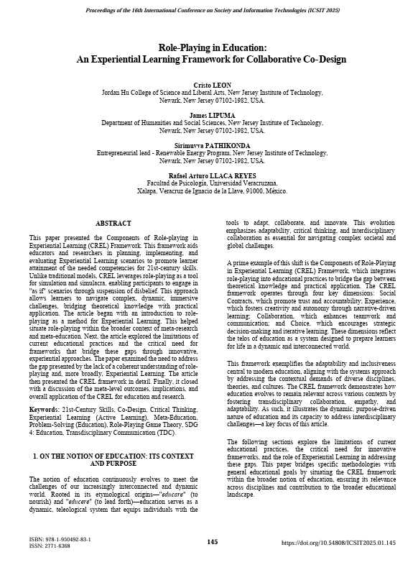
Experiential Learning Through Role-Playing
Role-Playing in Education: An Experiential Learning Framework for Collaborative Co-Design
León, C., Lipuma, J., Pathikonda, S., & Llaca Reyes, R. A. (2025). Role-Playing in Education: An Experiential Learning Framework for Collaborative Co-Design. In N. C. Callaos, J. Horne, & B. Sánchez (Eds.), Inter-Disciplinary Communication on the Transdisciplinary Notions of Education and Research (Vol. 1, pp. 145–153). International Institute of Informatics and Systemics. https://doi.org/10.54808/ICSIT2025.01.145

Slide 13
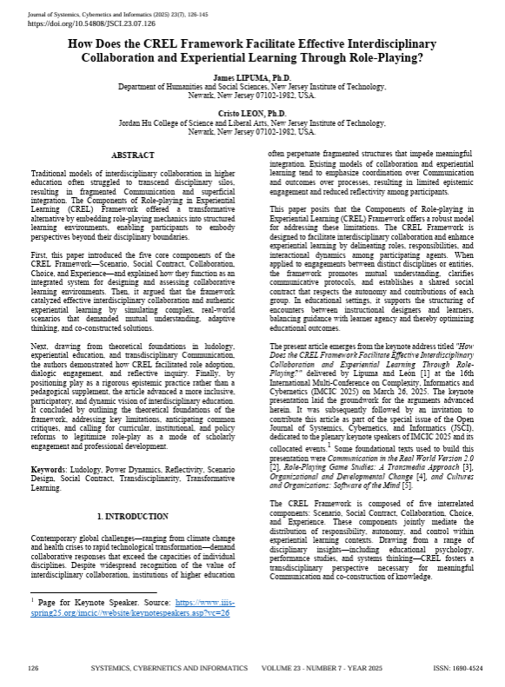
Experiential Learning Through Role-Playing
How Does the CREL Framework Facilitate Effective Interdisciplinary Collaboration and Experiential Learning Through Role-Playing?
Lipuma, J., & León, C. (2025). How Does the CREL Framework Facilitate Effective Interdisciplinary Collaboration and Experiential Learning Through Role-Playing? Journal of Systemics, Cybernetics and Informatics, 23(7), 126–145. https://doi.org/10.54808/JSCI.23.07.126

Slide 14
Experiential Learning Through Role-Playing
1. Experience
2. Reflection
3. Application

Slide 15
Introducing Engineers of Order and Chaos
Two-page simulation
Engineering roles
Collaborative problem solving

Slide 16
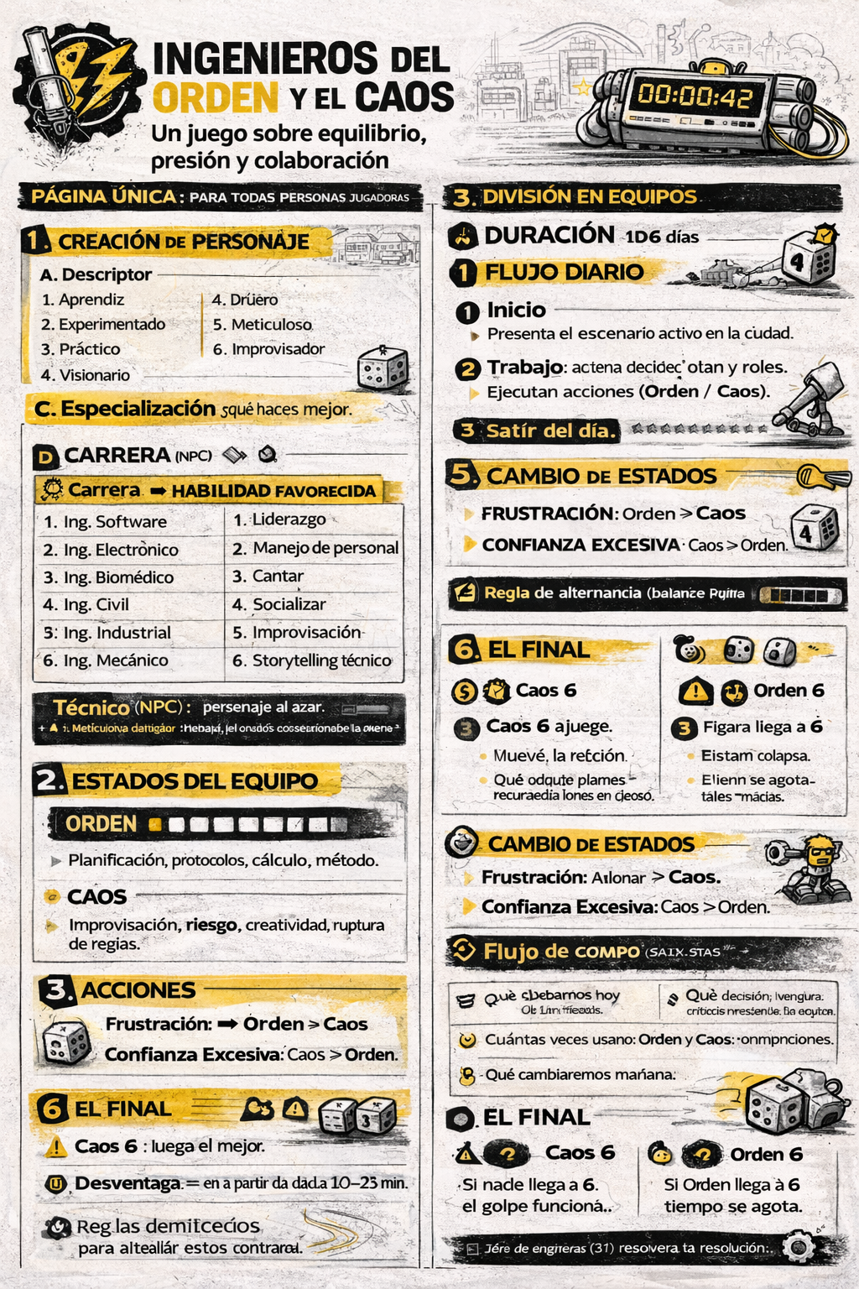
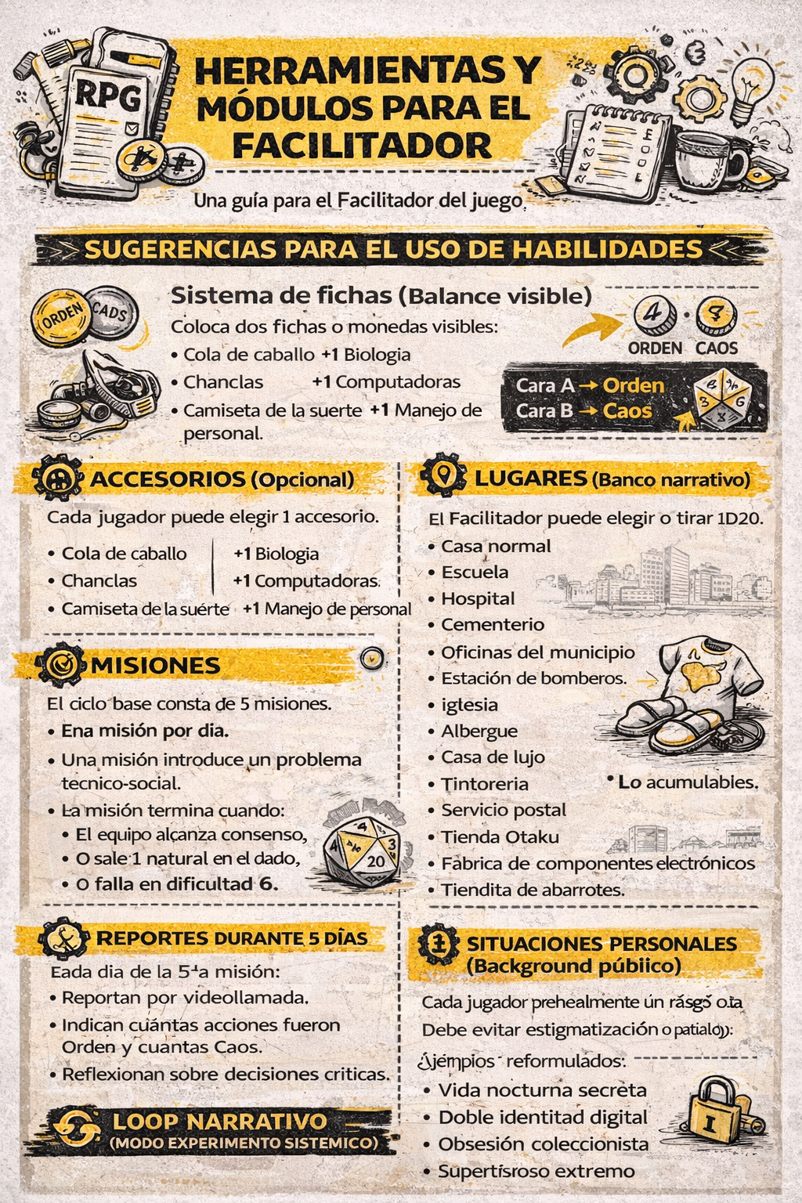

Slide 17
The Smart City Crisis
Mission briefing and scenario

Slide 18
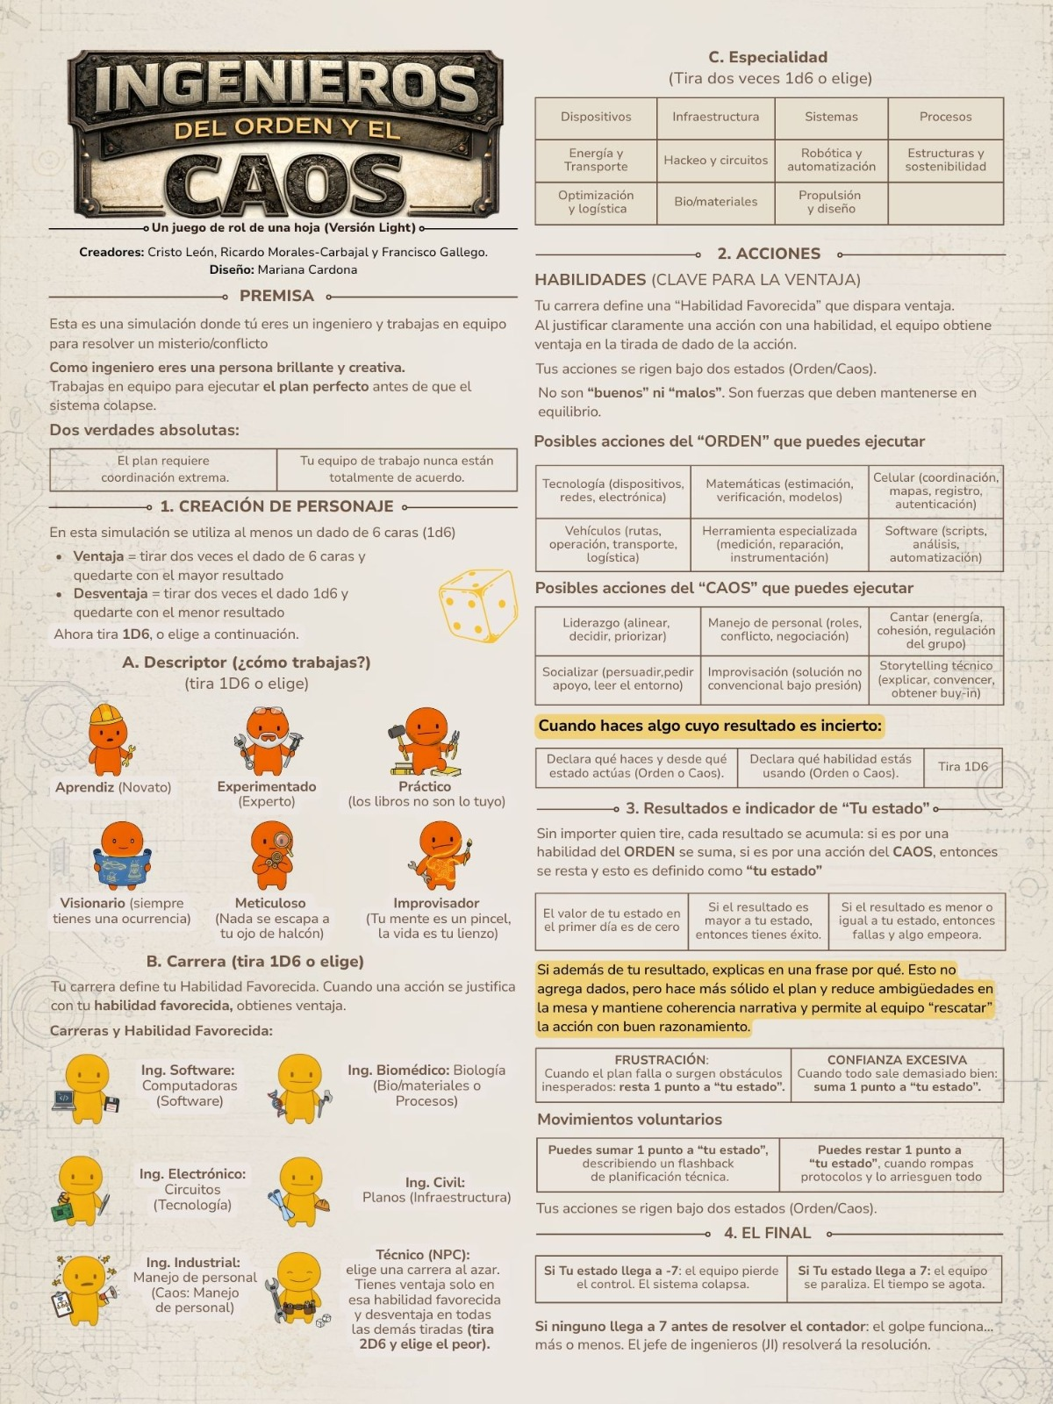
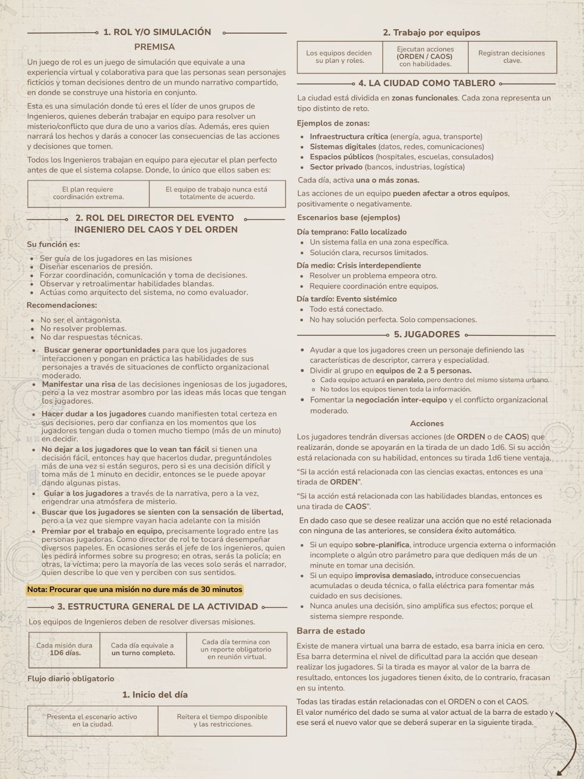

Slide 19
Gameplay Instructions
Select roles
Form teams
Analyze
Act
Adapt
Create character
Allow exploration
Initiate game
Debrief

Slide 20
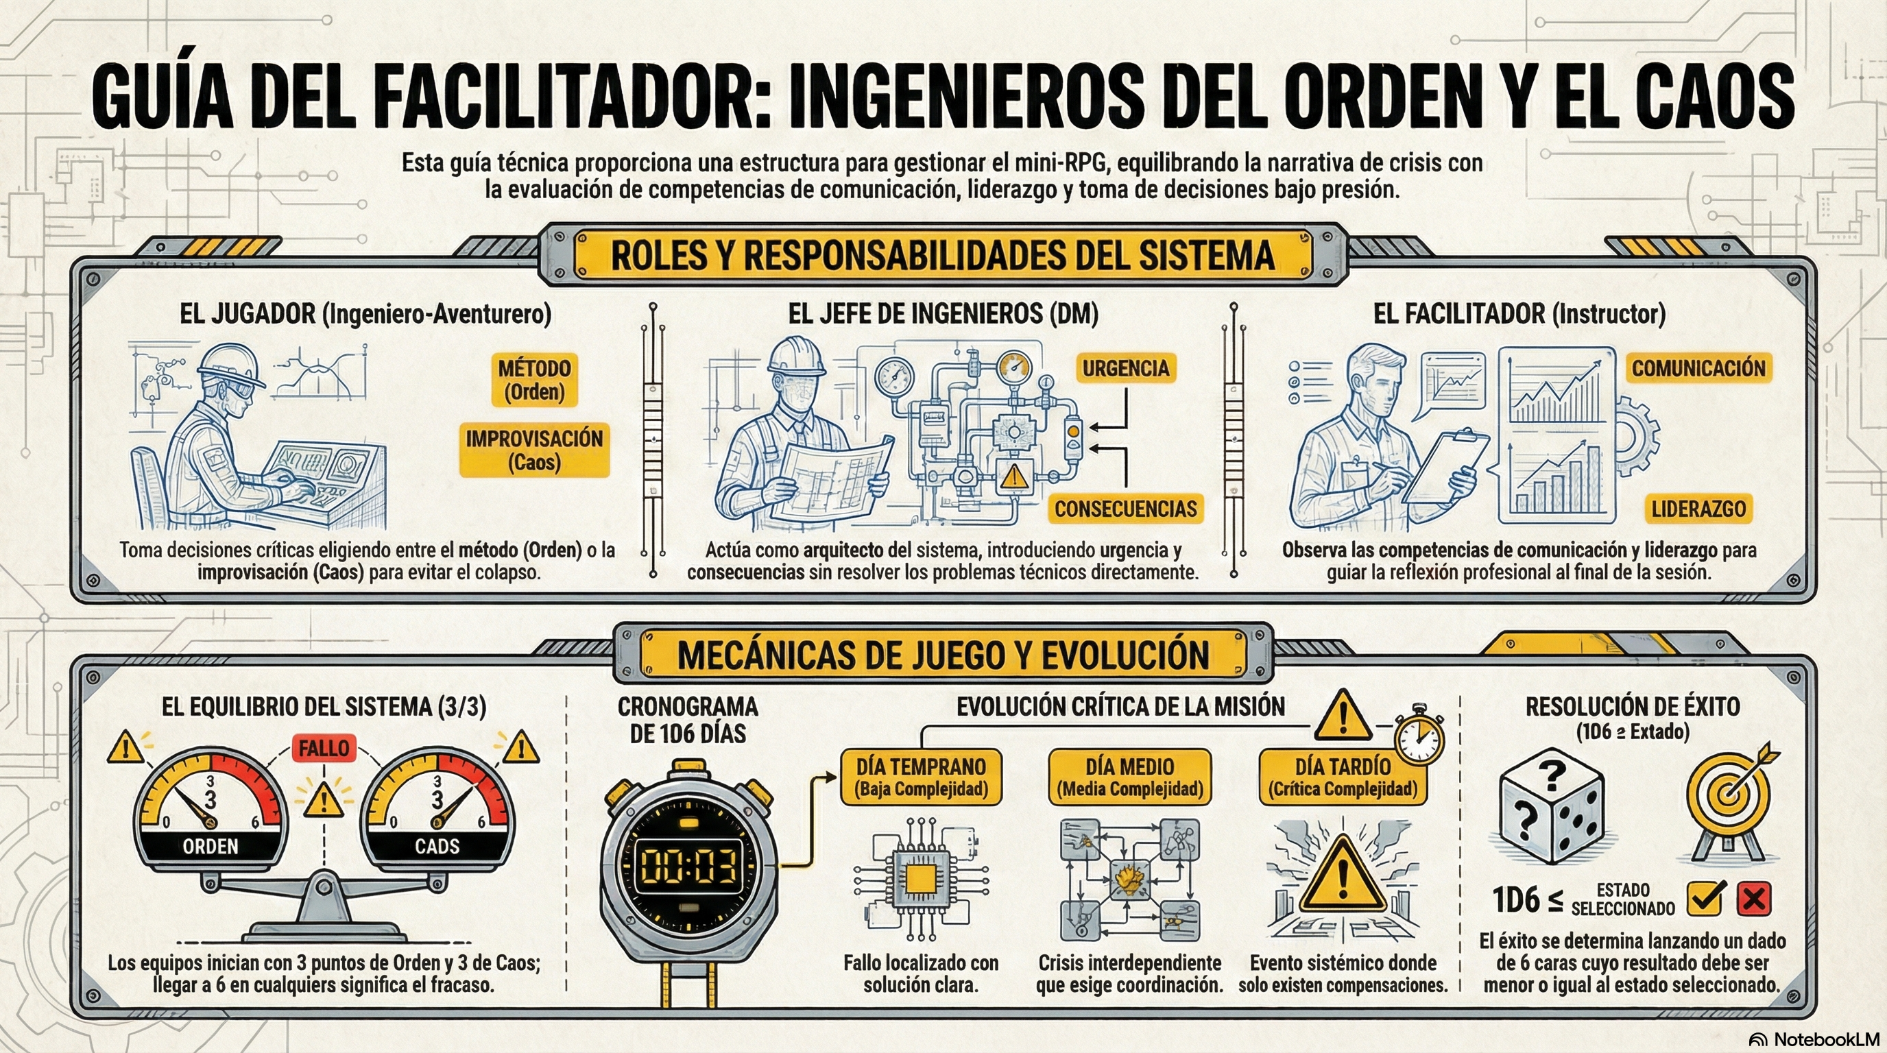

Slide 21
Debrief: What Happened?
Reflection questions

Slide 22
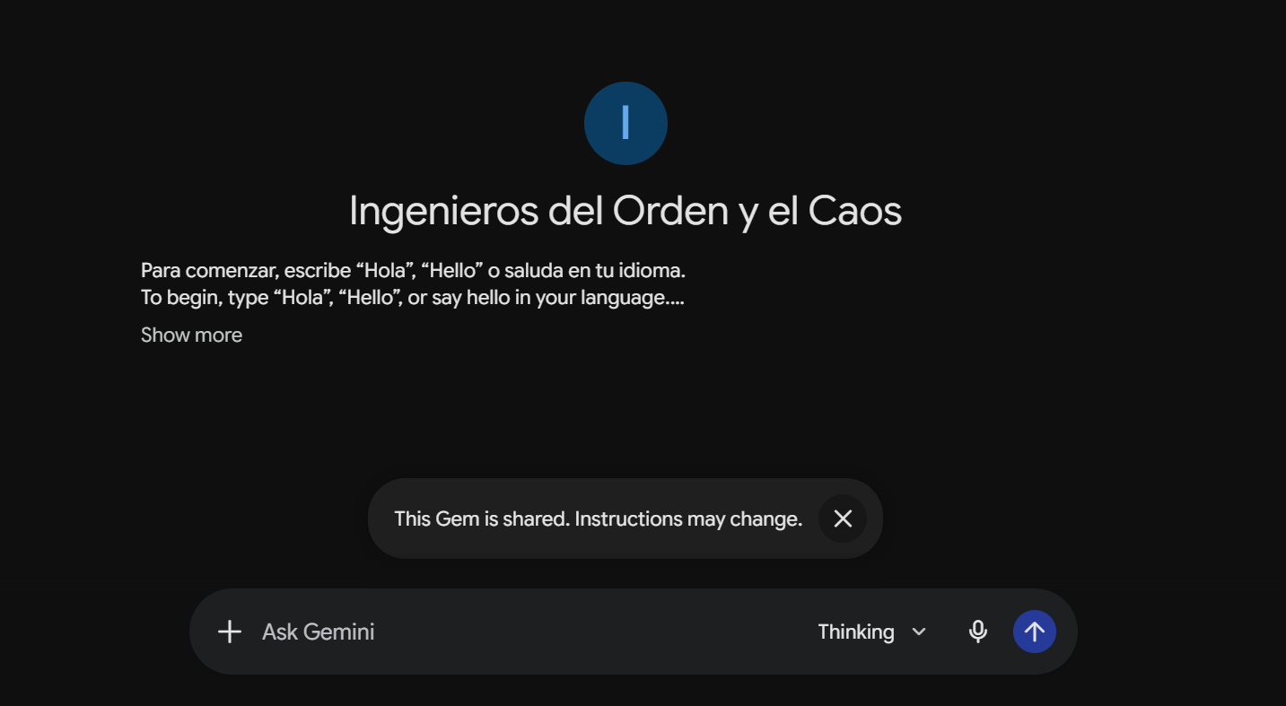
Gemini Gem

Slide 23
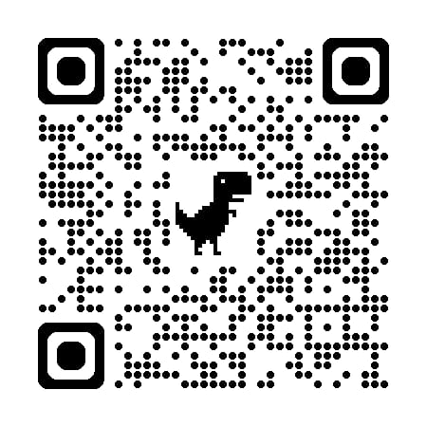
Gemini Gem

Slide 24
Order and Chaos in Practice
Examples observed during play

Slide 25
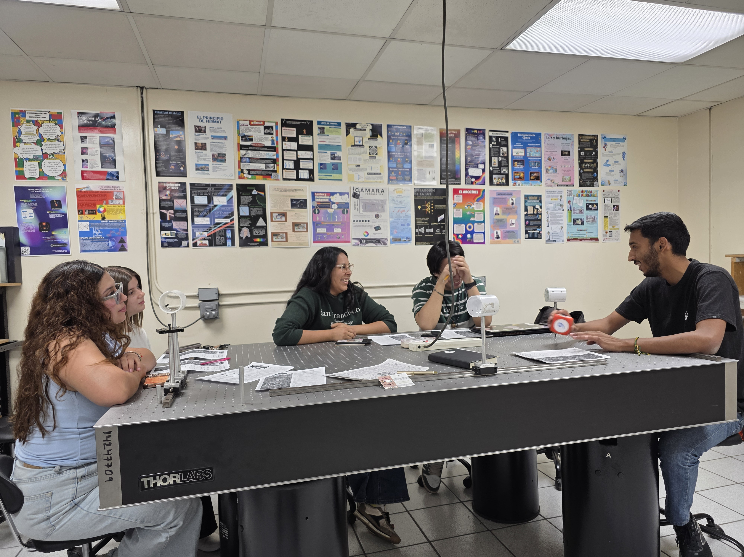
Mexico Beta Test 1

Slide 26
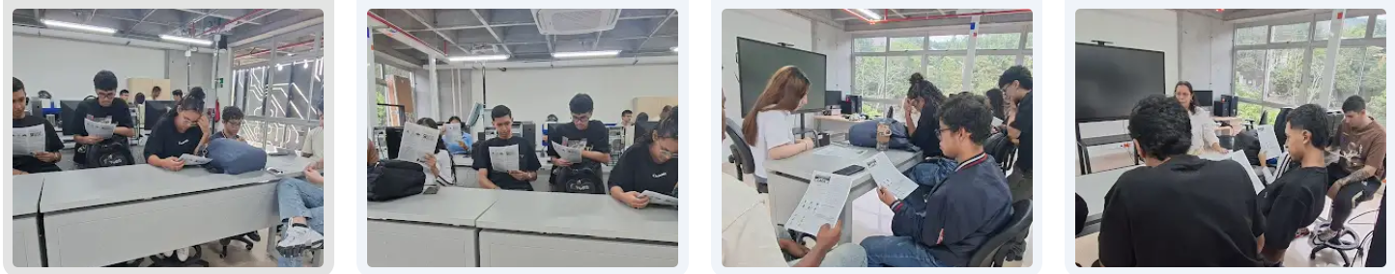
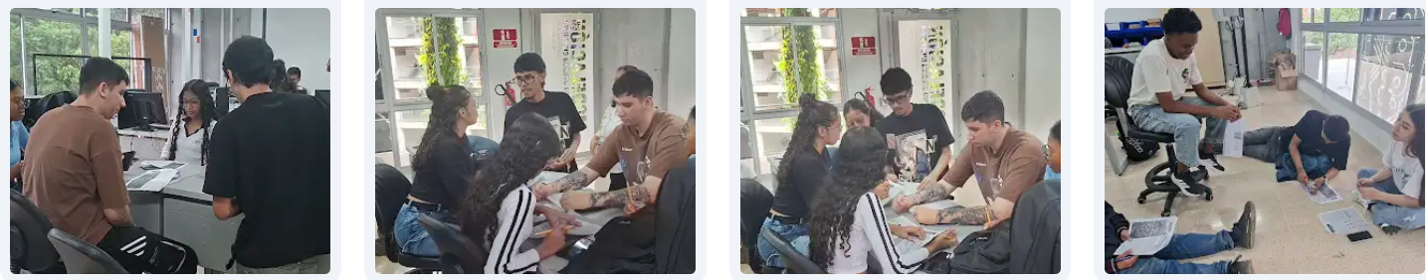
Colombia Beta Test 2

Slide 27
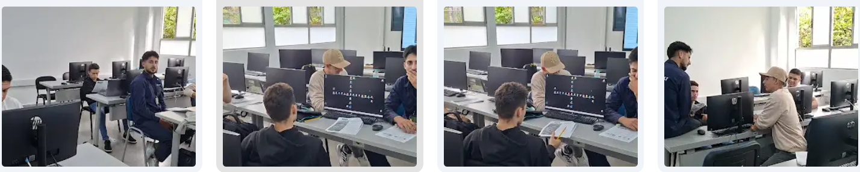
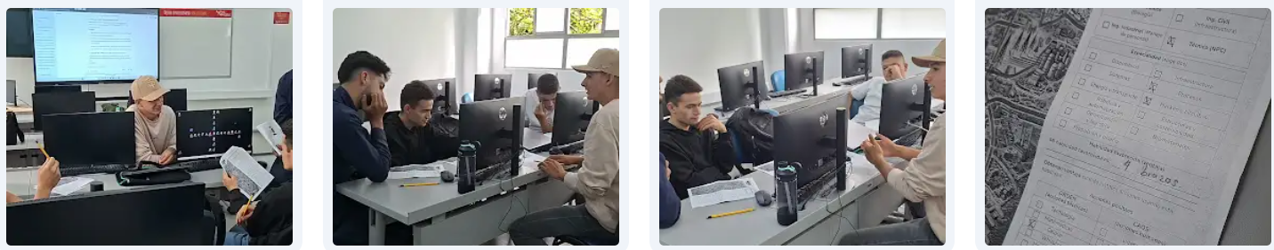
Colombia Beta Test 2

Slide 28
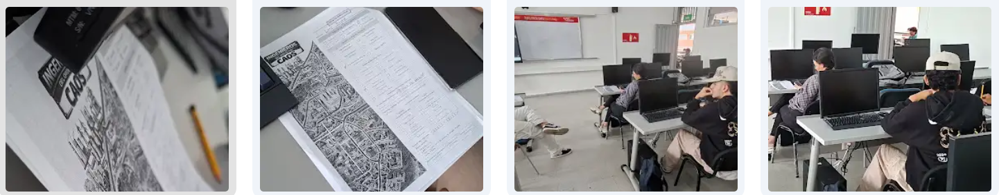
Colombia Beta Test 2

Slide 29
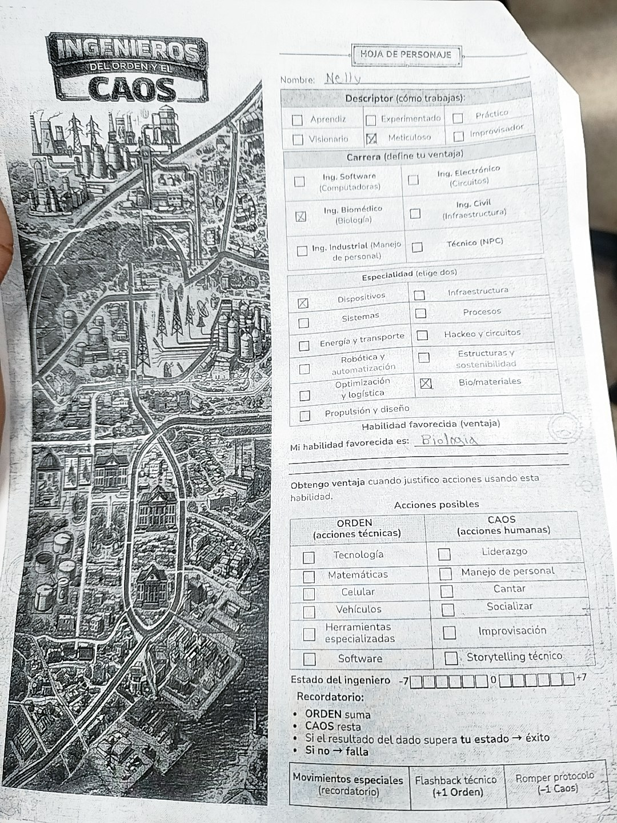
Colombia Beta Test 2

Slide 30
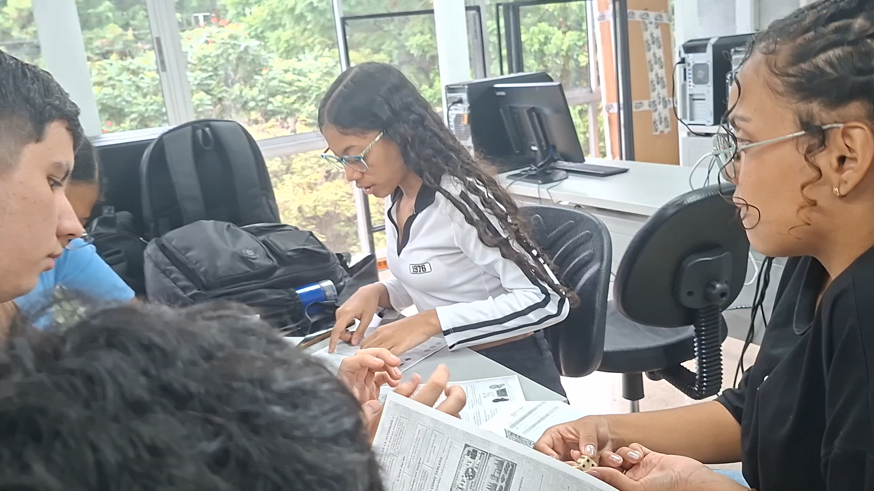
Mexico

Slide 31
Engineering Competencies Observed
Teamwork
Leadership
Communication
Systems Thinking

Slide 32
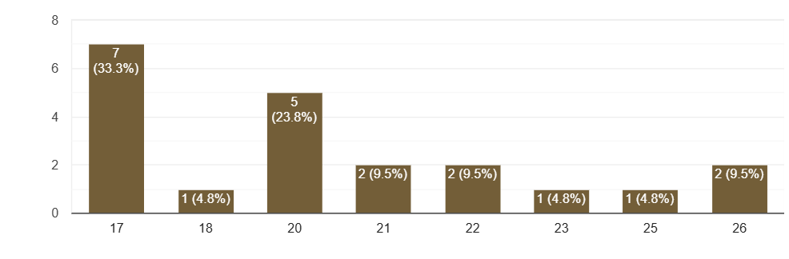
GenAI Play Survey n=21: Age

Slide 33
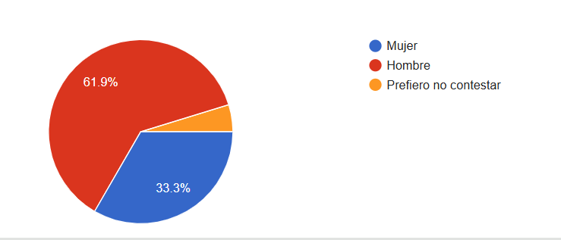
GenAI Play Survey n=21: Gender

Slide 34
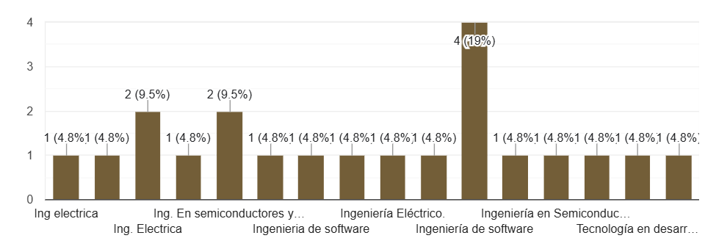
GenAI Play Survey n=21: Areas
Software Engineering

Slide 35
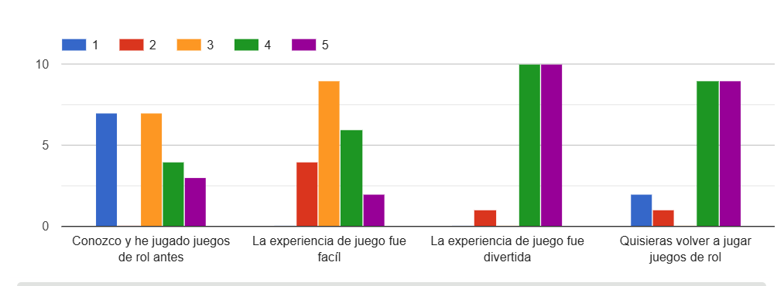
GenAI Play Survey n=21: Areas

Slide 36
Participatory Design Workshop
Missing disciplines
Missing competencies
Missing scenarios

Slide 37
Future Research and Classroom Applications
Pilots
Assessment
Adoption
Publications

Slide 38
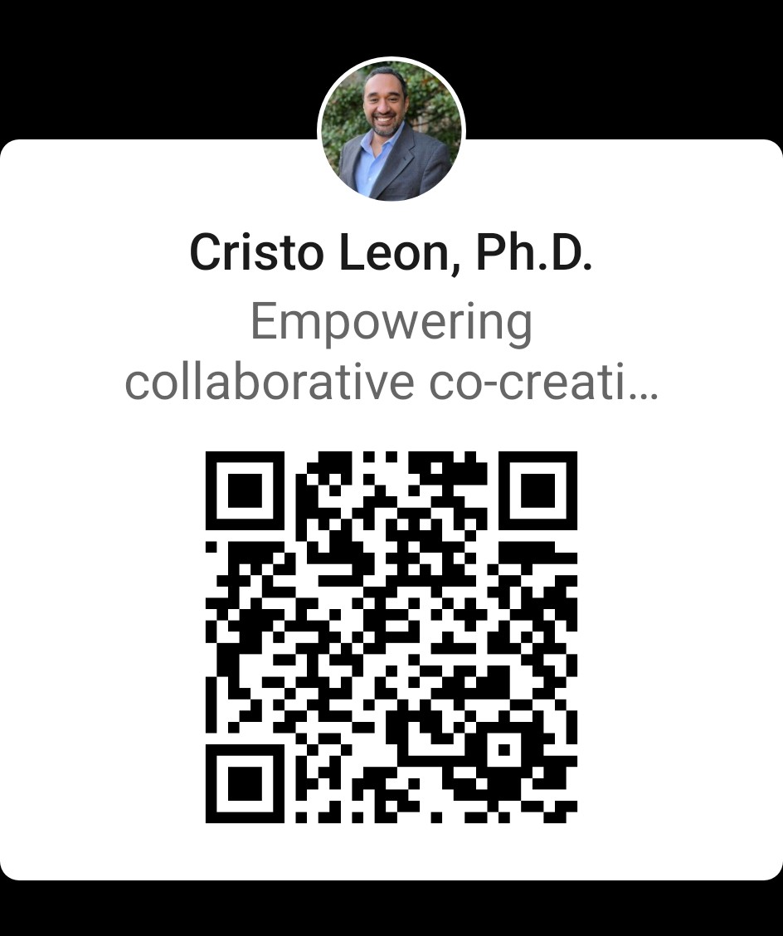
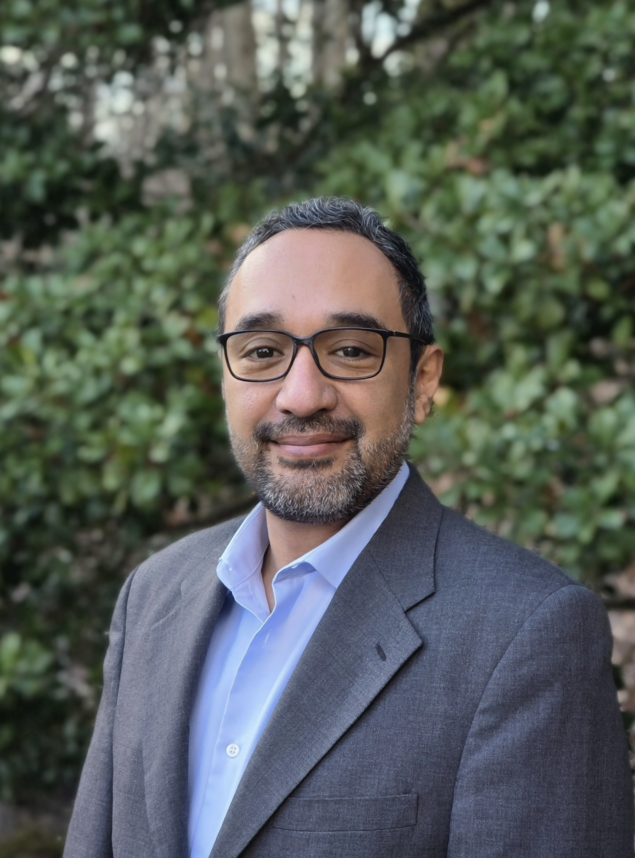
Conclusion
Let us Co-Create the Future of Engineering Simulations
Cristo Leon, Ph.D.
[he/him/his]
Director of Research, Jordan Hu College of Science & Liberal Arts
Office of Research
New Jersey Institute of Technology
leonc@njit.edu

Slide 39
Gemini Gem

Slide 40
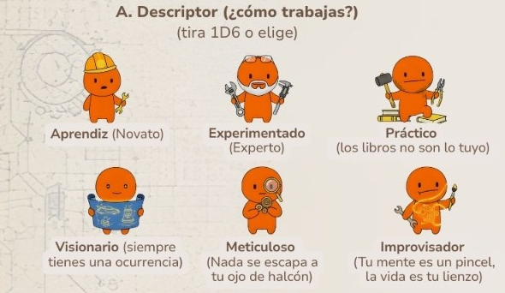
Mini Role-Playing Simulation
Engineer descriptors 1D6
Apprentice = Novice
Experienced = Expert
Practical = Hands-on
Visionary = Ideas
Meticulous = Organize
Improviser = Imagination

Slide 41
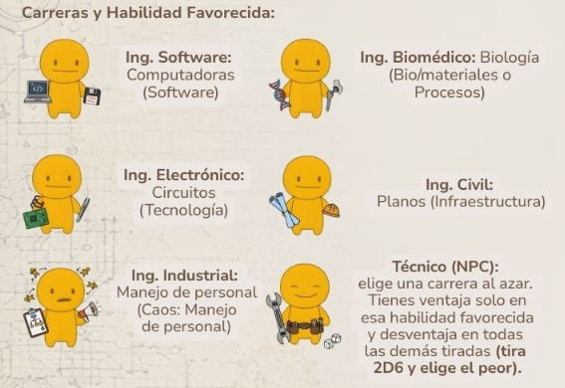
Mini Role-Playing Simulation
Engineer types 1D6
Software Engineer: Computers (Software)
Biomedical Engineer: Biology (Bio/materials or Processes)
Electrical Engineer: Circuits (Technology)
Civil Engineer: Blueprints (Infrastructure)
Industrial Engineer: (Personnel management)
Technician (NPC): Assistant (Disadvantage)

Slide 42
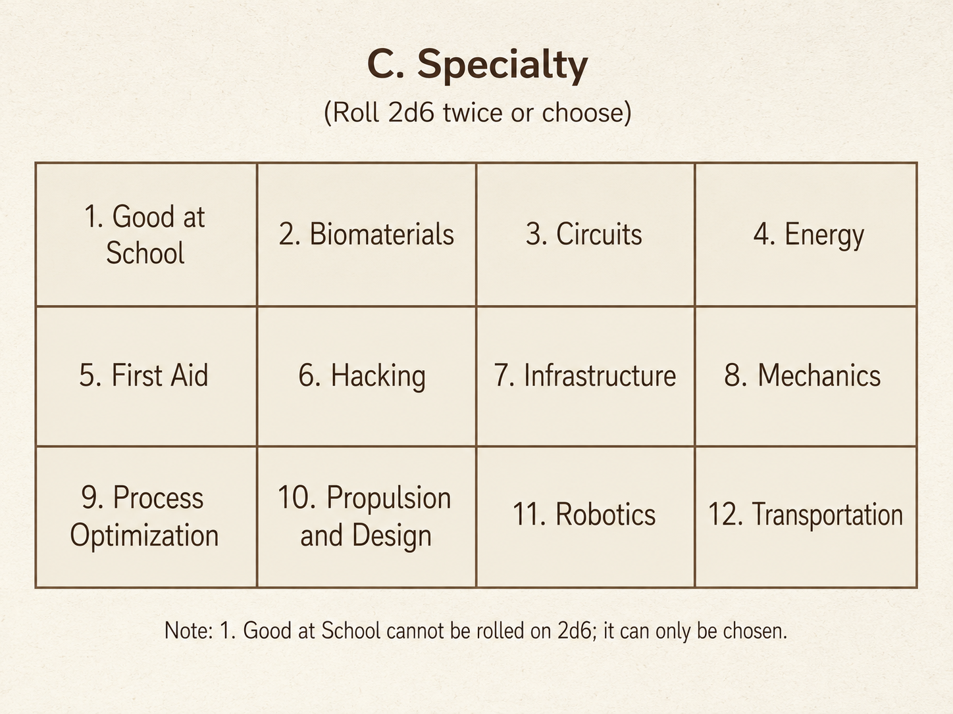
Mini Role-Playing Simulation
Engineer Specialties 2D6
(or choose)

Slide 43
Mini Role-Playing Simulation
Order 1D6
Technology (devices, networks, electronics)
Mathematics (estimation, verification, models)
Cell phone (coordination, maps, records, authentication)
Vehicles (routes, operation, transportation, logistics)
Specialized tool (measurement, repair, instrumentation)
Software (scripts, analysis, automation)
Chaos 1D6
Leadership (align, decide, prioritize, command)
Personnel management (roles, conflict, negotiation)
Singing (energy, cohesion, group regulation)
Socializing (persuade, ask for support, read the environment)
Improvisation (unconventional solution under pressure)
Technical storytelling (explain, persuade, obtain buy-in)

Slide 44
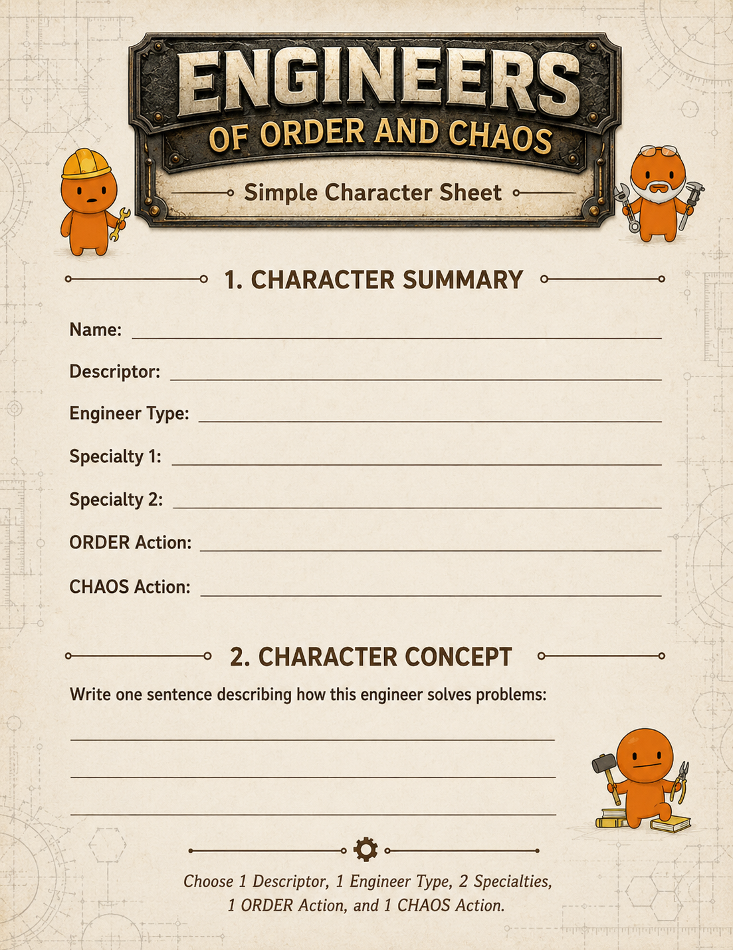
Mini Role-Playing Simulation

Slide 45
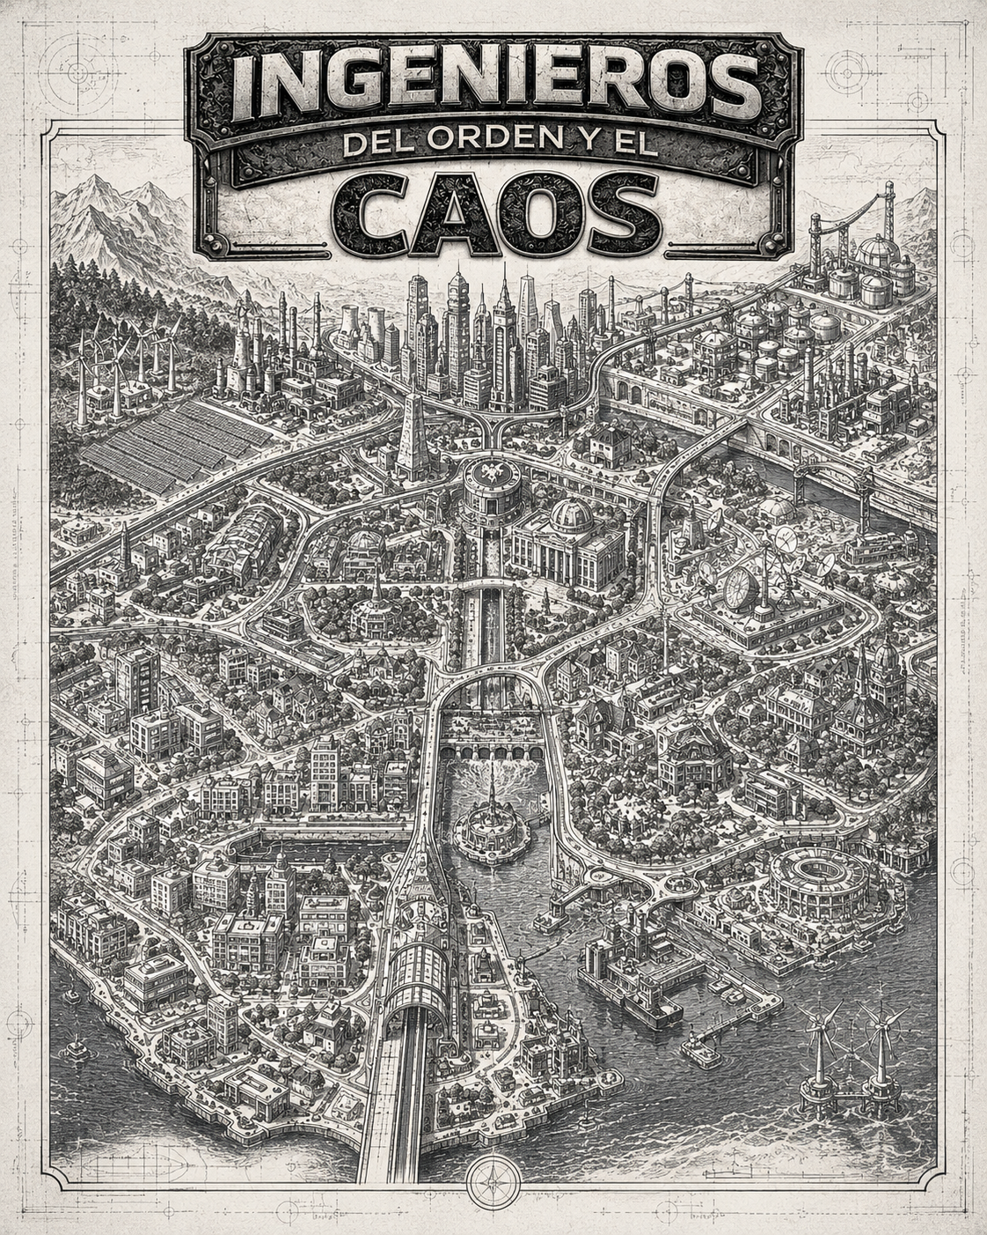
Mini Role-Playing Simulation

Slide 46
Sources
Frey, B. B. (2018). The SAGE Encyclopedia of Educational Research, Measurement, and Evaluation (1st ed.). SAGE Publications, Inc. https://doi.org/10.4135/9781506326139
Gibbs, G. (1988). Learning by Doing: A Guide to Teaching and Learning Methods (1st ed.). Further Education Unit (FEU).
Google. (2026). Ingenieros del Orden y el Caos Gem [Gem]. ‎Google Gemini. https://gemini.google.com/gem/5b8d15f59f95?usp=sharing
Kolb, D. (2014). Experiential Learning: Experience as the Source of Learning and Development, Second Edition (2nd ed.). Pearson FT Press.
León, C., Lipuma, J., Pathikonda, S., & Llaca Reyes, R. A. (2025). Role-Playing in Education: An Experiential Learning Framework for Collaborative Co-Design. In N. C. Callaos, J. Horne, & B. Sánchez (Eds.), Inter-Disciplinary Communication on the Transdisciplinary Notions of Education and Research (Vol. 1, pp. 145–153). International Institute of Informatics and Systemics. https://doi.org/10.54808/ICSIT2025.01.145
Lipuma, J., & León, C. (2025). How Does the CREL Framework Facilitate Effective Interdisciplinary Collaboration and Experiential Learning Through Role-Playing? Journal of Systemics, Cybernetics and Informatics, 23(7), 126–145. https://doi.org/10.54808/JSCI.23.07.126

