Slide 1
Managing change fatigue in learning organizations and its influence on engagement
Dr. Stephanie Bilderback, Instructor of Management
Emily Gill, Undergraduate Business Student

Slide 2

What Is This Study About?
Key Drivers of Change
  Digital transformation
  Online and hybrid learning
  Learning management systems
  Accreditation requirements
  AI integration
  Changing student expectations
Can organizations change too much, too often?

Slide 3

What Is a Learning Organization?
  Peter Senge (1990) assigned Learning Organization Five Disciplines:
    Systems Thinking
    Shared Vision
    Team Learning
    Personal Mastery
    Mental Models
Notes:
Most orgs approash hybrid work with a one size fits all mindset.

Slide 4
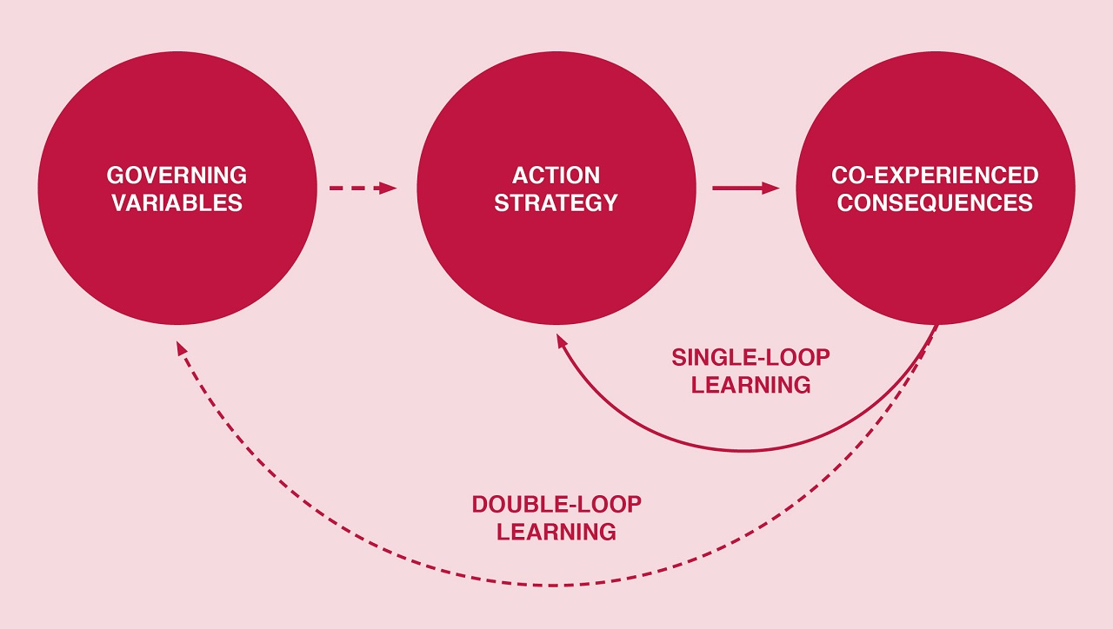
Organizational Learning and Adaptation
Organizational Learning
Argyris and Schön (1978):
  Single-loop learning
  Double-loop learning
Double-Loop Learning
Organizations:
  Correct errors
  Challenge assumptions
  Reevaluate existing practices
Notes:
Two big ideas guided us: HR practice is about what people really live, not what policy says. And the tech acceptance model — people use what feels simple. When you combine those, you get readiness.

Slide 5

The Adaptation Paradox
Learning Organizations Need:
Innovation
Agility
Continuous improvement
Potential Problem:
Continuous adaptation may exceed human capacity.
Adaptation Paradox
Creates tension between organizational adaptability and human sustainability.
Notes:
*one of the most widely accepted frameworks in psychology for describing personality*
Openness to experience – creativity, imagination, new ideas
Conscientiousness – organization, discipline, reliability
Extraversion – energy, outgoingness, sociability
Agreeableness – cooperation, trust, collaboration
Neuroticism - "emotional stability meter", high = overwhelmed easy, overthinks . Low = calm under pressure, emotionally steady

Slide 6

Technology as a Change Accelerator
Sources of Technology-Driven Change
LMS transitions
Hybrid instruction
Analytics platforms
Collaboration tools
Artificial intelligence
AI adoption should be viewed as an organizational learning challenge that requires sustained adaptation.

Slide 7
Human Limits and Change Management
Traditional Change Models
Kotter’s Eight-Step Process (1995)
Leadership support
Communication
Stakeholder buy-in
Missing Consideration
Human capacity is finite.
  Cognitive resources
  Emotional resources
  Behavioral resources
Notes:
This was the wow slide — training adequacy alone explained 92% of job satisfaction. That’s massive. Basically, when training feels real, employees are far more confident and engaged.

Slide 8
What Is Engagement?
Kahn (1990)
Investment of:
  Physical energy
  Emotional energy
  Cognitive energy
Schaufeli et al. (2002)
Three components
  Vigor
  Dedication
  Absorption

Slide 9
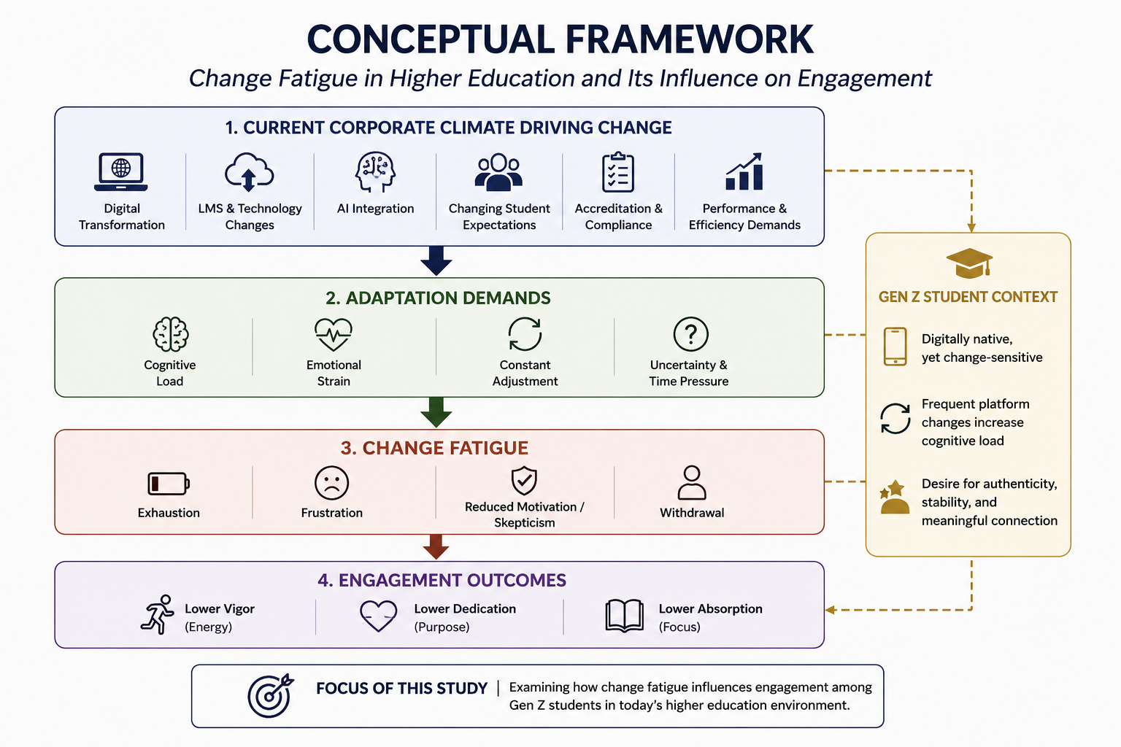

Slide 10
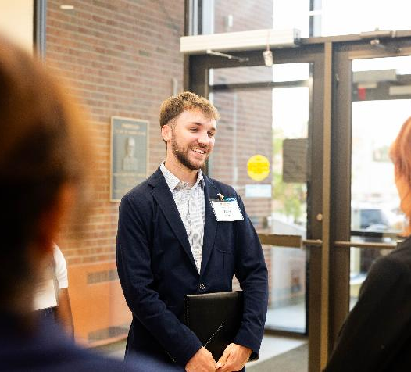
Why Higher Education Is Unique
Faculty Experience
Course redesign
Accreditation changes
Technology implementation
AI integration
Student Experience
Evolving academic expectations
Digital learning tools
LMS changes
Notes:
This shows usability is everything — the easier AI feels, the more employees actually use it. Training helps, but design matters just as much.

Slide 11

Gaps in the Literature
Existing Research Focuses On
Healthcare organizations
Corporate employees
Individual change initiatives
Missing Areas
Higher education environments
Student perspectives
Long-term cumulative change
AI-related adaptation demands

Slide 12
Conclusions & Future Research
Key Takeaways
Learning organizations depend on continuous adaptation.
Continuous adaptation can create change fatigue
Change fatigue reduces engagement.
AI may accelerate adaptation demands.
Sustainable change requires balancing innovation with human capacity.
Future Research
Examine how change fatigue influences engagement among both faculty and students in higher education.
Notes:
Most people felt moderately confident — they trust the tools but still worry about making mistakes or losing control. So confidence is good but cautious.

Slide 13
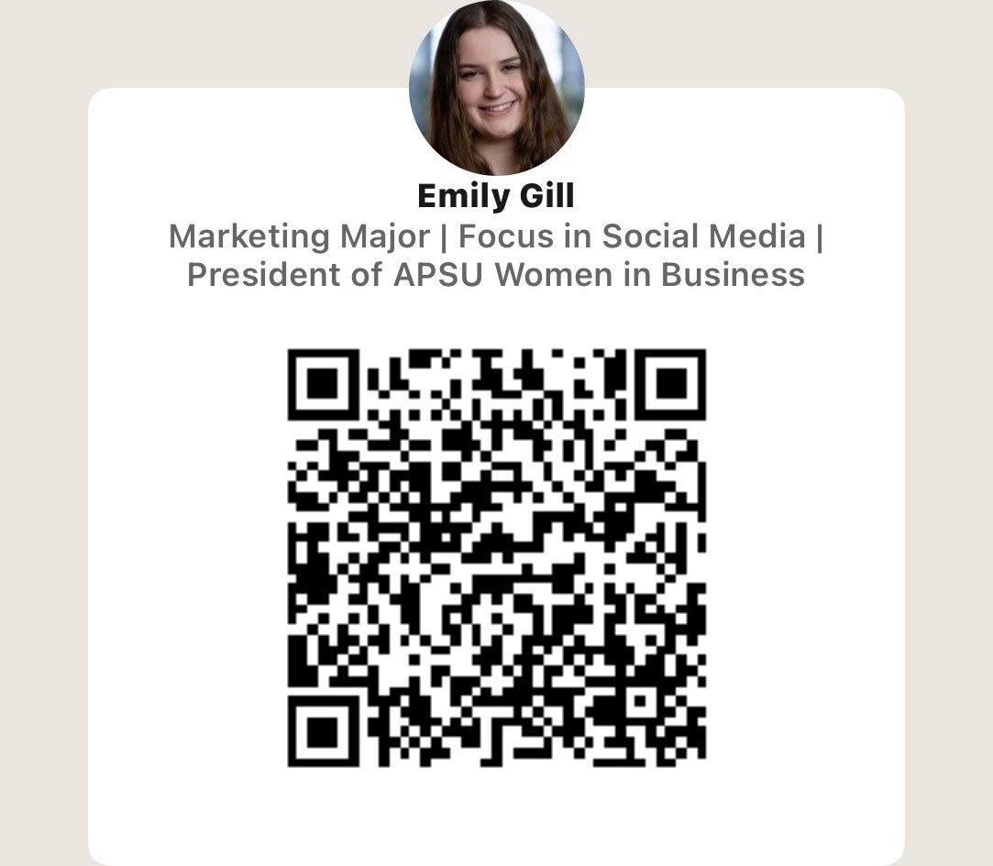
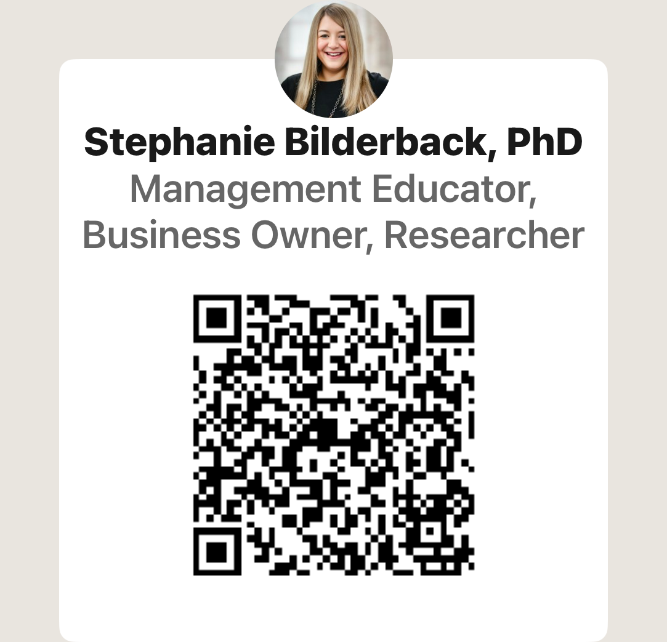
Questions and Comments
Please scan the QR codes to connect with us!
Emily Gill
Dr. Bilderback

