Slide 1



Building Support for Students
through GenAI Course Assistants
Negar Farakish and Hui Soo Chae
NYU School of Professional Studies
May 28, 2026

Slide 2
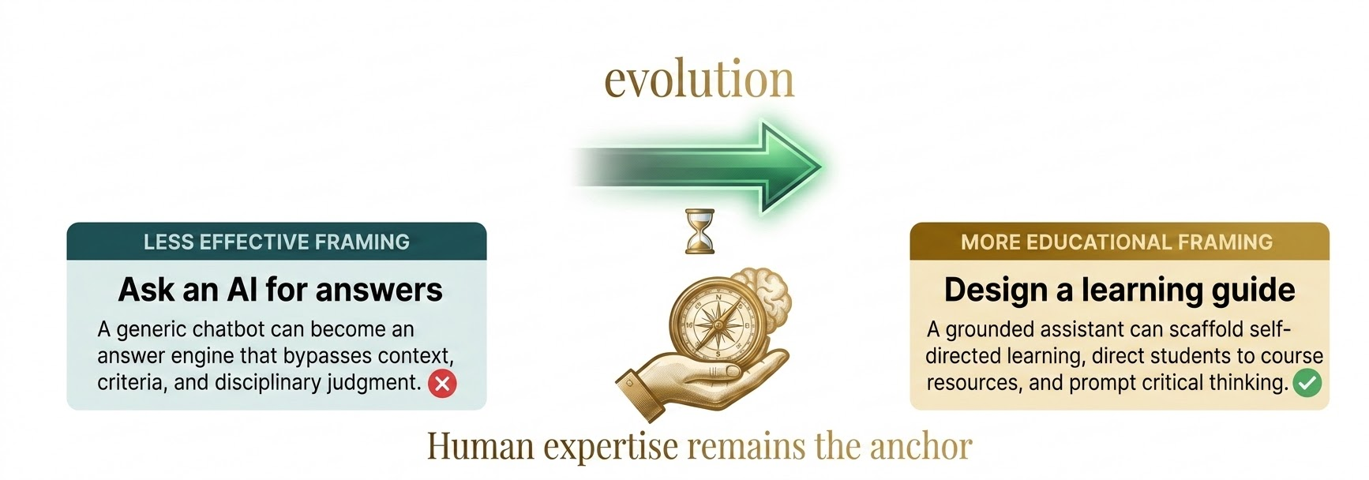
The Question Has Shifted
From whether to use GenAI to how to design it to strengthen teaching and learning:

Slide 3
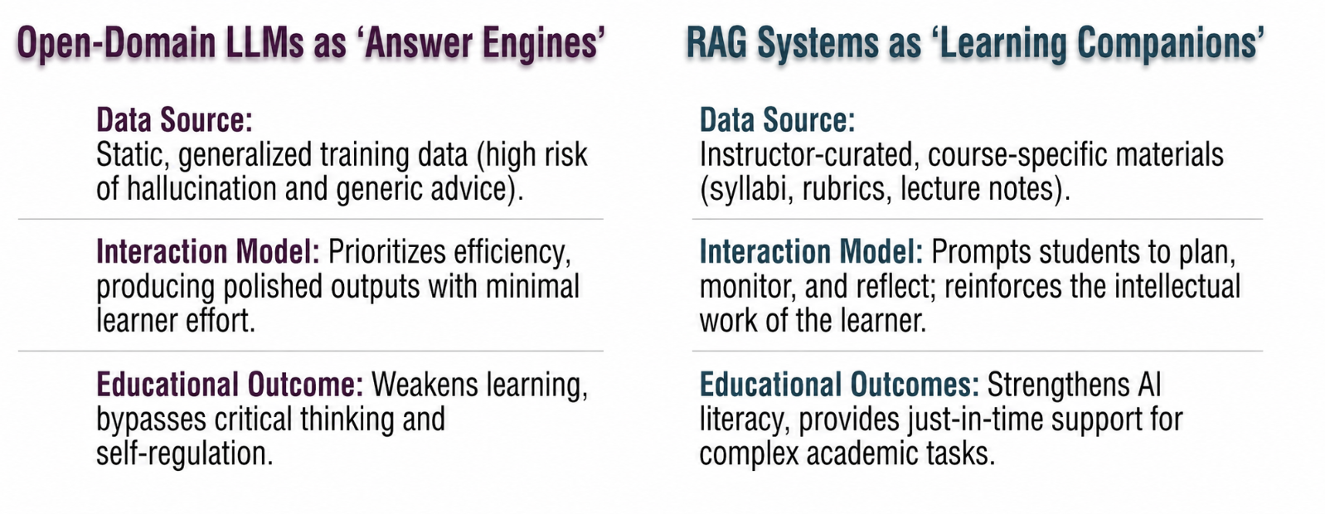
Creating Learning Companions
Using RAG (Retrieval-Augmented Generation) framework to create course-specific AI assistants grounded in the materials and disciplinary knowledge to advance student learning.

Slide 4
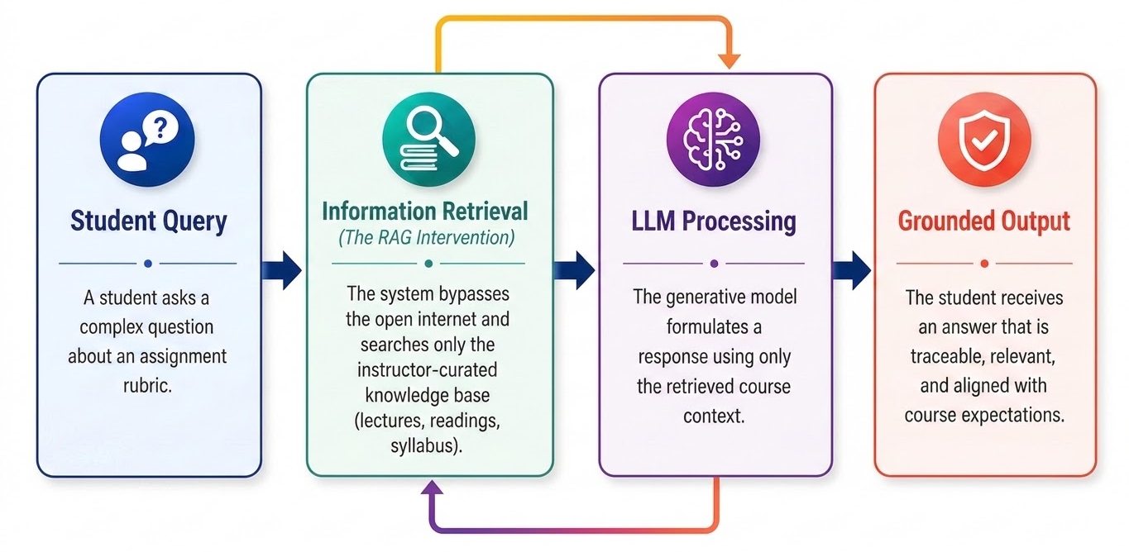
RAG Framework
Grounded Generation combines an LLM with external sources to improve relevance and traceability, preventing hallucinations and misleading academic advice.

Slide 5
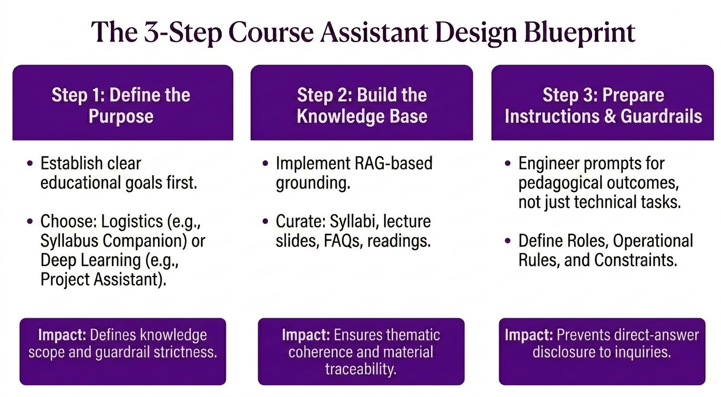
Designing AI Course Assistants

Slide 6
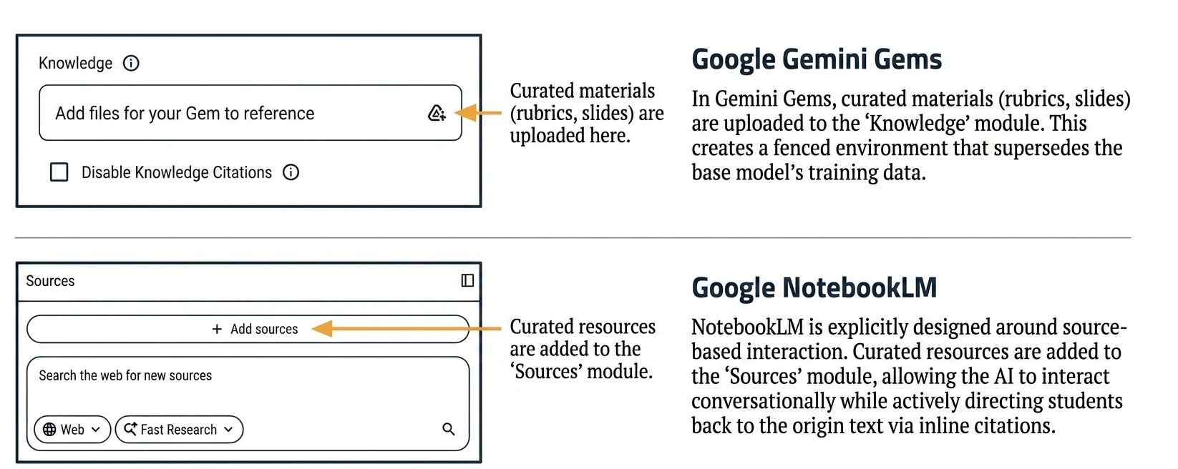
Platform Mechanics

Slide 7
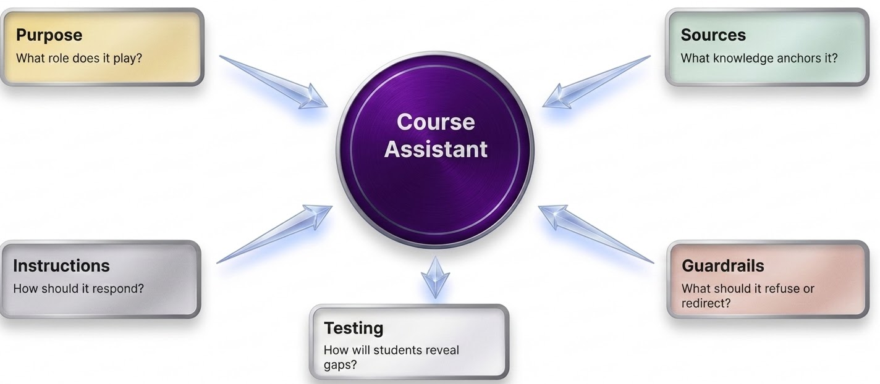
Design Decisions
Five design decisions faculty control:

Slide 8
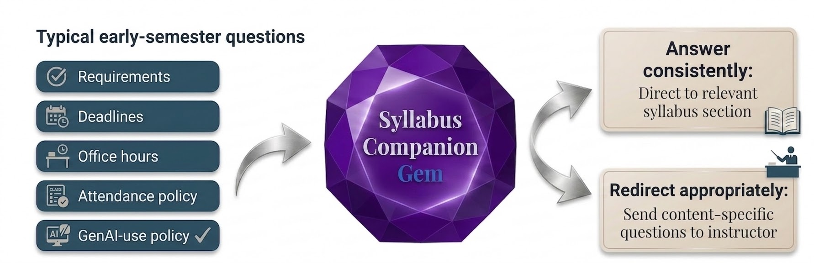
Syllabus Companion Gem
AI assistant can answer routine course logistics while encouraging contact with faculty for substantive learning questions.

Slide 9
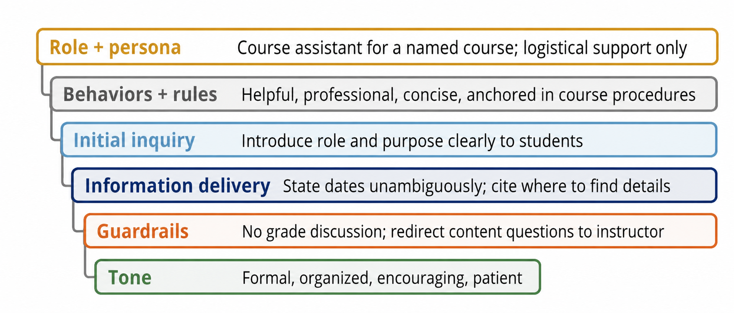
Syllabus Companion Gem
A well-designed course assistant prompt specifies role, behavior, information delivery, and boundaries.

Slide 10
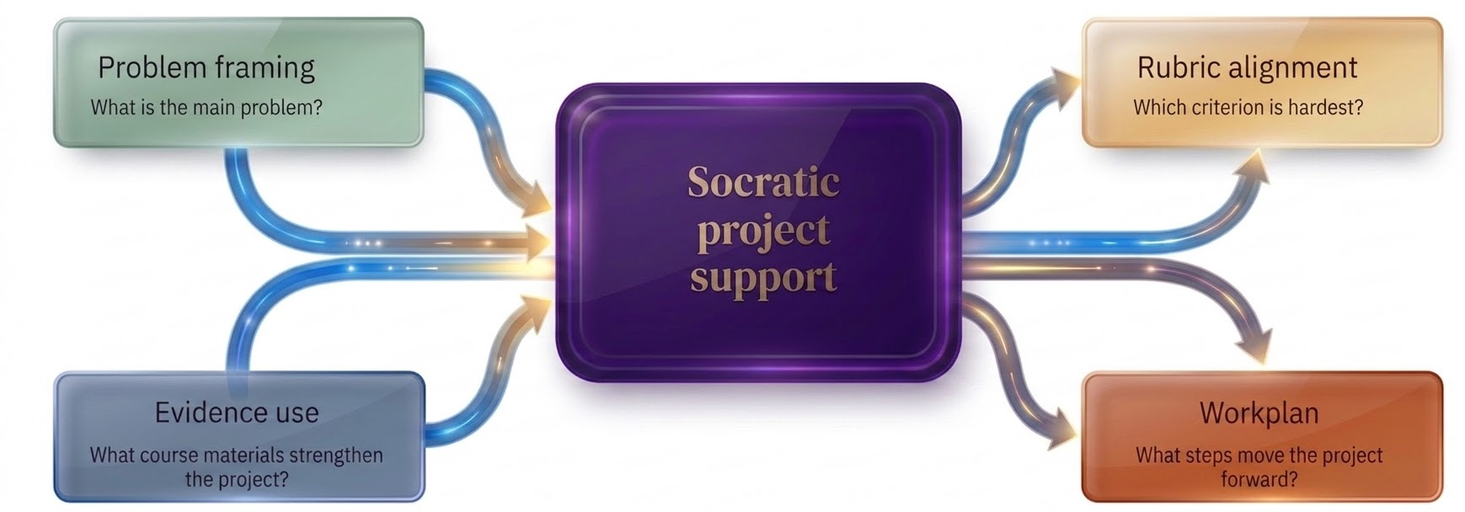
Project Assistant Notebook
NotebookLM can support projects by linking student decisions to learning outcomes, rubrics, and course resources.

Slide 11
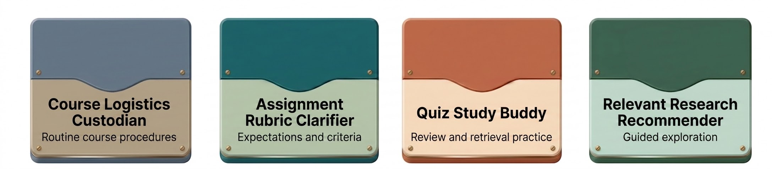
Starting Point
Start small, coherent, and low-risk:
A singular purpose
Small, aligned knowledge base
Clear boundaries

Slide 12
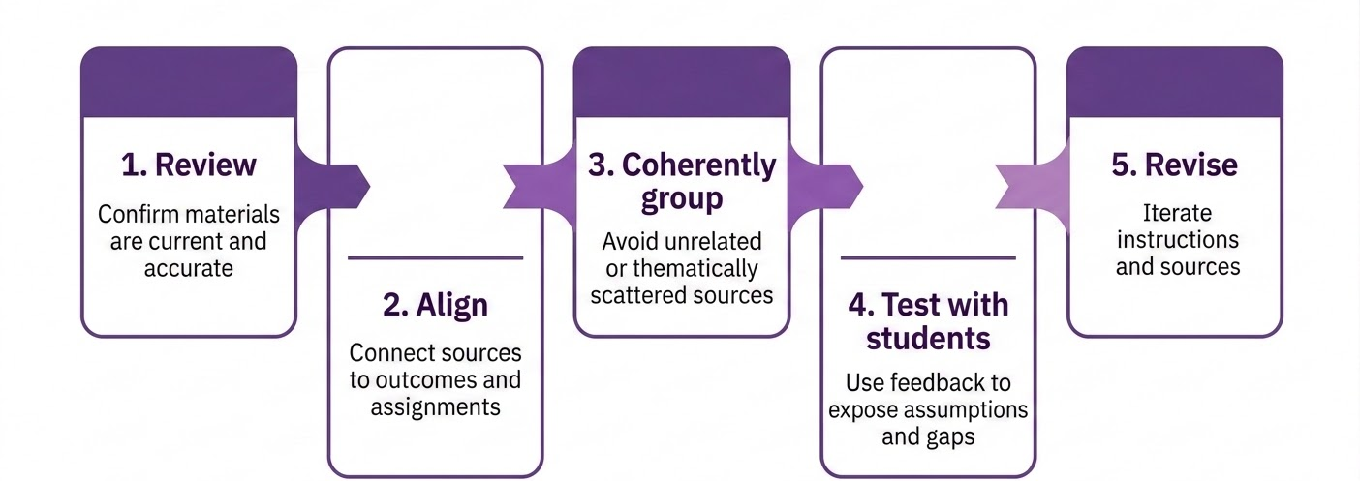
Knowledge Base
Materials should be reviewed, updated, and topically coherent before they are uploaded.

Slide 13
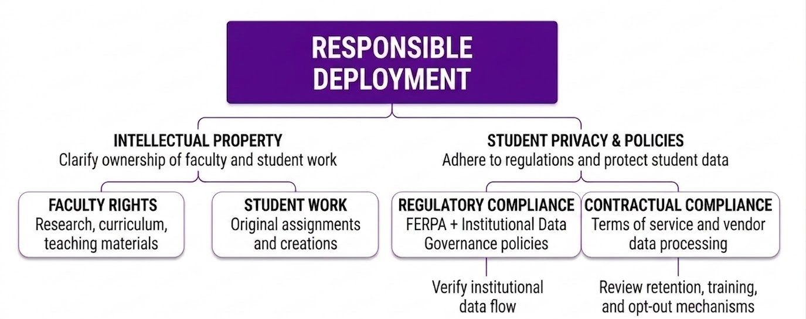
Guardrails

Slide 14
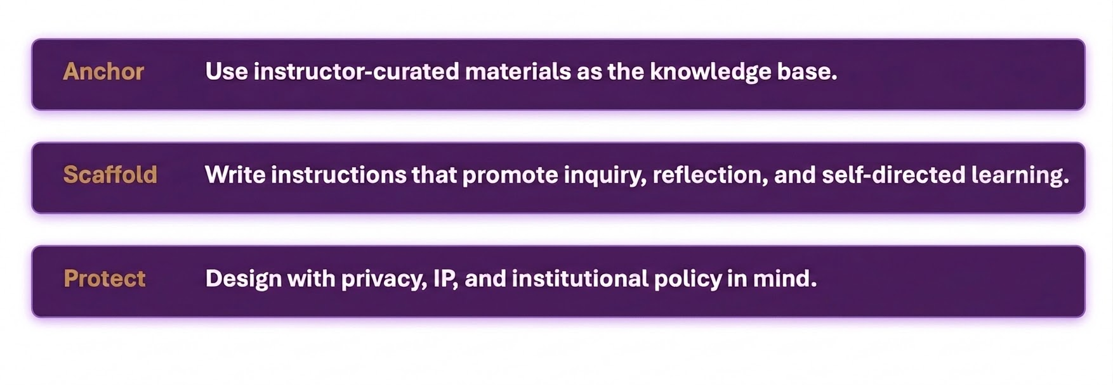
Knowledge Base
Course assistants should strengthen learning, not automate it. They should enhance students’ educational experiences, deepen understanding, and support meaningful learning:

