Slide 1
Streamlining Quality: Rethinking Online Course Review for the Future of Learning
May 29, 2026
Inspired by Purdue University Online’s QA Process

Slide 2
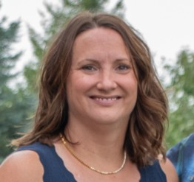
Sara Gretencord
Senior Quality Assurance Analyst, Purdue University
Sara Gretencord has worked at Purdue University for ten years, including the past five with Purdue Online’s Quality Assurance team, where she supports initiatives to ensure the quality and consistency of online learning experiences.

Slide 3

The Provocation
How can we transform quality assurance from compliance to innovation?
Online learning evolves quickly—quality processes must evolve too.
The goal: continuous improvement, not static evaluation.
Notes:
Let’s start with a question: How can we transform quality assurance from compliance to innovation? Online learning evolves faster than our processes often do. Too often, QA feels like a checkbox — a task to finish, not a process that fuels creativity. What if we thought of it differently? What if quality assurance were the spark that drives innovation in online education?

Slide 4

The Big Idea
Quality assurance should be a culture, not just a checklist.
Data, structure and communication drive collaboration.
The QA process should empower faculty, not burden them.
Notes:
Here’s the big idea: Quality assurance isn’t about control — it’s about culture. At Purdue, we’ve reframed QA as a collaborative ecosystem built on data, structure, and communication. When faculty, designers, and analysts work together, QA stops being a gatekeeper and becomes a growth partner — helping courses reach their full potential.

Slide 5

Why It Matters
Students deserve consistent, engaging, accessible learning.
Inconsistency = lost time and diminished trust.
A strong QA process ensures alignment between pedagogy, technology, and learner success.
Notes:
Why does this matter? Because students deserve the best possible learning experience — one that’s consistent, engaging, and accessible. Without structure, quality varies; without communication, trust fades. Our QA process gives faculty the support and tools they need to build courses that align with Purdue’s mission of academic excellence.

Slide 6
The Framework in Action: Four Steps to Streamlined QA
Submit Course Review Request (via Qualtrics) OR Data Obtained via iData
Data Processed & Tracked (Excel/SharePoint)
Communication with Admin Leads & Faculty
Courses Assigned, Reviewed, and Updated
Notes:
Here’s how it works in practice. We built a structured process that’s simple and replicable: Step 1 – Faculty, instructional designer, or other staff submit a review request through Qualtrics or data is obtained via our internal reporting partners, called iData. Step 2 – Our QA team processes and tracks that data systematically. Step 3 – We collaborate with faculty and administrators for approvals. Step 4 – Courses are assigned, reviewed, and updated. It’s structured, transparent, and sustainable.

Slide 7
The Human Element
Collaboration is the foundation: QA analysts, faculty, designers, administrators.
Shared accountability fosters transparency.
Streamlined communication minimizes friction.
Quality is everyone’s responsibility.
W. Edwards Deming
Notes:
But what really makes this work is the human side. The process connects faculty, designers, administrators, and analysts — each with a voice and a role. By treating QA as a partnership, we build trust and shared responsibility. It’s not about policing quality; it’s about empowering it.

Slide 8
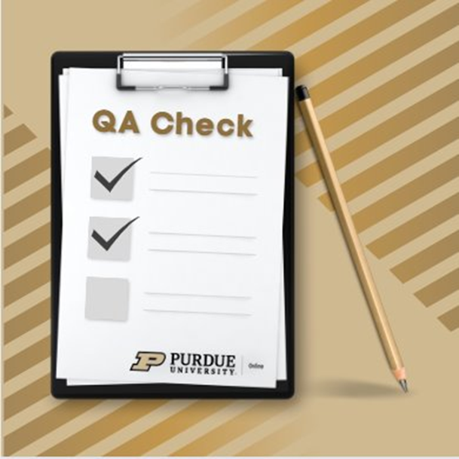
Key Takeaways
Consistency: One unified process.
Efficiency: Automated data handling.
Collaboration: Shared ownership of quality.
Scalability: Adaptable to other programs.
Notes:
So, what have we learned? Four key takeaways: Consistency — one process that works across all programs. Efficiency — automation reduces time and error. Collaboration — everyone contributes to the outcome. Scalability — this model can grow and adapt as learning evolves. In short, structure gives us freedom to focus on innovation.

Slide 9

The Future of QA
How can we use data analytics or AI to improve reviews?
What would QA look like if it were built for innovation, not inspection?
Future-focused, data-informed, and human-centered.
Notes:
Looking ahead, we’re asking new questions: How can data analytics or AI help us make smarter, faster reviews? How do we design QA systems that adapt to emerging technology rather than chase it? The goal is to make QA proactive — predicting quality challenges instead of reacting to them.

Slide 10

Call to Action
Challenge: Redefine QA as a living, evolving practice.
Collaboration between researchers and practitioners is key.
“Quality is not the destination—it’s the habit of continuous improvement.”
Notes:
So here’s my challenge to you: Rethink what QA means in your context. Make it a living, evolving practice — one that reflects curiosity, collaboration, and care for learners. As I often remind my team: Quality isn’t a destination; it’s a habit of continuous improvement.

Slide 11

“What small change could you make in your institution’s QA process tomorrow to make it more innovative?”
Notes:
I’ll leave you with one final thought: What small change could you make tomorrow that would make your QA process more innovative, more human, and more impactful? That’s how meaningful transformation begins — one intentional change at a time.

Slide 12
Contact info sgreten@purdue.edu

