Slide 1

Learning Ideas Conference 2026
Adaptive Learning
Using AI-Powered Risk Management to Sustain Innovation and Institutional Integrity
Arturo Rodriguez, PhD, MPH, MBA
Founder and Principal Consultant
Cynotex Strategy Partners
www.cynotex.net

Slide 2
SESSION ROADMAP
What you will leave with today
A working definition:
A risk guide for institutions:
An AI-powered framework:
Three working use cases:
A 30/60/90 plan:
ERM reframed as adaptive learning infrastructure, not a compliance checkbox
Five domains where institutions are most exposed.
A four-step method using tools you already have.
Enrollment, IT/policy compliance, and Research Integrity.
Concrete actions you can take Monday morning.

Slide 3
CONTEXT
Forces reshaping the higher education landscape
Technology disruption
Demographic decline
Generative AI, learning platforms, and credential alternatives compress program lifecycles from a decade to a semester.
The enrollment cliff hits institutions whose program portfolio has not adapted to working learners and non-traditional pathways.
Eroding public trust
Financial pressure
Research misconduct cases, free-speech incidents, and value-of-degree debates raise the cost of every reputational event.
Net tuition revenue softening, federal funding uncertainty, and rising compliance costs squeeze operating margins.
Cyber & policy exposure
Regulatory acceleration
Ransomware, FERPA/GDPR overlap, Title IX changes, and AI-use policy gaps expand the institutional attack surface.
State and federal AI legislation, accreditor expectations on outcomes, and DOL/IRS scrutiny shorten policy review cycles.

Slide 4
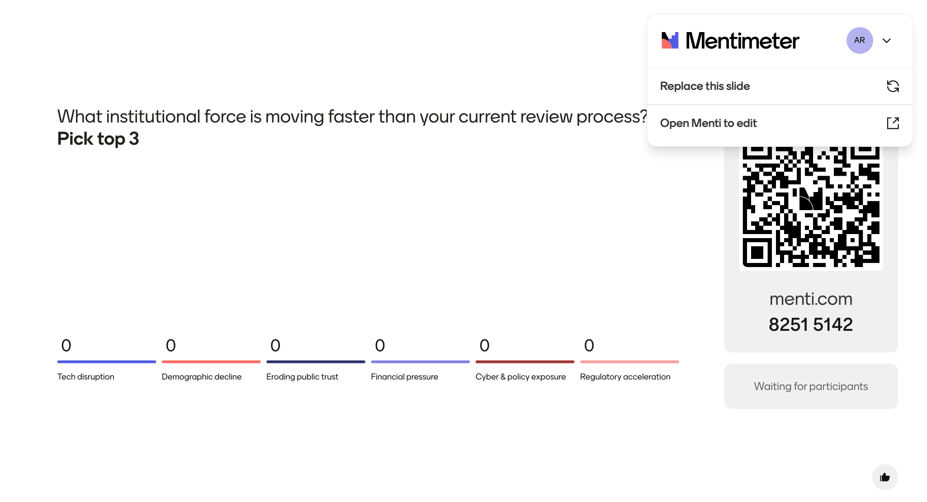
AUDIENCE QUESTION

Slide 5
THE CASE
Why ERM and why now
Reframing risk for the adaptive institution
The risk gap
From
Annual compliance exercise
95% of higher-ed institutions do not have a fully matured ERM program. ^{URMIA}
To
Continuous adaptive-learning signal
From
Risk as the brakes on innovation
72% of non-profit leaders (including higher-ed) do not rate their risk management processes as "mature" or "robust". ^{NC State ERM Initiative}
To
Risk as the steering of innovation
From
Owned by one office or committee
72% of of higher-ed leaders say their institution is exposed to material risks they cannot yet see clearly enough to act on. ^{United Educators}
To
Embedded across the entire organization
From
Annual report nobody reads
To
Live dashboard that informs Monday decisions

Slide 6
AEFP (Association for Educational and Financial Policy)
THE EVIDENCE
College and University Closures since 2010 (144 total)

Slide 7
THESIS
ERM redefined as adaptive-learning infrastructure
Enterprise Risk Management is the institutional capacity to sense, interpret, and respond to threats faster than the environment changes, and to convert that learning into strategic advantage.
Sensing
Interpretation
Response
Continuous detection of weak signals across academic, financial, and operational systems.
Shared frameworks that turn signals into prioritized, contestable judgments.
Decision rights and playbooks so action keeps pace with the rate of change.

Slide 8
RISK MAP
Five domains where institutions are most exposed
01
Academic & program
Enrollment shifts, program obsolescence, credential competition, accreditation drift.
02
Research & integrity
Misconduct, AI-assisted authorship (data + reference hallucinations), sponsored-program compliance, IP & export controls.
03
Financial & operational
Net tuition revenue, endowment volatility, deferred maintenance, vendor concentration.
04
IT, cyber & data
Ransomware, FERPA/GDPR exposure, shadow AI use, identity & access sprawl.
05
Reputation & policy
Title IX/IX-A, free speech, AI-use policy gaps, donor and community trust.

Slide 9
The AI inflection point for risk leadership
Risk work without AI
Risk work with AI in the loop
— Annual cycle. Inventory takes weeks.
+ Continuous scanning of internal + external signals.
— Heat maps built from memory and meetings.
+ Draft risk registers in hours, not quarters.
— Policy review queues that never clear.
+ Policy & contract review compressed 5–10x.
— Few staff spend more than 5% of time on risk.
+ Every leader gets a risk co-pilot in their workflow.
— Findings arrive after the decision is made.
+ Triage happens before, not after, the decision.
AI does not replace risk judgment. It removes the bottleneck that has prevented institutions from doing risk work at the cadence the environment now demands.

Slide 10
TOOLKIT
The AI toolkit available to risk leaders today
General-purpose LLMs
Document & contract review
Data & analytics copilots
ChatGPT, Claude, Gemini, Copilot
Acrobat AI Assistant, Harvey, Kira, Spellbook
Power BI Copilot, Tableau Pulse, Hex Magic
Drafting registers, summarizing policy, scenario writing, structured analysis.
Clause extraction, redlining, obligation tracking, syllabus and policy audits.
Enrollment trends, financial anomaly detection, ad-hoc “what-if” queries.
Monitoring & sensing
Security & GRC
Governance & guardrails
Perplexity, Feedly AI, Google Alerts AI
Microsoft Purview, Drata, Vanta, Hyperproof
NVIDIA NeMo, Databricks, Sailpoint
External signal scanning for accreditation, regulation, competitor moves.
Control mapping, evidence collection, continuous compliance posture.
Approved-use registries, data-loss prevention, audit logging of AI usage.
Vendor names are illustrative examples and not endorsements.

Slide 11
FRAMEWORK
AI-powered ERM in four steps
01
02
03
04
Identify
Assess
Triage
Respond
Surface emerging risks
Score probability × impact
Prioritize what moves now
Decide, document, monitor
Scan internal documents, dashboards, contracts, and external signals to generate candidate risks worth review.
Use a documented rubric; let AI standardize language while humans calibrate judgment.
Escalate fast-moving risks for executive attention and route slower-moving issues into standing governance channels.
Assign owners, define indicators, and turn each decision into a trackable signal for the next cycle.
Cycle monthly for fast-moving domains (IT, policy), quarterly for slower domains (program portfolio, finance).

Slide 12
PRACTICAL · PROMPTS
Prompts risk managers can use today
SURFACE EMERGING RISKS
STRESS-TEST A DECISION
“Based on the attached strategic plan and last year’s audit findings, list the top 10 risks we are under-weighting in the next 18 months. For each, give probability (1–5), impact (1–5), and a one-line rationale.”
“We are considering a major academic, policy, or technology decision. Generate five plausible ways this decision could fail within 24 months and identify the first leading indicator we would likely see.”
OUTPUT → A draft risk register for review.
OUTPUT → A pre-mortem for governance discussion.
SCAN FOR EXTERNAL SIGNALS
DRAFT A RESPONSE PLAN
“Summarize the last 90 days of regulatory, peer-institution, accreditor, and market developments relevant to this issue. Which three require follow-up this month, and why?”
“A ransomware incident has just disabled our SIS during registration. Draft the first 24 hours of decisions, owners, communications, and public facing questions we must be ready to answer.”
OUTPUT → A curated weekly external-risk digest.
OUTPUT → An editable incident-response runbook.
Always pair prompts with approved tools, vetted data, and a named human reviewer. AI drafts; leaders decide.

Slide 13
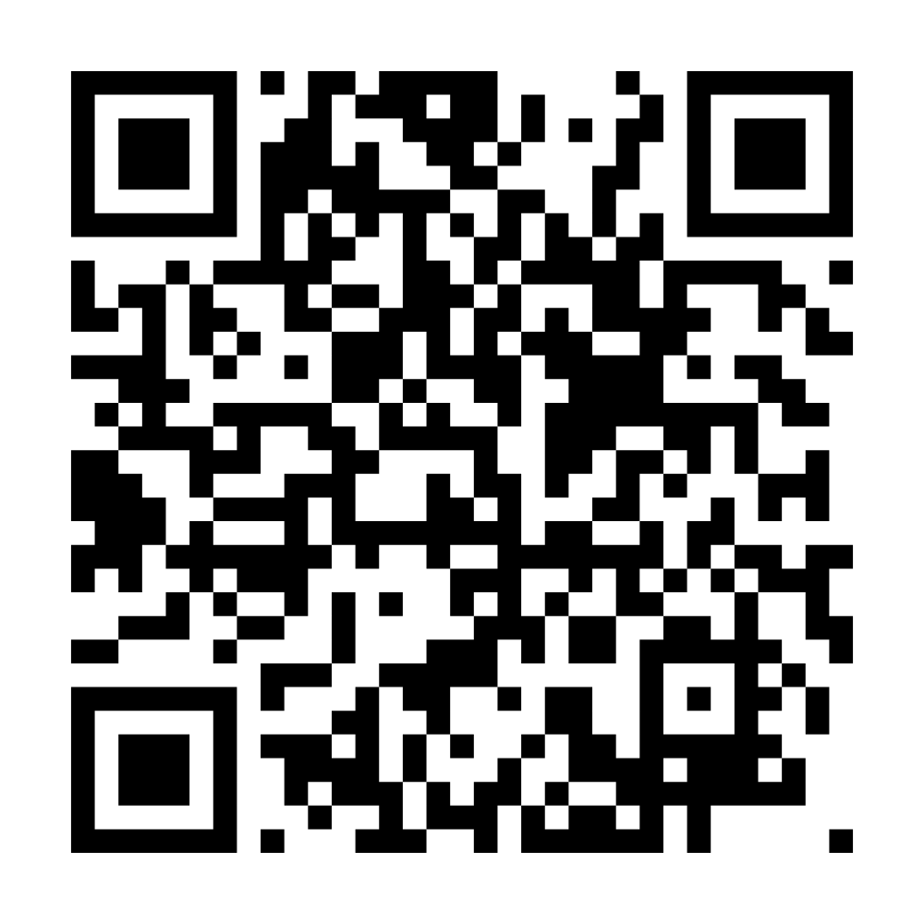
RISK REGISTER
Scan to get a free AI-Powered Risk Assessment and this template
https://cynotex.net/cynotex-ai-powered-risk-assessment/

Slide 14
RISK HEAT MAP
Insure, contingency plans, assign triggers
Mitigate immediately, assign owner, review constantly or terminate
Monitor and accept
Standardize controls, automate where possible and reduce operating drag

Slide 15
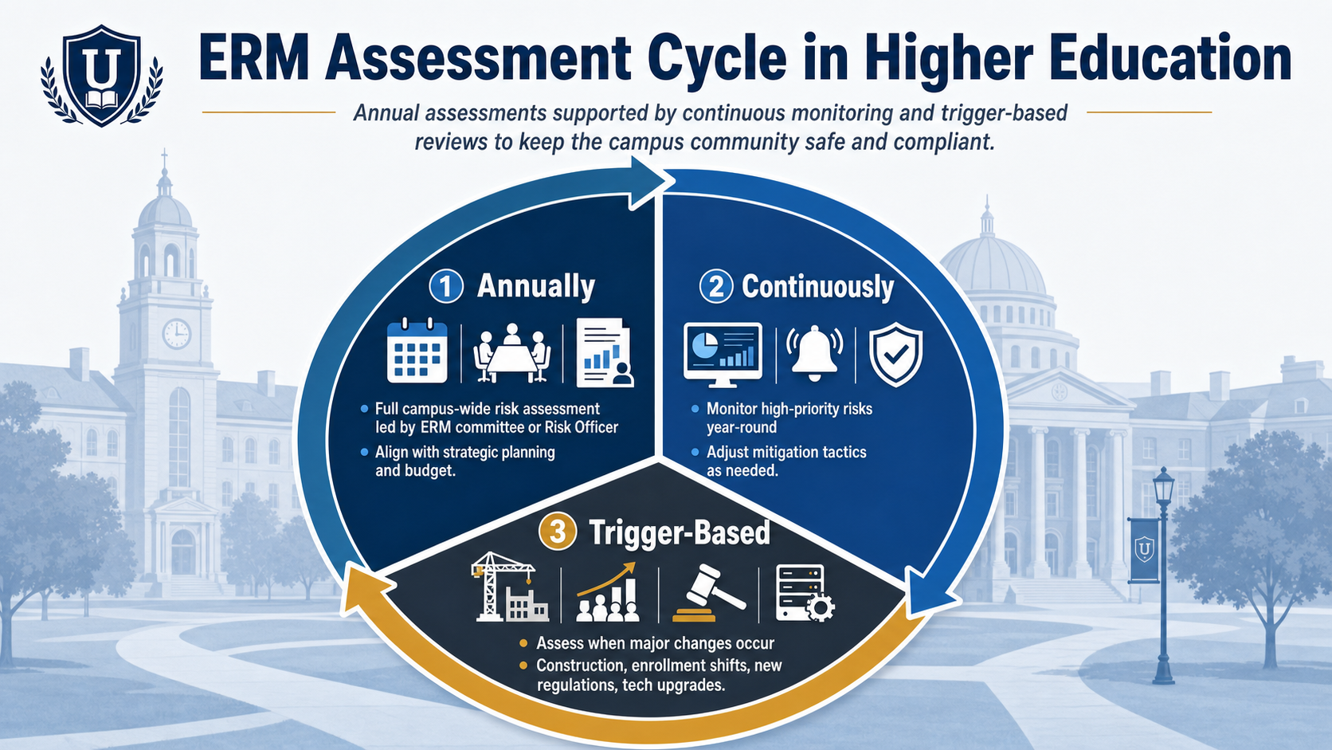
CONTINUOUS ASSESSMENT AND SURVEILLANCE

Slide 16
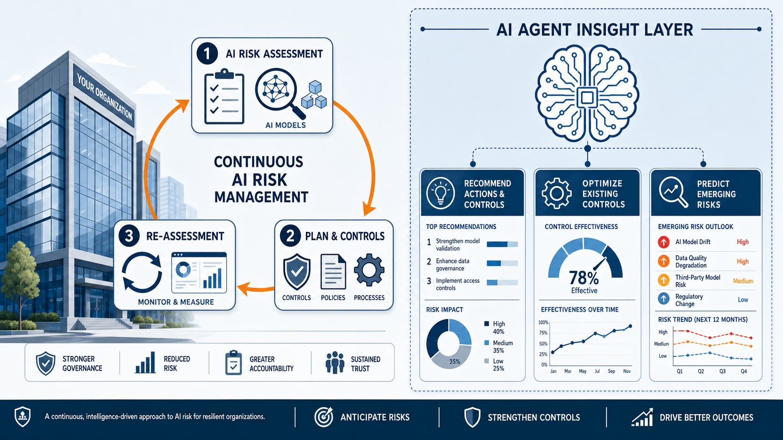
TRAINING THE AI AGENT

Slide 17
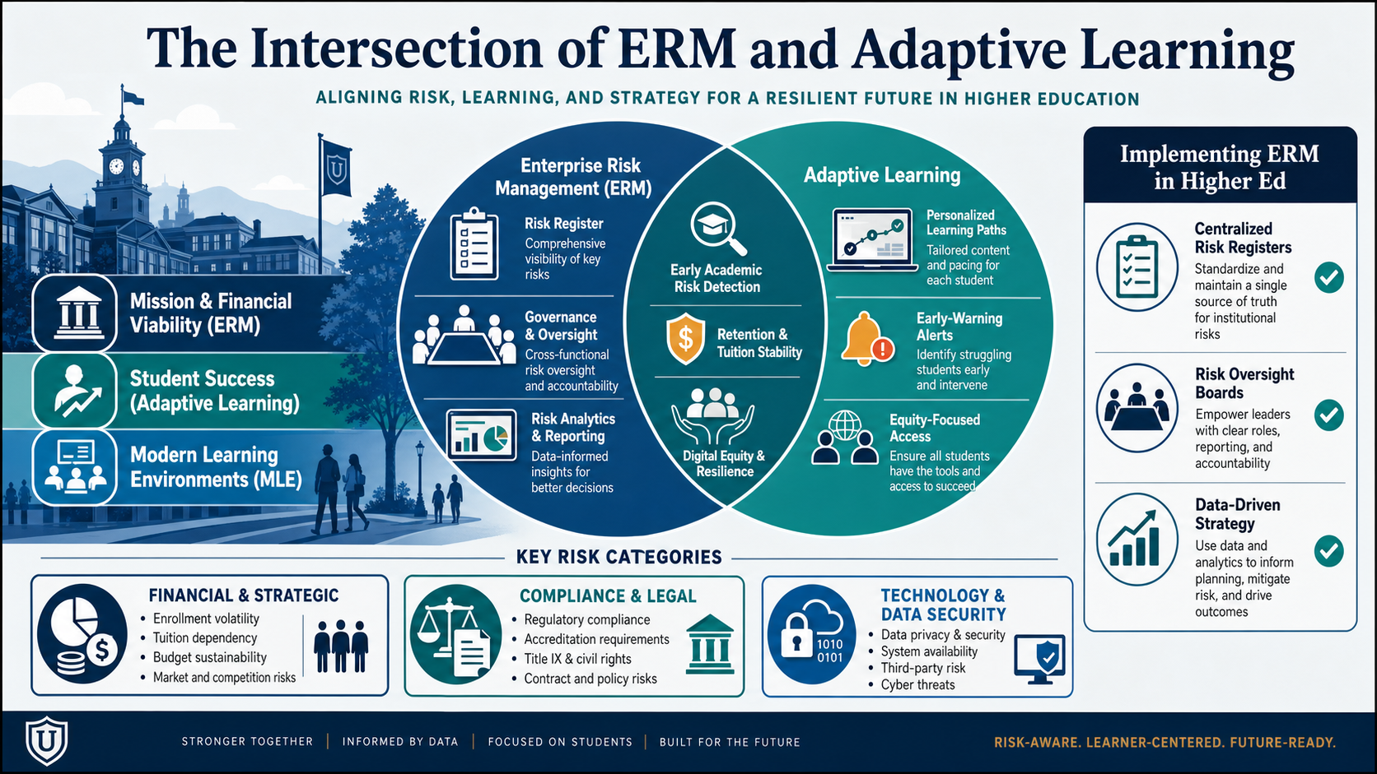
ADAPTIVE LEARNING

Slide 18
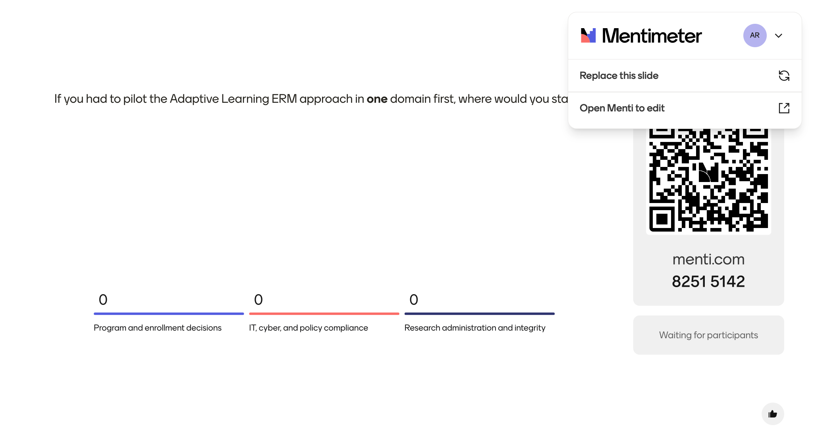
AUDIENCE QUESTION

Slide 19
USE CASE 01
Program and curriculum development/enrollment triaged in an afternoon
1
Ingest
SCENARIO
Feed 3 years of enrollment, completion, and labor-market data into a controlled LLM workspace, plus public BLS/IPEDS context.
A dean must decide which of 40 graduate programs to invest in, hold, or sunset before the next budget cycle.
2
Score
AI applies a documented rubric (demand, margin, mission fit, AI substitution risk) to every program and explains each score.
3
Cluster
Without AI: a 6-week working group. With AI: a working draft in an afternoon, refined over a week.
Programs grouped into Invest / Hold / Watch / Sunset tiers, with a one-paragraph rationale and dissenting view per program.
4
Decide
Dean and faculty council review tiers, override where appropriate, and lock decision criteria into the next program-review cycle.

Slide 20
EMBED · CURRICULUM AND EROLLMENT
Risk-aware program, curriculum development, and enrollment
Five practices to embed
A working question for every program review:
Signal scan at every review
“What would have to be true in five years for this program to still serve our learners, and what early signals tell us if it isn’t?”
Build labor-market, AI-substitution, and enrollment-trend scans into the standard program review packet.
Sunset criteria up front
Define the conditions under which a program will be paused or retired at the time it is approved.
Scenario-based design
— Adaptive program review prompt
Design new programs against 2–3 plausible futures, not a single forecast.
Faculty as risk sensors
Recommended reading:
Prioritizing Academic Programs and Services
Robert C. Dickerson
Faculty governance gains a structured channel to surface emerging risks they see in their fields.
Decision logs
Capture the assumptions behind each major curricular bet so future leaders can audit them.

Slide 21
USE CASE 02
IT security & policy compliance is continuous, not annual
1
Inventory
SCENARIO
AI parses SSO logs, expense reports, and procurement data to surface every AI tool in use across the institution.
The CIO needs to know TODAY where unsanctioned AI use is creating FERPA, contractual, or accreditation exposure.
2
Map controls
Each tool is mapped against NIST CSF, FERPA, and contractual data-use clauses, gaps flagged with severity and owner.
3
Draft policy fixes
AI drafts targeted policy amendments and faculty/staff guidance for the highest-risk gaps; legal and IT review and finalize.
Reframe: AI risk is a known-unknown problem, sense it continuously, not once a year.
4
Monitor
A weekly digest tracks new tools, new gaps, and remediation progress, feeding the executive risk dashboard.

Slide 22
EMBED · IT & POLICY
Embedding IT security & policy compliance
Cyber & ransomware
Data privacy & FERPA
Phishing-led account takeover, ransomware on research and admin systems, third-party breaches in LMS, SIS, and identity providers.
Student-record exposure through shadow AI tools, secondary use of learning analytics, and GDPR overlap on international learners.
CONTROL
CONTROL
Tiered backups with offline copies, mandatory MFA on privileged accounts, and tabletop exercises run twice a year with a written playbook.
Approved-tools list, AI-prompt data classification rules, and a standing review of vendor data-processing agreements.
Identity & access
AI-use policy gaps
Standing access for departed staff, over-permissioned faculty roles, and contractor sprawl across SaaS tools.
Faculty, staff, and students using AI without clear guidance on disclosure, data handling, grading, and intellectual property.
CONTROL
CONTROL
Quarterly access recertification, role-based provisioning tied to HR events, and least-privilege defaults on all new systems.
A short, plain-language AI-use policy, syllabus language templates, and a single intake channel for new AI-tool requests.

Slide 23
USE CASE 03
Research integrity monitoring at portfolio scale
1
Signal scan
SCENARIO
AI tracks retraction databases, PubPeer activity, and grant-disclosure inconsistencies tied to institutional authors.
The VPR wants a defensible, ongoing read on integrity risk across hundreds of active awards and thousands of publications.
2
Risk tier
Awards and labs are tiered by exposure (sponsor sensitivity, prior findings, disclosure completeness) using a documented rubric.
3
Targeted review
Tier-1 awards receive a structured human review; AI prepares the file and surfaces specific items to investigate.
AI does not adjudicate misconduct. It shortens the path from signal to qualified human review.
4
Close the loop
Outcomes feed back into rubrics and into onboarding/training for new PIs — institutional learning, not just enforcement.

Slide 24
EMBED · RESEARCH
Risk in research administration & integrity
Research misconduct
Sponsored-program compliance
Fabrication, falsification, plagiarism, now compounded by generative AI authorship and image manipulation.
Cost-share misalignment, effort reporting drift, time-and-effort certification gaps.
CONTROL
CONTROL
Pre-submission integrity screen plus a standing case-review panel with documented disposition timelines.
Quarterly variance audit on top 20 awards, plus AI-assisted clause-conflict review at award setup.
Export controls & IP
Data & subjects
Foreign-influence disclosures, dual-use research, faculty consulting overlaps.
IRB compliance, secondary-use creep, sensitive-data movement into unmanaged AI tools.
CONTROL
CONTROL
Disclosure dashboard tied to HR and OSP; risk-tiered review for new international collaborations.
Approved-tools list, IRB protocol templates that name AI use explicitly, audit of data exports.

Slide 25
GUARDRAILS
Ethical & governance principles for AI in ERM
Human accountability
Data minimization
AI recommends. Named humans decide. Every material risk decision has a documented owner and rationale.
Never feed identifiable student, patient, or research-subject data into general-purpose AI tools without explicit approval.
Approved-tools list
Auditability
Maintain a small, vetted list of AI tools cleared for risk work, and a fast lane to add new ones safely.
Log AI prompts, outputs, and the humans who acted on them. Treat AI as a member of the workflow that must be reviewable.
Bias scrutiny
Faculty governance
Stress-test AI outputs on programs, populations, and faculty groups where historical data may encode disadvantage.
Bring shared governance into AI policy design early and not after a controversy forces the conversation.

Slide 26
ROADMAP
A 30 / 60 / 90-day plan for academic leaders
30 DAYS
60 DAYS
90 DAYS
Organize & Scope
Pilot & Govern
Embed & Report
Convene a small ERM-AI working group across academic, research, IT, and finance.
Stand up an approved AI workspace with logging and data-governance controls.
Brief the cabinet and board risk committee with a live dashboard, not a static report.
Inventory current risks and AI tools already in use.
Run the four-step framework end-to-end on the two pilot domains.
Hand off ongoing operation to standing offices; schedule quarterly recalibration.
Pick two pilot domains.
Draft the first version of an institutional AI-use guidance memo.
Lock the four-step cycle into standing governance.

Slide 27
CLOSING
Three things to take home
01
ERM is adaptive-learning infrastructure.
The institutions that thrive will be the ones that can sense, interpret, and respond faster than the environment changes.
02
AI removes the bottleneck; not the judgment.
The constraint is rarely the technology. It is governance, workflow, and speed at which leaders can turn signals into action.
03
Start small, embed deeply.
Pick two domains, run the four-step cycle, and build a repeatable practice that can scale across academic, research, and operational decisions
Before you leave today, choose one move for the next 30 days:
1. Form the working group; 2. Inventory current tools and risks; or 3. Name your two pilot domains.

Slide 28

Thank You!!!!!
Cynotex Strategy Partners
Risk Management | Strategy | Grantwriting
www.cynotex.net

