Slide 1
The Forgotten Sense in Adult Learning: Vestibular Function,
Movement, and the Sensory Conditions of Cognition
Connie Hamner Campbell, doctoral student
Dreeben School of Education
The University of the Incarnate Word
San Antonio, Texas USA
chamner@student.uiwtx.edu
Pamela D. McCray, PhD., MBA
Dreeben School of Education
The University of the Incarnate Word
San Antonio, Texas USA
pmccray@student.uiwtx.edu
Notes:
Thank you for attending. Today I will discuss an often-overlooked factor in adult learning and workplace performance: the vestibular system. While digital technologies have transformed how adults learn and work, they have also changed how we physically engage with learning tasks. This paper explores whether reduced movement and reduced vestibular stimulation in screen-based environments may influence attention, cognitive endurance, and other learning-related processes.
Thank Dr. Pam McCray Dr. Norman St. Clair

Slide 2


Research and
Adult Learners 1978 Then and Now

Slide 3

Adult learners are engaging with changes in their environments
Adult work and education are increasingly screen-based.
Knowledge workers spend @7–10 hours daily interacting with screens [2], [18], [22], [1].
Multitasking media equivalent to 10h and 45min.[22],
Daily head movements have reduced significantly.
Sensory conditions and learning environments receive little research coverage.
Notes:
Key Points
Digital learning is now the norm.
Adult work and education are increasingly screen-based. "Modern knowledge work is heavily screen-based. An estimated 104 million working-age Americans spend more than seven hours per day in front of screens, and full-time employees average more than eight hours of work on weekdays."
Movement patterns have changed significantly.
Sensory conditions of learning receive little attention. Sensory conditions and learning environments little research
Kaiser Family Foundation children and young adults 8-18 7 h and 38 min. multitasking equivalent of 10h and 45min in 2010.
Nagata 2026 ABCD study ages 13-18 longitudinal across the country monitored cell phone use at school 70 minutes even with ban.

Slide 4
Reframing Adult Learning Through an
Embodied and Physiological Lens
Embodied Cognition:
Learning emerges through interactions of the
• Brain
• Body
• Environment
Physiological: Basic understanding is necessary
(Barsalou, 2008; Sheya & Smith, 2018)

Slide 5
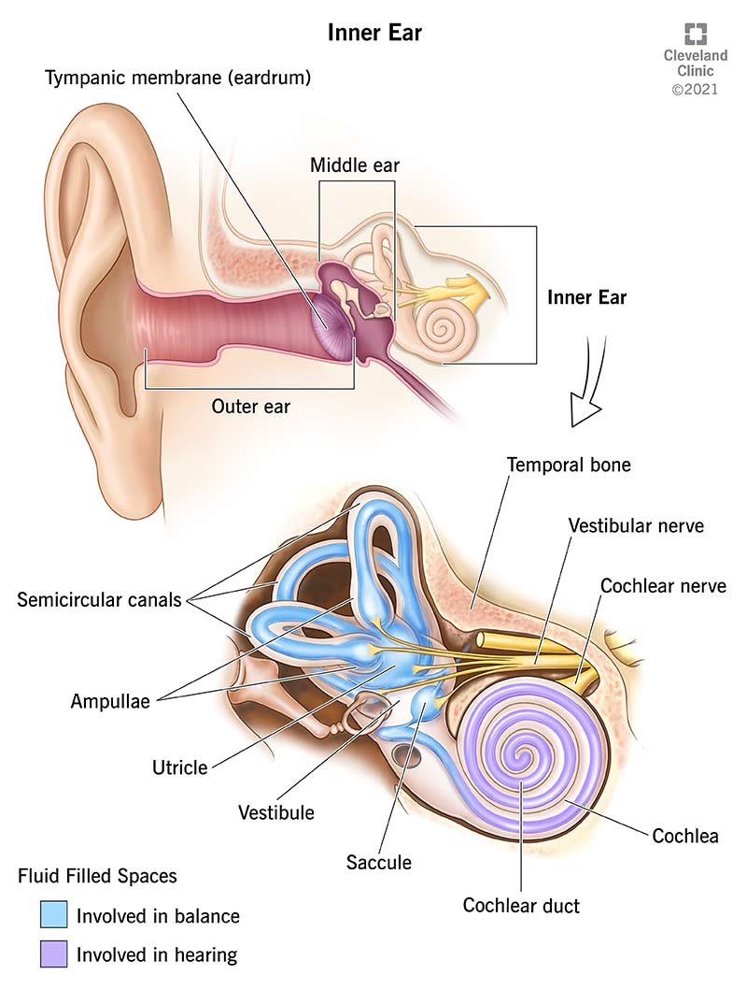
Understanding Simple Vestibular Physiology
Ancient organ located in the inner ear
Function:
Creates vestibular signals
Signals integrate information from all sense organs
Components:
Otoliths – linear body movements: up and down, left and right and spinning
Semicircular canals – rotational head movements
  Horizontal (no)
  Anterior or Superior (yes)
  Posterior (head to shoulder)

Slide 6

Importance of the Vestibular System
The system is activated by movement
Signals are continually available for the body
Vestibular Signals support:
Cognition [7], [10], [13], [20], [24], [25].
Memory [9],
Attention [17]
Spatial Awareness, Balance
Executive Functions, Reasoning, Problem Solving, Planning, Organizing ,
Self Monitoring and Emotional Regulation.
Stabile vision [7], [10], [11],
Maintains neural networks [8]
integrates all senses [1], [8]
Autonomic systems: homeostasis [8], [25]
Cardiac, Blood pressure, Respiration, Digestion, Endocrine system, hormones,
Epigenetic changes,.
Helps maintain homeostasis [8], [25]
Incidence of dysfunction is high: 35% in adults age 40
Notes:
Cognition refers to the broad set of mental processes used to acquire, process, store, and use information. It includes:
Decision-making

Slide 7
Evidence Linking the Vestibular Function and Cognition
Vestibular deficits reduced cognitive testing: atrophy and
impaired spatial memory in humans (Brandt, 2005).
Visuospatial ability, attention, executive function, and memory (Bigelow and Agrawal 2015).
Vestibular dysfunction leads to cognitive impairments:
knowledge in the field (Guo, 2024).
Vestibular function and hippocampal volume:
Baltimore Longitudinal Study of Aging (Kamil, 2018).
Development weaves brains, bodies and environments into cognition (Sheya, 2018).
From ear to uncertainty: Vestibular contributions to cognitive function (Smith, 2018).
Cognitive control in media multitaskers (Ophir, 2018).

Slide 8
The Good News: Vestibular Stimulating Exercises Improve
Important Skills for Adults and Children
Improved cognitive performance (children) vestibular rehabilitation combined ADHD and vestibular impairment (Lofti, 2017).
Vestibular therapy improved motor planning, attention, and academic performance in children with attention deficit hyperactivity disorders: (Moghadam, 2018).
Short vestibular and cognitive training improves oral reading fluency in children with dyslexia (Caldani,2021).
Spinning, rolling, head movements need to be included. Targeted specific vestibular movements appear to be important in addition to generalized movement (Moghadam, 2018)..

Slide 9
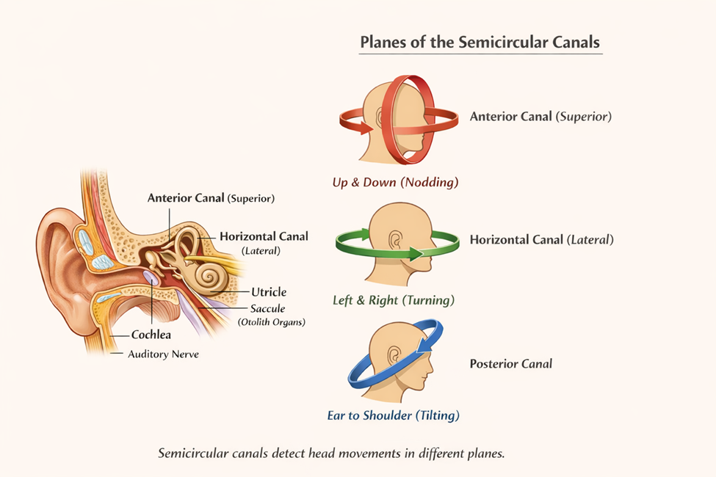




The Vestibular System: The Good News

Slide 10
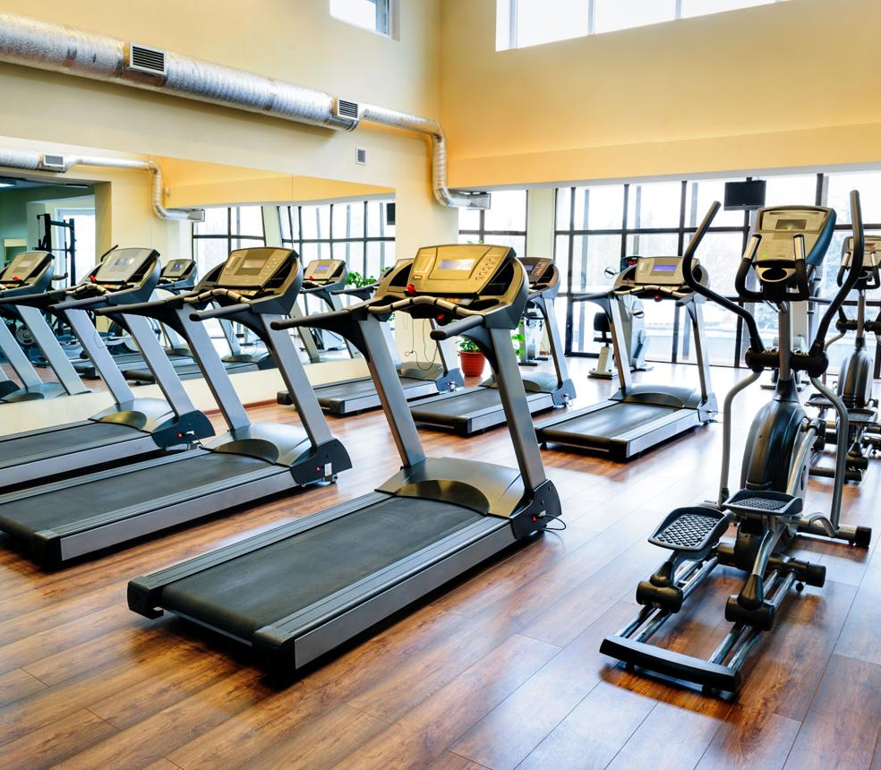
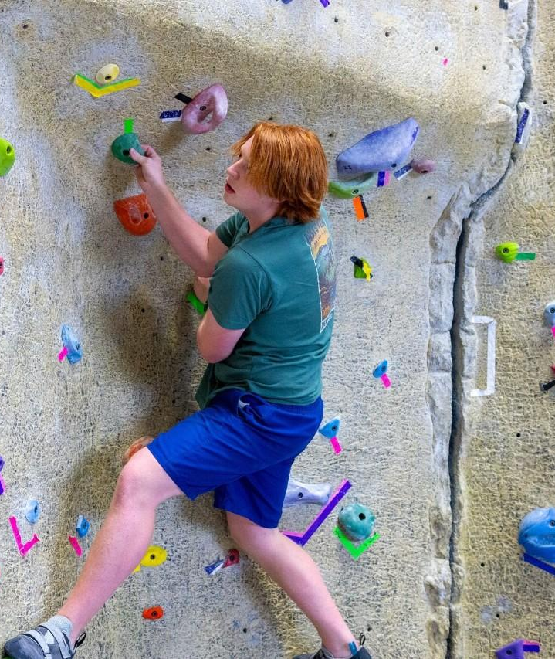
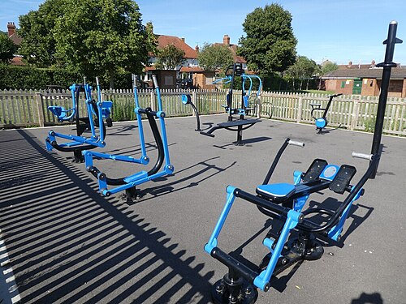

Implications for Adult Learning
How has the digital revolution has changed working and learning environments for adult learners?
How can we design learning environments with movement in mind?
-Classroom design
-Online instruction
-Break structures
(Bigelow & Agrawal, 2015; Smith et al., 2024)
How can we design work environments with movement in mind?
-Educate your team
-Rethink your spaces
-Use the Outdoors
-Coordinate Movement with Fun

Slide 11

Vestibular Research: A Puzzle
Findings are consistent with children.
Why are they so inconsistent for adults?
What Dosage is Important? How much? How long does it last?
Are Deficits Caused by Screen Usage The Same as Pathologies?
Are Deficits Permanent?
Why does “double dosing interventions” become more effective than one approach? Examples

Slide 12
Summary
What we are NOT saying:
screens directly damage the vestibular system.
reduced movement is the sole cause of academic difficulties.
vestibular exercises are a cure for learning problems.
current evidence proves a direct causal chain from screen use to
academic decline through vestibular deprivation.
Important Limitations
research is limited and much of it has been run in clinical settings
movement CAN be educational
Existing research raises important questions about whether reduced movement associated with modern lifestyles may influence vestibular development and learning.
Movement matters
Vestibular input deserves study
Adult learning research should investigate this relationship
Always consult your physician prior to implementing a movement program, especially if you have not been moving recently.
Citation:
(Campbell & McCray, current paper)

Slide 13

Conclusions and Questions
Main Takeaway
Digital learning environments influence not only information delivery but also the sensory conditions under which cognition occurs.
Final Question
Have we optimized digital learning for information delivery while overlooking the sensory conditions that support cognition?
Questions?

Slide 14
References
1. Agrawal, Y., Carey, J. P., Della Santina, C. C., Schubert, M. C., & Minor, L. B. (2009). Disorders of balance and vestibular function in U.S. adults: Data from the National Health and Nutrition Examination Survey, 2001–2004. Archives of Internal Medicine, 169(10), 938–944. https://doi.org/10.1001/archint
2. Agrawal, Y., Ward, B. K., & Minor, L. B. (2013).
Vestibular dysfunction: Prevalence, impact and need for targeted treatment.
Journal of Vestibular Research, 23(3), 113–117.
DOI: 10.3233/VES-130498
3. Associated Press. (2024, January 26). Screen breaks and the right desk setup offer relief from work-related eye strain. AP News.
4. Ayres, A. J. (1972). Sensory integration and learning disorders. Western Psychological Services.
5. Barsalou, L. W. (2008). Grounded cognition. Annual Review of Psychology, 59, 617–645. https://doi.org/10.1146/annurev.psych.59.103006.093639
6. Bigelow, R. T., & Agrawal, Y. (2015). Vestibular involvement in cognition: Visuospatial ability, attention, executive function, and memory. Journal of Vestibular Research, 25(2), 73–89. https://doi.org/10.3233/VES-150544
7. Božanić Urbančič, N., Battelino, S., & Vozel, D. (2024). Appropriate vestibular stimulation in children and adolescents—A prerequisite for normal cognitive, motor development and bodily homeostasis—A review. Children, 11(1), Article 2. https://doi.org/10.3390/children11010002
8. Brandt, T., Schautzer, F., Hamilton, D. A., Brüning, R., Markowitsch, H. J., Kalla, R., Darlington, C., Smith, P., & Strupp, M. (2005). Vestibular loss causes hippocampal atrophy and impaired spatial memory in humans. Brain, 128(11), 2732–2741. https://doi.org/10.1093/brain/awh617

Slide 15
10. Caldani, S., Moiroud, L., Miquel, C., Peiffer, V., Florian, A., & Bucci, M. P. (2021). Short vestibular and cognitive training improves oral reading fluency in children with dyslexia. Brain Sciences, 11(11), 1475. https://doi.org/10.3390/brainsci11111475
11. Gedik Toker, Ö., Tas Elibol, N., Erentürk, Ö., Erdem, S., Başöz Behmen, M., & Bal, N. (2023). Effect of digital screen usage on the visual-vestibular system interaction. Egyptian Journal of Otolaryngology, 39, Article 140. https://doi.org/10.1186/s43163-023-00506-z
13. Guo, J., Wang, J., Liang, P., Tian, E., Liu, D., Guo, Z., Chen, J., Zhang, Y., Zhou, Z., Kong, W., Crans, D., Lu, Y., & Zhang, S. (2024). Vestibular dysfunction leads to cognitive impairments: State of knowledge in the field and clinical perspectives (Review). International Journal of Molecular Medicine, 53(4), Article 36. https://doi.org/10.3892/ijmm.2024.5360
14. Kamil, R. J., Jacob, A., Ratnanather, J. T., Resnick, S. M., & Agrawal, Y. (2018). Vestibular function and hippocampal volume in the Baltimore Longitudinal Study of Aging (BLSA). Otology & Neurotology, 39(6), 765–771. https://doi.org/10.1097/MAO.0000000000001838
15. Loh, K. K., & Kanai, R. (2014). Higher media multi-tasking activity is associated with smaller gray-matter density in the anterior cingulate cortex. PLOS ONE, 9(9), e106698. https://doi.org/10.1371/journal.pone.0106698
16. Lotfi, Y., Rezazadeth, N., Moossavi, A., Haghgoo, H. A., Rostami, R., Bakhshi, E., et al. (2017). Preliminary evidence of improved cognitive performance following vestibular rehabilitation in children with combined ADHD and current vestibular impairment. Auris Nasus Larynx, 44(6), 700–707. https://doi.org/10.1016/j.anl.2017.01.011
17. Moghadam, S. F. (2018). Vestibular therapy improved motor planning, attention, and academic performance in children with attention deficit hyperactivity disorders: A randomized controlled study. Physical Medicine and Rehabilitation Research, 3(2), 1–6. https://doi.org/10.15761/PMRR.1000171
18. Nagata, J. M., Kim, K. E., Huang, O. H., Sportsman, D., Hale, L., Baker, F. C., & Christakis, D. A. (2026). Smartphone use during school hours by US youth in the Adolescent Brain Cognitive Development Study. JAMA, 335(5), 453–456. https://doi.org/10.1001/jama.2025.23235 18. Neophytou, E., Manwell, L. A., & Eikelboom, R. (2021).
Rideout, V. J., Foehr, U. G., & Roberts, D. F. (2010). Generation M2: Media in the lives of 8- to 18-year-olds. Henry J.
Kaiser Family Foundation.
Nagata, J. M., Kim, K. E., Huang, O. H., Sportsman, D., Hale, L., Baker, F. C., & Christakis, D. A. (2026). Smartphone use during school hours by US youth in the Adolescent Brain Cognitive Development Study. JAMA, 335(5), 453–456. https://doi.org/10.1001/jama.2025.23235 18. Neophytou, E., Manwell, L. A., & Eikelboom, R. (2021).
Smith, P. F., & Zheng, Y. (2013). From ear to uncertainty: Vestibular contributions to cognitive function. Frontiers in Integrative Neuroscience, 7, Article 84. https://doi.org/10.3389/fnint.2013.00084
Leigh, R. J., & Zee, D. S. (2015). The neurology of eye movements (5th ed.). Oxford University Press. https://doi.org/10.1093/med/9780199969289.001.0001

Slide 16
19. Ophir, E., Nass, C., & Wagner, A. D. (2009). Cognitive control in media multitaskers. Proceedings of the National Academy of Sciences, 106(37), 15583–15587. https://doi.org/10.1073/pnas.0903620106
21. Paulus, M. P., Squeglia, L. M., Bagot, K., Jacobus, J., Kuplicki, R., Breslin, F. J., Bodurka, J., Morris, A. S., Thompson, W. K., Bartsch, H., & Tapert, S. F. (2019). Screen media activity and brain structure in youth: Evidence for diverse structural correlation networks from the ABCD study. NeuroImage, 185, 140–153. https://doi.org/10.1016/j.neuroimage.2018.10.040
22. Rideout, V. J., Foehr, U. G., & Roberts, D. F. (2010). Generation M2: Media in the lives of 8- to 18-year-olds. Henry J. Kaiser Family Foundation.
23. Saniasiaya, J., Islam, M. A., & Salim, R. (2023). The global prevalence of vestibular dysfunction in children and adolescents: A systematic review and meta-analysis. European Archives of Oto-Rhino-Laryngology, 280(6), 2663–2674. https://doi.org/10.1007/s00405-023-07842-z
24. Sheya, A., & Linda Smith (2018). Development weaves brains, bodies and environments into cognition. Language, Cognition and Neuroscience, 34(5), 590–601. https://doi.org/10.1080/23273798.2018.1489065
24. Smith, P. F., & Zheng, Y. (2013). From ear to uncertainty: Vestibular contributions to cognitive function. Frontiers in Integrative Neuroscience, 7, Article 84. https://doi.org/10.3389/fnint.2013.00084
25. Yates, B. J. (2014).
Vestibulo-sympathetic responses
Journal of Vestibular Research, 24(1), 1–21.

