Slide 1

T L _{w} T & P A
with
and
e
a
c
h
i
g
e
a
r
n
ig
e
c
h
n
o
l
o
g
y
e
e
r
s
s
e
s
s
m
e
n
t
Prof. Yael Fisher
Achva Academic College, Israel
The Learning Ideas Conference - NY 2025

Slide 2




Slide 3



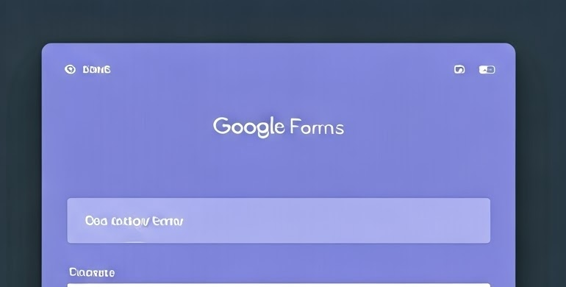
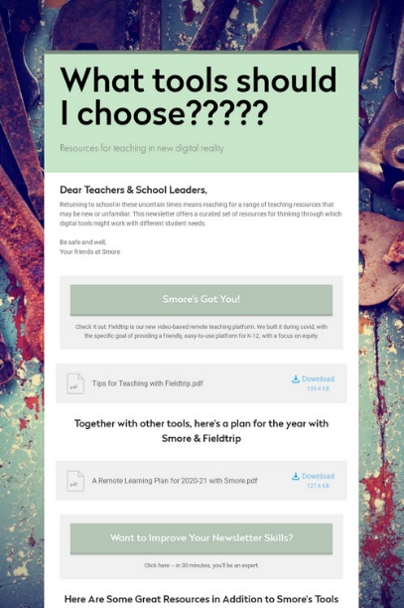





Slide 4

Stages of the Teaching Model
Teaching
1
Learning
2
Technology
3
emailing personal feedback forms
Peer Learning
4
peer assessment
5
11
Preparing & presenting digital posters
Online peer assessment
Learning & internalization
Peer Learning
Summery process
6
7
8
9
10

Slide 5

14 classes per semester = 14 doors
1
14

Slide 6


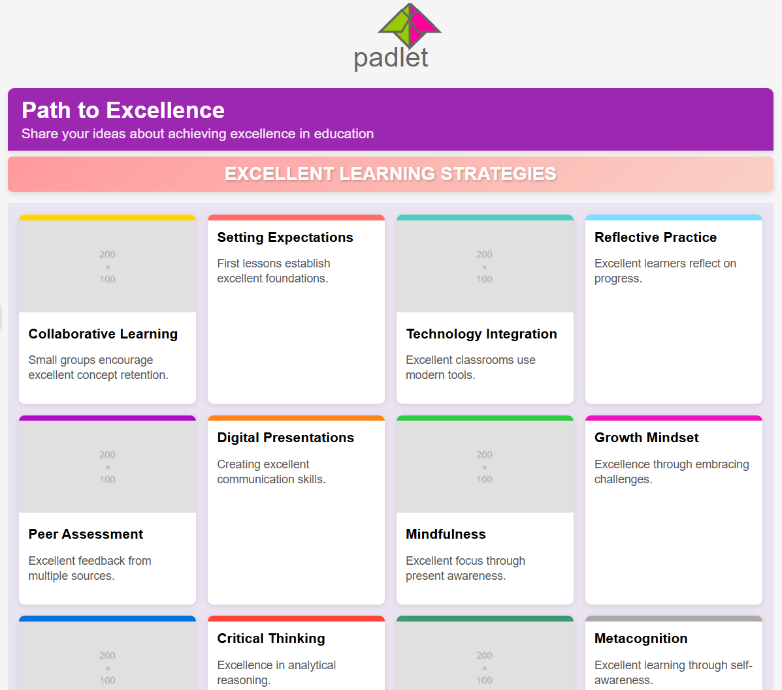
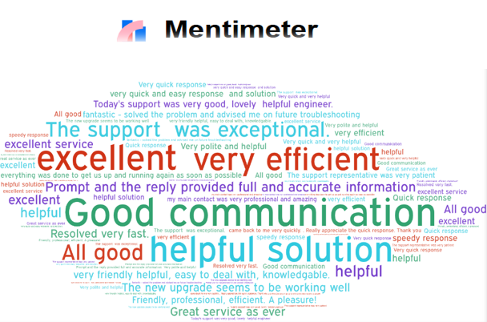
T
T L _{w} T & P A
1
3
Open a group
and a mailing list
Teaching
Setting Expectations
Mentimeter – Defining Excellence

Slide 7




T L _{w} T & P A
2
3
Direct teaching of a specific subject
Teaching
Assignment:
Group division in a shared document
Reading assignment

Slide 8


T L
T L _{w} T & P A
4
The Art of presentation
Teaching & Learning

Slide 9


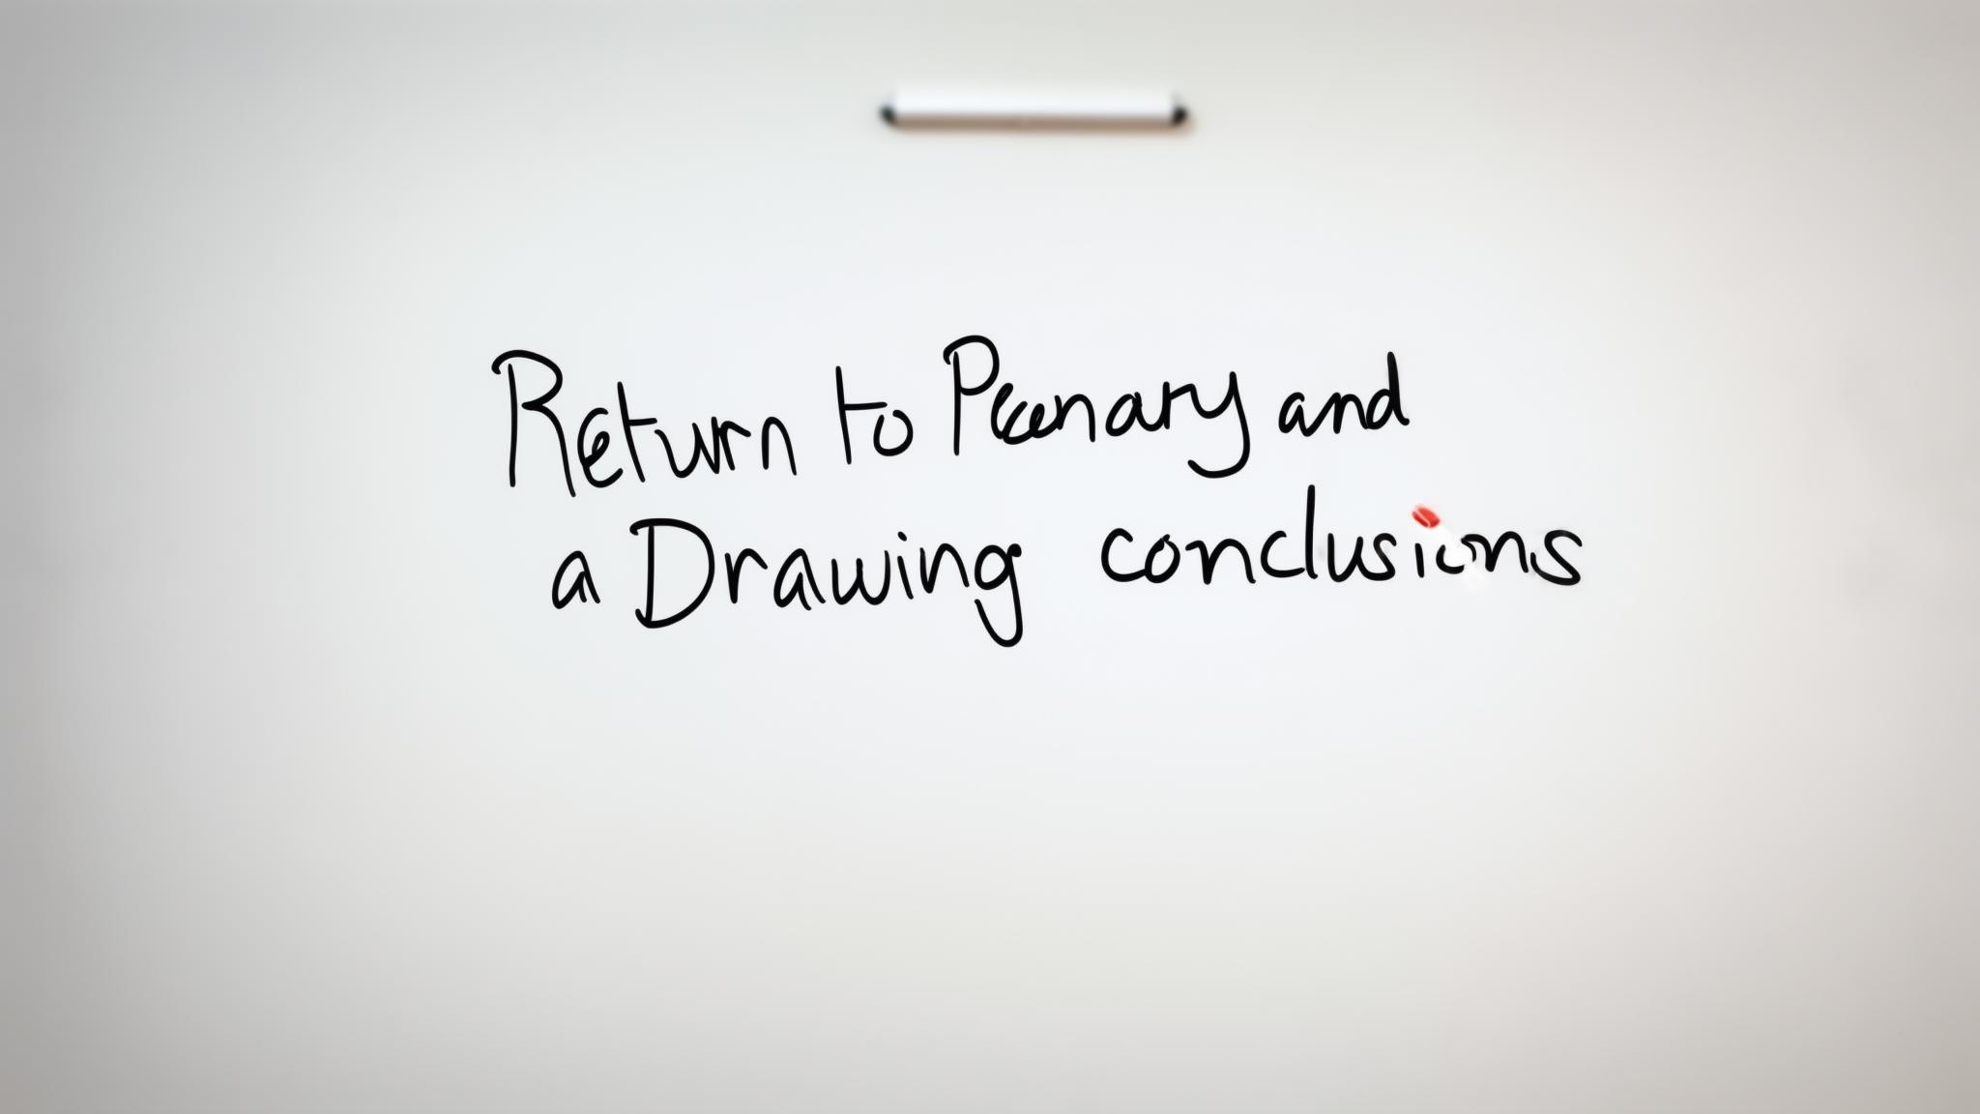
L _{w} T
5
T L _{w} T & P A
Peer Learning in Small Groups
Feedback on the Process
Learning with Technology
Learning Smore software
Return to Plenary and Drawing Conclusions

Slide 10

Reassurance for Building Personal Resilience

Slide 11

T L _{w} T & P A
6
L _{w} T
Learning with Technology
ERT

Slide 12

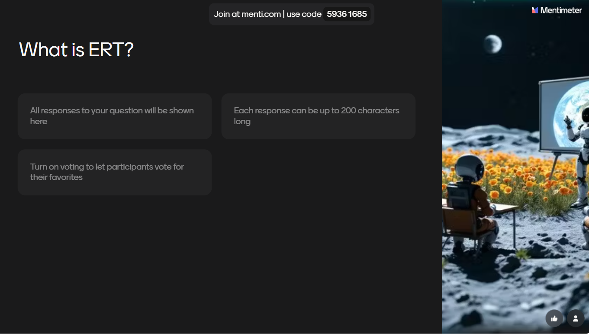


Slide 13







T L _{w} T & P A
6
E
L _{w} T
Learning with Technology
R
T

Slide 14
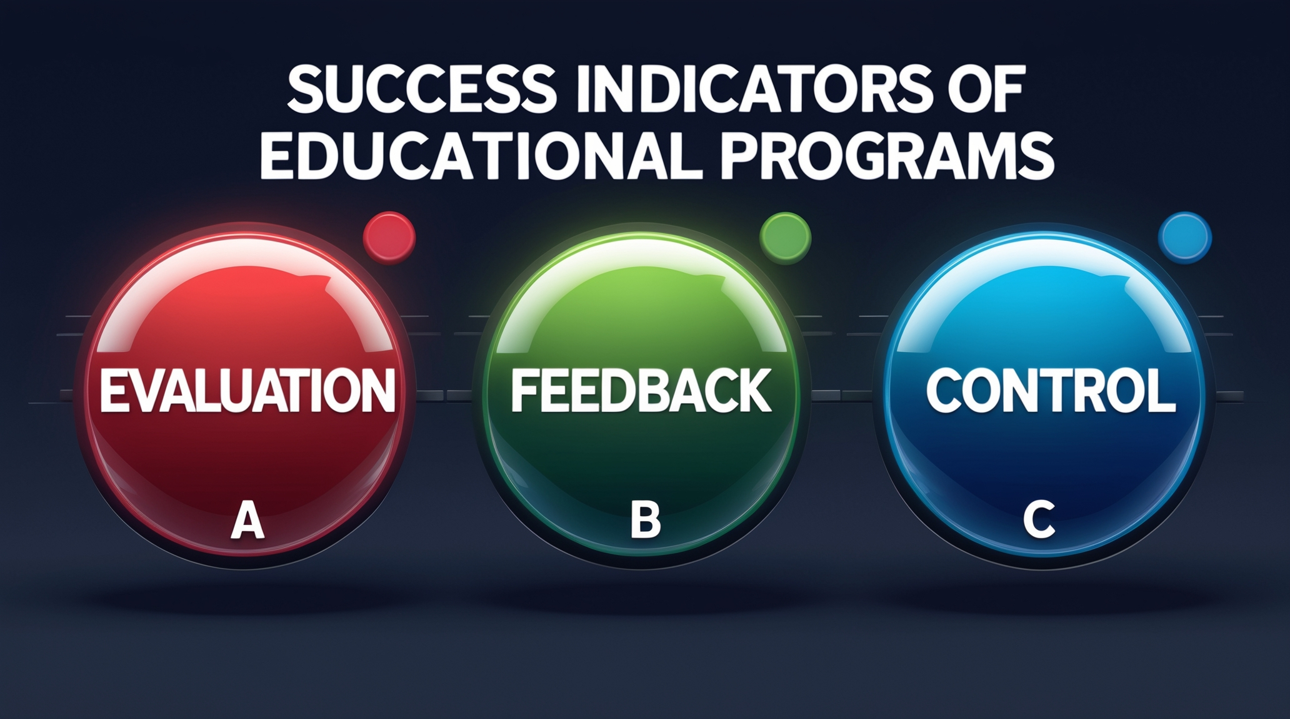

T L _{w} T & P A
6
Asynchronous online e-learning unit
L _{w} T
Learning with Technology

Slide 15

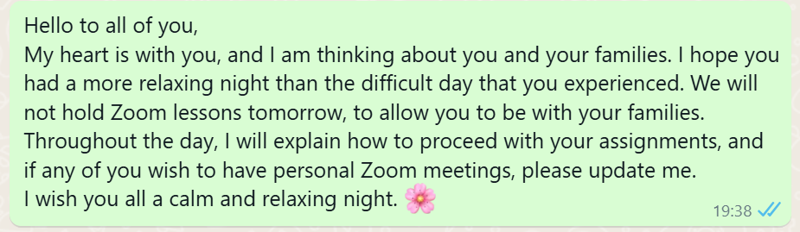
T L _{w} T & P A
6
Synchronous online e-learning
Reassurance for Building Personal Resilience
L _{w} T
Learning with Technology

Slide 16
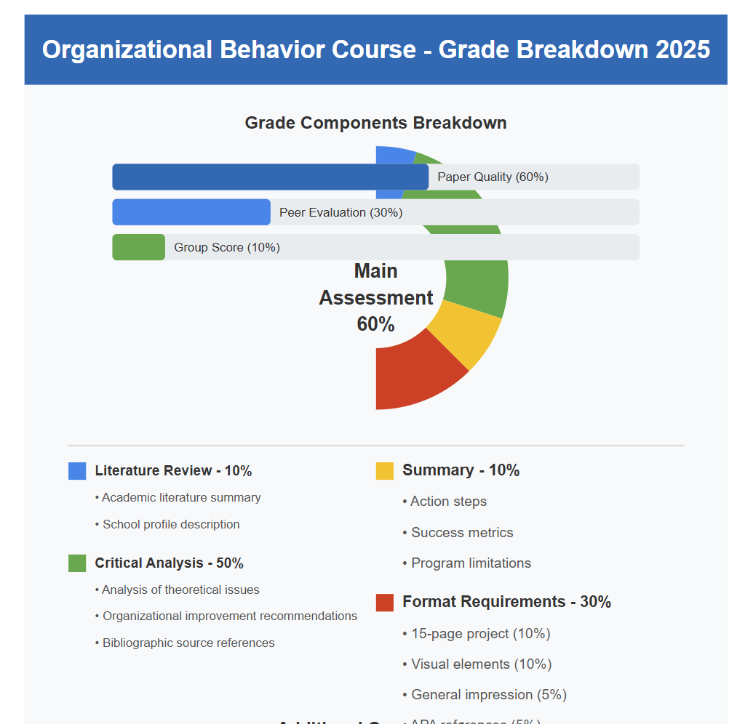
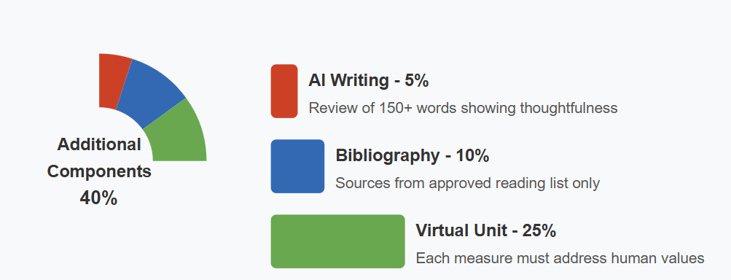
T L _{w} T & P A
T_{w}P A
7
Teaching with Peer Assessment

Slide 17
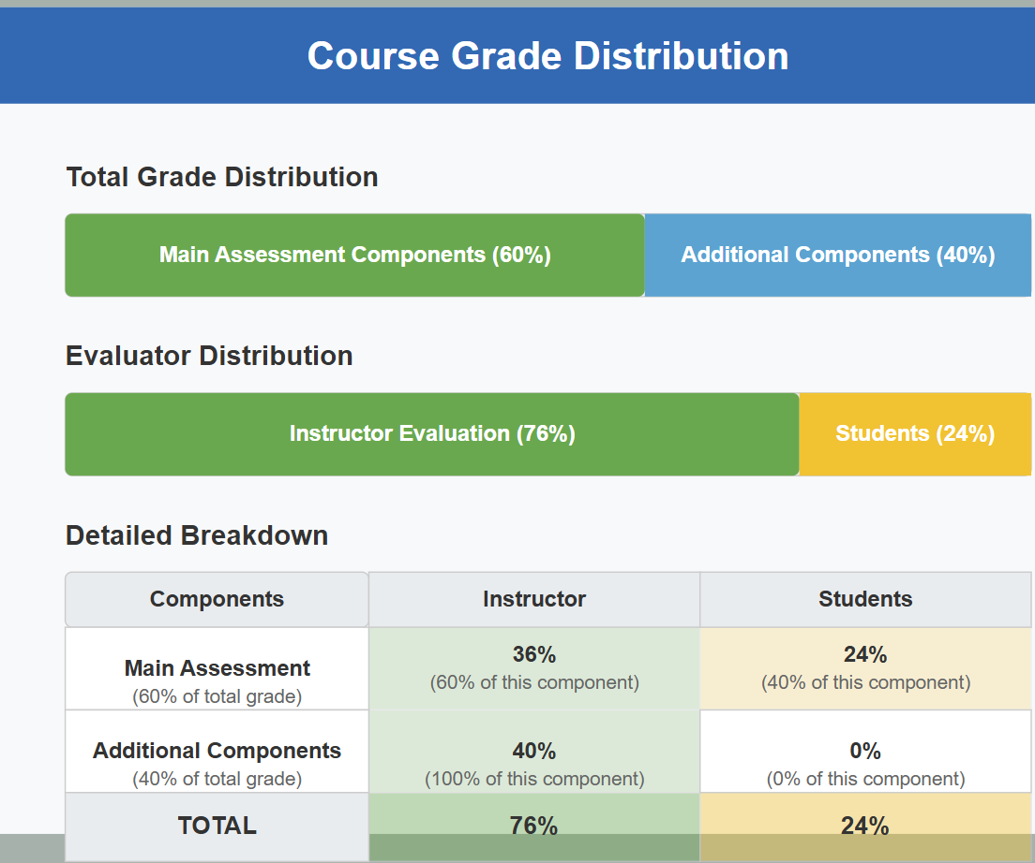
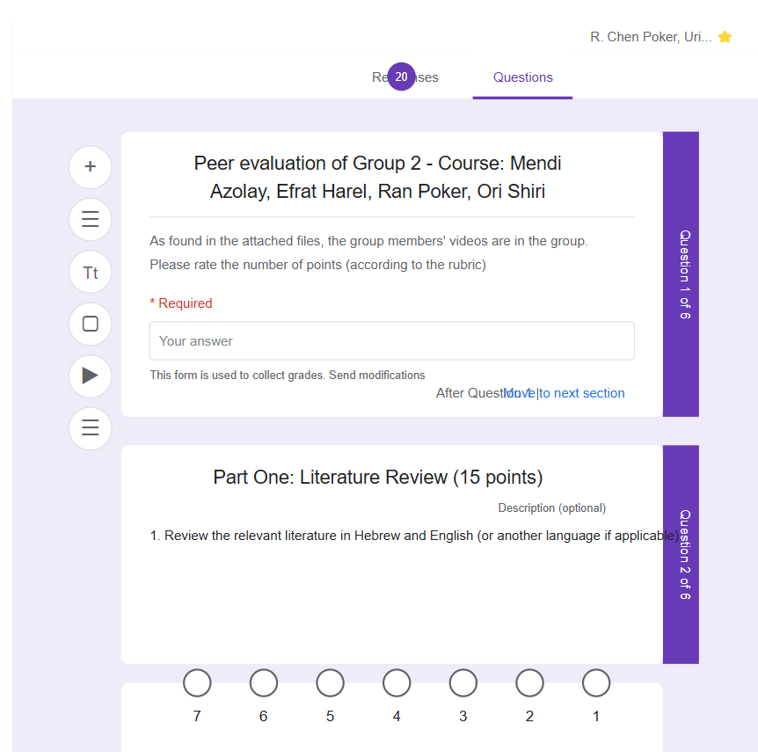
T L _{w} T & P A
7
T_{w}P A
Teaching with Peer Assessment

Slide 18


T L _{w} T & P A
8
Asynchronous online e-learning unit
L _{w} T
Learning with Technology

Slide 19
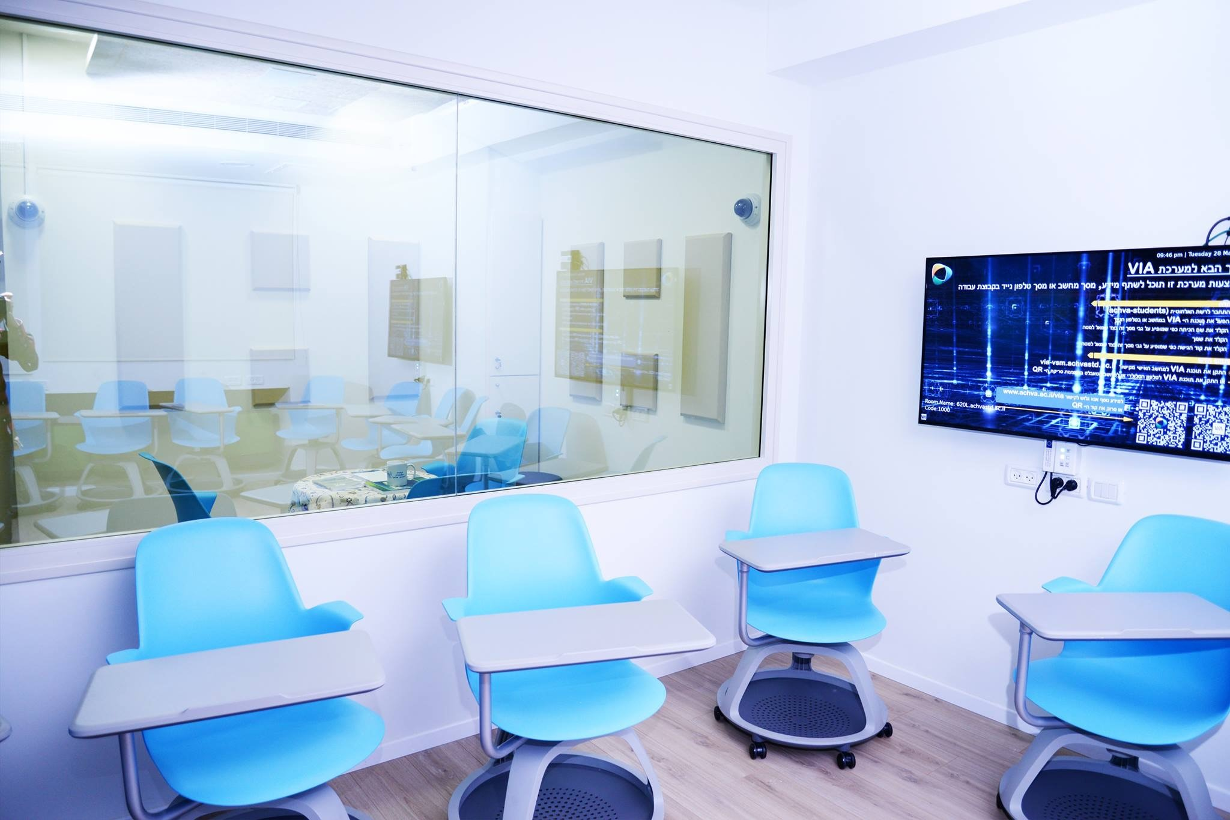
T L _{w} T & P A
9
10
11
Teaching & Learning with Technology

Slide 20

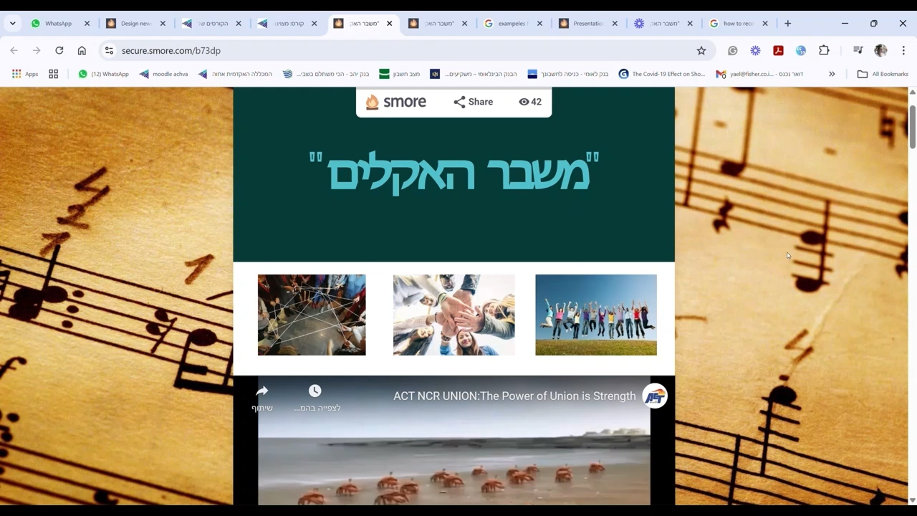
T L _{w} T & P A
12
13
“Climate Crisis”
Digital Presentation
https://secure.smore.com/n/b73dp

Slide 21
T L _{w} T & P A
12
13
Digital Presentation

Slide 22
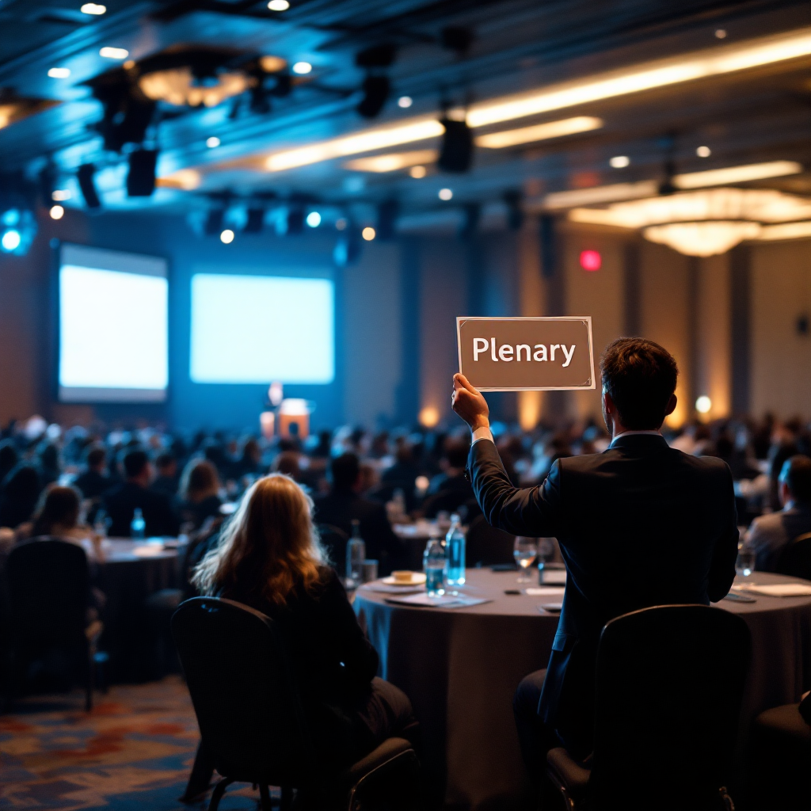
T L _{w} T & P A
14
Expectations Alignment Check

Slide 23
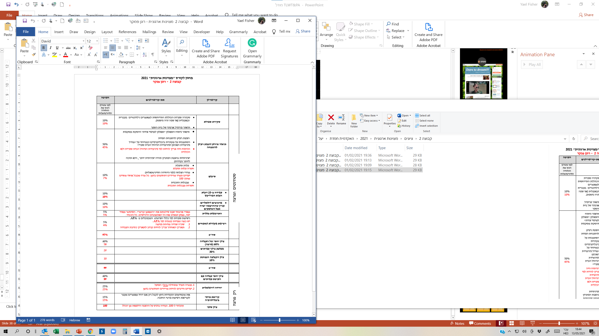
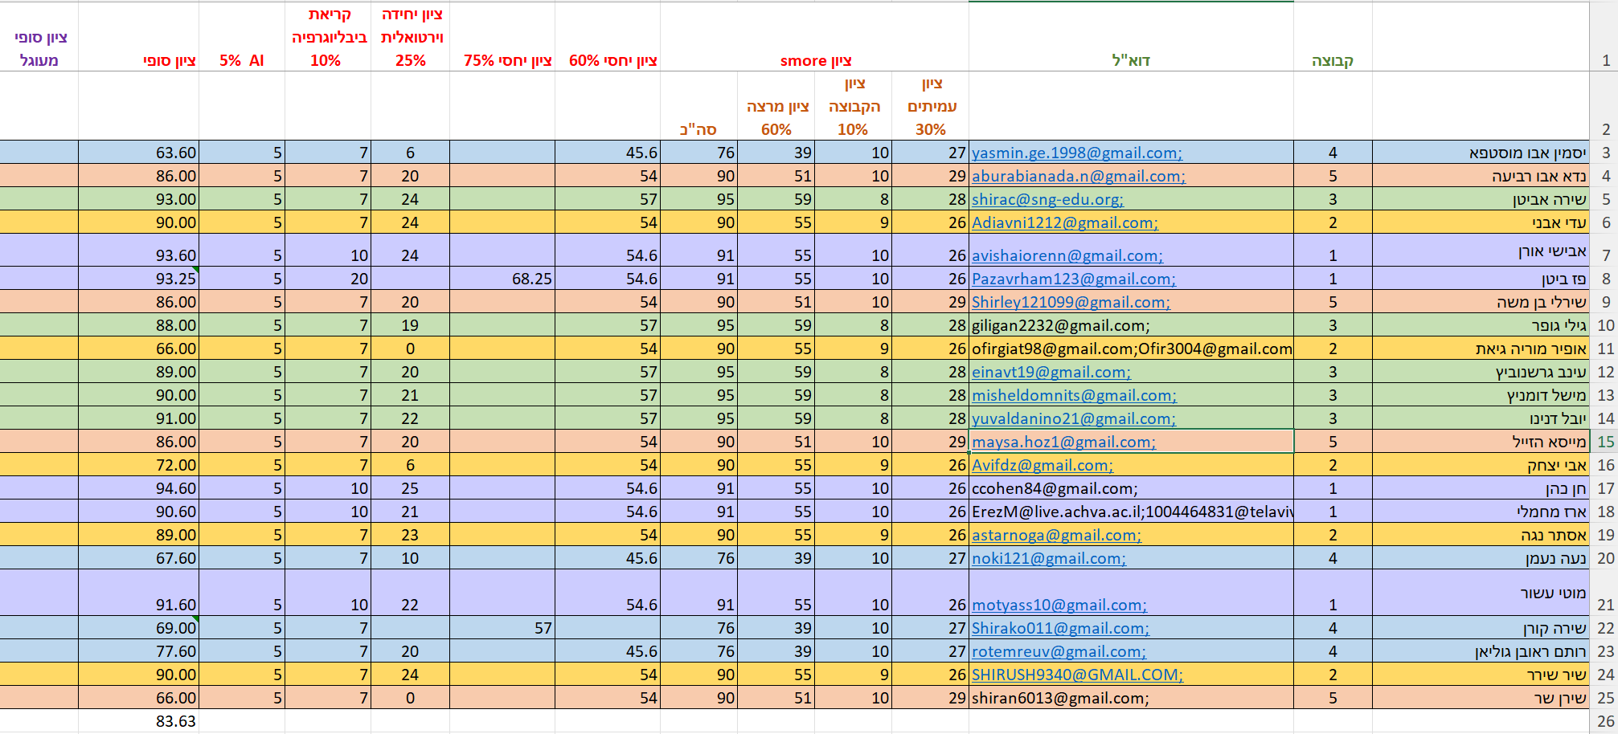
T L _{w} T & P A
2025 "Development of Organizational Excellence" scoring rubric

Slide 24

T L _{w} T & P A
June 18
Last day of the course
June 19

June 20

June 21
emailing personal feedback forms
100 = 

Slide 25
T L _{w} T & P A
with
and
e
a
c
h
i
g
e
a
r
n
ig
e
c
h
n
o
l
o
g
y
e
e
r
s
s
e
s
s
m
e
n
t
Prof. Yael Fisher
Achva Academic College, Israel
The Learning Ideas Conference - NY 2025

