Slide 1
Automotive Students' Performance Attitudes in the VRLE with Active and Passive Haptic Interaction
Dr. Turhan Civelek
Prof. Dr. Arnulph Fuhrmann
Institute for Media and Photo Technology, Technology Arts Sciences TH Köln / Germany
turhan.civelek@th-koeln.de

Slide 2
Automotive Students' Performance Attitudes in the VRLE with Active and Passive Haptic Interaction
  Immersive Learning Framework
  Digital Interaction Types
    AR (real-based)
    VR (fully virtual)
    MR (hybrid)
      VRLE Benefits
        Spatial visualization
        Active engagement
        Collaborative learning
      Learning Support
        Abstract concept teaching
        Strong presence & vivid experiences
        Personalization and motivation
    Note: High immersion ≠ better outcomes.
    Effectiveness depends on educational integration, not just technology level.

Slide 3
Automotive Students' Performance Attitudes in the VRLE with Active and Passive Haptic Interaction
Role of Haptics in VRLEs
Purpose: Align pedagogy with realistic, intuitive interactions.
Haptic Feedback: Complements visual & auditory input via touch & force cues.
Perception Channels
Tactile (skin) → texture
Kinesthetic (joints) → resistance
Technologies & Learning Impact
Sense Gloves: Vibration + force feedback for lifelike grasping
Simulate physical properties, reduce cognitive load
Boosts understanding, retention & tacit knowledge
Early use + quality feedback = better outcomes
AHL vs. PHL in Education
Few studies directly compare Active (AHL) vs. Passive (PHL) haptics
More research is needed to clarify their distinct pedagogical effects

Slide 4
Automotive Students' Performance Attitudes in the VRLE with Active and Passive Haptic Interaction
Related Studies on Haptic VRLEs
Haptic feedback for perception of volume, material, and interaction
Handwriting, motor skills, and character recognition
Tactile support in math for visually impaired learners
Devices like Sense Gloves and Haptic Links enable natural grasp
Gamification with haptics
In rehabilitation and medicine:
  Realistic anatomy and tissue resistance simulation
  Improved confidence, exam performance, and skill development
  Enhanced needle placement accuracy in dental anesthesia
Special applications:
  Posture correction in skiing
  Tactical and physical skill training in military/police
  Passive haptics in piano learning improve accuracy and speed

Slide 5
Automotive Students' Performance Attitudes in the VRLE with Active and Passive Haptic Interaction
Research Aim & Questions
  Main Objective:
    To investigate how an immersive VRLE — supported by SenseGlove technology—affects automotive students’ perceived performance attitudes.
    The study compares two conditions:
      Active Haptic Learning (AHL): with force feedback
      Passive Haptic Learning (PHL): without force feedback (with vibration feedback)
  Research Questions:
    Is there a significant relationship between experiencing AHL or PHL in the VRLE and students’ attitudes toward their own performance?
    Is there a significant difference in students’ perceived performance between the VRLE with AHL and the one with PHL?

Slide 6
Automotive Students' Performance Attitudes in the VRLE with Active and Passive Haptic Interaction
Research Focus Areas
  Interaction with virtual objects
  Assembly of vehicle parts
  User motivation
  Material richness
  Maintenance process improvement
  Usage in car workshop
Methodology
  Participants: 20 automotive students (TH Köln)
  Procedure:
    Passive haptic VRLE experience → 21-item survey
    Active haptic VRLE experience → Same 21-item survey
  Analysis: Paired-Sample T-Test via SPSS

Slide 7
Automotive Students' Performance Attitudes in the VRLE with Active and Passive Haptic Interaction
System Architecture
  Platform: Unity (C#)
  APIs/Libraries: SteamVR and SenseGlove SDK
  Hardware:
    SenseGlove – Force & vibration feedback to fingers
    Vive/Vive Pro Headsets – Immersion
    HTC Controllers - Capturing the position of Sensegloves

Slide 8
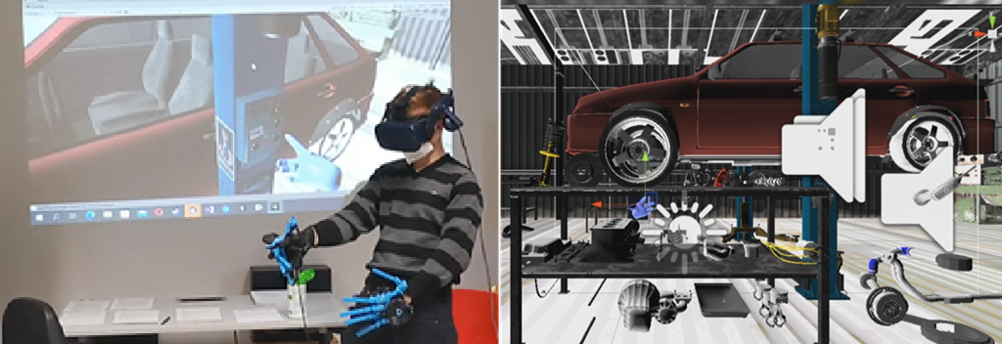
Automotive Students' Performance Attitudes in the VRLE with Active and Passive Haptic Interaction
VRLE Tools & Interaction Features
  Practical automotive training in immersive VR
  Force & vibration feedback for realistic interaction
  Interactive 3D workshop simulating real maintenance tasks
Main Interactive Components
  Virtual Car: Main object for assembly/disassembly tasks (video1 – 2)
  Vehicle Lift: Moves car up/down via virtual button
  Virtual Drill: Used to unscrew bolts with tactile feedback
  Spare Parts & Tools: For removing and installing components
Left: User wearing VR headset and SenseGlove interacting with VRLE
Right: In-app scene showing virtual workshop with car, lift, and tools

Slide 9
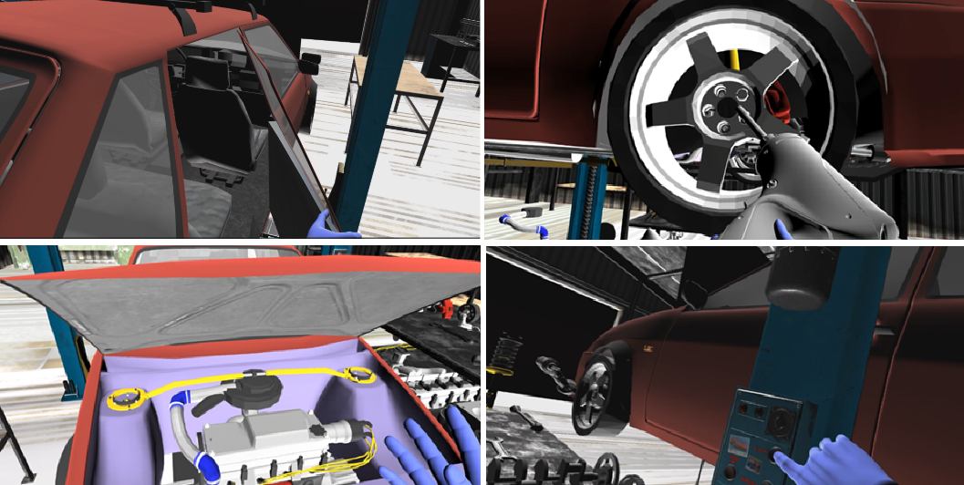
Automotive Students' Performance Attitudes in the VRLE with Active and Passive Haptic Interaction
VRLE: Functional Interactions & Feedback Features
  The VRLE enables hands-on automotive tasks via immersive, precise visual-haptic feedback.
Key Functional Features
  Door Interaction: Virtually open and close car doors (video3)
  Part Handling: Remove parts and install replacements
  Lift System: Raise or lower vehicle for easy access
  Spark Plug Wires: Manipulate the Spark Plug Wires (video4)
  Audio Feedback (video5):
    Drill sounds during bolt removal
    Lift motor noise while raising/lowering the vehicle
Figures: Disassembly scenes, drill use, engine interaction, and lift control with haptic-enabled VR hands

Slide 10
Automotive Students' Performance Attitudes in the VRLE with Active and Passive Haptic Interaction
Interaction Modes in the VRLE
  Active Haptic Mode:
    Activated when force feedback is on
    Users grasp objects with virtual hands
    SenseGlove transmits Force feedback to fingers
    Simulates physical interaction with virtual tools and parts.
  Passive Haptic Mode:
    Used when force feedback is off
    Objects can still be grasped and manipulated
    Vibration replaces Force feedback
    Delivers tactile cues without physical force

Slide 11
Automotive Students' Performance Attitudes in the VRLE with Active and Passive Haptic Interaction
Data Collection Process
  Study Focus:
    Investigated how active vs. passive haptics affect learning and attitudes in the VR car repair workshop
  Technology Used:
    Immersive VRLE with SenseGlove integration
      force feedback = active
      vibration only = passive
  Instrument:
    21-item attitude questionnaire
  Procedure:
    20 students from TH Köln were randomly selected
    First, each student used the passive haptic VR workshop → completed the survey
    Then, the same students used the active haptic version → completed the survey again

Slide 12
Automotive Students' Performance Attitudes in the VRLE with Active and Passive Haptic Interaction
Data Analysis
  Software Used:
    IBM SPSS Statistics 30.0.0.0
  Statistical Method:
    Paired-Sample T-Test applied to compare:
    Students’ attitudes after passive haptic experience
    Same students’ attitudes after active haptic experience
  Purpose of the Test:
    To assess performance attitude differences between two related conditions

Slide 13
Automotive Students' Performance Attitudes in the VRLE with Active and Passive Haptic Interaction
Results
  Analysis Focus:
    Compared Active vs. Passive Haptic Learning in students’ attitudes toward car maintenance
    Survey Scope (6 categories)
  Reliability:
    Cronbach’s Alpha = 0.954
  Key Findings:
    AHL scored higher than PHL across all factors
    Most notable differences:
      Interaction: 3.53 (AHL) vs. 2.72 (PHL)
      Motivation: 3.78 (AHL) vs. 3.38 (PHL)
Table 1. Paired samples statistics for active and passive haptic groups of factors.
Factors | Groups | N | M | SD | SE
Interaction | AHL | 20 | 3.53 | 1.05 | 0.23
 | PHL | 20 | 2.72 | 0.80 | 0.18
Assembly | AHL | 20 | 3.56 | 0.85 | 0.19
 | PHL | 20 | 3.25 | 0.98 | 0.22
Motivation | AHL | 20 | 3.78 | 1.08 | 0.24
 | PHL | 20 | 3.38 | 1.28 | 0.29
Material richness | AHL | 20 | 3.65 | 0.76 | 0.17
 | PHL | 20 | 3.46 | 0.80 | 0.19
Improvement | AHL | 20 | 3.81 | 0.90 | 0.20
 | PHL | 20 | 3.52 | 0.85 | 0.19
Usage | AHL | 20 | 3.72 | 1.09 | 0.24
 | PHL | 20 | 3.35 | 1.04 | 0.23
  Variability & Consistency:
    PHL showed higher SD → More varied participant responses
    AHL showed lower SE → More consistent evaluations

Slide 14
Automotive Students' Performance Attitudes in the VRLE with Active and Passive Haptic Interaction
Results – Correlation Analysis
  Purpose:
    Analyzed variable relationships under AHL vs. PHL using correlation (r) and p-values
  Interpretation Guide:
    r: -1 to +1 → closer to +1 = stronger positive link
    p < 0.05 → statistically significant
Table 2. Paired samples correlations for active and passive haptic groups of factors.
Factors | Groups | N | Correlation | p
Interaction | AHL - PHL | 20 | 0.27 | 0.253
Assembly | AHL - PHL | 20 | 0.79 | <0.001
Motivation | AHL - PHL | 20 | 0.61 | 0.004
Richness | AHL - PHL | 20 | 0.81 | <0.001
Improvement | AHL - PHL | 20 | 0.63 | 0.003
Usage | AHL - PHL | 20 | 0.65 | 0.002
  Key Correlation Findings:
    Strong & Significant Correlations (r > 0.60, p < 0.05) in:
      Assembly of vehicle parts, User motivation, Material richness, Maintenance process improvement, Usage in the car workshop
  Weak/Non-significant Correlation:
    Interaction with virtual objects → r = 0.27, p > 0.05

Slide 15
Automotive Students' Performance Attitudes in the VRLE with Active and Passive Haptic Interaction
Results – Comparative Performance
  Statistical Test: Paired-Sample T-Test
  Focus: Comparison of AHL and PHL groups across survey factors
  Statistically Significant Differences:
    Interaction with Virtual Objects (AHL significantly higher):
      Mean Difference = 0.82
      t(19) = 3.228, p = 0.004
    Assembly of Virtual Objects (AHL significantly higher):
      Mean Difference = 0.31
      t(19) = 2.298, p = 0.033
Table 3. Paired Samples Test for active and passive haptic groups of factors.
Factors | Groups | M | SD | SE | t | df | p
Interaction | AHL - PHL | 0.82 | 1.13 | 0.25 | 3.228 | 19 | 0.004
Assembly | AHL - PHL | 0.31 | 0.60 | 0.13 | 2.298 | 19 | 0.033
Motivation | AHL - PHL | 0.40 | 1.06 | 0.24 | 1.690 | 19 | 0.107
Richness | AHL - PHL | 0.18 | 0.51 | 0.11 | 1.599 | 19 | 0.126
Improvement | AHL - PHL | 0.29 | 0.76 | 0.17 | 1.711 | 19 | 0.103
Usage | AHL - PHL | 0.37 | 0.90 | 0.20 | 1.827 | 19 | 0.084
  No Significant Differences Found:
    Motivation, Material richness, Maintenance improvement, Workshop usage
    p > 0.05

Slide 16
Automotive Students' Performance Attitudes in the VRLE with Active and Passive Haptic Interaction
AHL vs. PHL Experience
  AHL Outperforms PHL:
    Statistically significant improvements in:
      Interaction with virtual objects
      Assembly of virtual components (p < 0.05)
  Higher Averages in AHL:
    Indicates enhanced user interaction and task performance
    Suggests active force feedback adds educational value
  Greater Variability in PHL:
    More inconsistent participant experiences
    Less reliable in supporting uniform learning outcomes

Slide 17
Automotive Students' Performance Attitudes in the VRLE with Active and Passive Haptic Interaction
Conclusion
  AHL vs. PHL Comparison:
    AHL performed better across all 6 factors, especially in:
      Interaction with virtual objects
        t(19) = 3.228, p = 0.004
      Assembly of parts
        t(19) = 2.298, p = 0.033
  Correlation Insights:
    Strong, significant correlations (r > 0.60, p < 0.05):
      Assembly, Motivation, Material Richness, Maintenance
    Weak/no correlation (r = 0.27, p > 0.05):
      Workshop Use
  Variability in Experience:
    PHL: More inconsistent (↑ SD)
    AHL: More consistent (↓ SE)
  AHL enhances interaction quality and task performance, but has limited impact on motivation and overall perception.

Slide 18
Automotive Students' Performance Attitudes in the VRLE with Active and Passive Haptic Interaction
Discussion
  Key Insight:
    AHL significantly improves interaction and assembly performance in VR settings.
  Impact:
    Suggests increased user engagement and task efficiency with active haptics.
  Limitations:
    No significant difference found in:
      Motivation
      Material richness
      Maintenance improvement
      Workshop usage
  Future Recommendations:
    Increase sample size for stronger statistical validity
    Explore different haptic applications and configurations
    Include qualitative methods for deeper insight into user perception

Slide 19
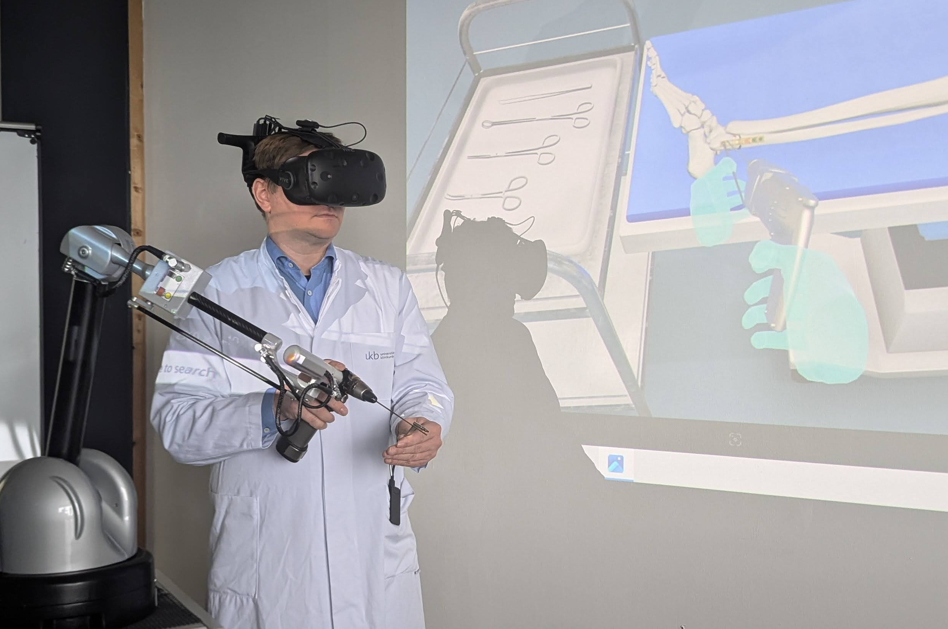
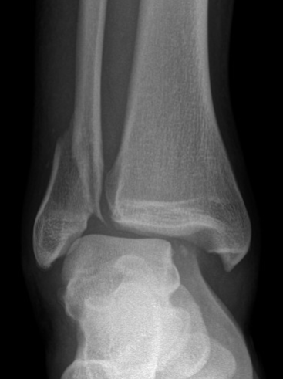
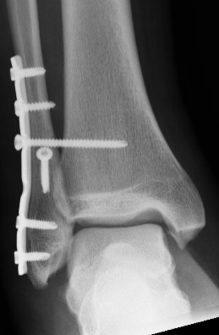

Current Research Project: VIRTOSHA - Authoring Tool for Virtual Reality Training Simulations of Osteosynthesis with Haptic Feedback and Tissue Simulation
Key Components of VITOSHA
Measurement of the mechanical properties of soft and hard tissues
Integration of measurement data into simulations for realistic interactions
Simulation of soft and hard tissues
Haptic interaction
Hand tracking
Digital data hub
This project is funded within the framework of the innovation competition gesünder.IN.NRW

Slide 20
Thank you for patiently listening to me so far.
For questions, please contact: turhancivelek@th-koeln.de

