Slide 1
Exploring Artificial Intelligence in Self-Regulated Learning: A Systematic Literature Review
Exploring AI in SRPL
Presenter: Sahith Tadepalli
Authors: Aidana Isaeva, Elis Özavnik, Isabella Rosamarie Acosta Delgado,
Jennifer Kaylie Hartono, Sahith Tadepalli, Matthias Christoph Utesch
Technical University of Munich
Arcisstraße 21, 80333
Munich, Germany
© Copyright by Sahith Kumar Tadepalli and Dr Matthias Christoph Utesch
Notes:
Hello everyone and thank you for attending my presentation here at the learning ideas conference today! My name is Sahith Tadepalli, and I’m excited to present our systematic literature review on how AI is reshaping education—specifically its impact on self-regulated personalized learning or in short form SRPL.”
"This work was conducted in collaboration with a fantastic research team at the Technical University of Munich and under the guidance of my Professor Dr. Matthias Christoph Utesch.“
"Today’s talk is based on a systematic literature review, and I’ll be walking you through our motivation, methodology, key findings, and implications.“
“Let’s start with a simple but powerful question.”

Slide 2
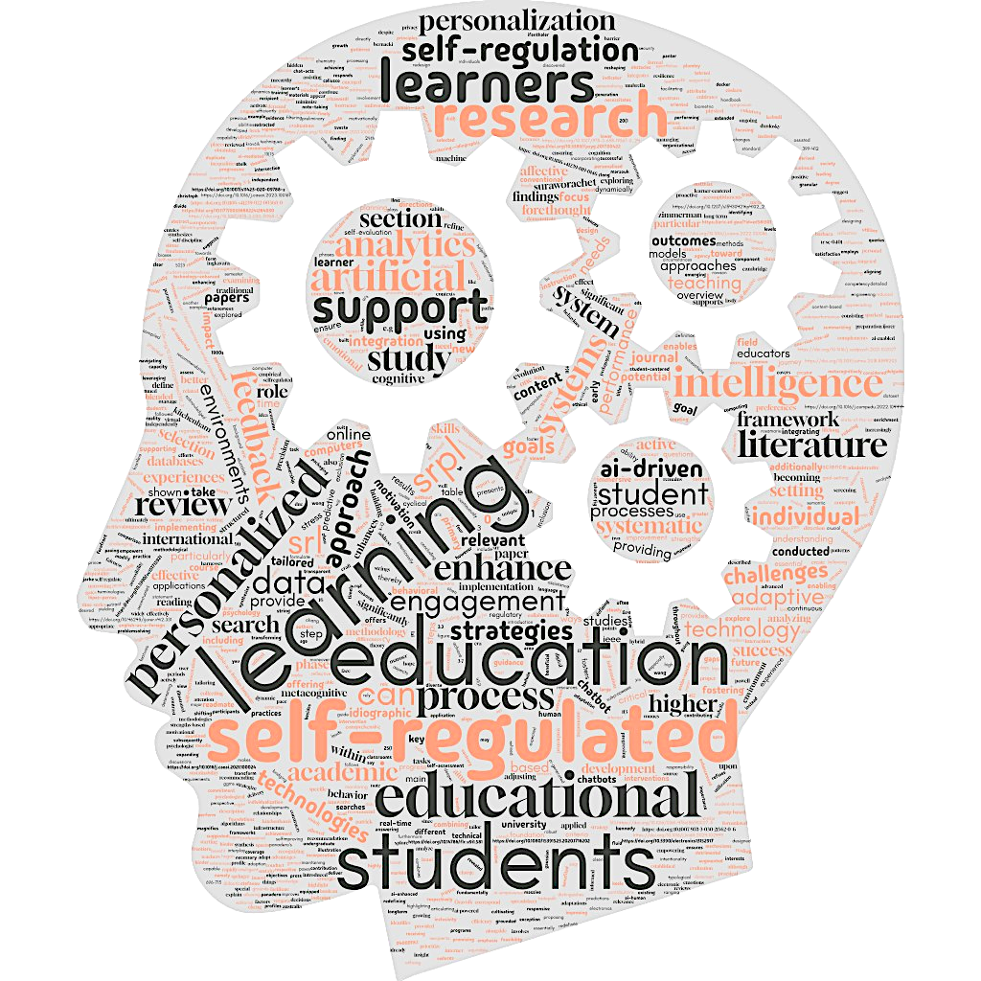
Exploring AI in SRPL
Do Smarter Systems lead to Smarter Students?
© Copyright by Sahith Kumar Tadepalli and Dr Matthias Christoph Utesch
Notes:
"This question shaped our entire research. In a world where learners are expected to be increasingly autonomous, we ask: Can AI systems make students better at learning how to learn?"
“We’re in a moment where learners are expected to manage complex academic tasks independently—yet many still lack the tools to do so effectively.”
“AI has the potential to offer personalized, dynamic support systems that evolve alongside the learner—systems that are smarter because students themselves are encouraged to becoming more independent.”
“To explore this intersection, we followed a rigorous research methodology.”

Slide 3
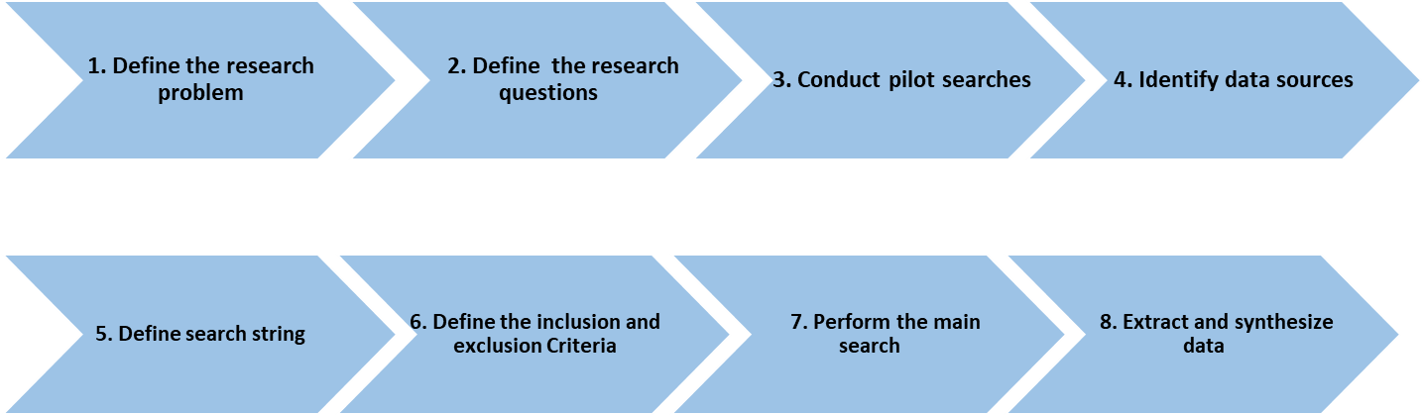
Methodology
Exploring AI in SRPL
Systematic literature review following the Barbara Kitchenham‘s methodology¹.
8 steps process:
1) Kitchenham B., (2004). Procedures for performing systematic reviews. Keele University Technical Report TR/SE-0401
3
© Copyright by Sahith Kumar Tadepalli and Dr Matthias Christoph Utesch
Notes:
"We followed Barbara Kitchenham’s 8-step process for systematic literature reviews."
These include: (read from slides)
“to look into the details of the steps individually…”

Slide 4
Exploring AI in SRPL
Methodology
Step 1. Define the research problem
Focus: Determining how AI can foster self-regulated personalized learning (SRPL) to effectively support student autonomy and improve learning outcomes.
Step 2. Define the research questions
RQ1. How can personalization enhance self-regulated learning?
RQ2. What are the current applications of AI in education within SRL?
RQ3. In what ways can AI support the development of learners’ self-regulation through personalization?
Step 3. Conduct pilot searches
Pilot searches on Google Scholar to get an overview of relevant studies.
Step 4. Identify the data sources
Two major databases: Web of Science and IEEE Xplore
4
© Copyright by Sahith Kumar Tadepalli and Dr Matthias Christoph Utesch
Notes:
"Our research was guided by three key questions:"
How can personalization enhance SRL?
What are the current AI applications in SRL?
How can AI support SRL through personalization?"
"We conducted pilot searches, refined search string and focused on two major databases: Web of Science and IEEE Xplore."

Slide 5
Exploring AI in SRPL
Methodology
Step 5. Define the search string using keywords:
“self-regulated personalized learning” AND “artificial intelligence”l
Step 6. Define the inclusion and exclusion criteria
Inclusion criteria
Studies published from 2018 to 2024
Studies written in English
Peer-reviewed studies
Studies covering AI applications in SRPL \\\within higher education or educational ///settings
5
© Copyright by Sahith Kumar Tadepalli and Dr Matthias Christoph Utesch
Notes:
(just read from the slides here)

Slide 6
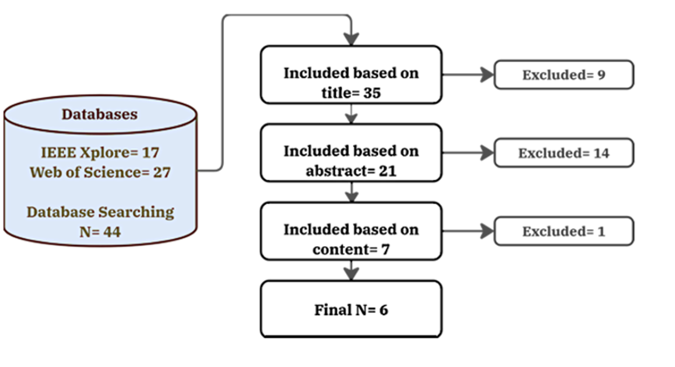
Exploring AI in SRPL
Methodology
Step 7. Perform the main search
We included additional sources outside the main scope to provide deeper background and further support our findings.
Step 8. Extract and synthesize data
We collected all findings from the primary studies in a spreadsheet and analyzed the data.
Based on this analysis, we drew conclusions and addressed all research questions.
6
© Copyright by Sahith Kumar Tadepalli and Dr Matthias Christoph Utesch
Notes:
"Our final selection included six core studies—filtered from an initial pool of 44—and additional background sources to deepen the analysis.“
"All resulting data was synthesized in a collaborative spreadsheet, with independent coding and bias minimization.“
“Let’s move to the educational foundations this review builds on—beginning with personalized learning.”

Slide 7




Exploring AI in SRPL
Literature review
Personalized Learning
Personalized learning tailors education to align with each student's strengths, needs, and interests, in contrast to the 'one-size-fits-all' approach¹
Core concept:
Adaptive learning
Individualization
Flexible learning environments
Student centeredness
1) Patrick, S., Kennedy, K., & Powell, A. Mean what you say: Defining and integrating personalized, blended, and competency education. International Association for K-12 Online Learning (iNACOL).
7
© Copyright by Sahith Kumar Tadepalli and Dr Matthias Christoph Utesch
Notes:
“Personalized learning focuses on aligning educational experiences with each learner’s strengths, interests, and needs—contrasting sharply with traditional, one-size-fits-all models it tailors content, pace and approach to the individual learner.
“Key components include adaptive tools, student-centered environments, and flexibility in pace and content.”
But personalization alone isn’t enough. Learners must also take charge. That’s where self-regulated learning comes in.”

Slide 8
Exploring AI in SRPL
Literature review
Self-Regulated Learning
A learner-centered approach where individuals intentionally take charge of their own education journey to achieve the desired outcomes¹
SRL cycle
1) Forethought phase
3) Self-reflection phase
2) Performance phase
Characteristics of a self-regulated learner:
Aware of strengths & weakness
Proactively manages learning even in challenging situations
Uses strategies to achieve academic goals
1) Zimmerman, B. J. Becoming a Self-Regulated Learner: An Overview. Theory Into Practice, 41(2), 64–70.
8
© Copyright by Sahith Kumar Tadepalli and Dr Matthias Christoph Utesch
Notes:
"Self-regulated learning empowers learners to set their own goals, choose strategies, and reflect on their outcomes."
“Self-regulated learners are aware of their strengths and weaknesses and thrive even in unfamiliar or difficult situations—and are proactive about growth.“
"Zimmerman’s cyclical model divides SRL into three key phases mirroring past/present/future we start with forethought, follow up with the performance phase , and conclude with the reflection phase."
Transition: “However, SRL also comes with its challenges.”

Slide 9


Exploring AI in SRPL
Literature review
Boosts academic success
Lack of discipline & motivation
Advantages
and
Challenges
of SRL
Difficulty in goal setting & time management
Enhances well-being
Develops life-long learning skills
Struggles in adapting strategies
9
© Copyright by Sahith Kumar Tadepalli and Dr Matthias Christoph Utesch
Notes:
“While SRL promotes academic success and lifelong learning skills, many students struggle with motivation, time management, or simply knowing what strategy to use.”
“That’s where personalized support can help—and where SRPL is born.”
“Let’s now define SRPL and why exactly it’s a powerful fusion of both of these models.”

Slide 10
SRPL: Self-regulated Personalized Learning
The Integration of Self-Regulated Learning & Personalized Learning
Exploring AI in SRPL
Self-regulated learning
Personalized learning
Learners actively shape their own education journey
Tailor education to each student’s needs
Focuses on:
Self-Regulated Personalized Learning
Adapts learning journey based on:
1
Goal-setting
Individual needs
1
2
Strategic planning
Learning preferences
2
3
Self-monitoring
Knowledge gaps
3
SRPL is built upon the foundation of SRL and enhances it through personalization
10
© Copyright by Sahith Kumar Tadepalli and Dr Matthias Christoph Utesch
Notes:
“Self regulated personal learning, or SRPL integrates the best of both worlds: self-regulation’s autonomy and personalization’s adaptability.”
“It helps learners set goals and plan strategically, while tailoring learning paths to their needs and preferences.”
The fusion is not just theoretical, it has real impacts
To give you a more practical classroom example: “Think of a system that detects when a student is stuck and offers just the right prompt based on past behavior.”
“Now let’s see how SRPL plays out in practice.”

Slide 11




Exploring AI in SRPL
Literature review
Key Benefits and Features
Proven Impact of SRPL
According to Ingkavara & Panjaburee¹, the implementation of SRPL can lead to:
Better academic results
More knowledge gain
Fostered self-regulation skills
Personalized learning paths
Goal-setting and planning
Learning evaluations
Continuous feedback system
1) Ingkavara, T., Panjaburee, P., Srisawasdi, N., & Sajjapanroj, S. The use of a personalized learning approach to implementing self-regulated online learning. Computers and Education Artificial Intelligence
11
© Copyright by Sahith Kumar Tadepalli and Dr Matthias Christoph Utesch
Notes:
Studies show that SRPL environments can boost academic performance and foster essential skills like planning, self-monitoring. As well as enhancing motivation.
“Key elements including Feedback loops and adaptive pathways make learning not only efficient, but sustainable.”
For example, in their study Ingkavara & Panjaburee showed that SRPL environments outperformed standard SRL ones in both engagement and performance.”
So how exactly does AI contribute to this? Let’s explore 4 key approaches.”

Slide 12
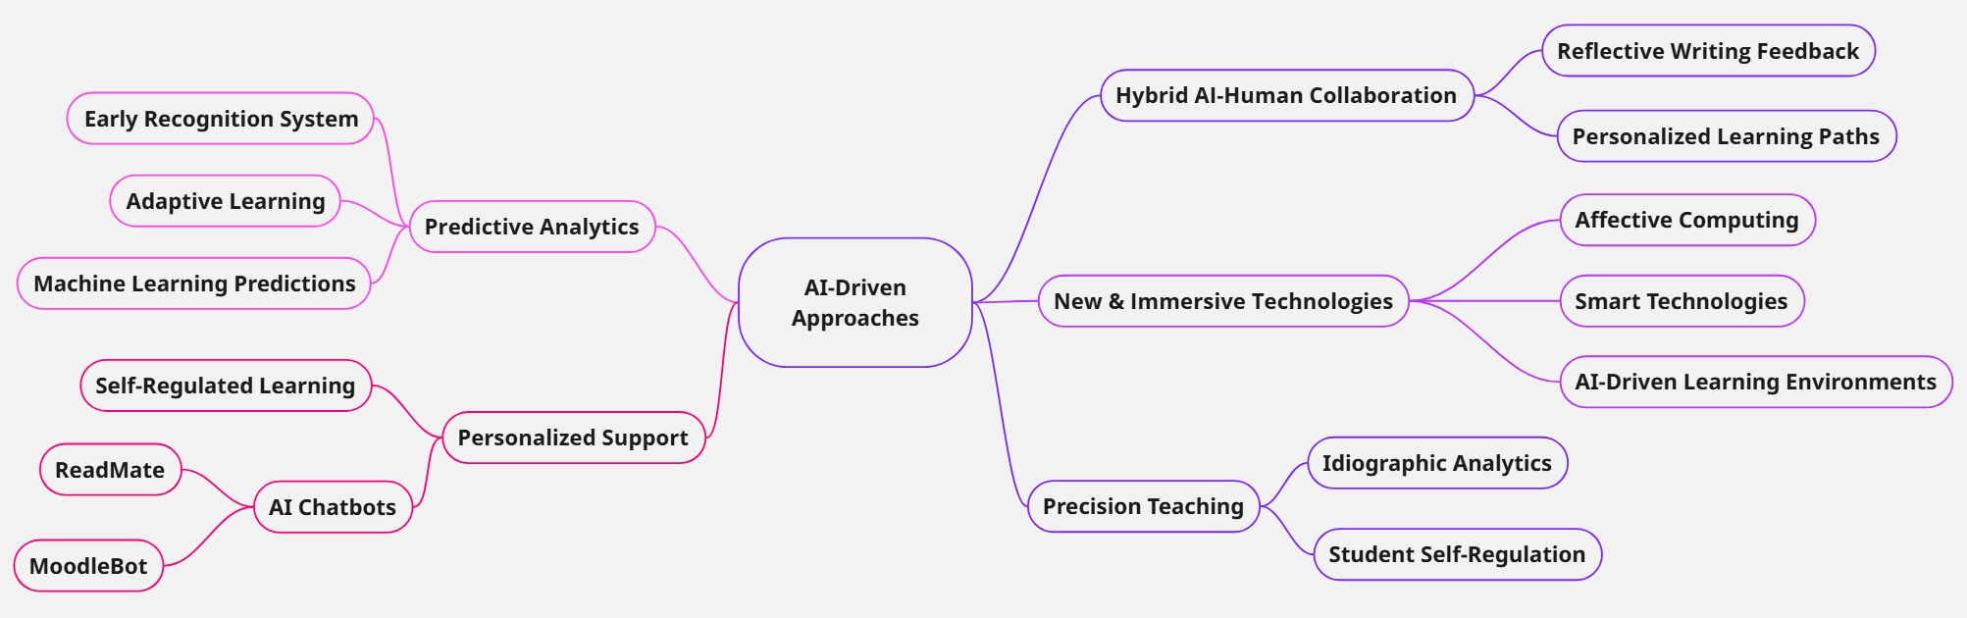
Exploring AI in SRPL
AI-Driven Approaches for Modern Teaching
© Copyright by Sahith Kumar Tadepalli and Dr Matthias Christoph Utesch
Notes:
Just introduce the key topics here

Slide 13

Exploring AI in SRPL
AI-Driven Approaches for Modern Teaching
Personalized Support with AI Chatbots
-> AI chatbots enhance learning by providing tailored support.
Examples:
  ReadMate (EFL learning) – boosts self-regulated reading through personalized feedback.¹
  MoodleBot (LLM-powered) – delivers customized exercises & clarifies course content.²
Impact:
  Increases student engagement and confidence.
  Reduces instructor workload.
1) Pan, M., Guo, K., & Lai, C. Using artificial intelligence chatbots to support English-as-a-Foreign Language students’ Self-Regulated reading. RELC Journal
2) Neumann, A. T., Yin, Y., Sowe, S., Decker, S., & Jarke, M. An LLM-driven chatbot in higher education for databases and information systems. IEEE Transactions on Education.
13
© Copyright by Sahith Kumar Tadepalli and Dr Matthias Christoph Utesch
Notes:
"Chatbots like ReadMate and MoodleBot support learners in real time.“
"They offer personalized reading materials, clarify course content, and provide feedback based on student input."
“They help learners stay on track, especially those with lower SRL skills.”
"This allows instructors to focus more on deep interaction while AI handles routine support.“
For example: “Imagine an AI bot that notices you’re struggling with a topic and suggests micro-lessons tailored to your pace.”
“Beyond support, AI can also predict who might need help—before they ask.”

Slide 14

Exploring AI in SRPL
AI-Driven Approaches for Modern Teaching
Predictive Analytics & Adaptive Learning
-> Machine learning enables early detection of at-risk students.
Examples:
Early Recognition System – uses online behavior & biometric data to predict outcomes.¹
Wearable sensors – track stress & motivation for proactive intervention.
Benefits:
Provides timely, tailored support.
Enhances real-time feedback and self-assessment.
1) Ciolacu, M., Tehrani, A. F., Binder, L., & Svasta, P. M. Education 4.0 - Artifi-cial Intelligence Assisted Higher Education: Early recognition system with machine learning to support students' success. 2018 IEEE 24th International Symposium for Design and Technology in Electronic Packaging (SIITME), 23–30. IEEE.
14
© Copyright by Sahith Kumar Tadepalli and Dr Matthias Christoph Utesch
Notes:
"AI systems like the Early Recognition System combine behavioral and biometric data to to identify at-risk students early.”
"Wearables track stress and motivation, allowing interventions to happen early."
"This real-time support turns passive systems into active collaborators in learning.“
Let us speculate on future improvements: “Imagine something along the lines of these systems also recommending wellness strategies based on mood trends, leading to optimal working conditions”
“But personalization can go even deeper—down to the individual’s emotional and behavioral patterns.”

Slide 15

Exploring AI in SRPL
AI-Driven Approaches for Modern Teaching
Precision Teaching with Idiographic Analytics
-> Focus on individual student behavior over time.
Example:
  Idiographic AI study (30-day analysis) – tracks motivation, stress & engagement.¹
Findings:
  Hope ↑ Engagement
  Stress ↓ Performance
Challenges & Potential:
  Data collection feasibility.
  Improved personalization for learners.
1) Saqr, M., Cheng, R., López-Pernas, S., & Beck, E. D. Idiographic artificial intelligence to explain students' self-regulation: Toward precision education. Learning and Individual Differences, 114, 102499.
15
© Copyright by Sahith Kumar Tadepalli and Dr Matthias Christoph Utesch
Notes:
“Idiographic AI tracks a student’s motivation, stress, and engagement over time—building a nuanced, personalized profile.”
"It enables highly personalized feedback loops tailored to that learner’s unique trajectory."
“While data collection at this scale is challenging, the personalization potential is enormous.”
“This kind of data-driven empathy allows instructors to intervene with nuance rather than guesswork.”
“And if we take it one step further, we arrive at immersive learning environments.”

Slide 16

Exploring AI in SRPL
AI-Driven Approaches for Modern Teaching
New and Immersive Learning Technologies
-> Interactive, adaptive, and personalized learning experiences.
Example:
  Affective computing in AR/VR¹
  AI-Driven Smart Learning Environments²
Findings:
  Supports diverse learners by detecting emotional states and adjusting content dynamically – enhances engagement and motivation
Benefits and Impact:
  Long-term learning success due to structured yet flexible educational pathways
1) Lampropoulos, G., Fernández-Arias, P., Antón-Sancho, Á., & Vergara, D. Affective computing in augmented reality, virtual reality, and immersive learning environments. Electronics, 13(15), 2917.
2) Tseng, S. S., & Zhou, Y. Guest editorial: Developing learner agency in smart environments. Educational Technology & Society, 1(3).
16
© Copyright by Sahith Kumar Tadepalli and Dr Matthias Christoph Utesch
Notes:
"VR and AR, combined with affective computing, respond to emotional states in real time."
"For example, if a learner shows signs of frustration, the system can adapt pacing or content delivery accordingly."
“These environments promote deep engagement, autonomy, and metacognitive growth.”
"This especially benefits students in special education or high-stress contexts.“
“Now let’s tie everything together in the context of AI-powered SRPL systems.”

Slide 17




Exploring AI in SRPL
Revolutionizing Education through AI and SRPL
AI-driven SRPL empowers learners to independently manage their learning processes (self-regulation) while receiving personalized support (personalized learning) from intelligent systems
Forethought phase
Enhances goal-setting
Encourages strategic thinking
Boosts motivation
Performance phase
Self-evaluation phase
Tracks and analyses student interactions
Provide feedbacks
Foster growth mindset
Dynamic learning adaptation
Empowers active learning
Personalized guidance
17
© Copyright by Sahith Kumar Tadepalli and Dr Matthias Christoph Utesch
Notes:
SRPL supported by AI spans the entire learning cycle.”
It supports all three phases of SRL: forethought (goal setting and the other stuff on the slides etc), performance (adaptivity), and reflection (feedback).“
“The system continuously adapts to student behavior, enabling a feedback-driven, personalized learning journey that helps students plan, stay on track and refine their own approach.
"The constant feedback loop fosters a growth mindset—one of the most valuable skills for lifelong learning.“
“This is what separates AI-powered learning from static, pre-scripted systems—it’s fluid, responsive, and personal.”
“Of course, no innovation comes without its challenges.”
"AI in SRPL must address issues like bias, privacy, digital divides, and ethical transparency.“
“We think Future research should focus on improving feedback quality, refining adaptive assessments, and ensuring ethical use of learning data. And are happy to see others further our research in these areas!
“Ultimately, our goal is to see the creation of learning environments where every student has an intelligent system standing behind them—not to replace teachers, but to empower learners.”

Slide 18
Thank you for listening!
We are looking forward to discussing and covering future research questions together with you in the near future
Exploring AI in SRPL
Notes:
To recap AI has the potential not just to teach, but to coach—helping students become better learners, not just faster ones.”
"Thank you for your attention. I’m looking forward to your thoughts, questions, and ideas for future research directions."

