Slide 1

How should education respond to generative AI?
Rupert Wegerif
Notes:
Acknowledge team

Slide 2
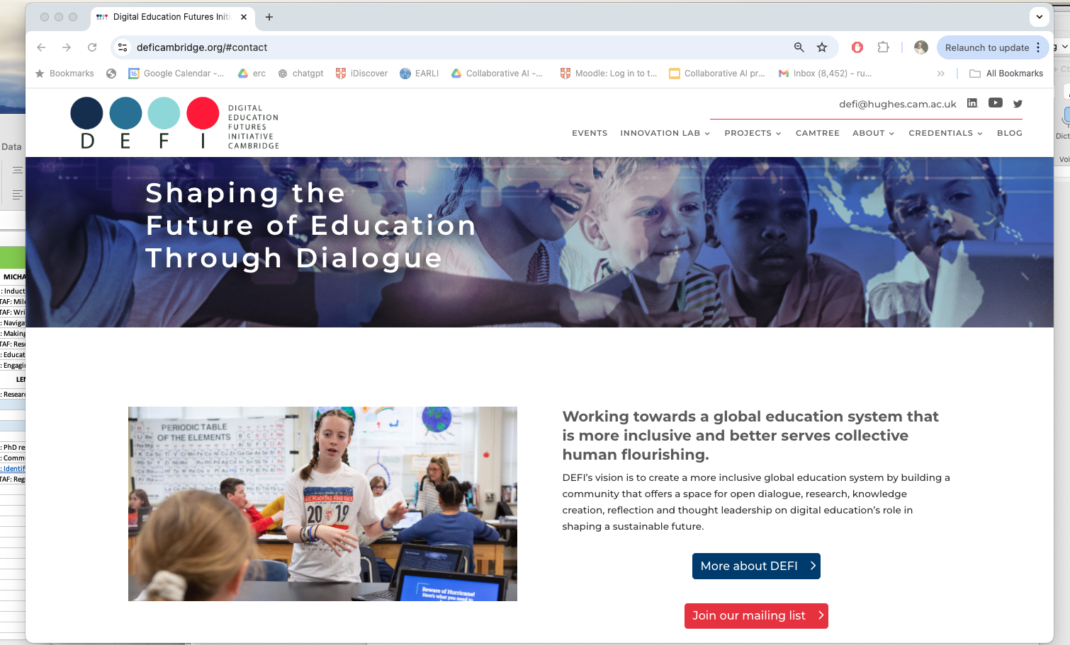
Notes:
Nice buzz – learnt stiuff – thanks tpo steve Watson Ann Kristen L Yuan and the others who have made this work. As Kevin said delighted to welcome you here on behalf od defi to Cambridge – all members of defi – state of mind – sign up – will share that stae of mind and vision thing. Story of anne and dr Jane – why I founded defi and why I am glad it is growing

Slide 3


Education is about design – it is not about describing the world but about changing it
What should we teach? How should we teach it? and why should we teach it?
What is Engineering Education for?
Technology has been treated as a supplement to education – we argue that it is central
Wegerif, R & Major, L (2024) The Theory of Educational Technology: Towards a dialogic foundation for design. Routledge
Notes:
Not neutral not human vs tech – always been about induction inot the use of tech – new tech needs new ed – dialogic ed

Slide 4

It is common to hear that:
“Education should be driven by human pedagogy and not by the needs of technology”
When theory is mentioned it is usually constructivism or social constructivism – about how humans make meaning
The theory of technology – the voice of technology is ignored
Worse it is treated as ‘other’ as the shadow of the human
But is this right?
Notes:
Wayne and dr Kim this morning – crtiicisng the tec reversion to the human – human conservative – just naturalized tech

Slide 5
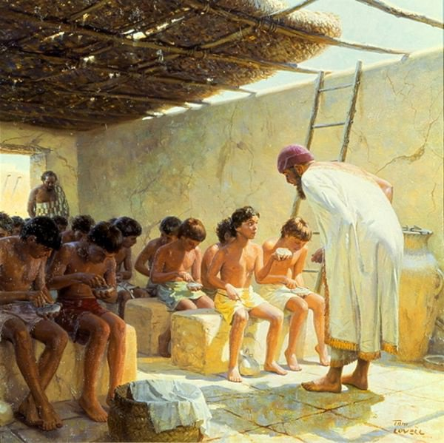

The first schools:
Edubas
A new technology
servicing a new technology
Notes:
2000 bce sumaria

Slide 6
Humans have always been hybrid
Speciation of humans from other apes involved fire, tool use and language
Language is a communications technology – consider how we create and share terms like ‘collective intelligence’ or ‘dialogic’
But it seems that the technology aspect of being human evolves faster than the biological side – language itself is hard-wired but formal education is needed for literacy (Geary) and used of language to think (Mercer and Wegerif – Oracy!)
Meaning (and agency) is not [only] human – it comes from participation in self-reproducing systems that combine the biological (natural tech) and the technological – systems like nation states and long term dialogues eg science

Slide 7
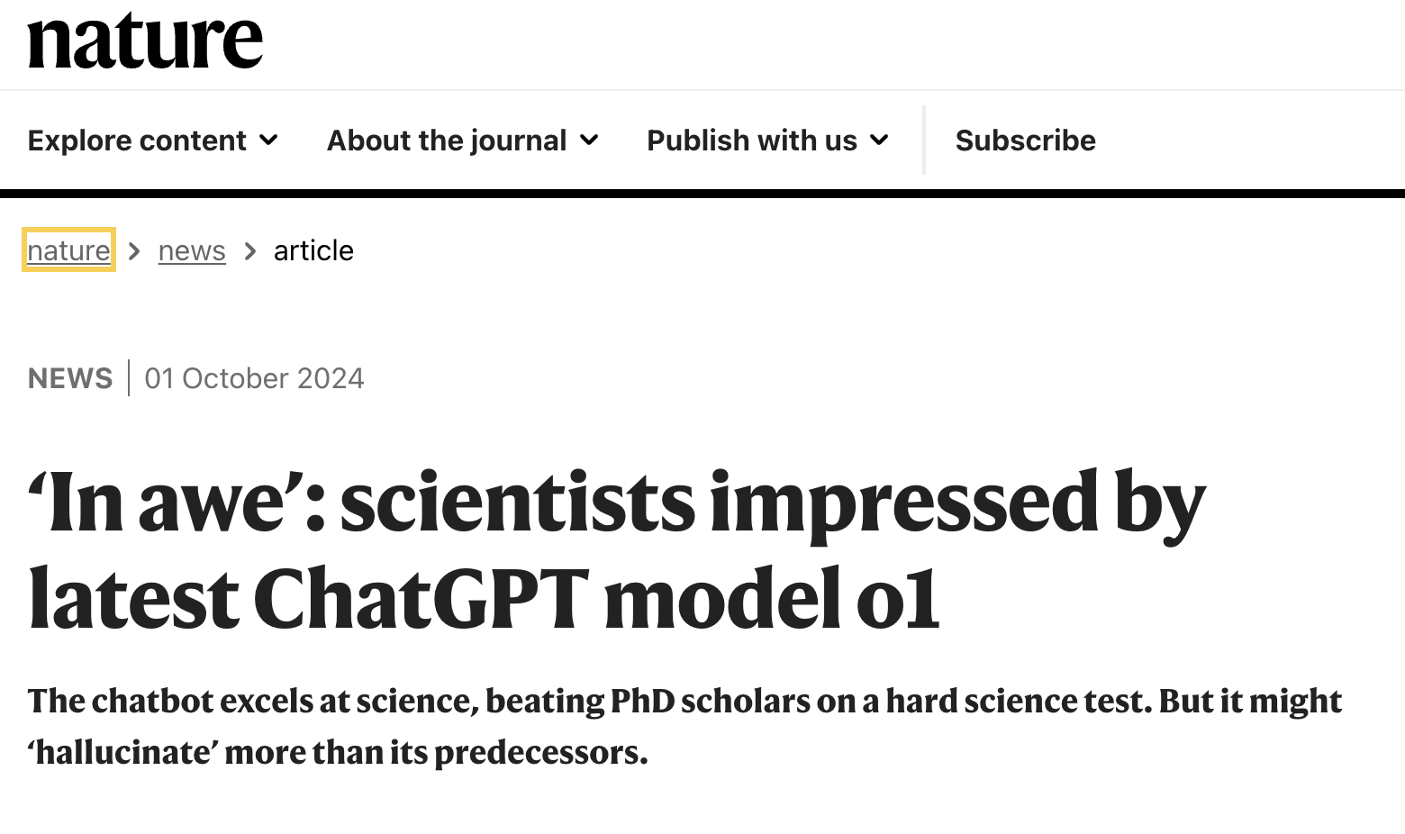
If AI can do better at written examinations than humans maybe it is time to question the validity of our assessments? To ask the question: what is engin education really for?
GPT-4 aced the SAT Reading & Writing section with a score of 710 out of 800, which puts it in the 93rd percentile of test-takers.
Business Insider, Nov 2023
Notes:
Educationh is not literacy and numeracy – these are intefaces – superficial technologies – educatin is often just a tech to support a tech

Slide 8


Slide 9
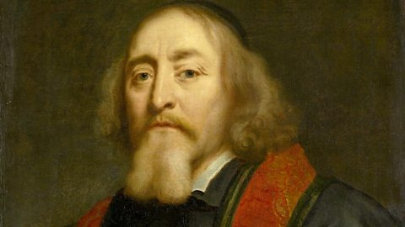
A global print based education system
“Instead of paper we have pupils whose minds have to be impressed with the symbols of knowledge. Instead of type we have the class books and the rest of the apparatus devised to facilitate the operation of teaching. The ink is replaced by the voice of the master, since this is what conveys information from the books to the mind of the listener”
Comenius, 1657 ‘The Great Didactic’
Comenius’s print based model of education was adopted by the whole of Europe and the USA during the 19th Century and since spread to the world.
Notes:
didactography

Slide 10
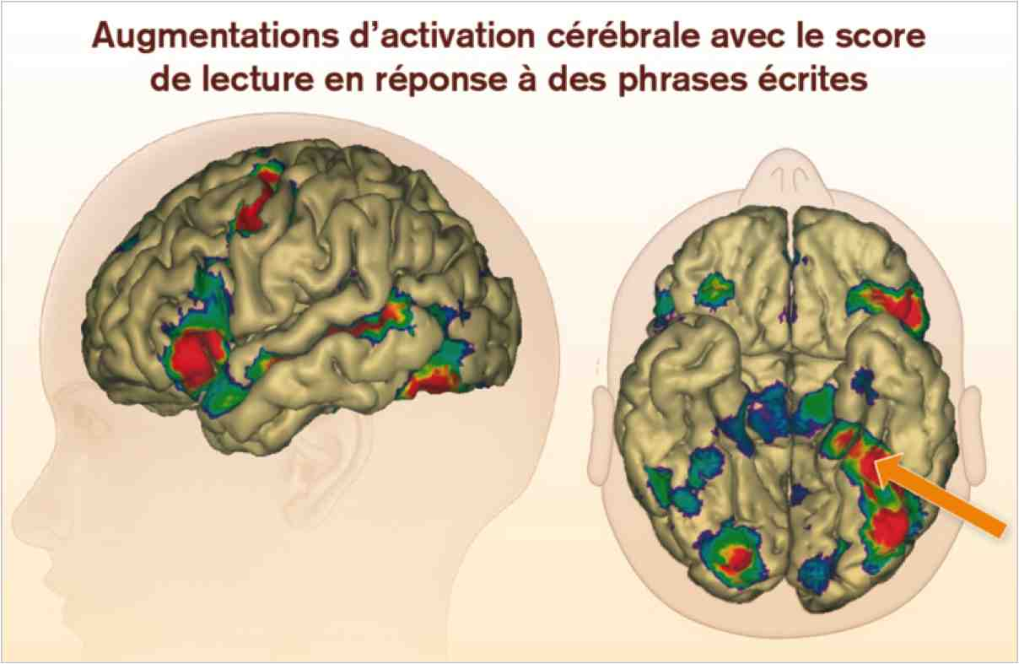
Writing changes the brain. Literates see words as well
as hearing them. Meanings become visible like things.
There is a shift from holistic perception to analytic.
(Dehaene 2009)

Slide 11
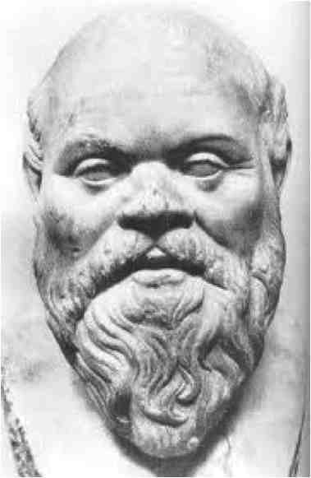
Socrates and the danger of writing
”Writing, Phaedrus, . . . is very like painting; for the creatures of painting stand like living beings, but if one asks them a question, they preserve a solemn silence. And so it is with written words; you might think they spoke as if they had intelligence, but if you question them, wishing to know about their sayings, they always say only one and the same thing”
Socrates according to Plato (approximately 370 BCE/2008)
Thinking requires dialogue, a play of different perspectives, asking questions, explaining …

Slide 12


Two ways of thinking about thinking
As formula/algorithm or as spark
meaning ‘is like an electric spark that occurs only when two different terminals are hooked together’ (Volosinov).
Notes:
But the voices we learn from are not all physically incarnated voices. In every dialogue there is also a witness voice. I may think I am trying to persuade you but even as I speak I can listen to myself and take an outside position. This is the position of the superaddressee who understands me even when you do not.

Slide 13



Two ways of thinking about knowledge
as representation
OR as relationship
A kind of thing, classified, stored, transferred into brains
‘learning is change in long term memory’
Learning through dialogue and participation
Joining communities
Expanding networks – process of participation
Notes:
Not same old with new means – actually what we mean by knowledge changes – or expanindg consciousness and community and identity through relationship – a living relationship

Slide 14


So what is education for?
Are we changing the human? Is so how?
O'shea, T., & Self, J. (1986). Learning and teaching with computers: The artificial intelligence revolution. Prentice Hall Professional Technical Reference.
Good to look at history
This is not the first AI in Education revolution
Notes:
the

Slide 15
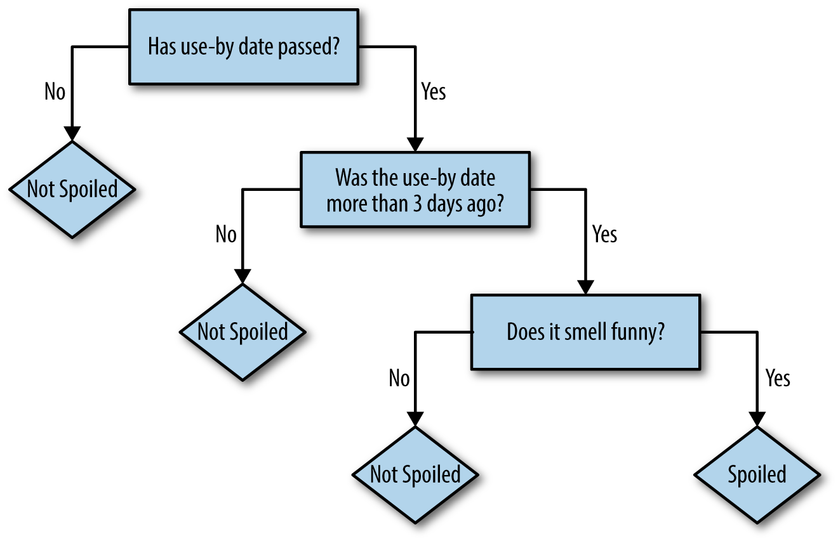
Good old-fashioned AI relies on if-then rules
Meaning = subsumption under a rule
(static and determined)

Slide 16
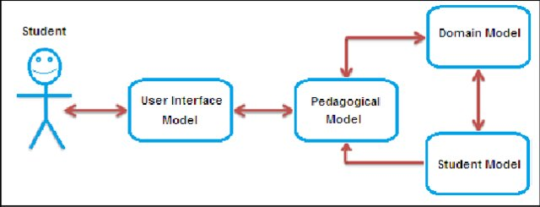
GOFAI has lots of rules in boxes triggering other rules in other boxes

Slide 17
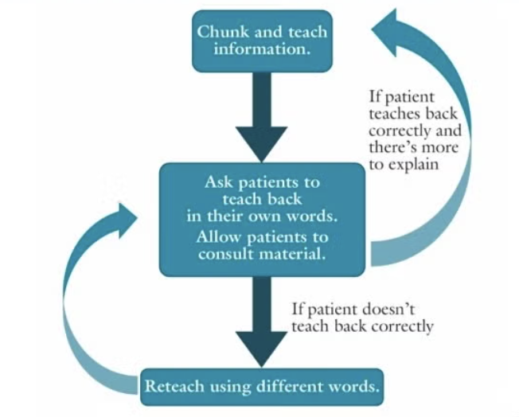
e.g ‘Teach-back’ method
[Or is it programming students to be more like the computers ?]

Slide 18
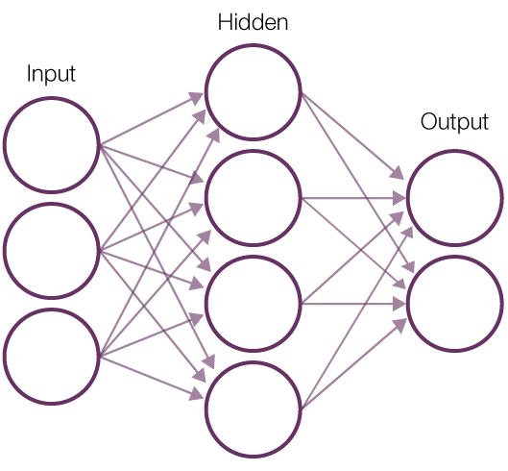
Generative AI
The model is trained on large amounts – 100s of billions - of data drawn largely from the Internet. It learns statistical patterns and relationships within that data.
Text is broken into smaller units (tokens), and the model predicts the most likely next token in a sequence, generating coherent responses.
Meaning = relationships and history of use (emergent and probabilistic)

Slide 19
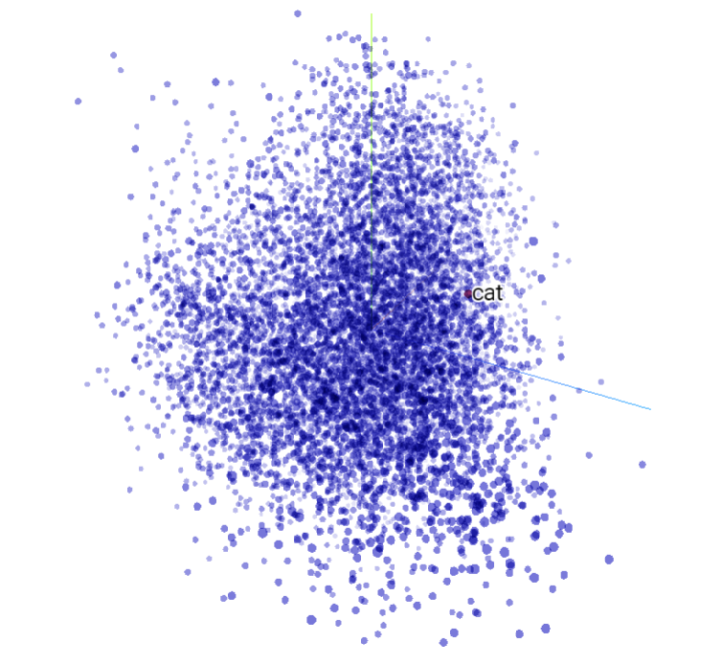
Let’s take a look
It’s complex
http://projector.tensorflow.org/
In real speech, there are many associations, so it is complex.
Notes:
Word embeddings are a fundamental technique in natural language processing (NLP) used to transform text into a numerical form that machine learning models can understand.
By capturing semantic relationships in multi-dimensional space, word embeddings enable various NLP tasks like text classification and machine translation.

Slide 20
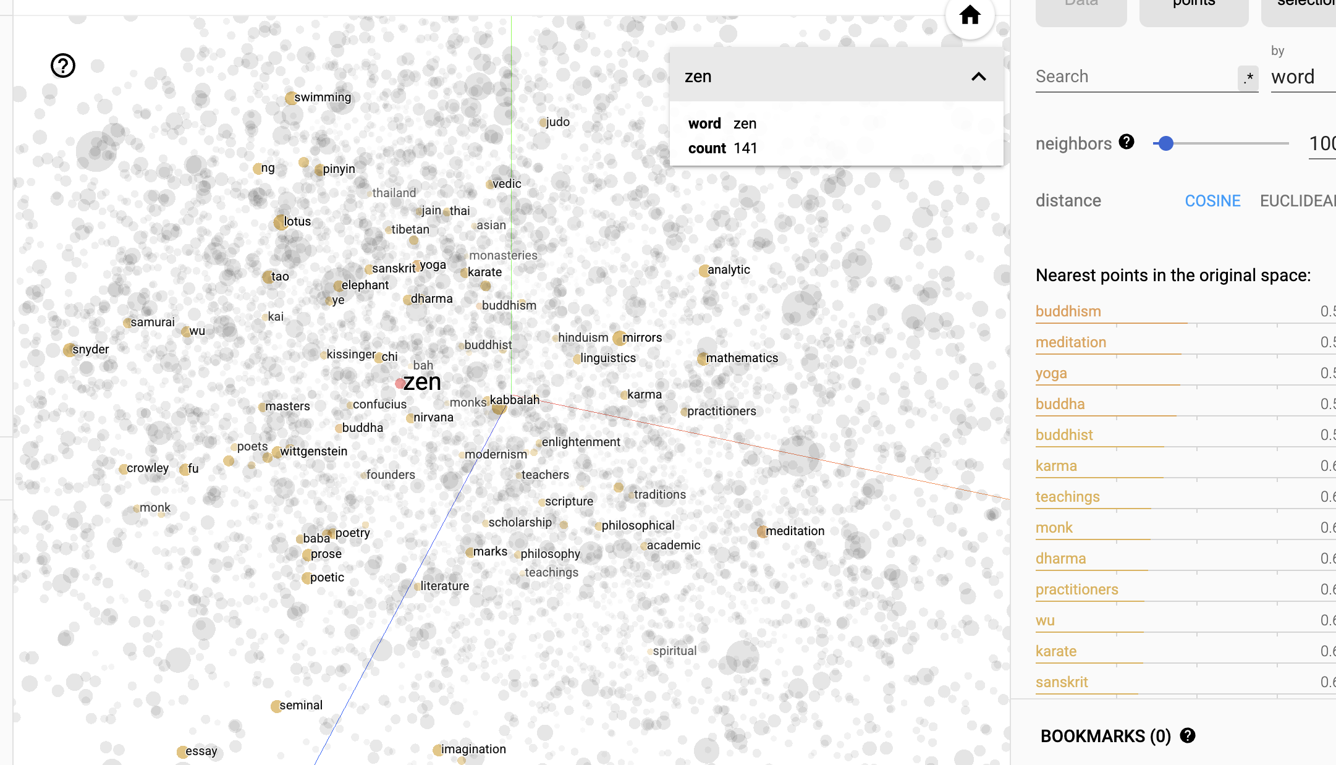
Let’s take a look
It’s complex
http://projector.tensorflow.org/
In real speech, there are many associations, so it is complex.
Notes:
Word embeddings are a fundamental technique in natural language processing (NLP) used to transform text into a numerical form that machine learning models can understand.
By capturing semantic relationships in multi-dimensional space, word embeddings enable various NLP tasks like text classification and machine translation.

Slide 21
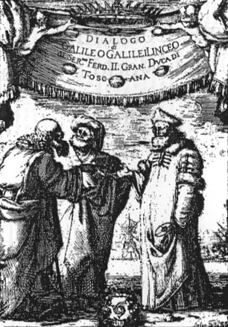
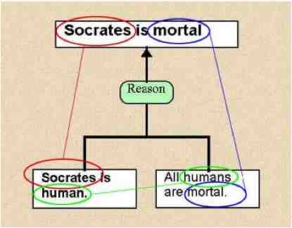
Around the end of the 16th Century, from Montaigne to Descartes, the dominant image of thinking changed from being about utterances in dialogues to being about propositions in proofs. (Toulmin, 2000)

Slide 22
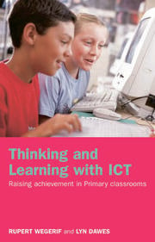


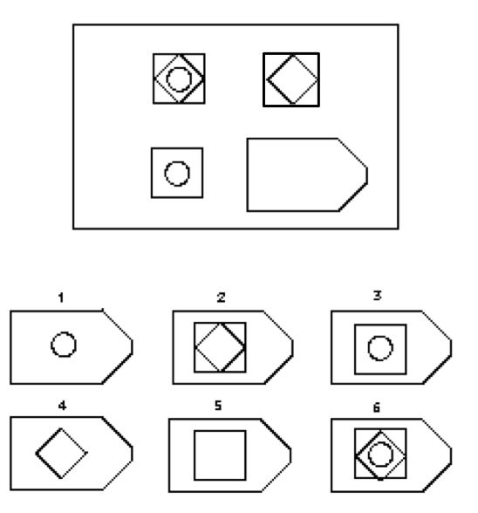
Putting the smart into the kids
Pre
Post
Impressive results – both groups and individuals increase reasoning test by between 5 and 10% over 3 months as a result of the Thinking Together intervention – also great results in curriculum learning

Slide 23
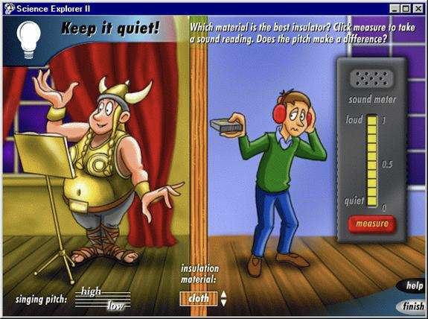

The students loved playing with simulations but did not pause to discuss them
So I added a talking bug

Slide 24
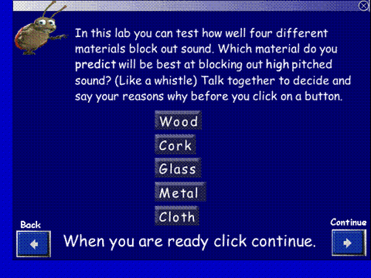
The bug would open up when they tried to press buttons and insist on talk

Slide 25
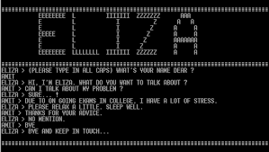
Raises the question of tech as a dialogue partner – is this real dialogue
Eliza pic

Slide 26
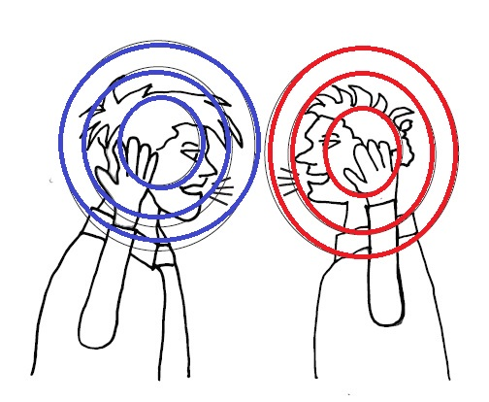
Two separate consciousnesses?
Notes:
The key was not just how they talked but their attitude to each other. This shows how they started not really listening

Slide 27
Pre-test dialogue
Notes:
The key was not just how they talked but their attitude to each other. This shows how they started not really listening

Slide 28
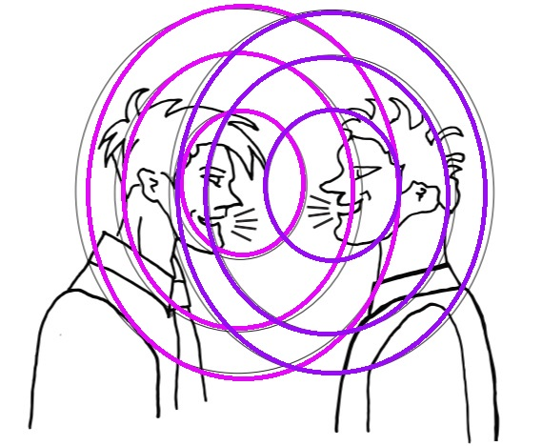
Post-test: moving into shared dialogic space
Notes:
This shows the post test when they created a shared dialogic space together moving their centre of identity into the middle between them.

Slide 29
Dialogue is (potentially) a self-transcendence engine
...transposing ourselves consists neither in the empathy of one individual for another nor in subordinating another person to our own standards; rather, it always involves rising to a higher universality that overcomes not only our own particularity but also that of the other. (Gadamer, 1989 304)
But it is not human (non only human) but always involves collab with tech. According to Gilbert Simondon everything individuates but psychological individuation does not stop but continues through ‘dialogue with technology’ to form new collective organisms he called 'transindividuals – ie ’ groups of people united through and by their use of technology.

Slide 30
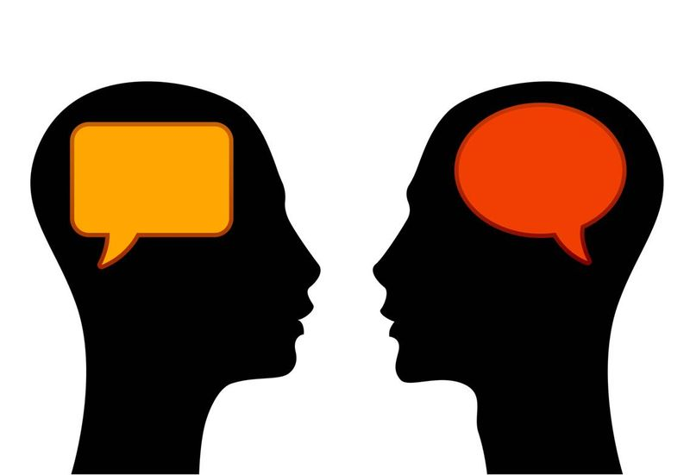
In every dialogue there is a ‘third’ voice – this can be a Generalised Other of the community of practice or the call of infinity (closing down or opening up?)
Infinite other
Superaddressee
Accountable talk or Infinite talk?
Notes:
But the voices we learn from are not all physically incarnated voices. In every dialogue there is also a witness voice. I may think I am trying to persuade you but even as I speak I can listen to myself and take an outside position. This is the position of the superaddressee who understands me even when you do not.

Slide 31

Dialogue is not between consciousness but between inside and outside

Slide 32

AI dialogue circles between a collective ‘dead’ outside and a living inside
The voice of AI is potentially everything that has already been said – it internalises and becomes inside in response to a challenge or question that is here and now for a student
Between them student and AI are a collective intelligence process – a co-intelligence
But only with dialogic pedagogy helping them to aks questions and think together with the AI
Notes:
How to integrate into exisiting system – need to learn – am humble – open – ignoriant -

Slide 33
Dumbing down or tooling up?
AI Tools in Society: Impacts on Cognitive Offloading and the Future of Critical Thinking
By Michael Gerlich 2025
The findings revealed a significant negative correlation between frequent AI tool usage and critical thinking abilities, mediated by increased cognitive
offloading.
BUT:
Exploring the Impact of Artificial Intelligence in Teaching and Learning of Science: A Systematic Review of Empirical Research
Firas Almasri 24
Research in Science Education (2024) 54:977–997
And plenty of other new papers show potential for positive effects

Slide 34
Could AI plus pedagogy of dialogue lead to a more thoughtful curriculum?
A return to Socrates but with added transmission of content knowledge?
The AI can prompt for talk and for thinking and can also feed in knowledge that is adaptive to the level and needs of students both individual and in groups
The students – the humans – added to the system - bring decision making, drive and creativity
This is double dialogic education –
1 learning how to think and ask questions in dialogues
2 learning how to participate and lead in ongoing long-term cultural dialogues eg science
Notes:
How to integrate into exisiting system – need to learn – am humble – open – ignoriant -

Slide 35
How to think together with AI
One student had the AI generate four distinct research methodologies, then critically examined the implications and potential pitfalls of each. Another used AI to explore opposing viewpoints, not to choose one but to understand the landscape of possibilities.
[This competence in thinking with AI] emerges through repeated cycles of three distinct types of engagement:
Exploratory inquiry, where users test boundaries and verify outputs
Targeted refinement, where they iterate and improve specific applications
Generative engagement, where they create entirely new approaches
Each cycle builds not just skill but judgment. Users develop an almost intuitive sense of when to trust AI suggestions, when to push back, and when to completely reframe the question. They learn to see AI not as a solution provider but as a thought partner in exploring possibility spaces.
…we might need to fundamentally rethink how we approach AI integration in educational settings. Instead of focusing on specific tools or techniques, perhaps we should be creating spaces for this cyclic exploration and reflection. It's less about teaching AI usage and more about fostering the capacity to navigate complexity with AI as a partner.
[Nick Potkalitsky on LinkedIn]

Slide 36
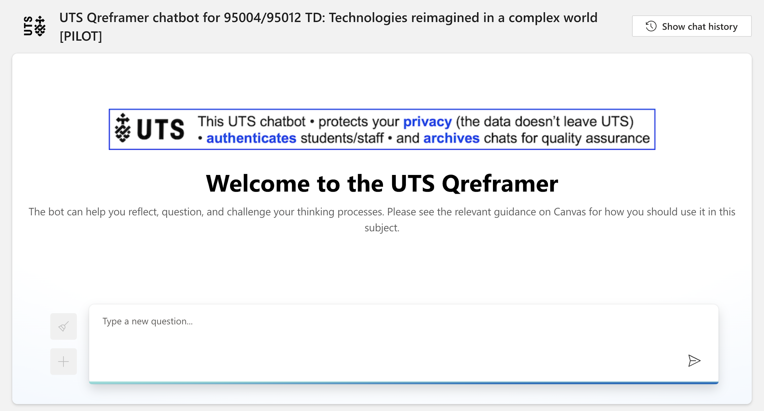

Slide 37
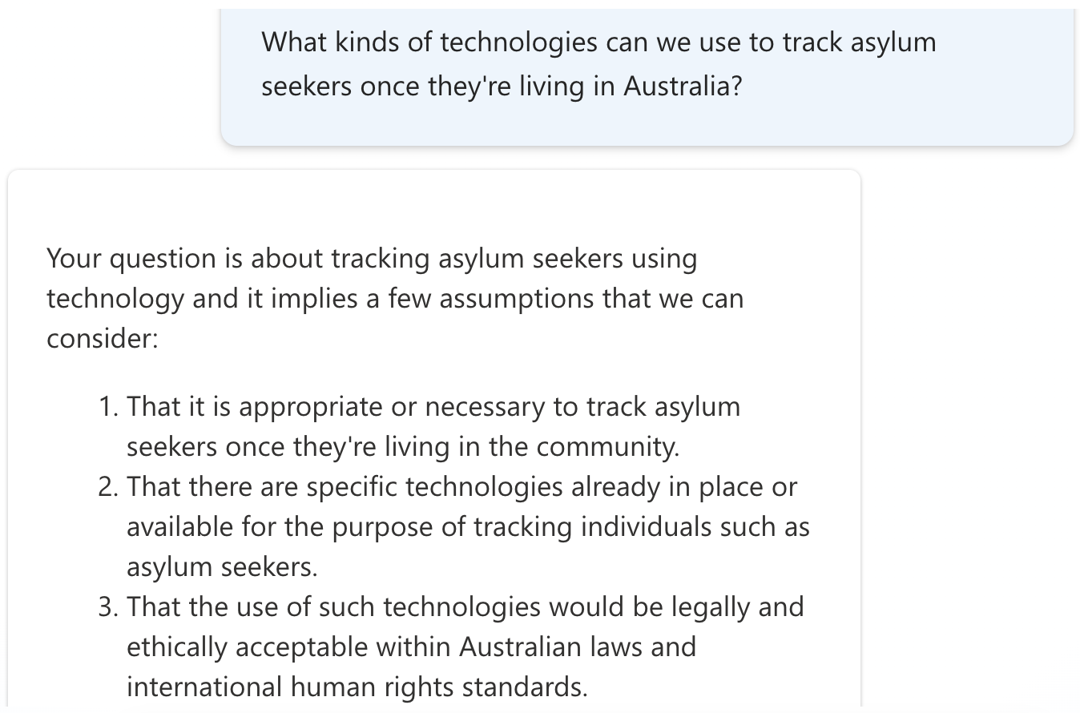

Slide 38
Exploring a new dialogic model of education with AI tutors
ChatGPT can switch between asking questions – prompting, facilitating, - and giving information in a way that is adaptive to each learner and each group. Induction into participation in a global long term dialogue like maths, science, history, citizenship etc
Student inquiry online supported by AI tutors
AI to form groups – support process – support staging
AI to serve as both active teacher (edubot) and passive knowledge resource - content
Requires initial education into how to dialogue with ChatGPT – ‘thinking together’
Notes:
A thousand teaching assitants online and offline –

Slide 39
The knowledge curriculum as ‘the dialogue so far’
double dialogic education –
1 learning how to think and ask questions in dialogues
2 learning how to participate and lead in ongoing long-term cultural dialogues eg science
Everything can be taught not as ‘is the case’ but ‘might be – this is why they said that ..’ ie teach not dead facts but living dialogue that the students can participate in
Notes:
How to integrate into exisiting system – need to learn – am humble – open – ignoriant -

Slide 40
The teacher as a model
The way in which the teacher talks is the biggest influence on how the students talk
Instead of saying ‘it is true’ say ‘this maybe true – this is why we think this – it could be wrong – how would we find out’ etc
All students have opportunities to contribute ideas
Ask for explanations
Ask and give reasons
Consider alternatives
Reach an agreement

Slide 41
But dialogue between humans is not enough
As well as direct collaboration there is indirect collaboration
Look for example at ‘stigmurgy’ in nature and also online
Ants coordinate by laying a chemical trail to say to others where to go and where not to go
The collective intelligence we need to tackle the challenges of the future such as global warming and how to cope with the AI-enhanced Internet is more than direct dialogue – it is dialogue with technology and that requires design

Slide 42
What is collective intelligence? Eg pandemic
1918 Influenza Pandemic:
Global Population (1918): Approximately 1.8 billion people.
Estimated Deaths: Approximately 50 million deaths worldwide.
Death Rate: Approximately 27.8 deaths per 1,000 people.​
COVID-19 Pandemic (2020-2021):
Global Population (2020): Approximately 7.84 billion people. ​
Estimated Excess Deaths (2020-2021): Approximately 14.91 million deaths worldwide. ​
Death Rate: Approximately 1.9 deaths per 1,000 people.
Scientists and governments coordinated in real time sharing data and ideas. Vaccines were developed and spread. Testing, tracing and data sharing enabled faster responses.
Notes:
And data Vaccines

Slide 43

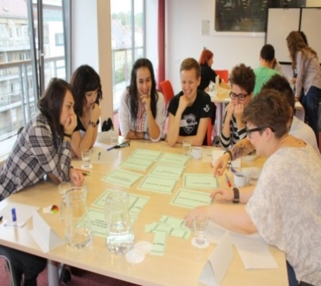
From industrial society to modern society…the market dictates what we value
Ability to work in a team structure
Ability to make decisions and solve problems
Ability to communicate verbally with people inside and outside an organisation
Ability to plan, organise and prioritise work
Ability to obtain and process information
Ability to analyse quantitative data
Technical knowledge related to the job
Proficient with computer software programs
Ability to create and/or edit written reports
Ability to sell, and influence others
Notes:
An important cultural trend supporting the development of CI education is the meaningful connection with the world of work, where people are increasingly being called upon to work together in a team structure.

Slide 44
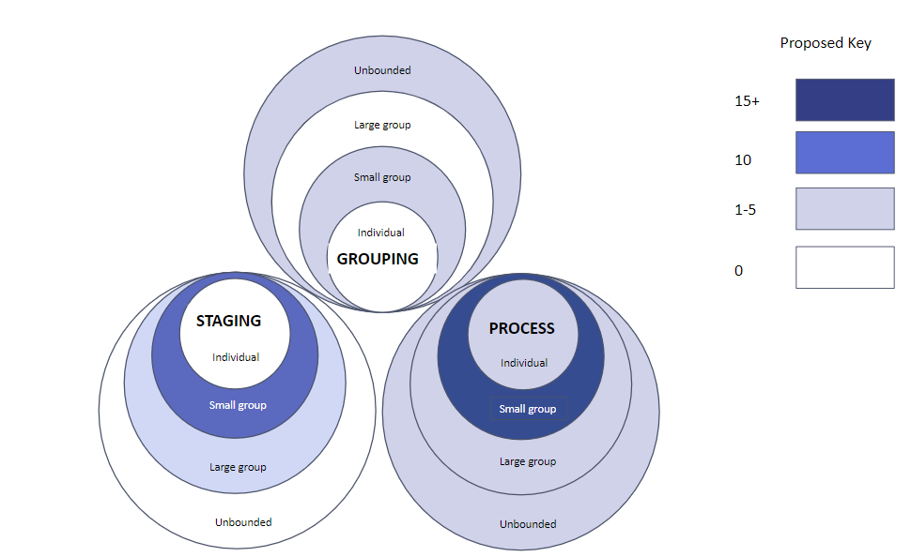
Framework for using AI for CI
A framework for Design Based Research
into AI to support education for Collective Intelligence
Imogen Casebourne, Shenpeng Shi, Mike Hogan, Wayne Holmes, Tore Hoel, Rupert Wegerif, Li Yuan. AI&ED 2025

Slide 45
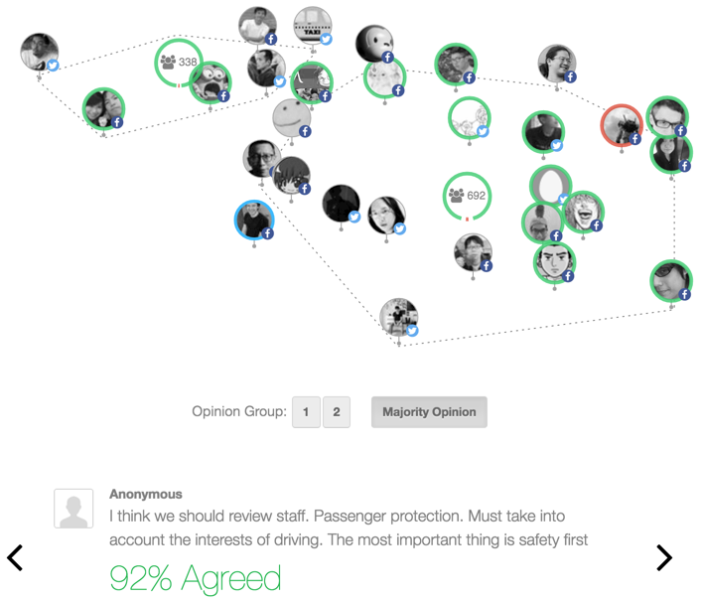
+ AI to synthesize from multiple views e.g Pol.is – bringing people together
Generates a map of the positions encouraging convergence
(Collective not just connected)

Slide 46
Education for Human-AI collective intelligence HAICI
Grouping: AI used to help in the forming and selecting of groups - selecting people with different character traits or backgrounds.
Process: AI used to support the micro-process of dialogue and deliberation within groups – agents who listen in to the dialogue and contingently prompt
Staging: AI used to support the staging or macro-process of creative innovation or problem-solving in groups over time.
Synthesising: comparing and synthesising to help creative emergence of best ideas
Two modes: active agent ‘edubot’ and as passive environment
A dimension of scale: individual, small groups, project teams, unbounded communities

Slide 47
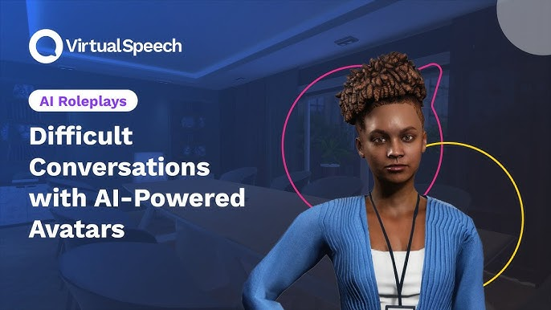
KTP UKRI funded project to develop edubots to coach better dialogue

Slide 48
A DEFI project: a universal moderator bot
A bot can impose equal turns and elicit ideas from those who have not yet spoken – it can also monitor and support the quality of the talk
What do you think?
Why do you think that?
Can you give reasons for that claim?
Could this be seen differently?
Do you agree with Brian? Or disagree? If so, why – give reasons
“discussions progressed quickly and were highly productive with the AI's assistance” Bo Yu PhD student

Slide 49
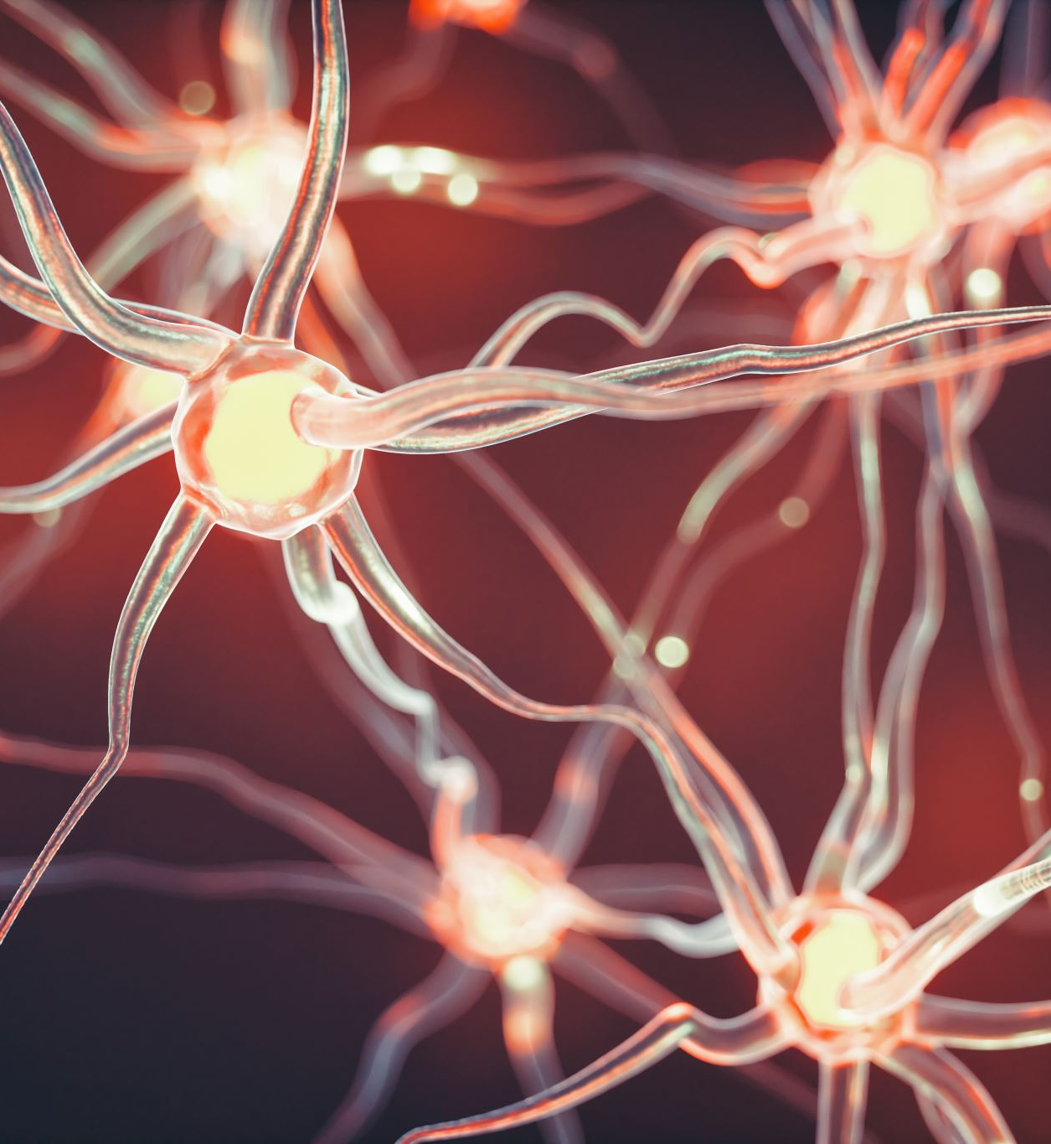
CAMBRIDGE OPEN
WEB OF
LEARNING
A RESEARCH PROJECT

Slide 50
INNOVATIVE, DESIGN BASED RESEARCH
Education design based research approach will allow the rapid testing and iteration of dialogue based methodologies that encourage students to collaborate successfully – our on-line dialogue community will include ‘baked-in’ Monitoring and Evaluation tools to provide indicators of impact on the fly, and encourage better behaviours through positive feedback loops.
Expert researchers will use the site to explore the impact of dialogical approaches with AI on teaching and learning, and use this as evidence to support advocacy for broader dialogical approaches across global education systems.
Participants will be trained and incentivised to participate as researchers and co-researchers in their own right.
4 Review
1 Plan
3 Test
2 Design

Slide 51
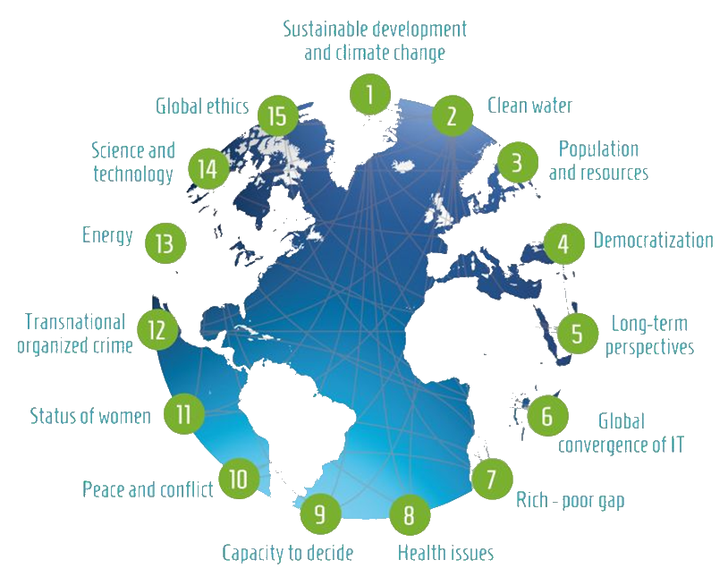
DEVELOPING LEADERSHIP TO ADDRESS GLOBAL CHALLENGES
The current generation of school age young people will inherit a world of uniquely complex and globalised challenge.
Future leaders must be prepared to collaborate across perceived boundaries of race, nationality, religion and culture – and education must equip them to be confident in doing this.

Slide 52

WHY DIALOGUE?
Participating in dialogue enables young people to learn and practice key 21st century skills of communication, collaboration, creativity and critical thinking, while at the same time having experiences that can break down prejudice through direct encounter with a diverse range of global peers, and simultaneously develop self-esteem and confidence. It empowers young people to lead in the development of their own, and global societies.
Dialogue is more than just a skill or a competence, it is also a means to prepare confident, articulate, creative and compassionate future leaders.

Slide 53

GLOBAL NETWORKING TO ADDRESS GLOBAL PROBLEMS
Participating students will collaborate with their global peers, putting their dialogue skills into practice to generate practical solutions to real-world problems.
Students will be recognized and incentivized through the accumulation of a suite of Cambridge OWL accredited micro-credentials

Slide 54
LEARNER JOURNEY
On boarding, registration including permissions & safeguarding training.
Training in the skills of dialogue – using a combination of LMS courses, & social learning with peers.
Ongoing accreditation through C-OWL Micro-credentials based on AI evaluation of process
(If appropriate) – mentoring & leadership roles within the site.
Sorted int ogroups by AI then Practicing dialogue skills with global peers supported by AI moderator bot
Practicing dialogue skills through collaborative work on global issues supported by AI

Slide 55
A new future oriented education system?
In person relationships between students and teachers are important but our current style of education is not good for producing the collective intelligence that we need to solve the challenges of the future
Can we use the AI-enhanced Internet to augment in person teaching with Internet mediated dialogic education in small groups and large groups to induct students into education as joining global dialogues to address global challenges?
Let us try some experimental research studies to see if we can design education for collective intelligence
https://www.deficambridge.org/ Follow: @DEFI_Cambridge email: defi@hughes.cam.ac.uk

Slide 56
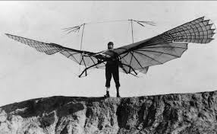

Slide 57
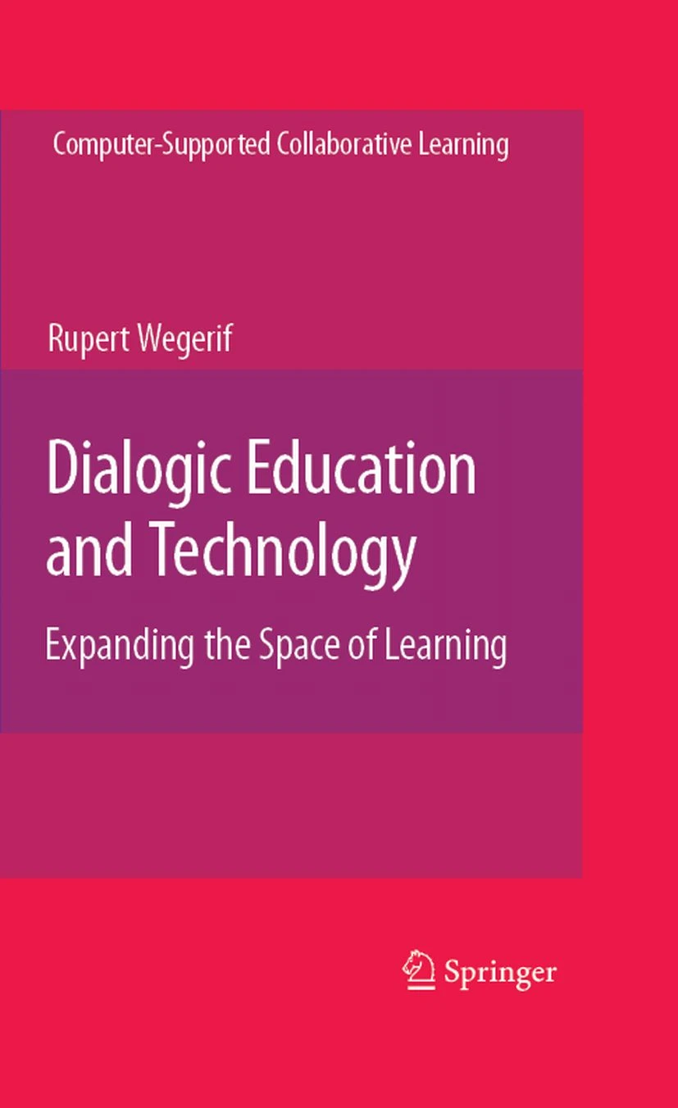
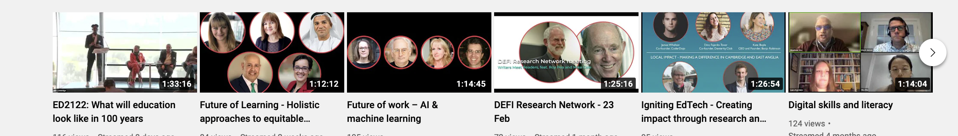
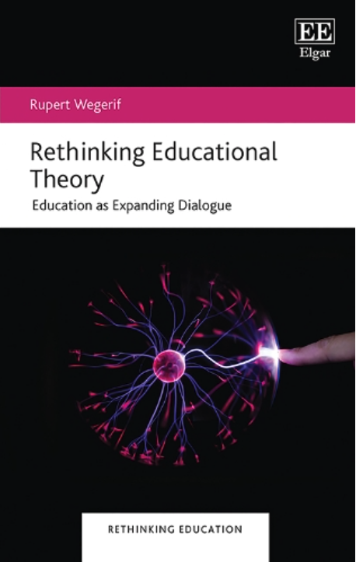
Thanks for listening!
Sign up at deficambridge.org and camtree.org Follow: @DEFI_Cambridge
email: defi@hughes.cam.ac.uk
And camtree.org plus the defi Cambridge youtube channel
Wegerif, R & Major, L (2024) The Theory of Educational Technology: Towards a dialogic foundation for design. Routledge
Wegerif, R. (2025) Rethinking Educational Theory: Education As Expanding Dialogue
Edward Elgar Publishing
Notes:
Publishing

