Slide 1

Integrating Generative Artificial Intelligence in Qualitative Research
Lessons, Strategies, and Ethical Considerations
Pamela D. McCray. Ph.D. & Norman S. St. Clair, Ph.D. University of the Incarnate Word
The Learning Ideas Conference
May 29, 2025

Slide 2
Introduction & Context
Rise of GenAI in academia
(Perkins & Roe, 2024; Rulfi & Spada, 2023; Slotnick & Boeing, 2024)
Underexplored in qualitative research
(Morgan, 2023; Pattyn, 2024; Resnik & Hosseini, 2024)
Presentation focus: Use GenAI as a research/thought partner in doctoral study

Slide 3

Study Purpose and Context
Purpose:
Examine validity of Comprehensive Institutional Model (CIM) stakeholder interventions in post-covid-19 environment
Context:
HyFlex learning and teaching environment, higher education, post-COVID-19
Stakeholders:
Faculty, graduate students, administrators from one private university in south central Texas
Methodology:
Instrumental case study using Design-based research (DBR)

Slide 4

Research Question Focus Areas
Primary Questions:
1. Faculty readiness for HyFlex
2. Instructional technology support
3. Graduate student support
4. Institutional sustainability
Sub-Questions:
1. Stakeholder perceptions of CIM recommendations
2. Communication loops
3. Iterative feedback

Slide 5
Methodological Approach
GenAI used as a triangulation and validation tool
Manual in-vivo coding done first
Researcher remained primary analytical instrument
Ethical protocols ensured anonymity

Slide 6
Researcher GenAI Prompting and Coding Design
Structured workflows
Prompt generated code tables for comparison AI validated researcher-created codes
AI validated researcher created codes
Domain-specific prompts for data organization

Slide 7
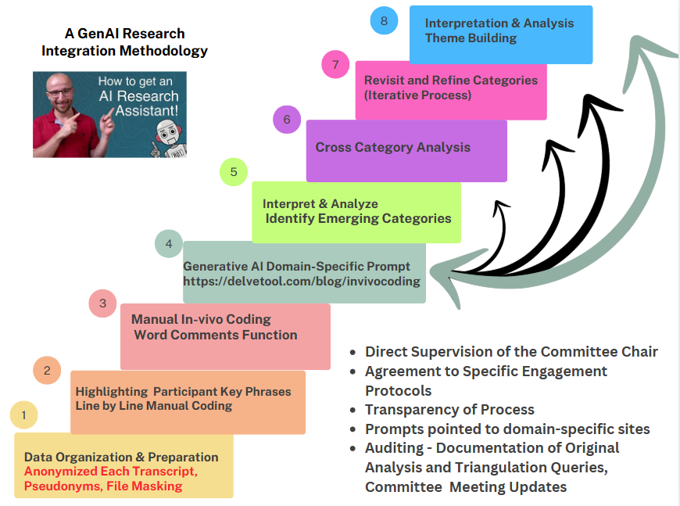

Slide 8
Theme Development Process: Partnering with GenAI
Data organized in Excel by stakeholder group
In-vivo codes grouped and categorized
ChatGPT used to validate researcher created emerging categories
Iterative refinement and validation of categories for theme development

Slide 9
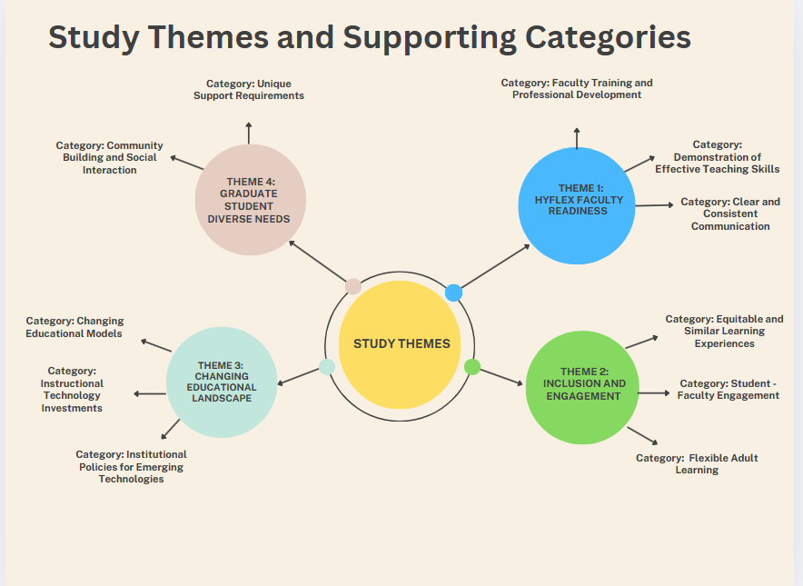
Key Categories and Themes:
GenAI’s Role in Deepening Data Insights

Slide 10
Ethical Considerations
Transparency and accountability in AI use
Avoid over-reliance on AI outputs
Ensure data privacy and secure storage
AI supports, not replaces, human insight

Slide 11
Lessons Learned & Best Practices
Define
Define AI vs. researcher roles
Use
Use structured prompts
Maintain
Maintain audit trail
Prioritize
Prioritize ethical integrity

Slide 12
Implications for Future Research
Comparative studies of AI efficiencies vs. traditional methods
Develop ethical AI research guidelines
Explore interdisciplinary AI use in academia

Slide 13

Conclusion
GenAI enhances qualitative research when used ethically
It is critical to maintain researcher accountability, rigor, and insights
Researchers must critically evaluate AI output for accuracy and relevancy

Slide 14



Slide 15

References upon request

