Slide 1





NEW Y0RK USA 2025
Student Dropout Prediction in Higher Education using Generative AI and Large Language Models
MUHAMMAD AMIN NADIM
3rd Year PhD Student
PhD in Learning Sciences and Digital Technologies
(University of Foggia & Pegaso Telematic University), Italy

Slide 2
2025
Introduction
🎓 Student dropout remains a persistent challenge in higher education, leading to personal, institutional, and societal costs.(Rosenzweig et al., 2022)
📈 The EU aims to reach 45% higher education attainment among 25–34-year-olds by 2030.(European Commission, 2024).⚠ This amplifies the need for effective dropout prediction systems.
⚠️ Existing prediction models often:
- Focus narrowly on academic metrics
- Miss motivational, psychological, and social factors
- Lack interpretability for educators
💡 This study introduces a novel approach using:
- Generative AI and Large Language Models (LLMs)
- Multidimensional student data (academic, psychological, demographic)
- Integration with educational theory for interpretable predictions
Student Dropout Prediction in Higher Education Using Generative AI and Large Language Models

Slide 3
2025
Why Use Large Language Models for Dropout Prediction?
✅ Traditional ML | 🧠 Large Language Models (LLMs)
Needs numeric input only (GPA, age) | Accepts diverse data types (text, scores, profiles)
Often black-box, hard to explain | Generates natural language explanations
Focus on linear or statistical patterns | Captures complex behavioral & motivational patterns
Lacks psychological understanding | Integrates psychological signals (e.g., motivation)
Actionable insights unclear | Insights linked to real interventions (mentoring, support)
LLMs offer a richer, more human-like understanding of students—transforming risk prediction into targeted, ethical action.
Student Dropout Prediction in Higher Education Using Generative AI and Large Language Models

Slide 4
2025
Research Objectives
This study presents the Pegaso Student Dropout Prediction (PSTUD) framework to develop and evaluate a theory-driven, interpretable, and ethically compliant dropout prediction using Large Language Models (LLMs) considering:
Develop the Pegaso Student Dropout Prediction (PSTUD) framework based on LLMs and grounded in
educational theory (e.g., Self Determination Theory, Tinto model for dropout, Exptency Value Theory).
Integrate psychological, academic, and demographic data into a unified, natural language
input format for dropout prediction.
Ensure ethical and privacy compliance using GDPR and Declaration of Helsinki standards.
Generate interpretable outputs in the form of human-readable risk narratives for educators and policymakers.
Evaluate the predictive performance (accuracy, balance, interpretability) of the LLM on synthetic and real
student profiles.
Pilot the framework for use in real educational institutions across diverse student populations.
Student Dropout Prediction in Higher Education Using Generative AI and Large Language Models

Slide 5
2025
Literature Review
Educational theory provides essential insight into why students drop out and how we can model dropout risk more effectively. PSTUD integrates these theories to inform feature selection and model explainability.
Theory | Core Concept | Applied Feature(s)
Tinto’s Student Integration Model (Samolia et al., 2023) | Dropout is linked to lack of academic/social integration | First-Year Integration Test (FIT), attendance, engagement data
Expectancy-Value Theory (Eccles et al., 2020) | Motivation = Expectation × Value of success | Academic Motivation Scale (AMS)
Self-Determination Theory (SDT) (Ryan et al., 2020) | Autonomy, competence, and relatedness drive motivation | BPNSFS (Basic Psychological Needs Scale)
Hardré & Reeve Model (Hardre et al., 2003) | Interplay of internal motivation and external context | Integrated AMS and FIT with environmental variables
These theories do not just inform the design of the dataset; they also help interpret the predictions made by the LLM, making the framework both theoretically grounded and actionable.
Student Dropout Prediction in Higher Education Using Generative AI and Large Language Models
Notes:
The Pegaso Student Dropout Prediction (PSTUD) framework is built on a comprehensive integration of leading educational and psychological theories to more accurately understand and address university dropout. By synthesizing Tinto’s Student Integration Model, Atkinson’s Expectancy-Value Theory, Self-Determination Theory (SDT), and the Hardré & Reeve model, PSTUD captures the complex interplay of motivational, environmental, and individual factors that influence student persistence.

Slide 6
2025
Literature Review
The Pegaso Student Dropout Prediction (PSTUD) framework is built on a comprehensive integration of leading educational and psychological theories to more accurately understand and address university dropout.
Empirical Evidence
Studies confirm the importance of motivation, environment, and context in dropout prediction
  Social desirability bias and technology acceptance are relevant factors in student engagement and reporting
Holistic Impact
  The integrated model enables multi-level, personalized interventions
  Supports more effective student retention strategies by tracking motivational evolution and contextual influences
This holistic approach enables the framework to assess not only academic and social integration but also students’ motivational states, psychological needs, and perceptions of their learning environment, providing a robust basis for predicting and preventing dropout.
Student Dropout Prediction in Higher Education Using Generative AI and Large Language Models

Slide 7
2025
Dataset & Ethical Considerations
Data Components:
1.Demographics: Age, gender, nationality, socioeconomic status
2.Academic Records: High school grades, first-year university credits, GPA
3.Psychological Instruments:
  FIT (First-Year Integration Test) → Social/academic integration
  AMS (Academic Motivation Scale) → Intrinsic/extrinsic motivation
  BPNSFS (Basic Psychological Needs) → Autonomy, competence, relatedness
Data Transformation (for LLM input):
The structured data is converted into text-based prompts for the LLM, making it possible to analyze risk in a contextual, narrative form.
Example Prompt Generated:
Student X is a 19-year-old female from a low socioeconomic background. She has moderate academic performance and reports low social integration. Motivational analysis (AMS) indicates decreasing intrinsic motivation. Psychological needs (BPNSFS) show unmet relatedness and autonomy.
The LLM then predicts: “High dropout risk — suggest social mentoring + motivation coaching.
Student Dropout Prediction in Higher Education Using Generative AI and Large Language Models

Slide 8
2025
Ethical Considerations
✅ Fully anonymized dataset
✅ GDPR-compliant (EU Regulation 2016/679)
✅ Informed consent for psychological assessments
✅ Research design aligns with the Declaration of Helsinki
✅ Approved by institutional ethics board
Student Dropout Prediction in Higher Education Using Generative AI and Large Language Models

Slide 9
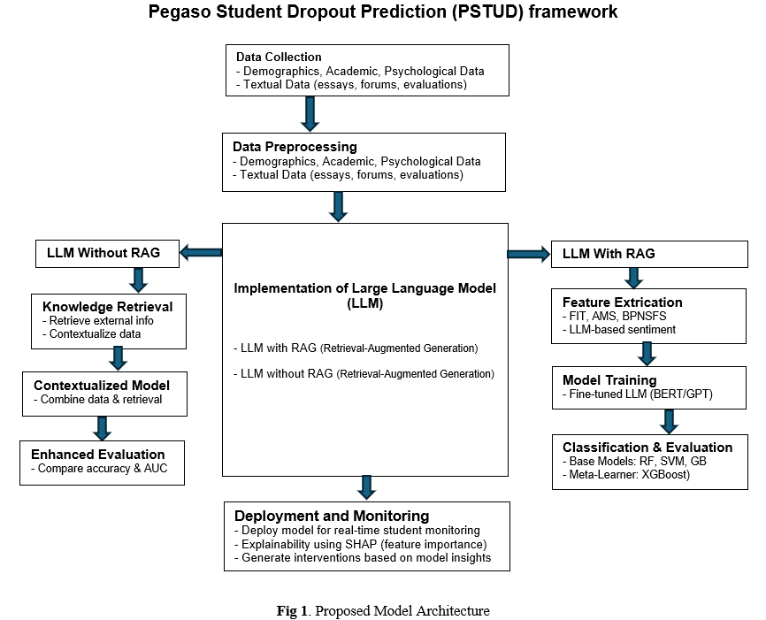
2025
Proposed Framework
The PSTUD framework collects and preprocesses demographic, academic, psychological, and reflective data. It employs Large Language Models (LLMs) with and without Retrieval-Augmented Generation (RAG) to refine predictions using external data. Key features like motivation and well-being are extracted, and fine-tuned models (e.g., GPT, BERT) are compared with traditional classifiers (e.g., Random Forest, XGBoost). SHAP-based explainability enables real-time monitoring and personalized interventions
Student Dropout Prediction in Higher Education Using Generative AI and Large Language Models

Slide 10
2025
Impact of NLI and Psychological Data Integration in PSTUD
By integrating psychological data and reframing dropout prediction as a Natural Language Inference (NLI) task, the PSTUD framework substantially improves both predictive accuracy and interpretability.
Leveraging Large Language Models (LLMs) to unify diverse data types into a single natural language format allows the model to capture complex and subtle relationships among academic, social, and psychological factors.
This comprehensive approach not only enhances the detection of at-risk students but also equips educators with actionable insights for more effective, targeted interventions.
Enhanced Predictive Power:
  Integration of psychological, academic, and social data
  NLI approach enables nuanced pattern recognition
Unified Data Representation:
  LLMs convert heterogeneous data into a single semantic framework
  Facilitates identification of subtle risk factors and interactions
Actionable Insights:
  Supports early detection and personalized intervention strategies for at-risk students
  Improves interpretability and practical utility for educators
Student Dropout Prediction in Higher Education Using Generative AI and Large Language Models

Slide 11
2025
Theoretical- Advance ML Integration in Dropout Prediction
The integration of educational theories (e.g., Tinto’s Integration Model, Self-Determination Theory) with advanced machine learning like Base Models (RF,SVM,GB) and Meta Learner (XGBoost) in the PSTUD framework bridges a critical gap in dropout prediction.
By mapping theoretical constructs-such as academic integration metrics (forum activity frequency) and psychological needs (autonomy scores) to model features, the framework ensures predictions align with pedagogical principles rather than mere statistical correlations.
This approach enhances interpretability, allowing educators to link risk factors (e.g., low social integration) to evidence-based interventions.
Theoretical Alignment:
  Tinto’s metrics → Forum post frequency, assignment submission patterns
  SDT needs → Autonomy, competence, and relatedness scores
  Atkinson’s Expectancy-Value → Motivation analysis via essay text
Benefits:
  Accuracy: improvement over traditional ML models (F1-score)
  Actionability: Predictions map to known retention strategies (e.g., peer mentoring for low social integration)
Student Dropout Prediction in Higher Education Using Generative AI and Large Language Models

Slide 12
2025
Anticipated Results and Insights from the PSTUD Framework
Initial evaluations of framework indicate that LLMs will outperform traditional models (e.g., logistic regression, random forest) in predicting student dropout by capturing complex patterns in multidimensional data.
Retrieval-Augmented Generation (RAG) is anticipated to enhance prediction quality by incorporating relevant external knowledge during reasoning.
The framework will generate interpretable, narrative-style outputs, such as: “Student A shows signs of declining motivation and low social integration. Recommend assigning a peer mentor and motivational support.”
Planned evaluation metrics include:
Accuracy F1-Score AUC (Area Under Curve)
Preliminary findings suggest that apply SHAP (SHapley values) to ensure transparency, identifying which features (e.g., motivation, social integration, academic performance) most influence predictions.
These insights are based on preliminary design and synthetic testing. Full results will follow after pilot deployment.
Student Dropout Prediction in Higher Education Using Generative AI and Large Language Models

Slide 13
2025
Conclusion
The PSTUD framework advances beyond conventional dropout prediction by not only identifying at-risk students but also uncovering the underlying causes and suggesting evidence-based interventions. By integrating Large Language Models (LLMs) with educational theory, PSTUD delivers interpretable, context-aware insights that bridge the gap between AI systems and human educators.
Grounded in ethical principles and driven by multidimensional data, this approach represents a significant innovation in student retention strategies, enabling more transparent, personalized, and theory-aligned decision-making in higher education.
Student Dropout Prediction in Higher Education Using Generative AI and Large Language Models

Slide 14
2025
Challenges and Future Works
  As institutions continue to face the challenge of student retention, frameworks like PSTUD can play a crucial role in forming strategic interventions and enhancing student success considering ethical compliance of world.
  Some challenges
  Privacy risks in handling sensitive psychological data
  Computational costs for real-time processing (≈200 GPU-hours)
  Need for validation across diverse institutions
  Future perspectives
  Pilot in Italian universities in 2025 under ethical board supervision.
  Track model-predicted vs. actual dropout over 2–3 semesters.
  Fine-tune smaller open-source LLMs for institutional deployment without cloud dependencies.
Student Dropout Prediction in Higher Education Using Generative AI and Large Language Models

Slide 15


2025
Thanks
QUESTIONS, SUGGESTIONS AND COMMENTS ARE VERY WELCOME
Looking for cross-university collaborations on piloting PSTUD in other educational contexts.
MUAHAMMAD AMIN NADIM
muhammad.nadim@unipegaso.it
Student Dropout Prediction in Higher Education Using Generative AI and Large Language Models

Slide 16
2025
References
Algharaibeh, S. A. The Construct Validity of Vallerand's Academic Motivation Scale (AMS). Journal of Educational Sciences, 11(9), 552. (2021) https://doi.org/10.1155/2021/5546794
Alzahrani, M. R. Predicting Student Performance Using Ensemble Models and Learning Analytics Techniques. Preprints.org. (2024) https://doi.org/10.20944/preprints202406.1100.v1
Eccles, J. S., Wigfield, A. From expectancy-value theory to situated expectancy-value theory: A developmental, social cognitive, and sociocultural perspective on motivation. Contemporary Educational Psychology, 61, 101859. (2020) https://doi.org/10.1016/j.cedpsych.2020.101859
European Commission. Educational attainment statistics. Eurostat. https://ec.europa.eu/eurostat/statistics-explained/index.php?title=Educational_attainment_statistics (2024)
Frontiers in Education. Factors contributing to university dropout: a review. Frontiers in Education, 8, 1159864. (2023) https://doi.org/10.3389/feduc.2023.1159864
Gao, Y., Xiong, Y., Gao, X., Jia, K., Pan, J., Bi, Y., & Wang, H. Retrieval-augmented generation for large language models: A survey. arXiv preprint arXiv:2312.10997. (2023) https://doi.org/10.48550/arXiv.2312.10997
Hardré, P. L., Reeve, J. A motivational model of rural students' intentions to persist in, versus drop out of, high school. Journal of Educational Psychology, 95(2), 347-356. (2003) https://doi.org/10.1037/0022-0663.95.2.347
Jeno, L. M., Dettweiler, U., & Grytnes, J. A. (2020). The effects of a goal-framing and need-supportive app on undergraduates' intentions, effort, and achievement in mobile science learning. Computers & Education, 159, 104022. http://doi.org/10.1016/j.compedu.2020.104022
Rosenzweig, E. Q., Wigfield, A., Eccles, J. S. Expectancy-value theory and its relevance for student motivation and learning. In K. R. Wentzel & D. B. Miele (Eds.), Handbook of motivation at school (pp. 93-110). Routledge. (2022) https://doi.org/10.1080/00461520.2021.1984242
Samoila, M. E., & Vrabie, T. (2023, June). First-year seminars through the lens of Vincent Tinto's theories of student departure. A systematic review. In Frontiers in Education (Vol. 8, p. 1205667). Frontiers Media SA. https://doi.org/10.3389/feduc.2023.1205667
Student Dropout Prediction in Higher Education Using Generative AI and Large Language Models

