Slide 1


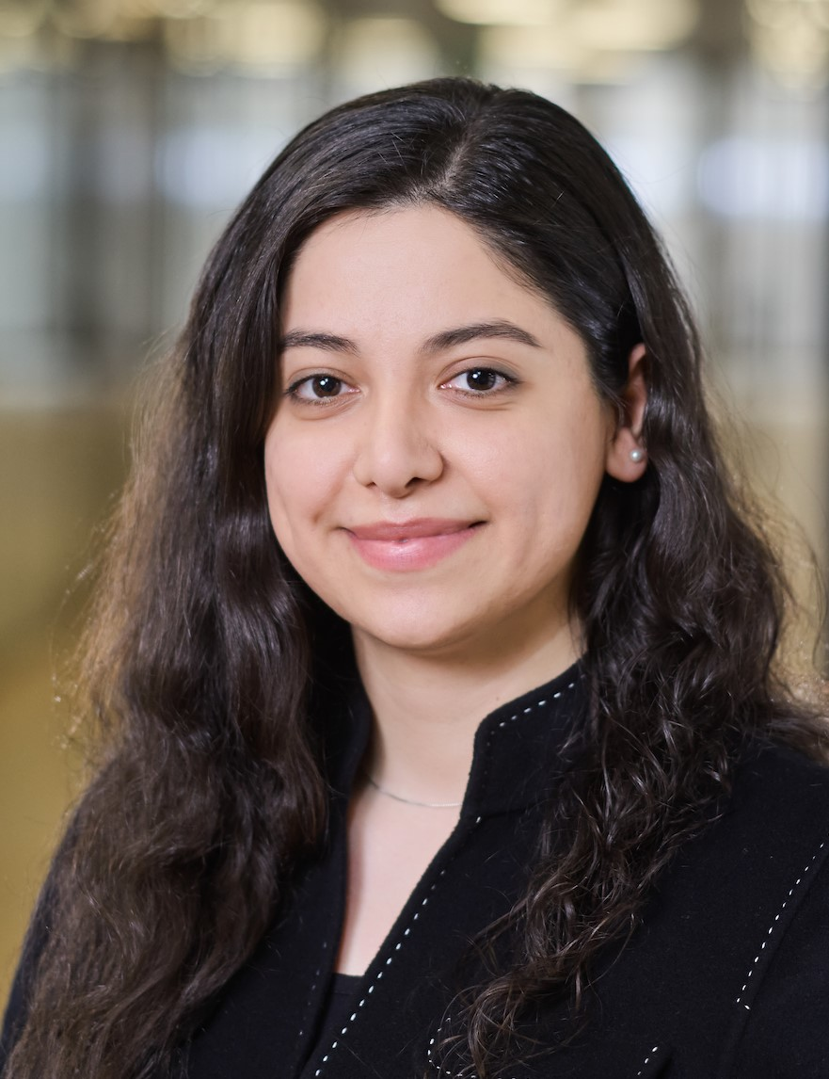
Engineering Education :
A Framework from Modeling to
Experimental Validation of Dynamic Systems
Prof. Fariba Moghaddam
Fereshteh Jafari
University of Applied Sciences and Arts Western Switzerland
1950 Sion, Switzerland

Slide 2
Table of contents
1. Overview
2. Methodology for Educational Framework
3. Modeling Approaches
4. Numerical Simulation Approaches
5. Hardware-in-the-Loop
6. Hands-on Experimentation
7. Case Study 1: PV System
8. Case Study 2: PVT System
9. Model Limitations and Applicability Scope
10. Conclusion
11. Future Work

Slide 3
1) Overview
Dynamic systems are essential across engineering fields (mechanical, electrical, chemical, energy networks, robotics, ...).
Effective education requires blending theory with hands-on learning.
This work proposes a comprehensive teaching framework with 4 components: - - Modeling
  - Numerical simulation
- Hardware-in-the-loop (HIL) testing
- Practical experimentation
Students progressively build, test, and refine models in simulated and real conditions.
The goal: bridge theory and practice to better prepare students for modern engineering challenges.

Slide 4
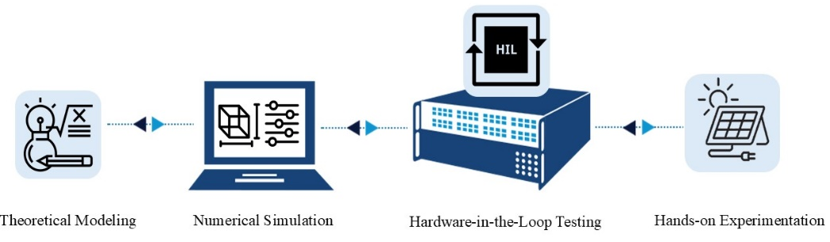
2) Methodology
Educational Framework to bridge 4 steps :
Modeling
Simulation
Hardware-in-the-Loop
Experimentation
Critical Thinking & Reflection → Analyze disparities between theory, simulation, and experimentation

Slide 5

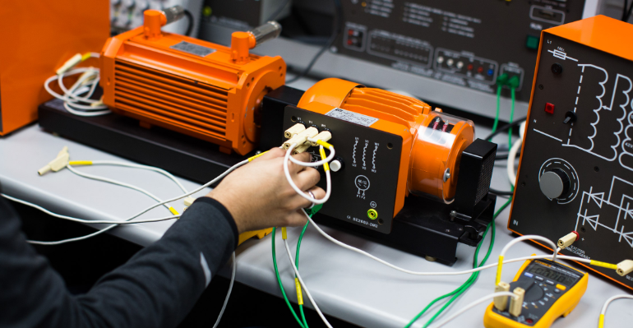
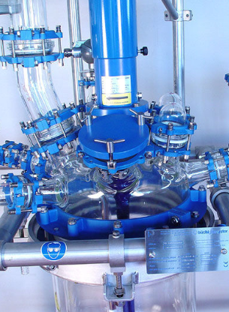
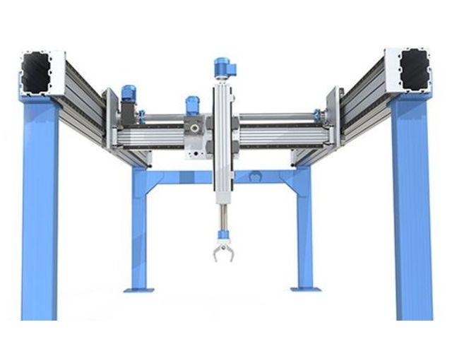
3) Modeling
Modeling is the process of creating a simplified mathematical or computational representation of a real-world system to be able to :
Analyze the system behavior
Control the system
Make future predictions

Slide 6
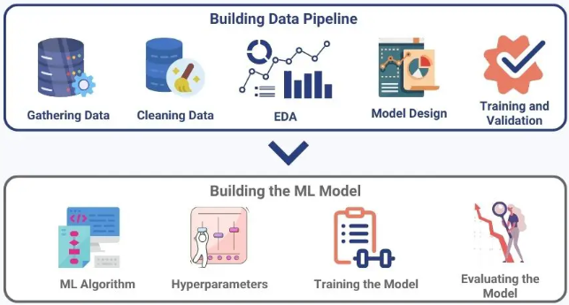
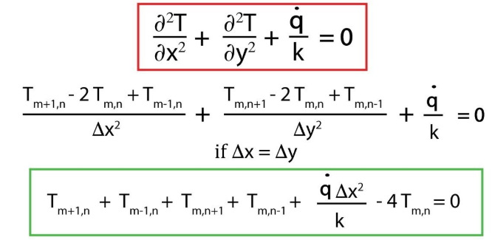
3) Modeling Approaches
Analytical
Based on fundamental principles, using mathematical differential equations, ...
Machine Learning
Based on datasets, using Data-Driven methods (Neural networks, Regression models,…)

Slide 7
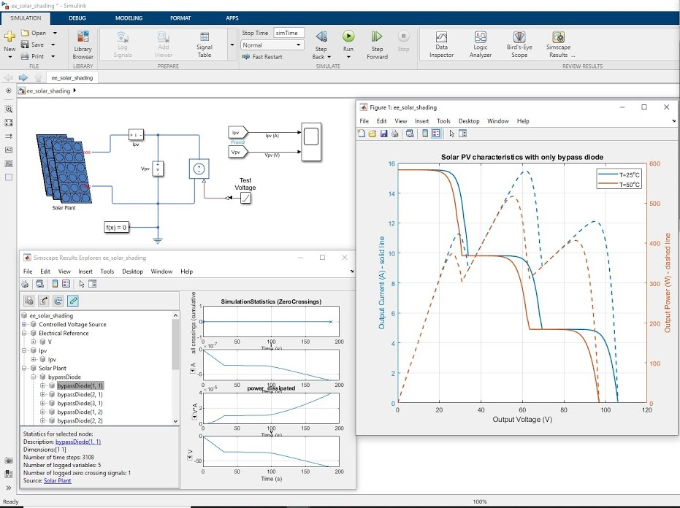
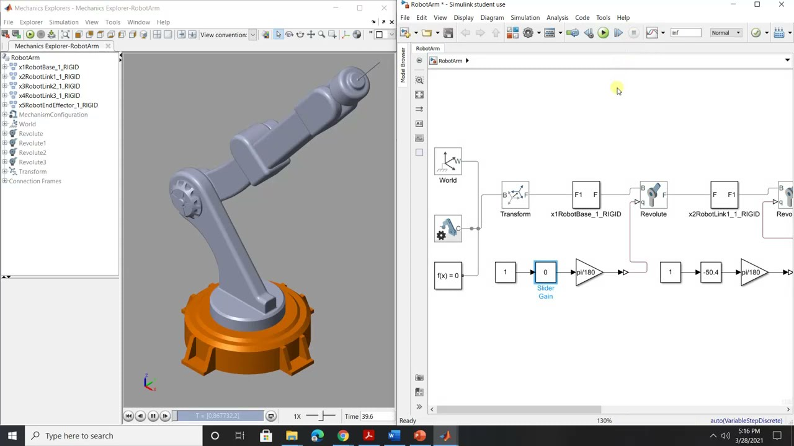
4) Numerical Simulation
Numerical simulation provides an environment to analyze the behavior of developed models under varying conditions to gain insights into system dynamics and evaluate model performance.

Slide 8
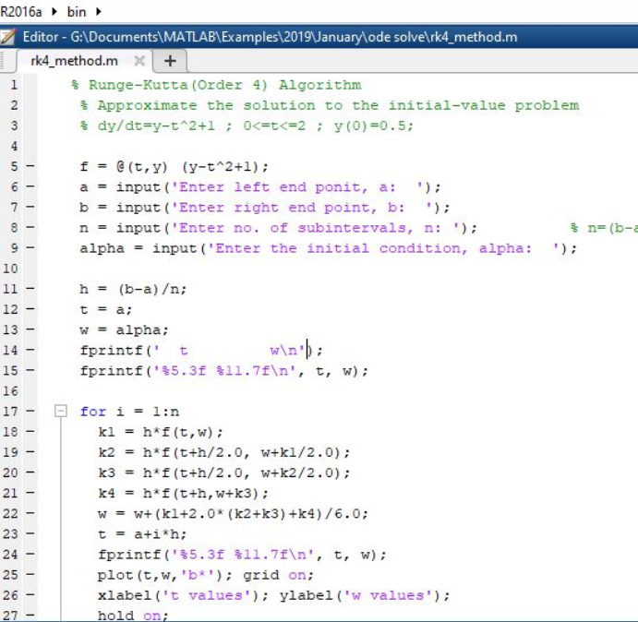
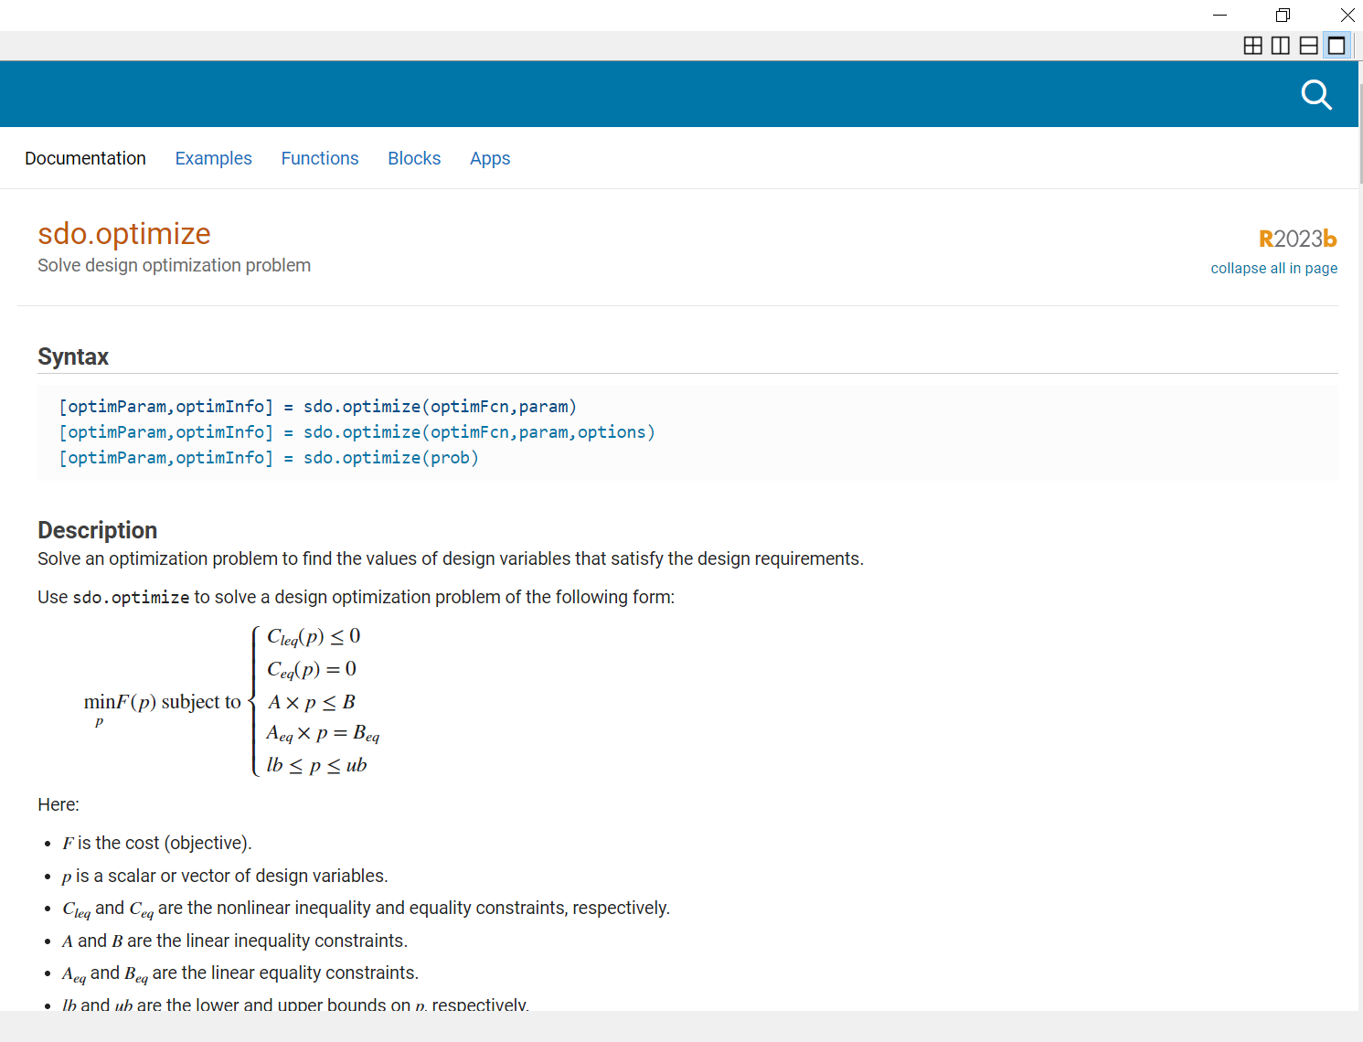
4) Simulation Approaches
For Analytical models
Solving differential equations, using numerical techniques (Euler, Runge-Kutta methods, …)
For ML-Based Models
Employing numerical optimization techniques (Gradient Descent, Backpropagation, …) for training and validating Data-Driven models

Slide 9
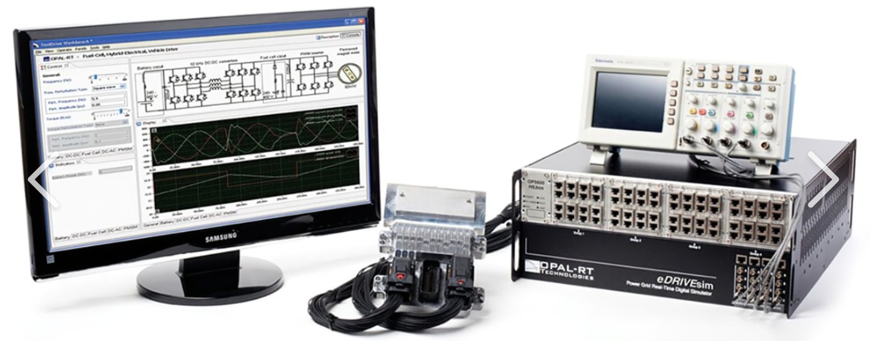
5) Hardware-in-the-Loop (HIL)
HIL environment (Speedgoat, OPAL-RT, or Typhoon, …) bridges the gap between theoretical software models and practical real-world systems by interfacing sensors, actuators, and control systems with the simulated environment to replicate real-world conditions.

Slide 10
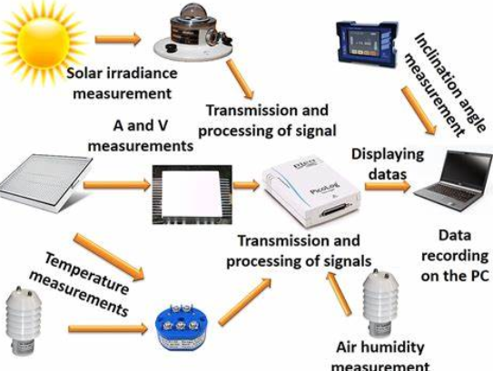
6) Hands-on Experimentation
This practical step reinforces the connection between theory and real-world applications through :
Adjust system parameters and analyze their effects
Validate the developed models
Analyze system response and refine models iteratively
Compare models via metrics

Slide 11
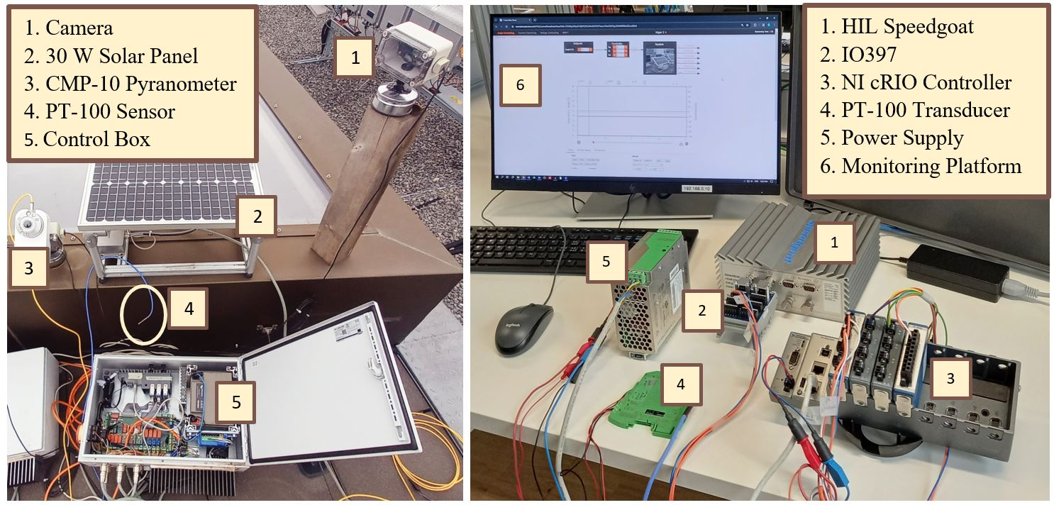
7) Case Study 1: PV System
Hardware-in-the-loop and experimentation setup of a Photovoltaic system
at the University of Applied Sciences Western Switzerland

Slide 12

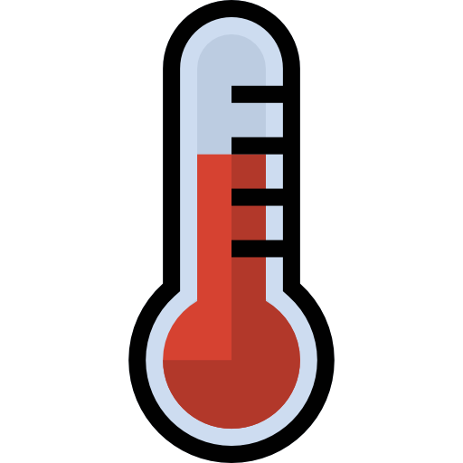
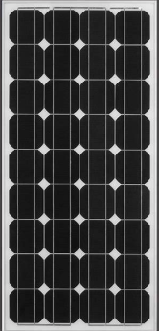
7) Case Study 1: PV System
1
Data Collecting
Data Preprocessing
2
Model Selection
Model Training (based on the appropriate dataset)
3
Model Validation & Testing (Based on unseen Dataset)
Model Evaluation via Metrics (Precision, Accuracy, …)
Data Analysis
Modeling Parameters Tuning for Optimization
Irradiance Ambiant Temperature
Voltage Current

Slide 13

7) Case Study 1: PV System
Simple Model
High Accuracy
Voltage Current
Data-driven Model : ML-Based
(Polynomial Regression)
Measured and estimated voltage and current

Slide 14
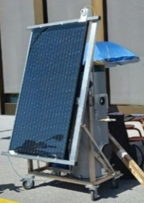
8) Case Study 2: PVT System
Experimentation setup of a Photovoltaic-Thermal system
at the University of Applied Sciences Western Switzerland

Slide 15
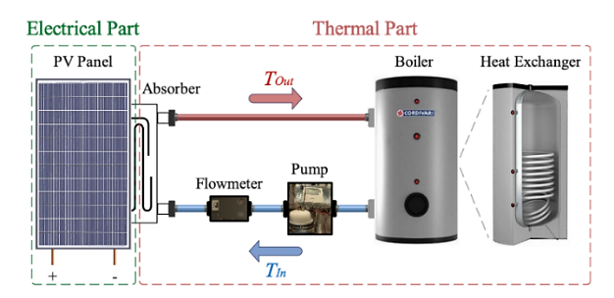
8) Case Study 2: PVT System
1
Data Collecting
2
Models Selection (LSTM, ARMA, PR, …)
3
Models Validation & Testing (Based on unseen Dataset)
Models Evaluation via Metrics (Precision, Accuracy, …)
Models Comparison (Analytical, LSTM, ARMA, PR, …)
Data Preprocessing
Data Analysis
Modeling Parameters Tuning for Optimization
Models Training (based on the appropriate dataset)
Irradiance Ambiant Temperature
Electrical Power Thermal Power

Slide 16
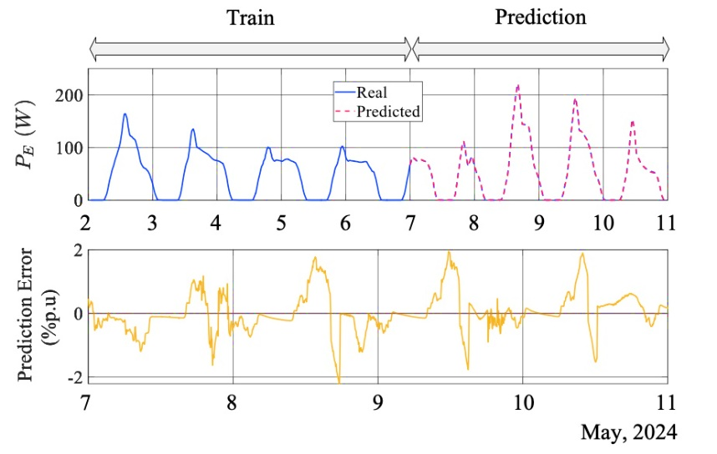
8) Case Study 2: PVT System
Simple Model
High Accuracy
Electrical Power Thermal Power
The trained and predicted electrical power of the studied PVT system in May 2024 (9 days), based on the Data-driven (Polynomial Regression) modeling approach

Slide 17
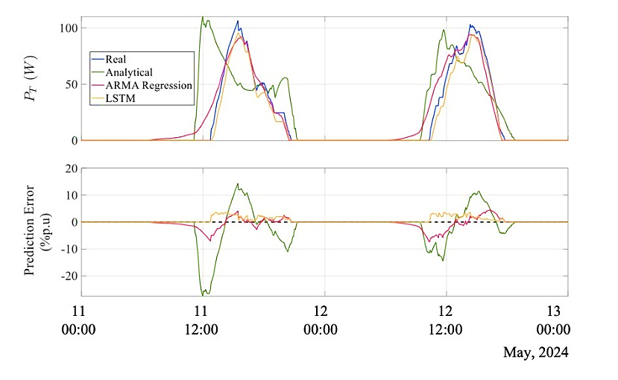

8) Case Study 2: PVT System
Electrical Power Thermal Power
Superior Accuracy of Data-Driven
High Accuracy for LSTM
Low Complexity for ARMA
The comparison of the predicted thermal power of the studied PVT system using analytical and different data-driven modeling approaches, in May 2024 (2 days)

Slide 18
9) Model Limitations and Applicability Scope
Analytical models rely on idealized assumptions that simplify system dynamics but can cause inaccuracies in real-world applications.
Data-driven models like PR, ARMA, and LSTM depend heavily on high-quality training data and are prone to bias and overfitting with limited or poor datasets.
Numerical simulations are limited by fixed initial conditions and environmental inputs, reducing their applicability across different regions or climates.
HIL testing bridges simulation and real experiments but is constrained by hardware and software limitations that may not replicate all real dynamic behaviors.
Experimental validation is essential but affected by disturbances, environmental variability, and equipment limitations, which can introduce uncertainty.

Slide 19
10) Conclusion
The proposed educational framework has the following advantages & limitations :
Advantages :
Enhances student understanding of dynamic systems through a theory-practice blend
Develops critical thinking, problem-solving, and technical skills
Encourages interdisciplinary learning with real-world tools
Limitations :
Simplified analytical models
ML models depend on data quality
HIL testing and Hands-on Experimentation limited by hardware/environmental constraints

Slide 20
11) Future Work
Collect and evaluate student feedback
Assess learning outcomes
Conduct student surveys and assess learning improvements
Refine the framework for broader applicability and impact

Slide 21
Thank you for your attention !
Questions & Feedback fariba.moghaddam@hevs.ch fereshteh.jafari@hevs.ch

