Slide 1
A 3-S (Strength, Stamina, Speed) Model for Medical Education
to Effectively Bridge Teaching and Learning
The Learning Ideas Conference
June 11, 2025
Mangala Sadasivan PhD., Bryan Kelly DO., Mary Hughes DO.
Michigan State University, College of Osteopathic Medicine

Slide 2
A 3-S (Strength, Stamina, Speed) Model for Medical Education
to Effectively Bridge Teaching and Learning
AGENDA
INTRODUCTION AND DISCLAIMER
RATIONAL FOR STUDY
DESCRIPTION OF THE 3-S MODEL – STRENGTH, STAMINA, SPEED
DESIGN OF MODULES (TESTING THE MODEL)
OBJECTIVES OF THE STUDY
METHOD
RESULTS
CONCLUSION AND NEXT STEPS
QUESTIONS
Notes:
Here is the agenda for my presentation

Slide 3
A 3-S (Strength, Stamina, Speed) Model for Medical Education
to Effectively Bridge Teaching and Learning
1. INTRODUCTION
STUDY INVESTIGATORS
DR. MANGALA SADASIVAN, PHD
DR. BRYAN KELLY, DO
DR. MARY HUGHES, DO
ASSOCIATE PROFESSOR
DEPARTMENT OF PSYCHIATRY
DIRECTOR OF PEAK LEARNING CENTER
COLLEGE OF OSTEOPATHIC MEDICINE
MICHIGAN STATE UNIVERSITY
PULMONOLOGIST AND CRITICAL CARE PHYSICIAN
HENRY FORD HEALTH SYSTEMS
FIXED-TERM FACULTY
COLLEGE OF OSTEOPATHIC MEDICINE
MICHIGAN STATE UNIVERSITY
EMERGENCY MEDICINE PHYSICIAN
AFFILIATED WITH MULTIPLE HOSPITAL IN LANSING, MICHIGAN
CHAIR AND PROFESSOR
OSTEOPATHIC MEDICAL SPECIALTIES
MICHIGAN STATE UNIVERSITY
DISCLAIMER: This presentation originated from my Lilly Fellowship Award. Data presented are preliminary and subject to change.
Notes:
Let me introduce myself and my co-collaborators. I’m Dr. Mangala Sadasivan, Associate Professor in the Department of Psychiatry at Michigan State University.
My colleagues are Dr. Bryan Kelly, Pulmonologist and Critical Care Physician at Henry Ford Health Systems and faculty member at MSU.
& Dr. Mary Hughes, Emergency Medicine Physician affiliated with multiple hospitals in the Lansing, Michigan Area. She is also Chair and Professor at MSU.

Slide 4
A 3-S (Strength, Stamina, Speed) Model for Medical Education
to Effectively Bridge Teaching and Learning
2.
RATIONAL
MEDICAL EDUCATION
@MICHIGAN STATE UNIVERSITY
COLLEGE OF OSTEOPATHIC MEDINCE
EXPECTIONS ON STUDENTS ENTERING MEDICAL SCHOOL
EXPECTIONS ON FACULTY TEACHING IN MEDICAL SCHOOL
Notes:
What makes medical school challenging for students at MSU is that they are expected to master large volumes of complex content information in a short window of time.
What makes teaching within the medical curriculum at MSU challenging is that faculty are expected to present volumes of complex content information in logical way from the bottom up (Basic Science to Systems information) in a short time frame.

Slide 5
A 3-S (Strength, Stamina, Speed) Model for Medical Education
to Effectively Bridge Teaching and Learning
CHALLENGES FACED BY STUDENTS & FACULTY IN MEDICAL EDUCATION
STUDENTS
APPROACH LEARNING FOCUSED ON CONTENT
“WHAT TO…”
VOLUME of information
COMPLEXITY of Information
TIME for teaching & learning
FACULTY
APPROACH TEACHING
USING BLOOMS TAXONOMY FOCUSED ON METHODS
“HOW TO…”
Notes:
It became apparent to us quickly that both students and faculty were faced with the same problem.
They had volumes of complex information that they had to master or teach within a short time frame.
In addition, students were approaching learning focused on content “What to…. learn?”
While faculty were approaching teaching using Blooms Taxonomy focused on methods “How to…. learn?”
This connection between the “what” and the “how” was not always apparent to the students. In my opinion, this created a gap between teaching and learning.

Slide 6
A 3-S (Strength, Stamina, Speed) Model for Medical Education
to Effectively Bridge Teaching and Learning
3. DESCRIPTION
3-S MODEL
END GOAL : PASS THEIR COMLEX BOARD EXAMINATION
DESIGN : 3- S MODEL (BUILDING STRENGTH, DEVELOPING STAMINA, INCREASING SPEED)
OBJECTIVE : USE THE 3- S MODEL TO TRAIN STUDENTS IN CRITICAL THINKING SKILLS
HYPOTHESIS : USING THIS MODEL, WE CAN EFFICIENCTLY PREPARE STUDENTS FOR BOARD EXAMINATIONS AND SIMULTANEOUSLY BRIDGE THE GAP BETWEEN TEACHING, LEARNING.
Notes:
To bridge this gap between teaching and learning we began with the End Goal. Here the End Goal was for students to Pass their Board Examinations.
We then asked the Q “How do we train students to meet this goal?”
Searching the Literature widely, we realized that students needed to develop skills in critical thinking to meet this goal.
Then drawing from the literature on “Skill building - we found that
1. – student must build strength of content knowledge,
2. - develop stamina for this content and
3. - increase speed of access for this content to solve critical problems.
This provided the rubric to design the 3-S Model for Medical Education.
So, our objective for this study was to use this model to train students in critical thinking. Our hypothesis was that “using this model not only can we efficiently and effectively prepare students for their board examinations, but we can simultaneously bridge the gap between teaching and learning

Slide 7
A 3-S (Strength, Stamina, Speed) Model for Medical Education
to Effectively Bridge Teaching and Learning
END GOAL : STUDENTS WILL PASS THEIR COMLEX BOARD EXAMINATION
SKILLS NEEDED TO MEET THIS END GOAL
1. STRENGTH OF BASIC SCIENCE AND/OR FOUNDATIONAL KNOWLEDGE
2. STAMINA TO RETAIN THAT KNOWLEDGE LONG TERM
3. SPEED OF ACCESS FOR THAT KNOWLEDGE WHEN PRESENTED WITH A
CLINICAL PROBLEM.
Notes:
Now that we had our end goal.
We studied the blueprint for this exam.
We know the students need to develop this specific skill in critical thinking to meet this end goal.
We broke down this skill into three component parts. – Students must build strength of content knowledge, develop stamina for that content and then build speed of access for that knowledge when presented with a clinical scenario.

Slide 8
A 3-S (Strength, Stamina, Speed) Model for Medical Education
to Effectively Bridge Teaching and Learning
END GOAL : STUDENTS WILL PASS THEIR COMLEX BOARD EXAMINATION
SKILLS NEEDED - STRENGTH, STAMINA, SPEED
SUB-GOALS | METHOD
BUILDING STRENGTH | SELF-DIRECTED LEARNING
DEVELOPING STAMINA | CASE-BASED LEARNING
INCREASING SPEED | QUESTION-BASED LEARNING
Notes:
Then our next step was to take the three components and go back to the literature to identify the best method to get the job done.
What we found was that
1. Self-Directed learning was best utilized for building strength,
2. Case-based learning for developing stamina and
3. Q-Based learning to increase speed of access for the content knowledge

Slide 9
A 3-S (Strength, Stamina, Speed) Model for Medical Education
to Effectively Bridge Teaching and Learning
4.
DESIGN OF MODULES
(TESTING THE MODEL)
RESPIRATORY COURSE
3 MODULES
HYPOXEMIA
ASTHMA/COPD
PLEURAL DISEASES
SCHEMATIC FOR EACH MODULES
STRENGTH
STAMINA
SPEED
PRE-TEST 1ST ATTEMPT
POST-TEST 1ST ATTEMPT
ATTACH BASIC SCIENCE
TO A BRIDGE (TEMPLATE)
PRACTICE RETRIEVAL
WITH COACHING
PRE-TEST UNLIMITED
POST-TEST UNLIMITED
SELF-DIRECTED
LEARNING
CASE-BASED
LEARNING
QUESTION-BASED
LEARNING
Notes:
Dr. Kelly and Dr. Hughes both teach within the Respiratory course at MSUCOM so testing the application of this model within this course was logical.
This is also the very last course that students take before they take their boards.
However, the course involves many instructors, so to keep it manageable we asked our two faculty to identify three major topics that they could create into modules and come up with the schematic (or bridge) that they could use to teach that content.
They picked Hypoxemia (content delivered before the first exam), Asthma/COPD (content delivered before the 2nd exam) and Pleural diseases (content delivered before the 3rd exam).
We also have baseline data on the students in terms of their Quintile ranking (1 being high and 5 being low) in the class at the start of the Respiratory course.
Using the schematic and content provided by the faculty and with the help of a student team, we create self-directed learning activity to coach students on memorizing basic science content and simultaneously coached them on how to annotate information onto the schematic (providing context) to build stamina for that content.
Faculty was also provided a specific template to write board style questions that I could use to train the students in test-taking skills to build speed of access for their content knowledge.

Slide 10
A 3-S (Strength, Stamina, Speed) Model for Medical Education
to Effectively Bridge Teaching and Learning
TEAM MEMBERS
STUDENT TEAM
LEARNING SPECIALIST
FACULTY TEAM
A LEAD STUDENT WHO COMPLETED THE COURSE THE YEAR BEFORE AND STUDENT VOLUNTEERS WITHIN THE CLASS
DR. MANGALA SADSIVAN
DR. BRYAN KELLY
DR. MARY HUGHES
OTHER BASIC SCIENCE FACULTY
TECH/MEDIA/DESIGN/STAT TEAM
MSU STAFF PROVIDED SUPPORT AS NEEDED
Notes:
With the Model in place, we created a more elaborate team for implementation. We had a student team to provide feedback and faculty team to create materials. We had Tech, media, design and stat on standby.

Slide 11
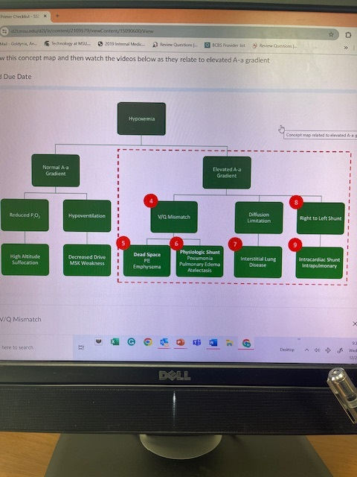
A 3-S (Strength, Stamina, Speed) Model for Medical Education
to Effectively Bridge Teaching and Learning
SCHEMATIC
Dr. DiCarlo’s Material integrated
Ch 5- Pulmonary Gas Exchange I
Ch 2- Pulmonary Mechanics I
Ch 5- Pulmonary Gas Exchange II (Emphysema)
Ch 3- Pulmonary Ventilation II & I (flow-volume loops/dead
space)
Ch 1- Basic Concepts I & II (Pneumothorax & Pleural effusion)
Ch 5- Pulmonary Gas Exchange II (Pulmonary edema))
Ch 2- Pulmonary Mechanics II (Atelectasis prevention)
Notes:
Here is an example of a schematic – this is Hypoxemia.
Students are instructed on where to annotate specific content (providing context for the bs knowledge) which will be useful to them when the instructor (Dr. Kelly) teaches his clinical content on Hypoxemia.
In addition, students had to show mastery of the basic science content through pre-tests formatted within their self-directed learning objectives.
This SD exercise was completed immediately before Dr. Kelly presented his lecture using the same schematic.
After his lecture, once again students completed post-tests to show mastery of the content linking the basic science to the clinical information.
Finally, to address Speed training, students attended group coaching session focused on efficiency to access stored content using my board prep template.

Slide 12
A 3-S (Strength, Stamina, Speed) Model for Medical Education
to Effectively Bridge Teaching and Learning
5.
OBJECTIVES
OBJECTIVES OF THE STUDY
BRIDGE THE GAP BETWEEN TEACHING AND LEARNING USING THE 3-S MODEL.
TRAIN STUDENTS IN CRITICAL THINKING SKILLS (STRENGTH, STAMINA, SPEED) USING THE MODEL.
ULTIMATE GOAL TO INCREASE BOARD SCORES.
Notes:
Our Objectives are to Bridge the Gap, train the students in the critical thinking skills and hopefully meet our goals to increase board scores.

Slide 13
6.
METHOD
A 3-S (Strength, Stamina, Speed) Model for Medical Education
to Effectively Bridge Teaching and Learning
QUASI EXPERIMENTAL STUDY DESIGN
SUBJECTS – MEDICAL STUDENTS ENROLLED IN THE FINAL SYSTEMS COURSE - RESPIRATORY
- ALL STUDENTS SERVED AS THEIR OWN CONTROLS.
DATA COLLECTION – SCORES ON EXAMS 1, 2, 3, & COMPREHENSIVE FINAL EXAM
& COMLEX LEVEL I BOARD SCORES.
ALL EXAMS HAD QUESTIONS FROM THE MODULES WHICH WE TAGGED AS
LILLY ITEMS AND QUESTIONS FROM OTHER INSTRUCTORS WE TAGGED AS
NON-LILLY ITEMS.
INCENTIVES – PROVIDED IN THE FORM OF POINTS TOWARDS FINAL GRADE
REASON FOR INCENTIVES – MODEL IS UNFAMILIER TO STUDENTS (WE WANTED THEM FOCUS)
Notes:
METHOD – SEE SLIDE

Slide 14
A 3-S (Strength, Stamina, Speed) Model for Medical Education
to Effectively Bridge Teaching and Learning
RESEARCH
QUESTIONS
  1. DO STUDENTS PERFORM BETTER ON LILLY ITEMS COMPARED TO
NON-LILLY ITEMS ON EXAMS 1, 2, 3 and FINAL EXAM?
2. HOW DOES THIS DIFFERENCE BETWEEN LILLY AND NON-LILLY
ITEMS PLAY OUT IN TERM OF A STUDENT’S QUINTILE
RANKING?
3. HOW DOES THIS DIFFERENCE PLAY OUT ON LEVEL 1 BOARD EXAMS?
Notes:
To test our model,
we looked at all 3 exams, the final comprehensive exam scores and the COMLEX Level I Board Exam Scores.
Each exam contained module items taught by Dr. Kelly that we tagged as Lilly items and other content taught by other faculty within the course which we tagged as non-Lilly items.

Slide 15
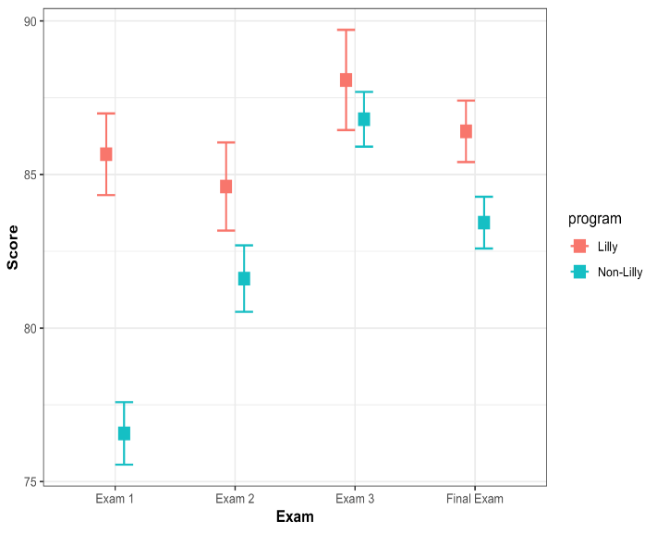
A 3-S (Strength, Stamina, Speed) Model for Medical Education
to Effectively Bridge Teaching and Learning
7.
RESULTS
Mean Comparisons – Exam 1, 2, 3 & Final
Figure 1 Average scores for LILLY and NON-LILLY items on each exam, with a 95% confidence internal
Notes:
RESULTS – MEAN COMPARISONS

Slide 16
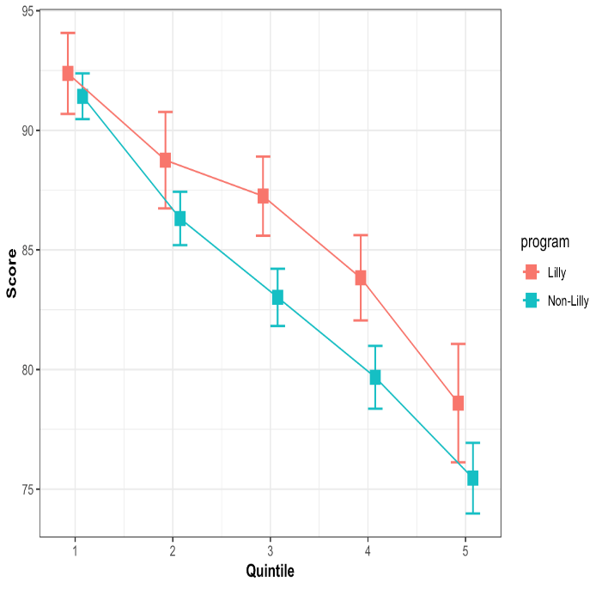
A 3-S (Strength, Stamina, Speed) Model for Medical Education
to Effectively Bridge Teaching and Learning
Mean Final Exam score by Quintile
Figure 2: Comparisons of mean Final Exam scores by Quintile
Notes:
RESULTS – QUINTILE RANKING

Slide 17
A 3-S (Strength, Stamina, Speed) Model for Medical Education
to Effectively Bridge Teaching and Learning
COMLEX LEVEL 1 DATA
Table 1: Distribution of COMLEX 1 results
COMLEX Level 1 Result | Number of Students
FAIL | 29
NO SCORE | 10
PASS | 265
Notes:
RESULTS – COMLEX LEVEL I DISTRIBUTION P/F

Slide 18
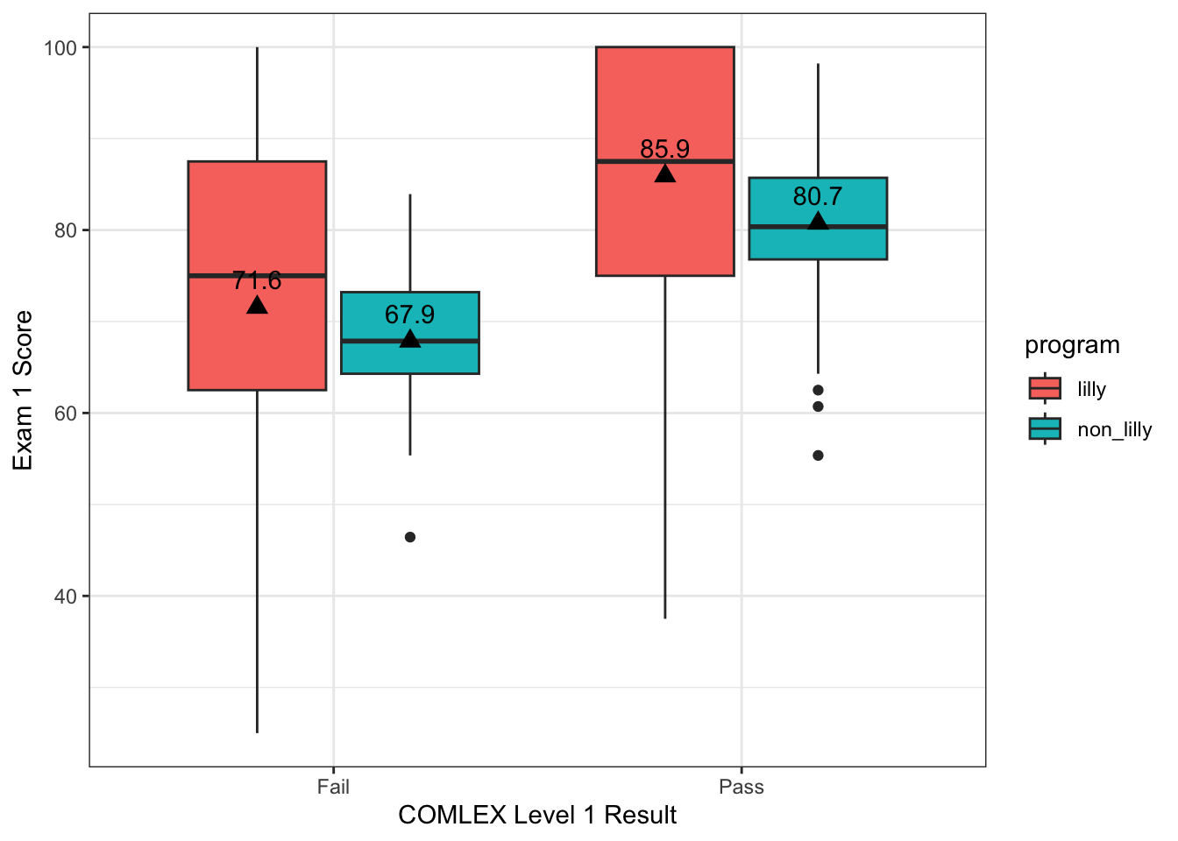
A 3-S (Strength, Stamina, Speed) Model for Medical Education
to Effectively Bridge Teaching and Learning
COMLEX LEVEL 1 DATA
Figure 5: Final exam scores by COMLEX 1 Pass/Fail
Notes:
RESULTS – FINAL EXAM SCORES BY COMLEX P/F

Slide 19
A 3-S (Strength, Stamina, Speed) Model for Medical Education
to Effectively Bridge Teaching and Learning
ODDS RATIO
Logistic Regression for COMLEX Pass/Fail
 | COMLEX I
Predictors | Odds Ratios | CI | p
(Intercept) | 0.02 | 0.00 – 0.29 | 0.005
final exam (Lilly scores) | 1.09 | 1.05 – 1.13 | <0.001
Observations | 274
R² Tjur | 0.083
A Higher score (on Lilly items) within the Final Exam increased the odds of the student passing the Complex Level 1 Exam
Notes:
RESULTS – LOGISTIC REGRESSION for COMLEX P/F

Slide 20
A 3-S (Strength, Stamina, Speed) Model for Medical Education
to Effectively Bridge Teaching and Learning
8.
CONCLUSION
CONCLUSIONS
  THE 3-S MODEL USING A BRIDGE SEEMS TO EFFECIENTLY CONNECT TEACHING
  AND LEARNING.
  ALTHOUGH THIS IS PRELIMINARY DATA AND MUST BE VIEWED WITH CAUTION,
  BASED ON THE ODD’S RATIO DATA, THE FINAL EXAM SCORES RELATED
  TO THE MODULES WITHIN THIS COURSE MAYBE USEFUL IN
  IDENTIFYING STRUGGLING STUDENT EARLY TO PROVIDE
  COACHING TO PREPARE THEM FOR BOARDS.
Notes:
CONCLUSIONS

Slide 21
A 3-S (Strength, Stamina, Speed) Model for Medical Education
to Effectively Bridge Teaching and Learning
NEXT STEPS
RECOMMENDATIONS
1. CREATE MORE MODULES WITHIN THE RESPIRATORY COURSE THAT LEND THEMSELVES
WELL TO USE WITH THE MODEL.
2. RECRUIT OTHER FACULTY TO TEST OUT THE 3-S MODEL FOR SPECIFIC MODULES WITHIN
THEIR COURSES
3. RECRUIT AND TRAIN FACULTY TO WRITE QUESTIONS WITHIN MODULES USING OUR TEMPLATE
SPECIFIC TO THEIR COURSES.
COLLECT MORE DATA TO VALIDATE THE VALUE OF THIS MODEL FOR MEDICAL EDUCATION
5. GET FEEDBACK USING A QUESTIONNAIRE TO SEE HOW STUDENTS PERCEIVE THEIR PREPAREDNESS
FOR BOARDS USING THE MODEL.
Notes:
RECOMMENDATIONS – NEXT STEPS

Slide 22

A 3-S (Strength, Stamina, Speed) Model for Medical Education
to Effectively Bridge Teaching and Learning
9.
QUESTIONS
QUESTIONS
THANK YOU
Notes:
QUESTIONS

