Slide 1
Integrating Generative AI in Active Learning:
A Case Study in Project Management Education
Matti Koivisto Ph.D.
South-Eastern Finland University of Applied Sciences

Slide 2

Passive and active learning
Learning can happen in many forms
These forms are typically divided into two methods
  Passive learning: “ a form of learning that relies on information transmission from a teacher to a learner with little two-way interaction and the learner is required to absorb rather than act on knowledge” [1]
  Active learning: “an instructional activity involving students in doing things and thinking about what they are doing [7]".

Slide 3
Examples of the active learning methods
Focus of
the study

Slide 4
Case study method
An instructional approach that uses real-world or simulated scenarios to encourage students to apply their knowledge, analyze complex issues, and develop problem-solving skills.
Key features:
  Realistic context: Situation that mimics real-life challenges.
  Multiple perspectives: Cases involve multiple stakeholders.
  Critical thinking: Students must identify problems, evaluate options, and justify their recommendations.
  Collaborative learning: Often done in groups, promoting teamwork and communication skills

Slide 5
Questions of interest:
How to adapt and integrate new technologies into classroom teaching?
How can we use generative AI together with a case study method?

Slide 6

Technology adaptation and utilization
Information Systems (IS) researchers have for decades investigated the factors and processes that affect how users adopt and utilize information technology.
They have primarily employed two approaches [19] :
  information system success and
  technology acceptance
Both approaches aim to understand why users accept or reject information systems and how system design features impact user acceptance, though they use different methods to achieve this.

Slide 7

Information system success
IS success studies typically examine the system's effects at either the organizational or individual level.
At the organizational level, success is often gauged by economic indicators like return on investment or payback time.
At the individual level, many researchers measure IS success through user satisfaction.
However, user satisfaction alone is a weak predictor of system use [19] and it should be used together with other dimensions of suc-cess, such as system use, system quality, and benefit constructs

Slide 8

Technology acceptance
Techology acceptance approach has produced several competing models, each identifying different determinants of acceptance.
Notable examples include
  Innovation Diffusion Theory [20],
  Technology Acceptance Model [21], and
  Theory of Reasoned Action [22].
These models generally link individual reactions and intentions to the actual use of the information system [23].
In the empirical part of the study a modified version of TAM was used

Slide 9
Technologies and education
The integration of new technologies in education has been widely studied.
Typically, these studies use some traditional technology acceptance model like TAM as a starting point and extend or modify it in some way.
However, there are two main challenges to apply TAM to education.
  First, although students are the actual users of the technology, they do not decide tools and exercises but teachers make the decisions for them.
  Second, there has been a significant shift in higher education from traditional content-focused instruction to outcome-driven learning [27]. As a result, the teaching methods and technologies used are not goals but are merely tools for achieving the learning goals.

Slide 10
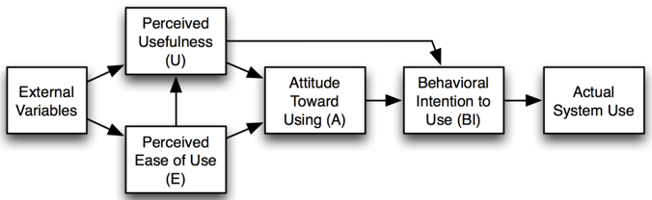
Technology acceptance model (TAM)
Elements used in this study

Slide 11

Study design

Slide 12

Design principles
The exercise used in the study was design according to the educational development method known as backward design [28] which consists of three stages [27]:
  Identifying desired learning goals
  Determining the method to evaluate and assess learning and
  Planning learning activities and content.

Slide 13

Learning goals
Students who participated in the exercise were told the following direct goal:
  Try to find out the status of the project by efficient communication with the AI-based project manager.
However, the indirect or hidden goal of the exercise was to identify the strengths and weaknesses of participants own conversation style as a manager.

Slide 14

Methods to evaluate learning
The achievement of the direct goal was analyzed using three methods:
  Self-assessment,
  Teacher assessment and
  AI feedback
The AI was used to give qualitative feed back on strengths and weaknesses of the student’s conversation style as a manager.

Slide 15
Communication style evaluation
The strengths and weaknesses of the students' conversations were analyzed using a deductive content analysis based on three dimensions of the International Project Management Association’s Individual Competence Baseline [31]:
  Contextual competences which focus on the broader context in which the work takes place.
  People competences which emphasize the soft skills like leadership, team-work, and communication
  Practice competences which cover the hard management skills like meth-ods, tools and techniques used in project management to implement them successfully.

Slide 16





Learning activity
Meeting with
the project
manager
Discussion
Meeting with
the project
manager
Writing
a report
Evaluation
and feedback
Instructions
A week
later:
Teacher’s
evaluation
and
feedback
Aim,
structure,
tools
Project
status
after
5 weeks
Traffic
lights,
findings
Project
status
after
7 weeks
Students’
feedback
and their
view on
the project
Self-
evaluation
and AI feedback

Slide 17

Demonstration
Demo App

Slide 18
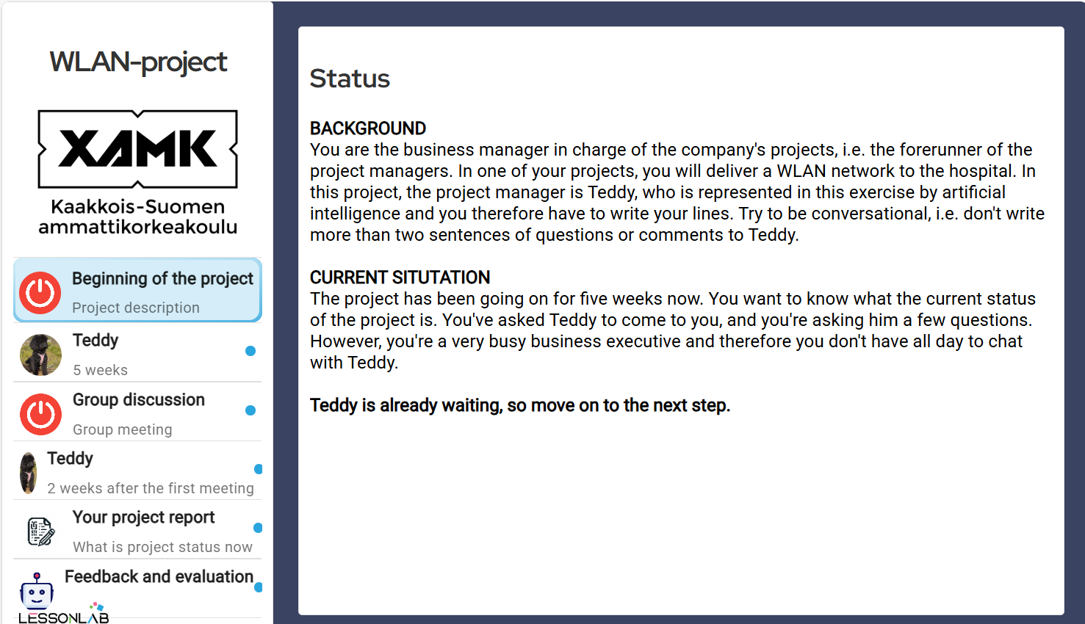

Slide 19
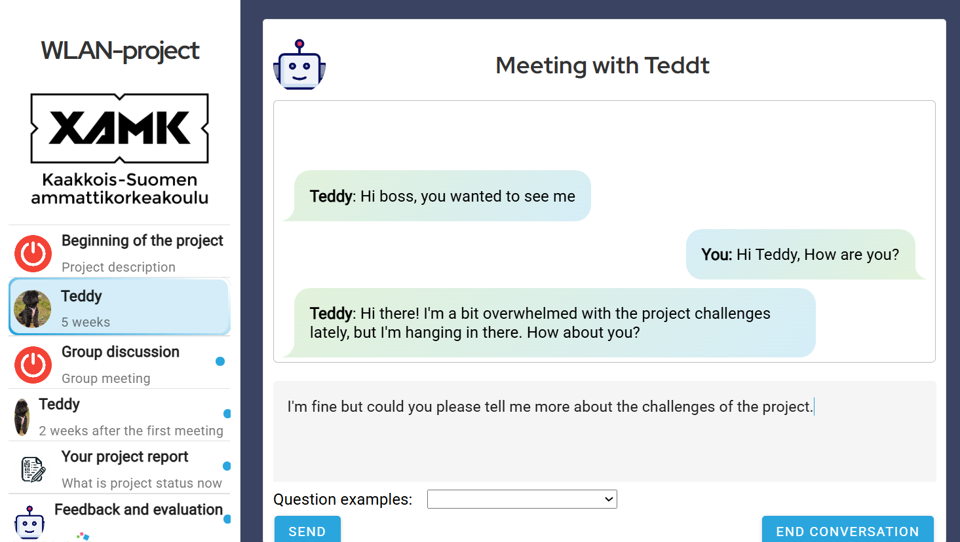


Slide 20
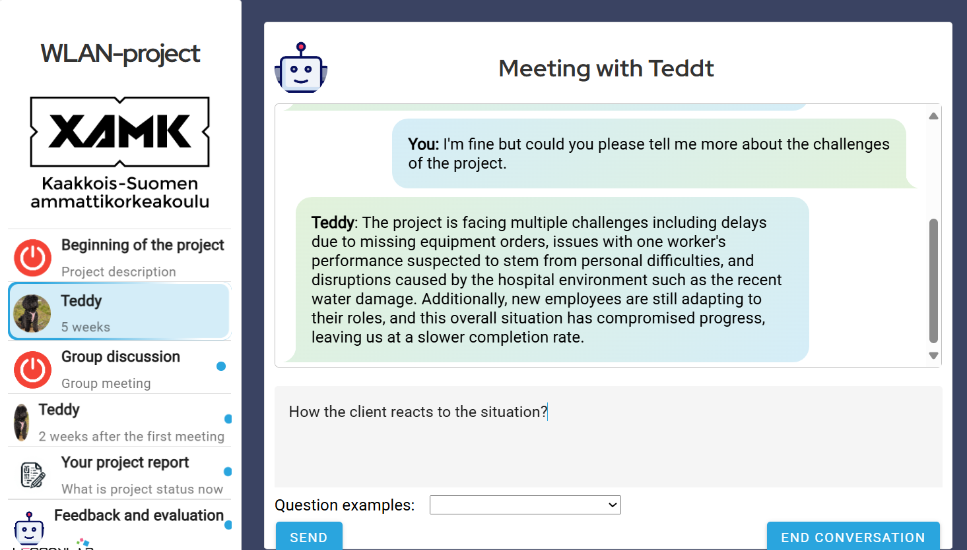

Slide 21
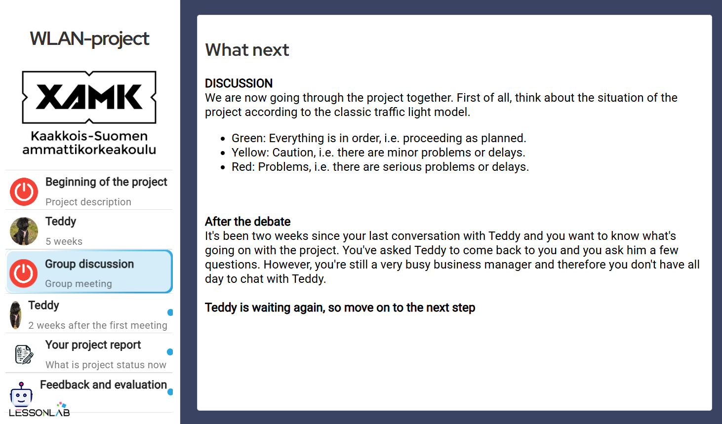

Slide 22
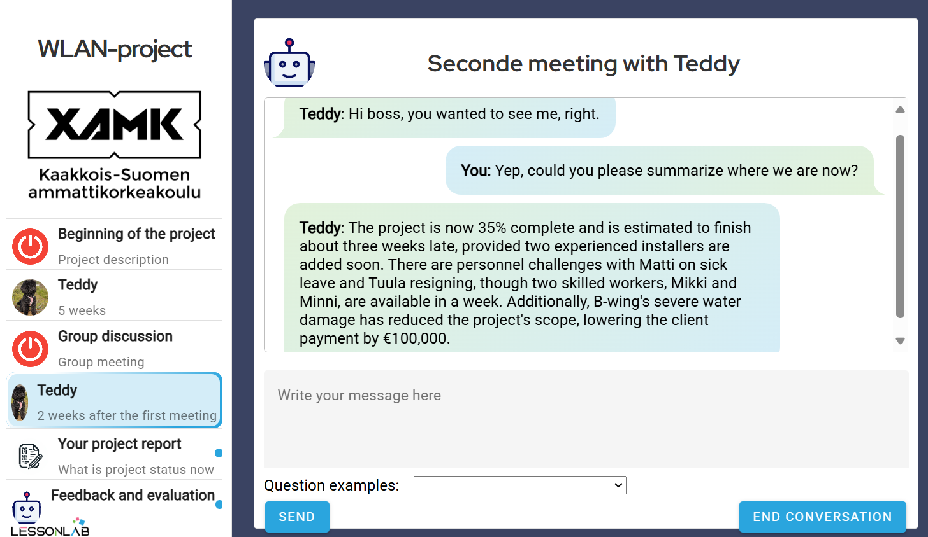


Slide 23
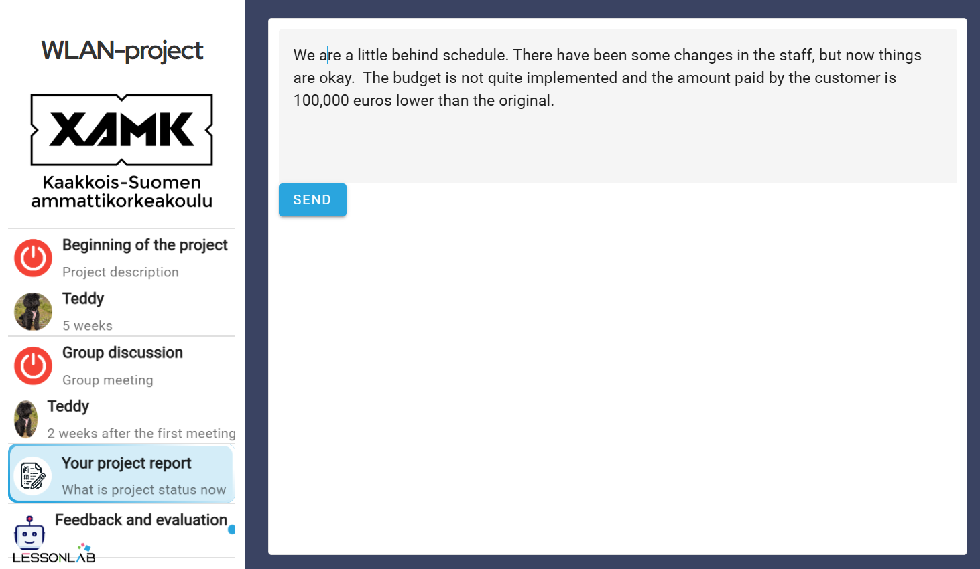

We are a little behind schedule. There have been some changes in the staff, but now things are okay. The budget is not quite implemented and the amount paid by the customer is 100,000 euros lower than the original.

Slide 24
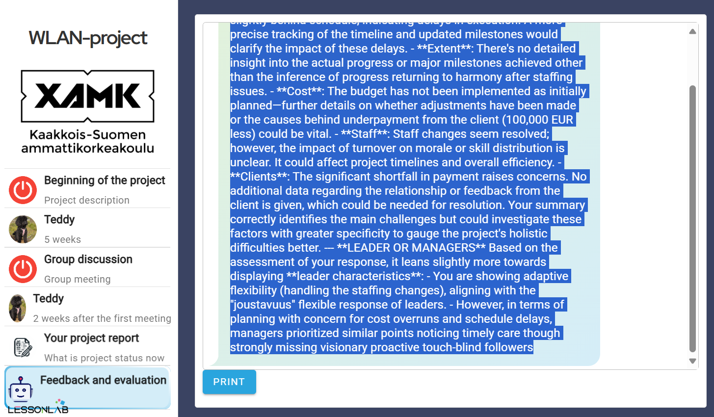

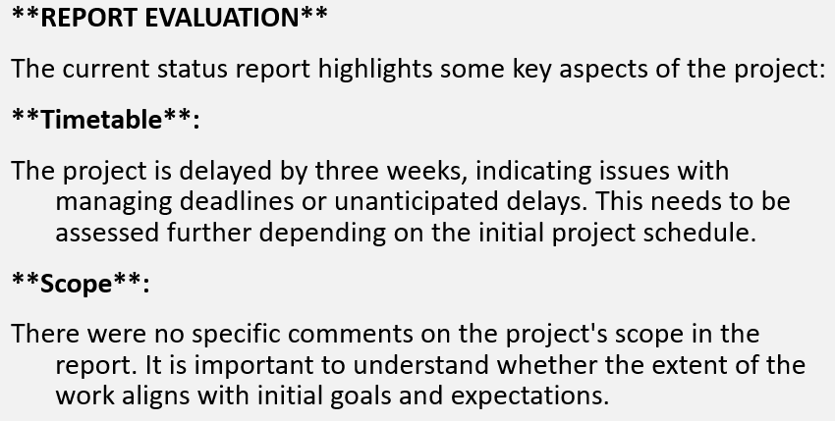

Slide 25

Results

Slide 26
Findings on teacher’s and self-evaluation or grading
The achievement of the learning goals of the exercise was analyzed using learners' self-assessment and the grades given by the teacher on a scale of 1–5.
  The average self-assessment score was 3.74 (SD 0.59),
  The average teacher's grade was 3.63 (SD 0.66).
Results indicate that both the students and the teacher felt that the students were able to determine the status of the project well (verbal equivalent for grade 3) or very well (verbal equivalent for grade 4).

Slide 27
Findings on technology acceptance
Based on a feedback questionnaire
The results suggest that in the AI-based active learning exercise, perceived usefulness significantly influences students' attitudes, unlike ease of use.
This observation likely indicates that the benefits of a learning task shape students' attitudes towards it, and they do not expect to learn without effort.

Slide 28
Findings on communication style
The majority of students concentrated more on the technical aspects of the project, such as time, costs, and scope, rather than on people or “bigger picture”.
  This might be typical for us engineers ☺

Slide 29
Conclusions
The results indicated that perceived usefulness significantly influenced students' attitudes towards the exercise*, while ease of use had no impact.
Both students and teachers felt that the exercise helped to achieve the direct learning goals of the exercise.
The findings on the strengths and weaknesses of students' conversation styles with the AI project manager, highlighting the importance of both technical and soft skills in successful project management.
* Statistically significant (p=.05).

Slide 30
References 1/2
1. Drew, C.: 11 Examples of passive learning. http:// https://helpfulprofessor.com/, last ac-cessed 2025/03/07.
2. UC Berkeley Center for Teaching and Leaning Homepage. https://teaching.berkeley.edu/teaching-guides-resources/teaching-your-course/active-learning, last accessed 2025/03/07.
3. Mamombe, C. and Mathabathe, K.C. Active versus passive learning: Comparative case study of problem-solving competencies in stoichiometry. Eurasia Journal of Mathemat-ics, Science and Technology Education 20(6), (2024).
4. Kevin A. Nguyen, K. A., Borrego, M., Finelli, C. J., DeMonbrun, M., Crockett, C., Tharayil, S., Shekhar, P., Waters, C. and Rosenberg, R.: Instructor strategies to aid im-plementation of active learning: a systematic literature review. International Journal of STEM Education 8(9), 1-18 (2021).
5. Freeman, S.; Eddy, S.L.; McDonough, M.; Smith, M.K.; Okoroafor, N.; Jordt, H.; Wenderoth, M.P. Active learning increases student performance in science, engineer-ing, and mathematics. In Proceedings on. National Academy of Science. USA (2014).
6. McConnell, D. A., Chapman, L., Czajka, D., Jones, J. P., Ryker, K. D. and Wiggen. J.: Instructional utility and learning efficacy of common active learning strategies. Journal of Geoscience Education 65, 604–625 (2017).
7. Bonwell, C.C., and Eison, J.A. Active learning, creating excitement in the classroom. ASHE-ERIC Higher Education Report No. 1. Washington, DC: The George Washing-ton University, School of Education and Human Development. (1991).
8. Fink, L.D. Creating significant learning experiences. San Francisco, CA: Jossey-Bass. (2003).
9. Freeman, S., Eddy, S.L., McDonough, M., Smith, M.K., Okoroafor, N., Jordt, H., and Wenderoth, M.P. Active learning increases student performance in science, engineer-ing, and mathematics. In Proceedings of the National Academy of Sciences, 111:8410–8415. (2014).
10. Ghilay, Y. and Ghilay, R.: TBAL: Technology-based active learning in higher educa-tion. Journal of Education and Learning; 4(4), 10-18 (2015).
11 Adi, D. P. Introverted and extroverted students' learning attitude in Chinese speaking class. In Proceedings of the Fifth Prasasti International Seminar on Linguistics. (2019).
12. Laal, M. and Laal, M. Collaborative learning: what is it? Social and Behavioral Sciences 31 491 – 495 (2012) .
13. Hurmuzan. S.: A review of brainstorming techniques in higher education. Thinking Skills and Creativity 27, 78-91 (2018).
14. Gerring, J. What is a case study and what is it good for? American Political Science Review 98(2), 341-354 (2004).
15. Savery, J. Overview of problem-based learning: Definitions and distinctions. Interdisci-plinary Journal of Problem-based Learning 1. (2006)

Slide 31
References 2/2
16. University of New South Wales: Simulations. https://www.teaching.unsw.edu.au/simulations last accesses 2025/03/09
17. Låg, T. and Saele, R. G.: Does the flipped classroom improve student learning and aat-isfaction? A systematic review and meta-analysis. AERA Open 5(3), 1–17 (2019).
18. McMahon, K. Peer teaching: Overview, benefits & models. https://www.togetherplatform.com/blog/peer-teaching-overview-benefits-models. last visited 2025/9/3.
19. Wixom B. and Todd P. A theoretical integration of user satisfaction and technology ac-ceptance, Information Systems Research, 16(1), 85-102 (2005).
20. Rogers E. Diffusion of innovations (4th ed.), The Free Press. New York, USA (1995).
21. Davis F. Perceived usefulness, ease of use, and user acceptance of information tech-nology, MIS Quarterly, 13(3), 319 – 340 (1989).
22. Fizbein M. and Ajzen I. Belief, attitude, intention, and behavior: An introduction to theory and research. Addison-Wesley, Reading, USA (1975)
23. Venkatesh V., Morris M., Davis G., and Davis F.: User acceptance of information tech-nology: Toward a unified view, MIS Quarterly, 27(3), 425 – 478 (2003).
24. Park, S. Y., Nam, M.-W. and Cha, S-B.: University students' behavioral intention to use mobile learning: Evaluating the technology acceptance model. British Journal of Educational Technology 43(4), 592-605 (2012.).
25. Shyr, W-J., Wei, B-L. and Liang, Y-C.: Evaluating students’ acceptance intention of augmented reality in automation systems using the technology acceptance model. Sus-tainability 16(5), (2024).
26. Al-Emran, M.: Evaluating the use of smartwatches for learning purposes through the integration of the technology acceptance model and task-technology fit. International Journal of Human-Computer Interaction 37(19), 1874-1882 (2011).
27. Lungu, J.: Backward design – an innovative instructional model in planning higher ed-ucation courses. Bulletin of the Transilvania University of Braşov, Series VII: Social Sciences 17(66) (2024)
28. Wiggins, G. and McTighe, J.: Understanding by design 2nd ed. Alexandria, VA: Asso-ciation for Supervision and Curriculum Development (2005).
29. Pahi, K., Hawlader, S., Hicks, E., Zaman, A. and Phan, V.: Enhancing active learning through collaboration between human teachers and generative AI. Computers and Edu-cation Open. 6 (2024).
30. University of Oxford. Centre for Teaching and Learning: An introduction to writing ef-fective learning outcomes. https://www.ctl.ox.ac.uk/effective-learning-outcomes last visited 2025/03/09.
31. International Project Management Association: Individual Competence Baseline for Project Management version 4.0 (2015).

