Slide 1
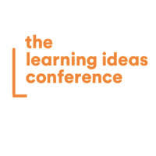
Tourism Employees' Well-Being: An Innovative Educational Framework Integrating the PERMA Model of Well-Being and Transformative Learning
Sofia Kallou, Aikaterina Kikilia,
Michail Kalogiannakis, Dimitrios Papachristos
May 29th 2025
New York

Slide 2
Contents
1. Introduction-Objective of the Study
2. Literature Review
3. Methodology
4. Discussion
5. Conclusions
6. Future Research

Slide 3
Introduction (1)
Researchers have focused considerable attention on psychological well-being
happiness
performance
motivation
commitment

Slide 4
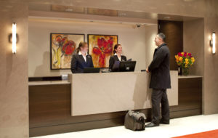
Introduction (2)
There has been little focus on the well-being of employees within the tourism sector
Prioritizing tourism employees' well-being has become essential
This study addresses a gap by proposing an educational framework for enhancing the well-being of tourism employees

Slide 5



The objective of the study
The main objective of this study is to propose an educational framework for well-being in tourism education and training based on the PERMA model integrating TL and digital educational technologies.

Slide 6

The Importance of Wellbeing in the Tourism Sector
There is insufficient research on the well-being of tourism employees.
Employee well-being
engagement
job satisfaction
mental health
productivity

Slide 7

Positive Psychology and Seligman’s PERMA Model (1)
Positive Psychology has emerged as a field dedicated to enhancing human behavior by concentrating on and promoting:
strengths,
positive emotions,
accomplishments

Slide 8
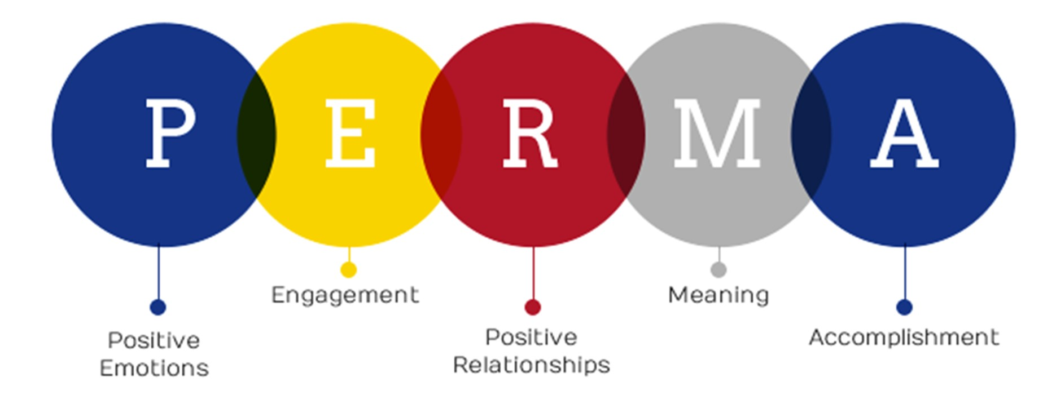
Positive Psychology and Seligman’s PERMA Model (2)

Slide 9
Positive Psychology and Seligman’s PERMA Model (3)
Positive emotions
Emotional well-being
Job satisfaction
Engagement
Commitment to achieve goals
Concept of flow
Relationships
Positive relationships
Reduced stress level
Reduce feelings of loneliness, anxiety
Meaning
Accomplishment
Sense of purpose
Reduces negative emotions, stress
Achieving goals
Success
Enhance well-being

Slide 10

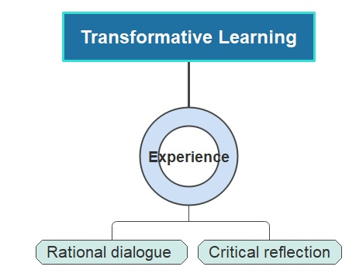
Transformative Learning Theory in Tourism Education
Learner-centered
Active participation
Enhanced educational experience

Slide 11
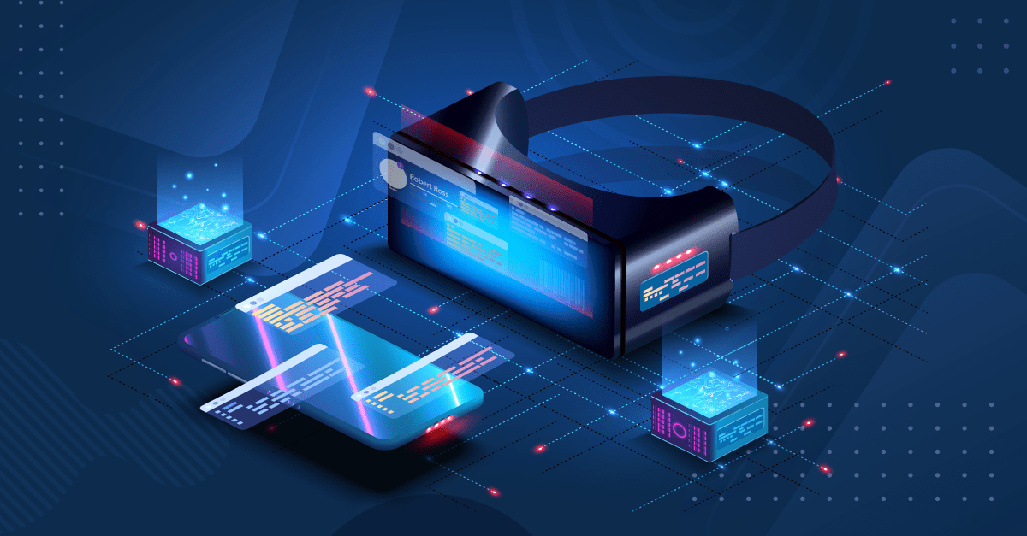
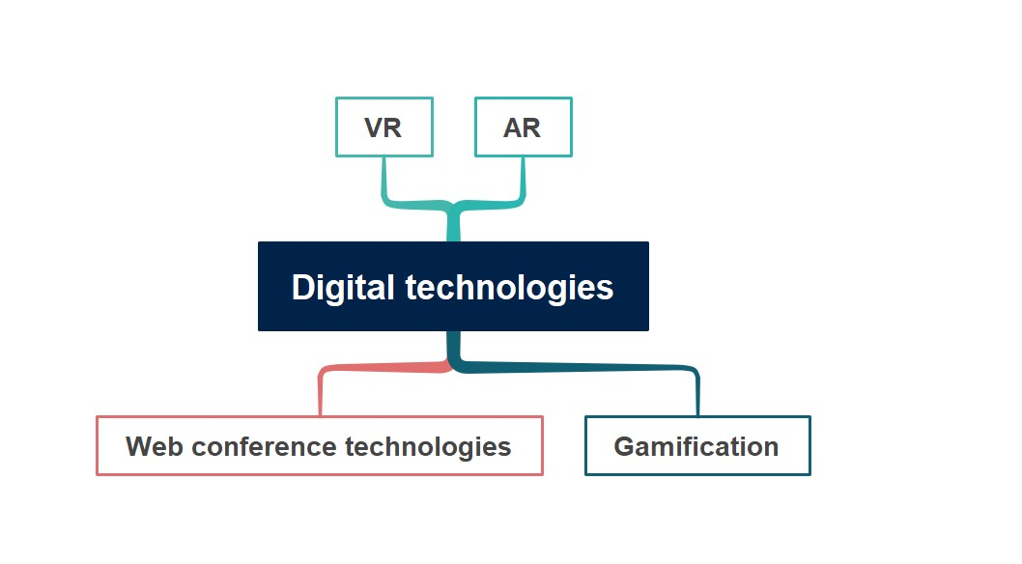

Digital learning environments and tourism education
Flexibility
Learning outcomes
Emotional experiences

Slide 12
Methodology (1)
Conceptual Educational Framework
The PERMA well-being educational framework aims to:
introduce learners to the key components of well-being,
promote positive emotions and nurture healthy relationships,
equip learners with practices that enhance their overall well-being.

Slide 13
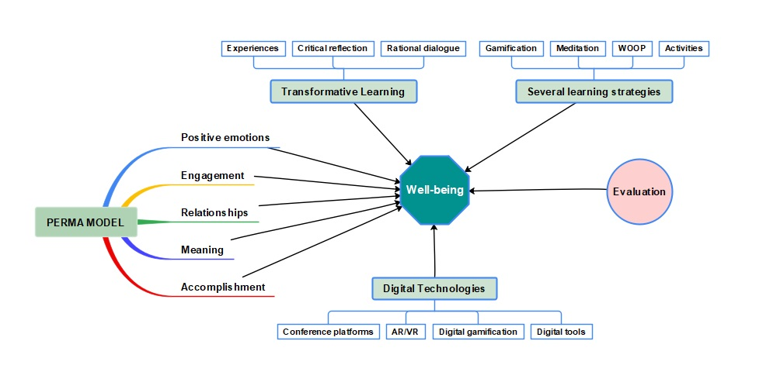
Methodology (2)
The well-being educational framework in tourism education and training

Slide 14
Methodology (3)
Strategies of the proposed educational program
PERMA model | Positive emotions
Strategies based on TL | -Critical questions about emotions and well-being -Emotional intelligence training intervention -Positive reframing and expressing gratitude
Several learning strategies | -Sharing positive stories -Incorporating enjoyable activities online -Resilience training
Digital Technologies & tools | Conference platforms, virtual teams, quizzes, e-books
Techniques | Presentation, teamwork, brainstorming, projects

Slide 15
Methodology (4)
Strategies of the proposed educational program
PERMA model | Engagement
Strategies based on TL | -Critical reflection and dialogue about learners’ goals and strengths
Several learning strategies | -Tools for developing learners’ strengths -Applying the WOOP technique to pursue goals -Gamified learning experiences
Relationships
- Engaging in online discussions and critically reflecting on past experiences - Emotional intelligence intervention -Art-based activities
-Compassion-focused meditation -Skills for setting and respecting boundaries -Exercises to manage excessive self-sacrificing tendencies
Digital Technologies & tools | Conference platforms, digital gamification, digital workshops, quizzes, VR/AR
Techniques | Teamwork, projects, simulated educational scenarios
Conference platforms, VR/AR, virtual teams, journaling
Teamwork, role-play, simulated educational scenarios, projects

Slide 16
Methodology (5)
Strategies of the proposed educational program
PERMA model
Strategies based on TL
Several learning strategies
Meaning | Accomplishments
-Adopting TL for establishing connections with tourism professionals from different countries -Reflecting on meaningful past experiences -Critical questions about assumptions | - Critical reflection and dialogue related to goals, hope, encouragement, and positive savoring -Providing feedback through coaching and recognizing learners' efforts
-Apply the acquired knowledge for the advantage of the community | -Practicing positive savoring techniques and celebrating achievements -Using praise and encouragement -Sparking hope through reflective journaling exercises
Digital Technologies & tools
Techniques
Conference platforms, digital storytelling, virtual teams, online forums | Conference platforms, quizzes, videos
Teamwork, case studies, journaling, projects | Projects, teamwork, journaling, case studies

Slide 17

Discussion
An educational framework centered on the well-being of tourism employees adopting the PERMA model and based on Transformative Learning and digital technologies is proposed
Previous research in the tourism sector has mainly focused on tourists’ experiences
A comprehensive examination of tourism employees' well-being is necessary

Slide 18


Conclusions
The study highlights the necessity of well-being programs for tourism employees
The framework introduces an innovative program in tourism education and training
Incorporating well-being programs into the curriculum of tourism education and training is vital
Nurturing personal development and growth

Slide 19

Contribution
This study provides theoretical insights and practical implications for designing well-being training programs in the tourism sector
It contributes to the literature on well-being by addressing scholars' calls

Slide 20

Future Research
Application of this framework in tourism education and training
Artificial intelligence (AI) technologies should be integrated into this framework

Slide 21

Thank you for your attention!
Sofia Kallou, skallou@uniwa.gr, Aikaterina Kikilia, akikilia@uniwa.gr,
Michail Kalogiannakis, mkalogian@uth.gr, Dimitrios Papachristos, dimpap2009@gmail.com
May 29th 2025
New York

