Slide 1



EI
The Role of Gen AI in Enhancing the Emotional Intelligence of Entrepreneurs
АI
Juraj Mikuš
PhD., Assoc. prof.
Department of Strategy and Entrepreneurship
at Comenius University Bratislava, Slovakia
Anna Pilková
Prof, MBA.
Department of Strategy and Entrepreneurship
at Comenius University Bratislava, Slovakia
Nazim Ali
Senior Lecturer &
Deputy Director of Education
School of Medicine
Keele University, UK
Yuliia Fedorova
PhD. Assoc. prof. Department of Strategy and Entrepreneurship, Comenius University Bratislava, Slovakia; V.N. Karazin Kharkiv National University, Ukraine
Denys Kovalenkо
Prof., Director of the UEPA, V.N. Karazin Kharkiv National University, Ukraine
The Learning Ideas Conference 2025
18th annual conference
Innovations in Learning and Technology for the Workplace and Higher Education

Slide 2

EI as a key Soft skill
Sustainable Development Goals №3
good health and well-being;
EI helps to cope with stress and stay healthy in the workplace
EI
Sustainable Development Goals №4
quality education
EI leads to active knowledge-sharing behaviour, cooperation and effective communication, which creates additional value for companies
Sustainable Development Goals
EI is the capacity for recognizing our own feelings and those of others, for motivating ourselves, and for managing emotions well in ourselves and in our relationships (Goleman, 1998)
Notes:
Emotional intelligence is the ability to perceive, express, understand and regulate emotions.
Salovey and Mayer (1997) defined emotional intelligence as “the ability to perceive emotions, integrate emotions to facilitate thought, understand emotions and to regulate emotions to promote personal growth.”
Reuven Bar-on (1997) described EQ as “an array of personal, emotional and social abilities and skills that influence one’s ability to succeed in coping with environmental demands and pressures”.
The most popular are D. Goleman's definitions.
Goleman (1998) defined Emotional intelligence as ‘the capacity for recognizing our own feelings and those of others, for motivating ourselves, and for managing emotions well in ourselves and in our relationships.”

Slide 3
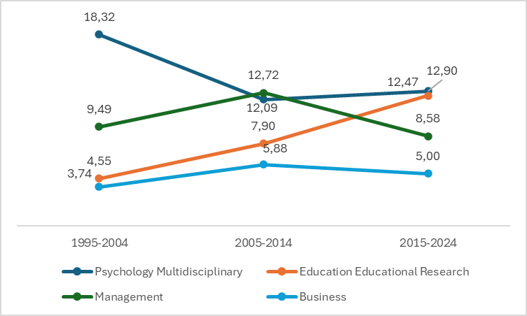
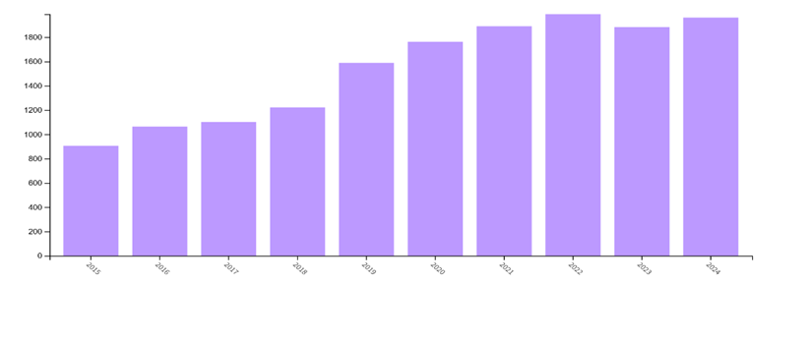
The interest in EI has increased
Figure 1. The scientific publications on the topic of EI in the last 10 years in WoS (source: WoS)
Figure 2. The scientific publications on the topic of EI in the last 30 years in WoS
(source: WoS, own elaboration)
Notes:
The annual increase in scientific research (Figure 1) enriches the understanding of the composition of EI, allowing knowledge to be pooled in interdisciplinary studies.
Over the past 30 years, interest in EI has increased and taken an interdisciplinary direction. In the Web of Science databases, the focus on EI has shifted from psychology to education (Figure 2).
The categories of management and business retain the leading positions in terms of EI topics.
The positive impact of EI on success in entrepreneurship is shaping new challenges in the educational environment.

Slide 4
The Role of EI in Entrepreneurship
Entrepreneurial Intention
[Bonesso et al., 2018], [Padilla-Melendez et al., 2014],
[Zampetakis & Moustakis, 2006]
Relationship Management and Networking
[Leutner et al., 2014]
EI
Entrepreneurial Self-Efficacy
[Salvador, 2008], [Zhao et al., 2005]
Risk Tolerance
[Panagiotis & Dimo, 2015]
Stress Tolerance and Perseverance
[O’Boyle et al., 2011]
Creativity and Innovation
[Leutner et al., 2014], [ScienceDirect, 2022]
Notes:
Entrepreneurial Intention is the intention to start a business (Entrepreneurial passion is a source of energy for starting a business and is labelled by researchers as a key competency of an entrepreneur)
Relationship Management and Networking
Emotional intelligence improves the ability to build and maintain relationships with stakeholders, including investors.
Entrepreneurial Self-Efficacy
Higher emotional intelligence leads to greater confidence in one’s entrepreneurial abilities.
Risk Tolerance
Entrepreneurs with higher emotional intelligence show less risk aversion and more positive attitudes toward risk.
Stress Tolerance and Perseverance
High emotional intelligence enhances stress tolerance and persistence in overcoming entrepreneurial challenges.
Creativity and Innovation
Emotional intelligence is associated with enhanced creative thinking and innovation in entrepreneurship.

Slide 5
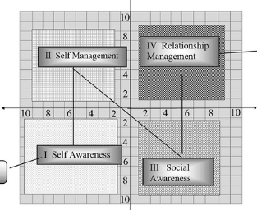
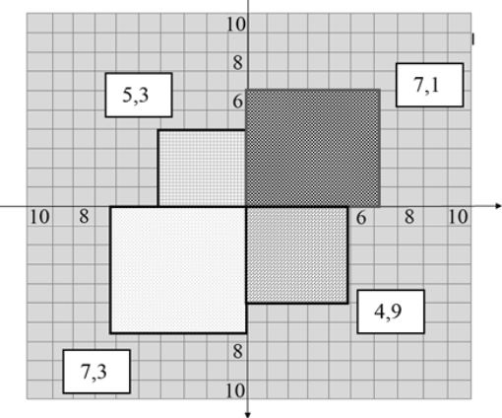
The 4-component instrumental model of Emotional Intelligence (in the business environment) (4EI Model)
EI component | Characteristics of the entrepreneurial EI component
Self-Awareness | SA is the ability to identify opportunities for creating value, generate new ideas, think strategically, analyse, plan and forecast based on understanding one's motives, behaviours, weaknesses and strengths.
Self-Management | SM is the ability to control one's behavior to achieve one's goals, to adapt, to take responsibility, be motivated, use time and resources effectively under conditions of risk and uncertainty.
Social Awareness | SocA is the ability to understand and empathise with the emotions of colleagues, team members, investors, consumers, and stakeholders, accept differences of other cultures and generations, uphold corporate culture, and foster teamwork.
Relationship Management | RM means building effective communications and cooperation, healthily resolving conflicts, leadership, and the ability to inspire and manage a team and realise the potential of team members.
4EI Model
EI profile {HLSAE; HLSME; HLSocAE; ALRME}
EI profile based on the questionnaire “Emotional Intelligence in Business” (Example)
Notes:
To measure and develop an entrepreneur's EI, it is convenient to use the The 4-component instrumental model in (4EI Model). Like the latest version of Goleman's model The 4EI Model consists of 4 components. But this model provides support for the 19 main important in business competencies
The 4EI Model consists of the following components namely Self-Awareness of Entrepreneurs (SA), Self-Management of Entrepreneurs (SM), Social Awareness of Entrepreneurs (SocA), and Relationship Management of Entrepreneurs (RM). The model helps to build an entrepreneur’s EI profile. The 4EI Model uses the Stan scale from 0 to 10. For every component, the results from 0–3 is a low level (LL), more than 3 to 7 is an average level (AL), and more than 7 to 10 is a high level (HL). The 4EIE Model consists of quadrants equal to the component's value (0 to 10).
A reliable, validated questionnaire “Emotional Intelligence in Business” can be used to assess the 4EI Model components. Pre-test and Post-test allow monitoring the dynamics of entrepreneurs' EI development according to thethe 4EI Model.
The slide shows an example of a pre-entrepreneur's EI profile (graphical and analytical interpretation). The use of the ‘Questionnaire Emotional Intelligence in Business’ chatbot, created on the Smart Sender online platform, allows you to give feedback to the respondent and makes the survey more attractive to respondents.

Slide 6
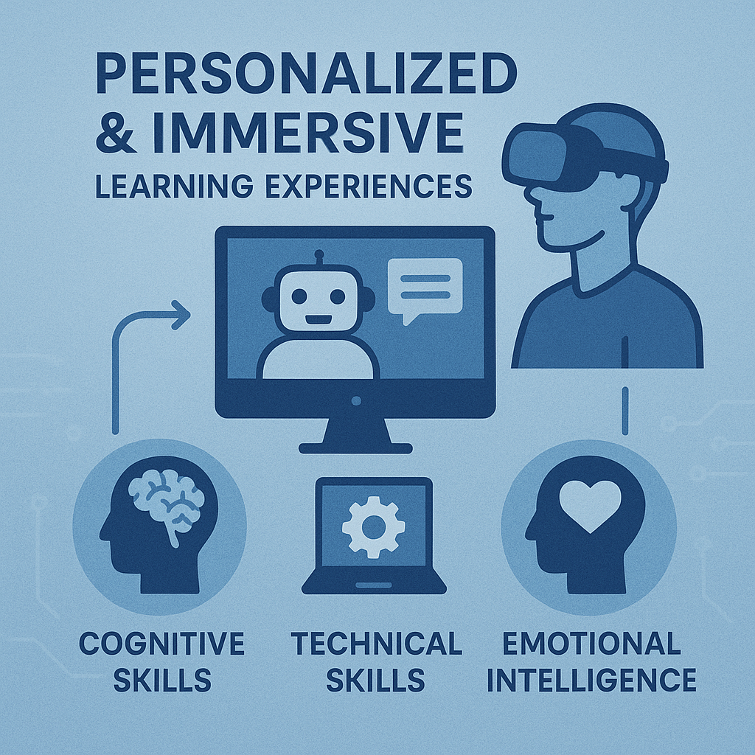
Emerging Role of Gen AI
GenAI introduces new methods for EI training
Customizable, scalable, and immersive
Expands beyond cognitive skills to emotional development
* All images have been generated using GenAI tools
Notes:
Generative AI is opening new frontiers in how we develop emotional intelligence (EI). Our research demonstrates that GenAI can also support emotional development across all four domains of the 4EI Model: self-awareness, self-management, social awareness, and relationship management. Its key strengths lie in scalability, personalization, and its capacity to create immersive learning experiences. these technologies align with constructivist learning theory by enabling learners to actively engage in real-world scenarios and receive immediate, personalized feedback. This not only fosters metacognitive regulation but has been shown to increase motivation and long-term retention of emotional skills. In essence, GenAI is not just an assistive tool; it’s a pedagogical enabler that can reshape how we develop leadership and interpersonal capabilities in entrepreneurial education.

Slide 7
Research Goal and Framework
Goal: Enhance EI using GenAI in entrepreneurial education
Based on the 4EI Model: Self-Awareness, Self-Management, Social Awareness, Relationship Management
Tools evaluated through literature review and model application
4-component instrumental model
of Emotional Intelligence
(in the business environment)
Notes:
Our aim is to provide practical recommendations for applying GenAI to improve the four key components of Emotional Intelligence—Self-Awareness, Self-Management, Social Awareness, and Relationship Management—using the validated 4EI model as our guiding framework.
To inform these recommendations, we conducted a comprehensive literature review and evaluated GenAI tools for their suitability in entrepreneurial education.

Slide 8
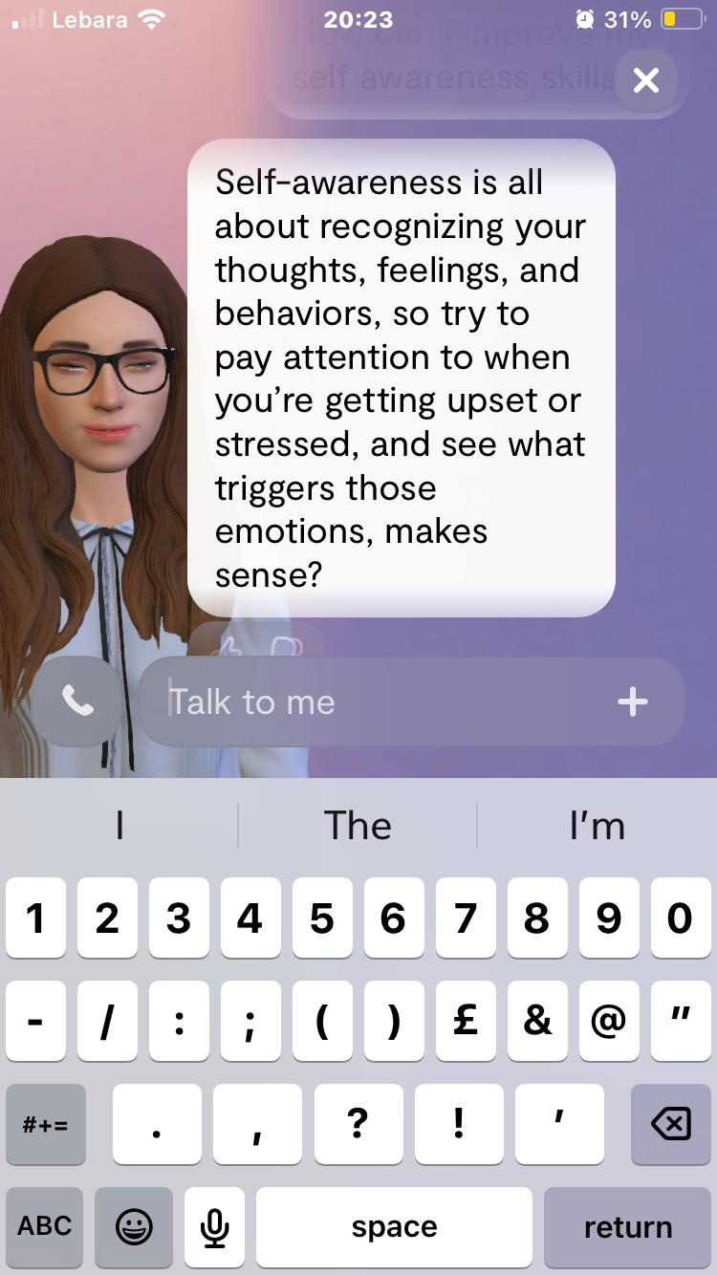

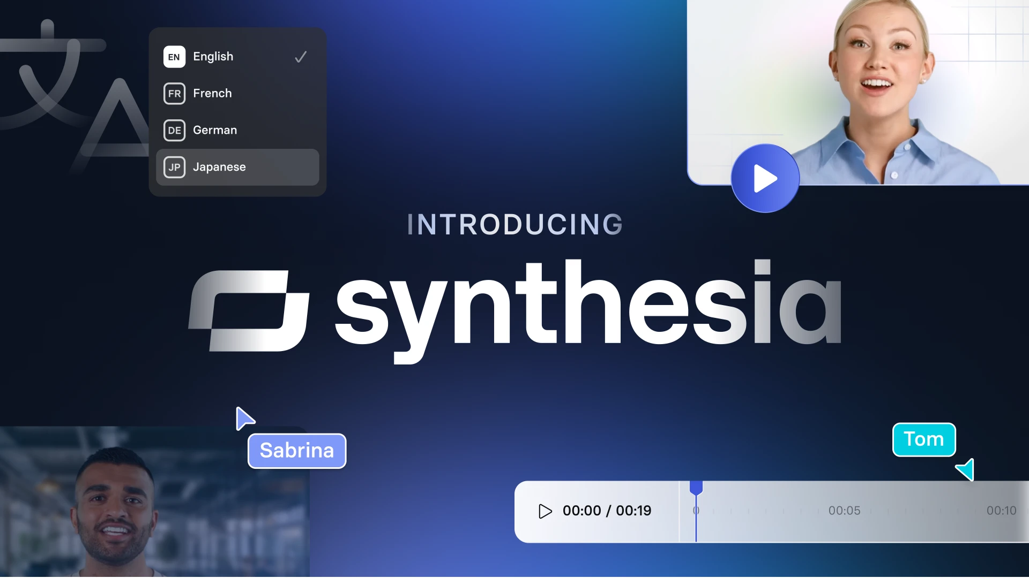
GenAI Tools overview
Chatbots (Replika, Woebot)
Custom GPTs & RAG-based systems for domain-specific support
Multimodal tools (e.g., Synthesia, CrewAI)
=> Theoretical framework and a practical roadmap for educators
Notes:
We grouped the tools into three main categories:
Conversational Chatbots: These include Replika and Woebot, which support emotional exploration and reflection. They are particularly effective at the foundational level for promoting self-awareness and initial self-regulation. However, they are limited by their generalized pretraining and lack of domain-specific customization unless further fine-tuned or enhanced with retrieval mechanisms.
Custom GPTs and RAG-Based Systems: These tools enable a higher degree of personalization. RAG (Retrieval-Augmented Generation) allows chatbots to access specific, up-to-date content relevant to the learner’s context, making them ideal for building competencies like self-management and social awareness. Custom GPTs can also be fine-tuned to align with the 4EI framework, supporting entrepreneurs with tailored coaching interactions.
Multimodal Tools: Tools like Synthesia and CrewAI allow us to go beyond text-based interfaces and introduce video-based and simulated social environments. These are particularly useful for training higher-order EI skills such as empathy, interpersonal communication, and conflict resolution. When paired with platforms like Unity or Engage VR, these tools can support immersive learning experiences—something we highlight later in our proposed advanced deployment strategy.
By matching these tools to each EI domain, we not only provide a theoretical framework but also a practical roadmap that educators and institutions can use to enhance EI among entrepreneurs with scalable, technology-driven solutions."

Slide 9
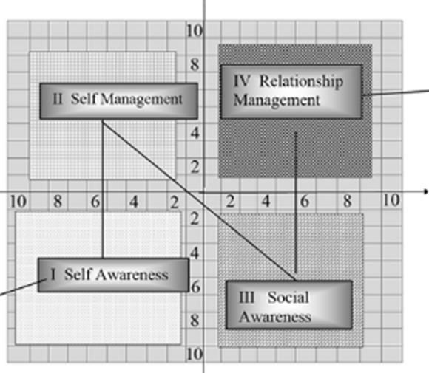
GenAI Application in 4EI Model
Self-Awareness: Sentiment analysis, reflective chatbots
  Replika and Woebot
Self-Management: Risk analysis, behavior tracking
  RAG-enhanced or fine-tuned chatbots
Social Awareness: Empathy training, video simulations
  Chatbots and Synthesia
Relationship Management: Communication simulation, HR scenarios
  Simulation agents - CrewAI
Notes:
We show how specific generative AI tools align with the four core components of the 4EI Model—Self-Awareness, Self-Management, Social Awareness, and Relationship Management. This mapping is based on our literature review and the functional capabilities of current GenAI tools.
Let’s walk through each component:
Self-Awareness
For this foundational component, tools like Replika and Woebot serve as reflective companions. They prompt users to express thoughts and emotions, helping them identify personal strengths and areas for growth. In tandem, sentiment analysis tools—such as those available via Hugging Face—can analyze user responses to detect underlying emotional states. These insights can be aggregated into personalized EI profiles, enabling targeted reflection and self-understanding.
Self-Management
Here, GenAI tools focus on helping users regulate emotions, build resilience, and evaluate decisions under uncertainty. We apply behavior tracking through conversational data and integrate risk simulations using RAG-enhanced or fine-tuned chatbots. These systems can provide scenario-based feedback—guiding users through emotionally challenging business situations to improve impulse control and stress management.
Social Awareness
To foster social and emotional insight, empathy training tools are essential. Chatbots like ChatGPT can be scripted to simulate interpersonal dialogue with emotional depth. Additionally, text-to-video platforms like Synthesia allow us to create AI-generated roleplay scenarios, letting users observe or engage with emotionally expressive avatars. These environments help entrepreneurs recognize social cues and develop cultural sensitivity—skills vital for effective communication and collaboration.
Relationship Management
The highest-order EI domain, relationship management, involves conflict resolution, influence, and team-building. Simulation agents, including those available in platforms like CrewAI, allow learners to practice interacting with various personality types and leadership styles. These simulations mimic workplace interactions, helping users rehearse how to navigate tension, build rapport, and lead with empathy. These tools can also be used to simulate recruitment interviews and HR scenarios, supporting decision-making in emotionally charged contexts.
By aligning GenAI tools with each EI component, we move from general awareness to immersive, targeted development strategies. These mappings are not just theoretical—they form the foundation of the tiered deployment strategy that we introduce in the next slide, scaling from simple chat-based tools to complex VR-integrated training systems."

Slide 10
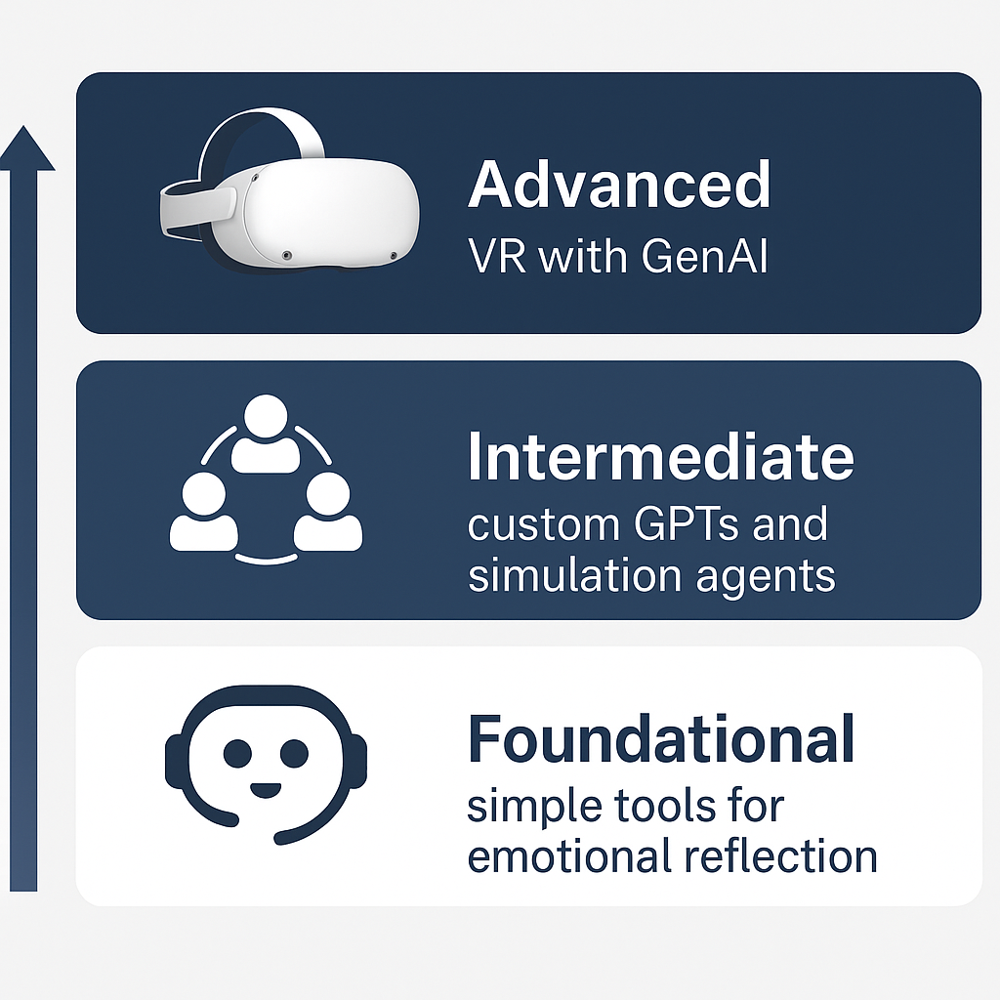
Tiered Deployment Strategy
Foundational lv: Chatbots + sentiment analysis
Intermediate lv: RAG + fine-tuned GPTs + simulation agents
Advanced lv: Immersive VR + GenAI-driven avatars
Notes:
We propose a tiered deployment model. At the foundational level, users interact with simple tools for emotional reflection. Intermediate tools include custom GPTs and simulation agents. At the advanced level, we integrate VR with GenAI for high-fidelity, emotionally responsive training.

Slide 11
Foundational Tools in Practice
Chatbots like Replika & Woebot for reflection
Sentiment analysis via Hugging Face
Personalized EI profiles
Notes:
At the foundational level, we focus on introducing accessible, low-barrier tools that can support entrepreneurs in developing core EI skills— self-awareness and self-management.
We begin with chatbots like Replika and Woebot, which are especially valuable for individuals with limited prior exposure to emotional intelligence training. These tools engage users in reflective, conversational interactions. Replika, for example, prompts users to articulate how they’re feeling, explore their reactions to events, and consider alternative perspectives. While originally designed for general mental health support, these tools can be adapted for entrepreneurial use to help individuals reflect on their leadership style, responses to stress, and interpersonal challenges.
To deepen the impact of these reflections, we recommend pairing chatbots with sentiment analysis tools. Platforms like Hugging Face offer APIs that analyze user language for emotional content—detecting patterns such as stress, frustration, enthusiasm, or optimism. These insights can be aggregated over time to create personalized EI development profiles. Such profiles highlight the individual’s emotional tendencies, strengths, and areas for improvement. For example, an entrepreneur who frequently expresses frustration in response to setbacks might benefit from targeted prompts focused on resilience and reappraisal.
This tier does not require high technical or financial investment, making it scalable and ideal for early-stage interventions. It sets the foundation for more structured, immersive training by helping users build emotional vocabulary and awareness—key stepping stones for emotional intelligence development.
In summary, the foundational level leverages lightweight, accessible tools to support reflection, emotional monitoring, and insight. It is the first step in a progressive, tiered strategy that scaffolds learning toward more dynamic and immersive forms of EI development.

Slide 12
Intermediate Solutions
RAG architecture for up-to-date content
Custom GPTs for domain-specific learning
Simulation agents in platforms like CrewAI
Question
Retriever
LLM
Response
Specific knowledge base
The RAG system
Notes:
Moving up to the intermediate level, we introduce tools and methods that support more personalized and context-specific emotional intelligence training. At this stage, the goal is to move beyond basic self-reflection and offer more dynamic, responsive learning experiences.
A key advancement here is the use of Retrieval-Augmented Generation (RAG) systems and custom GPTs. These technologies address the limitations of pre-trained, generic chatbots by enabling the inclusion of domain-specific content. With RAG, for instance, a chatbot can pull real-time, relevant information from a curated knowledge base to support emotionally intelligent responses that are grounded in entrepreneurial context—such as handling investor pressure, giving feedback to a team, or responding to failure.
Custom GPTs, on the other hand, are fine-tuned models trained on instructional material, case studies, or EI frameworks. These models act more like virtual tutors or coaches, adapting to user input and providing real-time, emotionally intelligent prompts. Their responses are not only conversational but also pedagogically aligned to scaffold growth in areas like self-regulation, resilience, and emotional decision-making.
An exciting innovation at this level is the introduction of simulation agents, which represent different personality types or team roles. When integrated into GenAI-powered platforms like CrewAI, learners can engage with multiple agents simultaneously—each behaving differently based on assigned emotional or professional profiles. This enables entrepreneurs to rehearse empathy, negotiation, and conflict resolution in group dynamics, mimicking real workplace situations.
However, while these tools offer rich interaction, they are still constrained by their two-dimensional (2D) format. They cannot yet capture the full range of emotional nuance seen in real life, such as tone of voice or body language. That’s why we propose the next progression—advanced immersive training—which we’ll cover in the next segment.
To summarize, the intermediate level bridges the gap between generic emotional support and targeted, responsive learning. It brings context, interactivity, and personalization to the forefront—enabling entrepreneurs to develop and rehearse emotional competencies in more realistic, decision-driven settings.

Slide 13
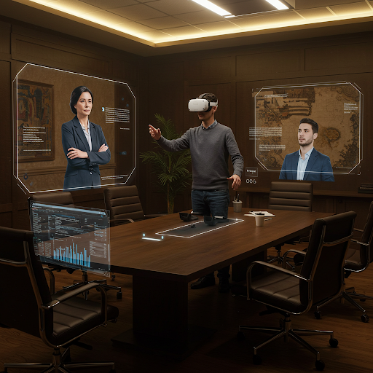
Advanced Immersive Training
GenAI + VR = dynamic, realistic EI training
Avatars react to tone, gestures, and context
Scenario-based learning for high-pressure EI situations
Notes:
At the advanced level, we reach the most immersive and experiential tier of emotional intelligence training—one that combines the capabilities of generative AI with virtual reality (VR) to deliver emotionally rich, embodied learning experiences.
In this stage, entrepreneurs interact with AI-driven avatars in fully simulated, three-dimensional environments. Unlike scripted training videos or chatbot interactions, these avatars are powered by GenAI, enabling them to respond dynamically to the learner’s tone of voice, choice of words, emotional expressions, and even non-verbal cues like posture and gestures. This allows for real-time, emotionally intelligent conversation that mirrors real-life social interactions.
For example, a user might enter a virtual team meeting where avatars display varying emotional responses to a project failure. One avatar might express frustration, while another shows support. The entrepreneur is then challenged to manage the group dynamic—applying emotional regulation, active listening, empathy, and leadership—all within a realistic, consequence-driven scenario.
This kind of emotionally adaptive simulation is where GenAI truly differentiates itself from traditional EI training methods. It allows learners not just to understand EI concepts intellectually, but to practice them in high-pressure, emotionally charged situations—such as delivering difficult feedback, de-escalating conflict, or navigating ethical dilemmas.
The potential here is vast, but we also acknowledge that this level requires significant investment: VR hardware, content development, technical expertise, and interdisciplinary collaboration. However, even lightweight versions—like AI-scripted scenarios embedded in VR platforms such as EngageVR—can offer impactful entry points.
the advanced level pushes the boundaries of what’s possible in EI training. It transforms learning from passive instruction to active emotional rehearsal—an approach especially vital for entrepreneurs who must lead with empathy, communicate under pressure, and navigate complex human relationships in high-stakes environments."

Slide 14
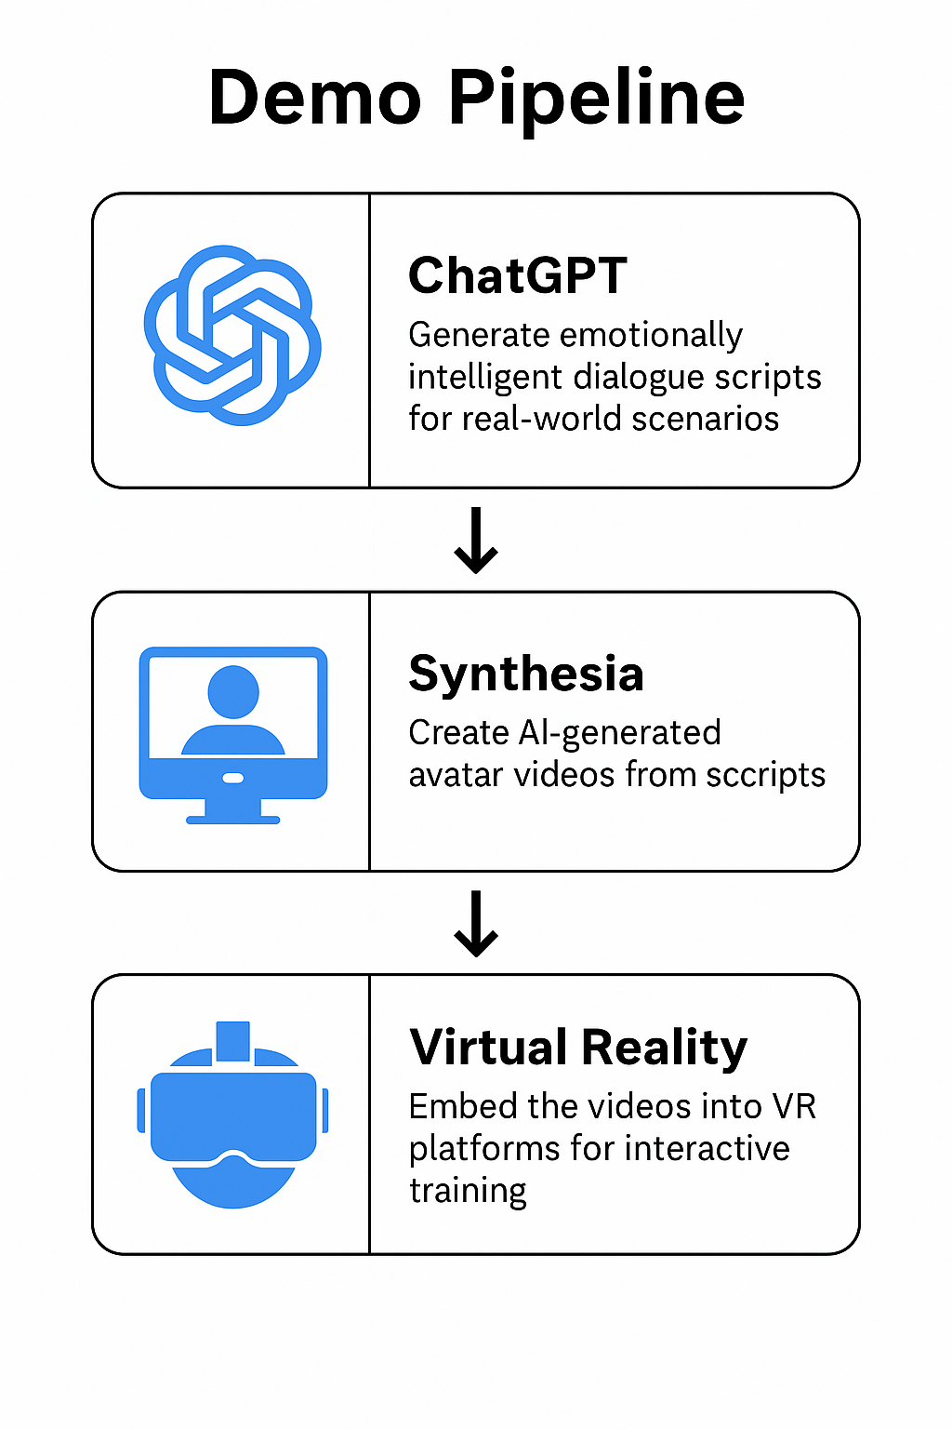
Practical Example
Use ChatGPT to script emotionally intelligent dialogues
Generate videos with Synthesia
Embed into platforms like Engage VR
Notes:
Based on our findings we can propose a demo pipeline—a practical example that shows how educators and developers can build immersive, emotionally responsive training environments using GenAI tools, without needing advanced coding or design skills.
The pipeline starts with ChatGPT, which is used to generate emotionally intelligent dialogue scripts. These scripts are tailored to simulate real-world entrepreneurial scenarios—such as negotiating with a co-founder, managing a team dispute, or pitching under pressure. ChatGPT’s role here is to provide nuanced, emotionally aware dialogue that reflects the kinds of interpersonal challenges entrepreneurs face.
Next, these scripts can be fed into Synthesia, a text-to-video platform that creates AI-generated avatar videos. Synthesia brings the dialogue to life by producing realistic video clips where avatars display appropriate facial expressions, tone of voice, and gestures. This transforms text-based scenarios into visually rich, emotionally expressive scenes, making the learning experience far more engaging and relatable.
Finally, these video assets are embedded into virtual reality platforms, such as Unity or Engage VR. Once in VR, users can interact with the avatars and navigate emotionally charged situations in a safe, simulated space. These scenarios allow learners to practice empathy, emotional regulation, and decision-making—core emotional intelligence skills—in an environment that mimics real interpersonal tension and complexity.
What’s important here is accessibility. Our approach makes it possible to design immersive EI training tools without needing to code, design 3D environments from scratch, or invest in large-scale production teams. This opens the door for educators, startups, and training organizations to begin integrating GenAI into their emotional intelligence curricula at a low cost and with relatively short development cycles.
This proof-of-concept not only validates the potential of GenAI to enhance EI training but also demonstrates how scalable and adaptable these tools are. It’s a key step toward democratizing access to high-quality emotional development resources—especially in entrepreneurial education where such training is often underdeveloped."

Slide 15
Key Findings & Recommendations
GenAI can accelerate EI development for entrepreneurs
Tiered approach aligns tools with readiness levels
Immersive experiences hold greatest promise
Notes:
In conclusion, our research highlights the transformative potential of generative AI in advancing emotional intelligence training—particularly in the entrepreneurial context, where emotionally intelligent leadership is crucial. We propose a tiered deployment strategy that allows learners to engage with GenAI tools at different levels of complexity and readiness. This ensures that emotional intelligence training is accessible to all—whether you're a novice starting with chatbots like Replika, or an experienced learner engaging in advanced simulations within a VR environment. The structure allows for scalable growth and adaptability across a wide range of educational and professional settings. At the highest level, immersive GenAI-powered environments offer realistic, emotionally charged experiences that mimic the complexity of real-world human interactions. These scenarios are especially valuable for entrepreneurs, who must regularly navigate stress, uncertainty, and interpersonal challenges while remaining emotionally agile. What we emphasize here is that emotional intelligence is not a soft skill it’s a foundational skill for leadership, innovation, and resilience. The ability to manage oneself and engage constructively with others is critical to building inclusive teams, adapting to change, and driving sustainable success. GenAI gives us a powerful, scalable toolkit for embedding EI development into the heart of entrepreneurial education. But technology alone is not enough. For successful implementation, we need collaboration across disciplines—educators who understand pedagogy, developers who can build responsive systems, and designers who can create intuitive, human-centered experiences. In summary, the future of EI training lies at the intersection of psychology, AI, and immersive learning. By working together, we can ensure that GenAI becomes not just a tool for automation, but a catalyst for deeper human connection, emotional growth, and leadership development.

