Slide 1

How Many Steps Does It Take to
Build a Learning Tool?
An Overview of Our Learning Design Lab
Felix Brito, Ph.D. | Sara Ombres
Embry-Riddle Aeronautical University – Worldwide Campus

Slide 2
Session Overview
Learning Design & Technology team
Online course development process
Challenges
DesignER Learning Design Lab
Idea development process
DesignER teams
Design Thinking approach
Developed ideas
Bigger outcomes

Slide 3
Learning Design & Technology
Instructional Design & Development
Instructional Technology
Media Production
Learning Support & Development

Slide 4
Online Course Development Stakeholders
Intern
Bookstore
Academic
Chair
Course
Developer
Instructional
Designer
Director
Senior
Instructional
Designer
Online
Library
Instructional
Consultant
Media
Producer
Instructional
Technologist
Digital
Media
Specialist
Associate
Dean
Web Applications Developer
Learning
Support
Specialist
GenAI
Specialist
Advisor
IT
Gaming & Simulation
Developer

Slide 5
Online Course Development Process
Analysis/
Design Meeting
Course
Design
Worksheet
Project
Kickoff
Modules 1-3
Multimedia Production
Final
Round of Reviews
First
Round of Reviews
Tool Review
Process
Project
Wrap-Up
Modules 4-9

Slide 6
Tight deadlines
Don’t exist
challenges
Tools
Time
Don’t meet needs of team
Heavy workload

Slide 7
DesignER
Learning Design Lab
Product development-oriented initiative
Ad-hoc groups in cross-functional style
Design thinking principles
Agile exploration of new ideas
Innovative and instructionally-sound learning products
Adoption of the developed learning products

Slide 8
small wins
short product development windows

Slide 9
market
research
quality assurance
DesignER teams
faculty + staf
development
communications

Slide 10

Design Thinking Steps
  1.Define
  3.Prototype
  2.Ideate
  4.Test

Slide 11
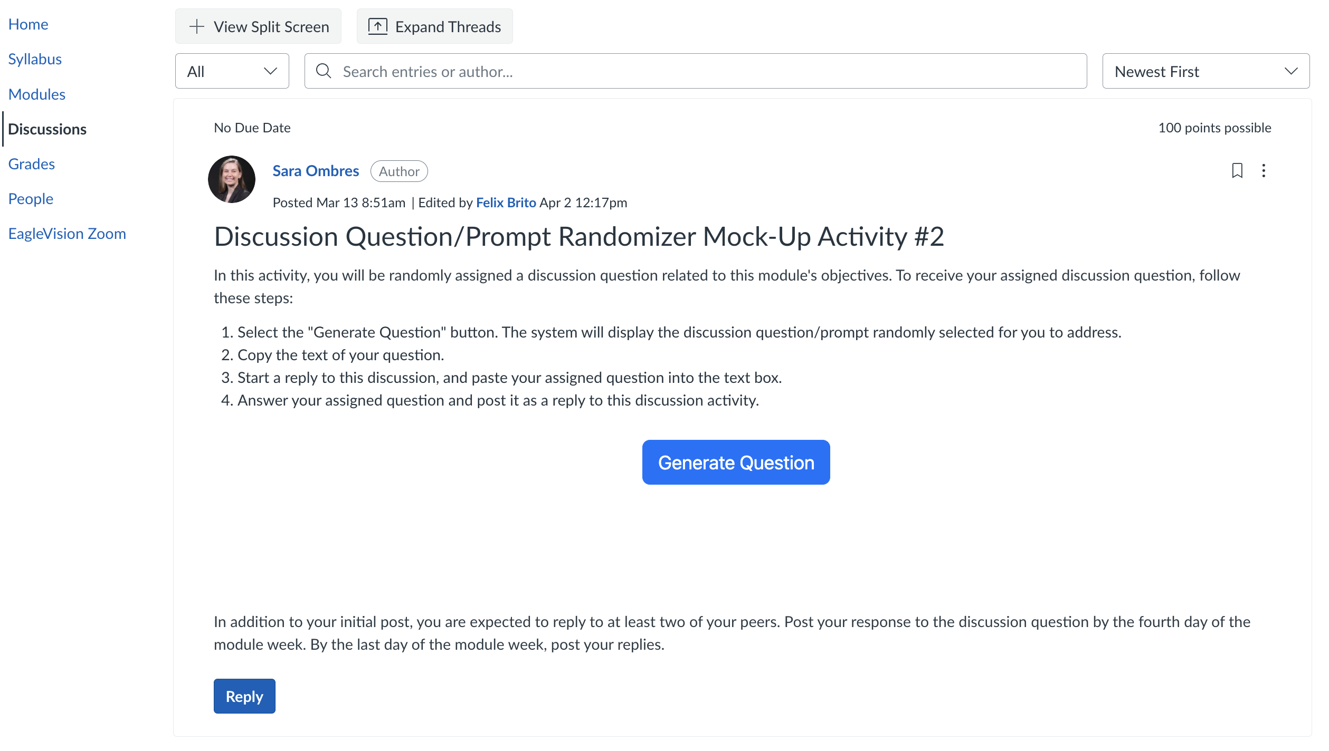
Developed
Idea
Discussion
Question/Prompt
Randomizer

Slide 12
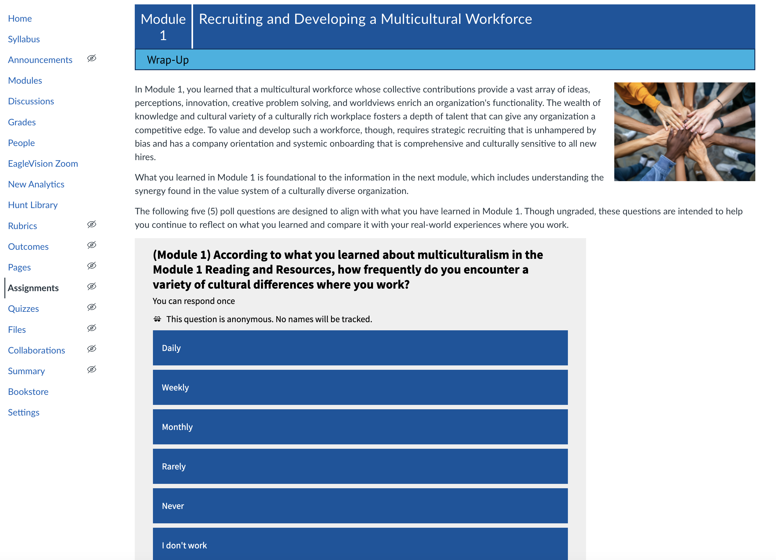
Developed
Idea
Polling in
Canvas
pages

Slide 13
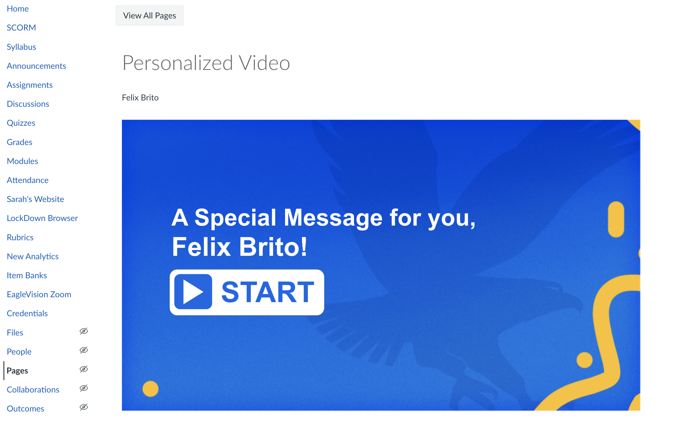
Developed
Idea
Course
Personalization

Slide 14

DesignER Recognition
DesignER Hall of Fame
Small Wins, Big Impact

Slide 15
Collaboration
outlet
bigger outcomes
Creative
outlet

Slide 16

?
Notes:
Thank you and contact information slide

