Slide 1

ENHANCING CONTROL IN MICROGRIDS WITH SIMULINK AND OPC: A METHODOLOGY TO BOOST RESEARCHERS AND STUDENTS’ SKILLS
Authors:
Enrico Elio De Tuglie, Luigi Pio Savastio, Giulia Amato, Giovanni Maulà and Arya Abdollahi
Dept. Electrical and Information Engineering, Polytechnic University of Bari
June 11-13 2025
The Learning Ideas Conference 2025

Slide 2
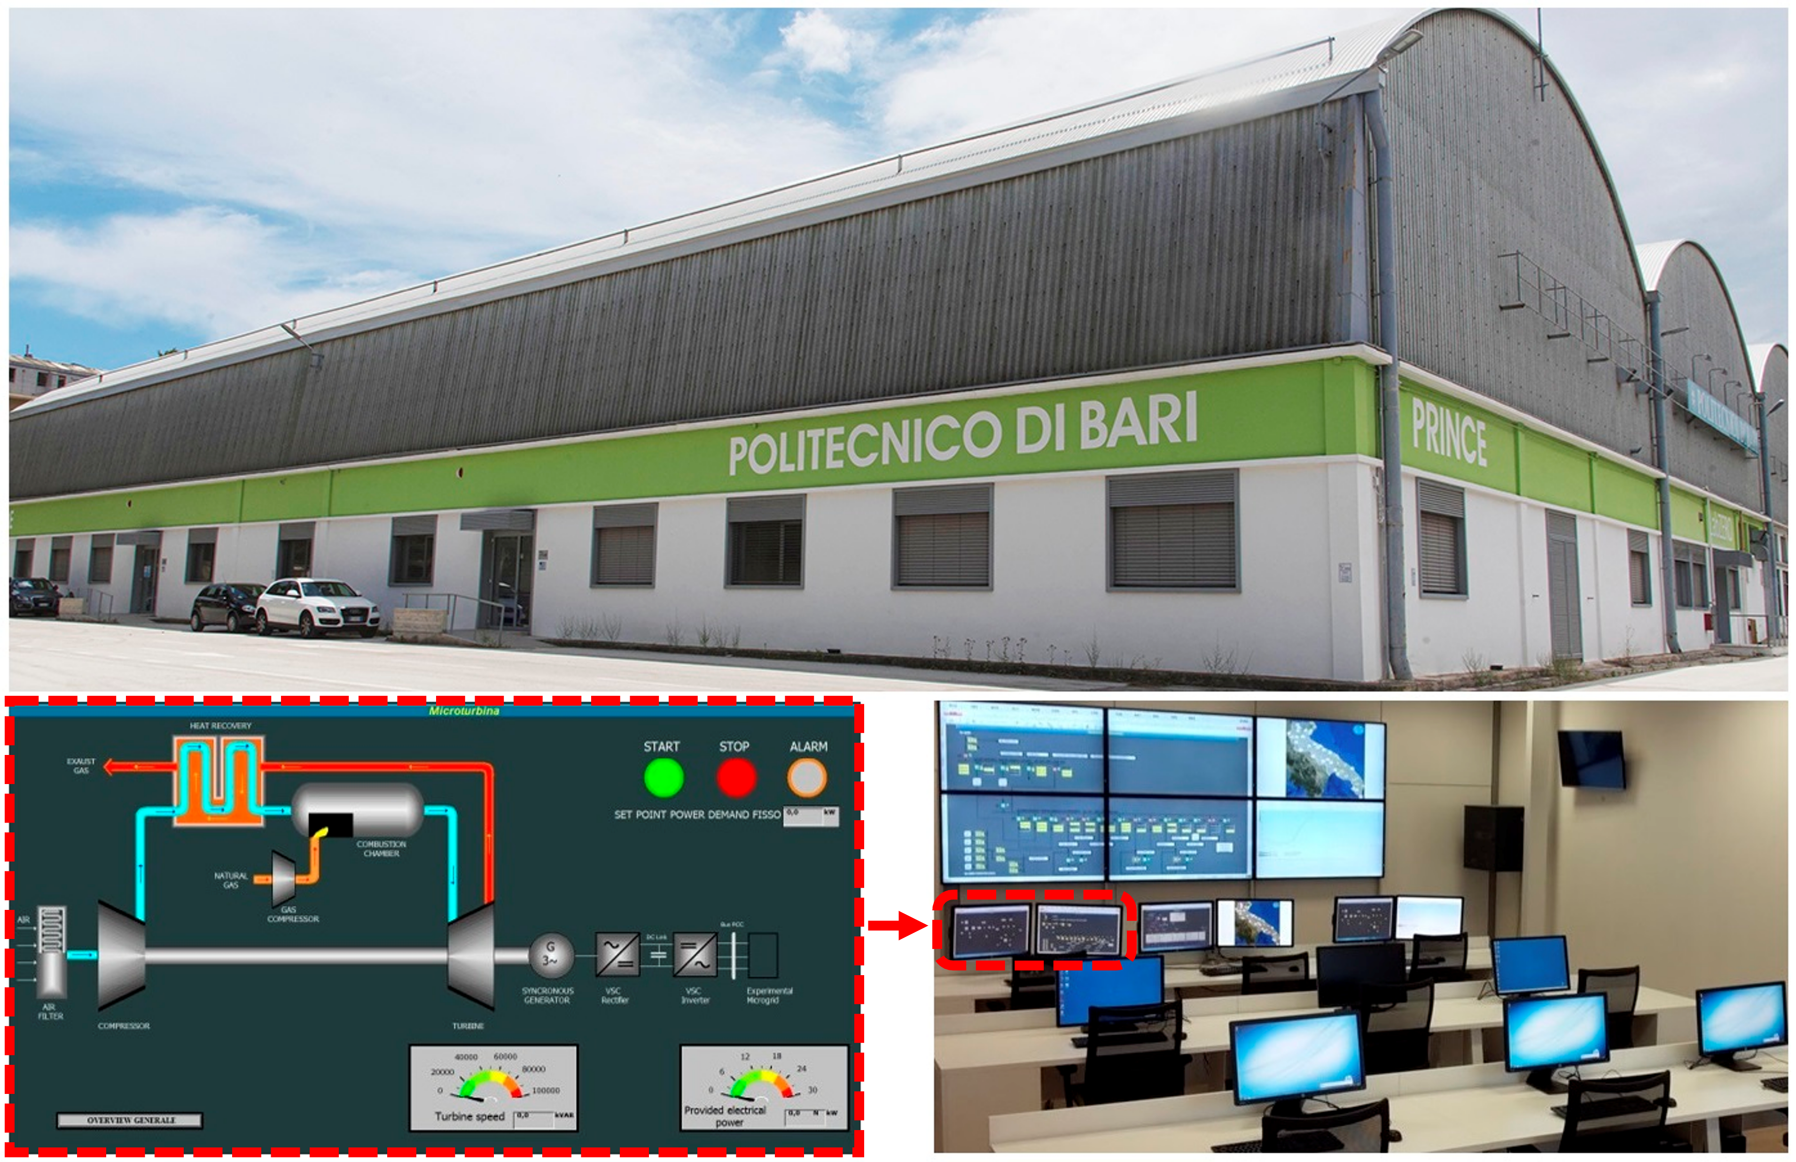
MAIN AIM
The aim of this work is to provide a comprehensive overview of the use of the OPC protocol in the integration between MATLAB/Simulink and PLC for real-time applications.
Researchers and students gain skills in:
Industrial automation
Smart energy management
Comunication protocols
Monitoring system
Management system with SCADA
De Tuglie et al.
Polytechnic University of Bari

Slide 3
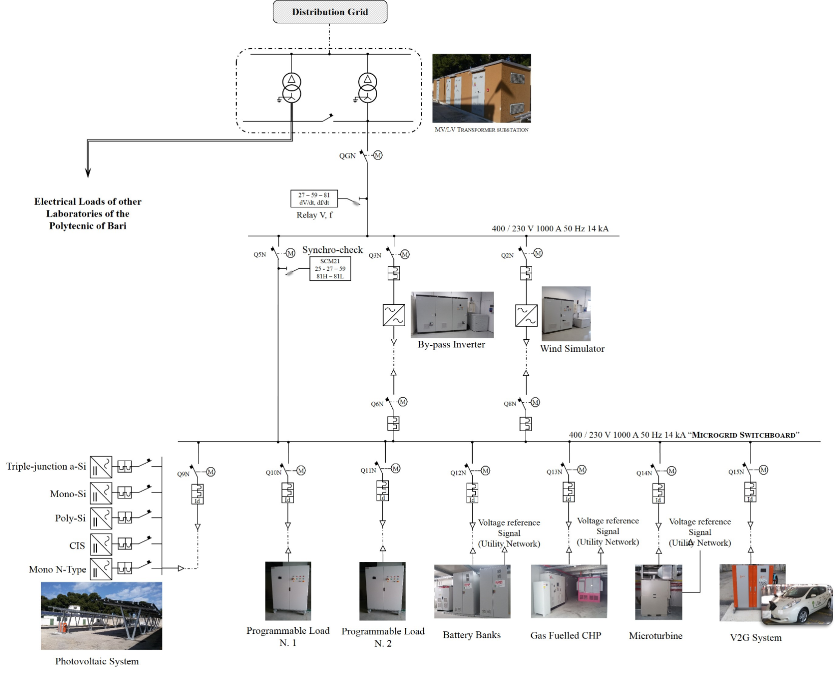
MICROGRID IN PRINCE LAB
The microgrid includes:
Cogenerator
Microturbine
Photovoltaic
Wind turbine simulator
BESS
Programmable Loads
V2G System
FOR THIS WORK WE CONSIDER ALSO COGENERATOR AND PROGRAMMABLE LOAD
De Tuglie et al.
Polytechnic University of Bari

Slide 4
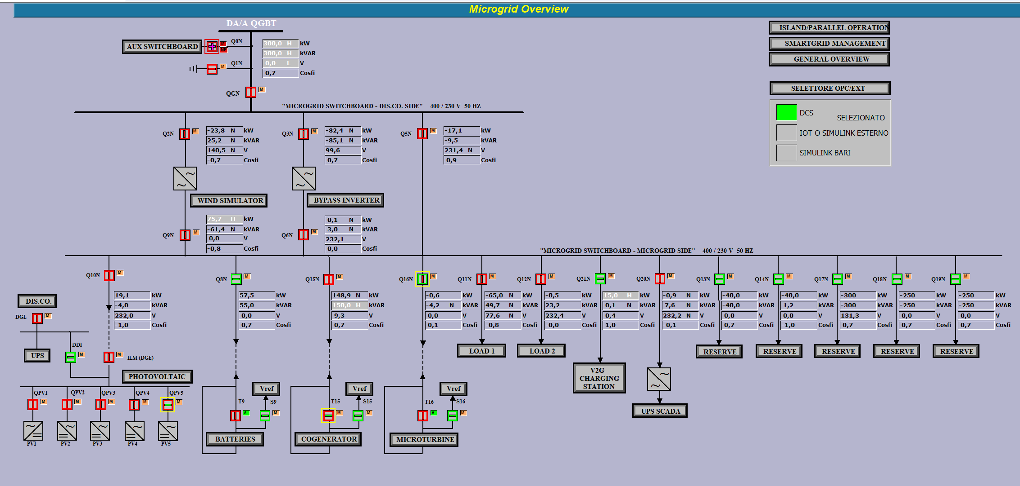
MICROGRID’S SYNOPTIC
De Tuglie et al.
Polytechnic University of Bari

Slide 5
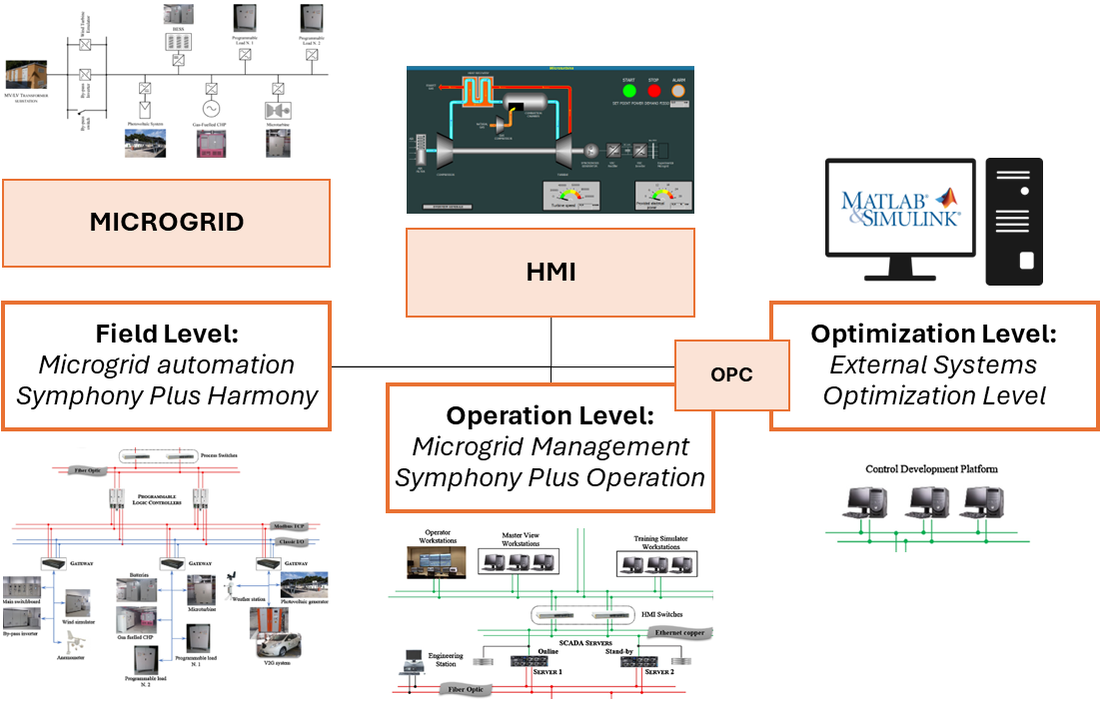
MICROGRID IN PRINCE LAB
The microgrid’s architecture:
Field level: managed by the PLCs installed on ech field device
Operation level: optimal management and safety
External systems Optimization Level: the students can implement alternative control logic interacting with the field control system
De Tuglie et al.
Polytechnic University of Bari

Slide 6
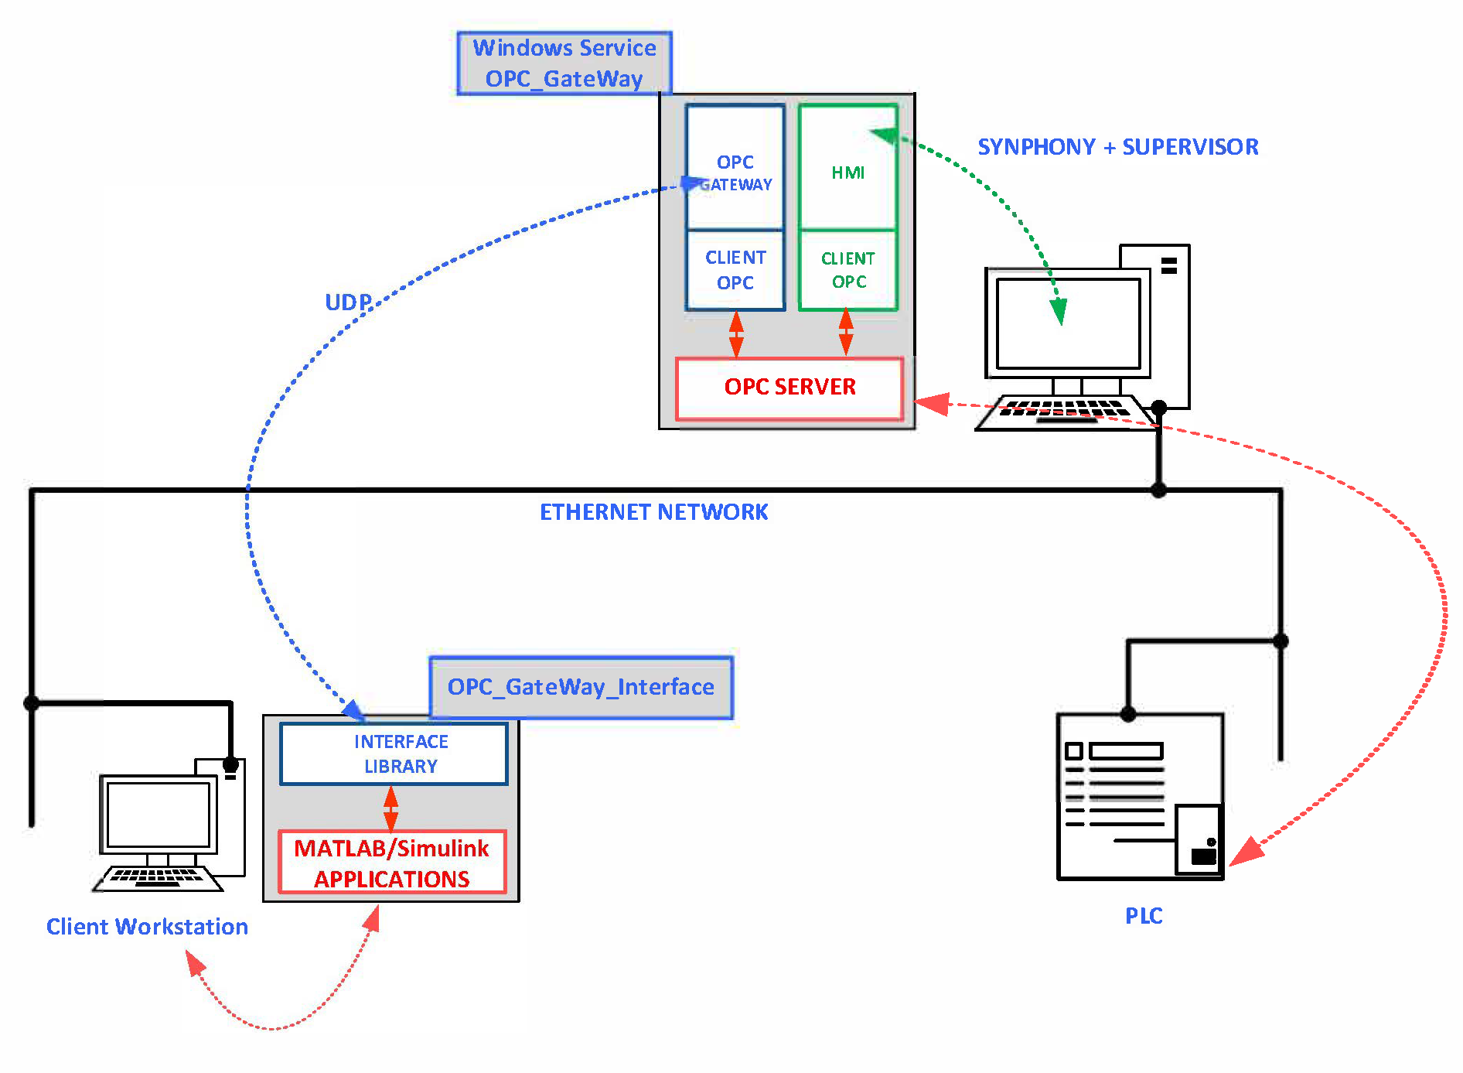
SIMULINK PROGRAMMING
Layout:
Client Workstation: used to develop the Simulink Model
OPC GateWay Interface: enables data exchange between industrial devices and management software using the OPC protocol
OPC Server: sends commands to the PLC and receives data for the management system
De Tuglie et al.
Polytechnic University of Bari

Slide 7
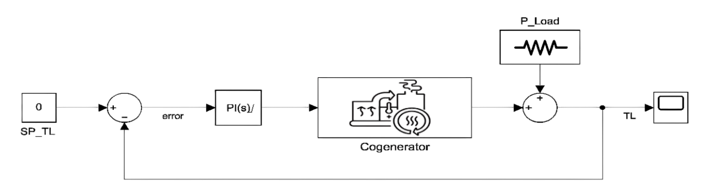
OFFLINE SIMULINK MODEL
This model represents the digital twin of the real generator and load in microgrid:
Cogenerator is represented by a transfer fuction provided by system identification toolbox.
PI controller to closed loop action. This is limitated by upper and lower limits of cogenerator that correspond to 0 and 60 kW
P_Load is a vector of real negative electric load
SP_TL is the setpoint of TieLine that is set equal to 0
De Tuglie et al.
Polytechnic University of Bari

Slide 8
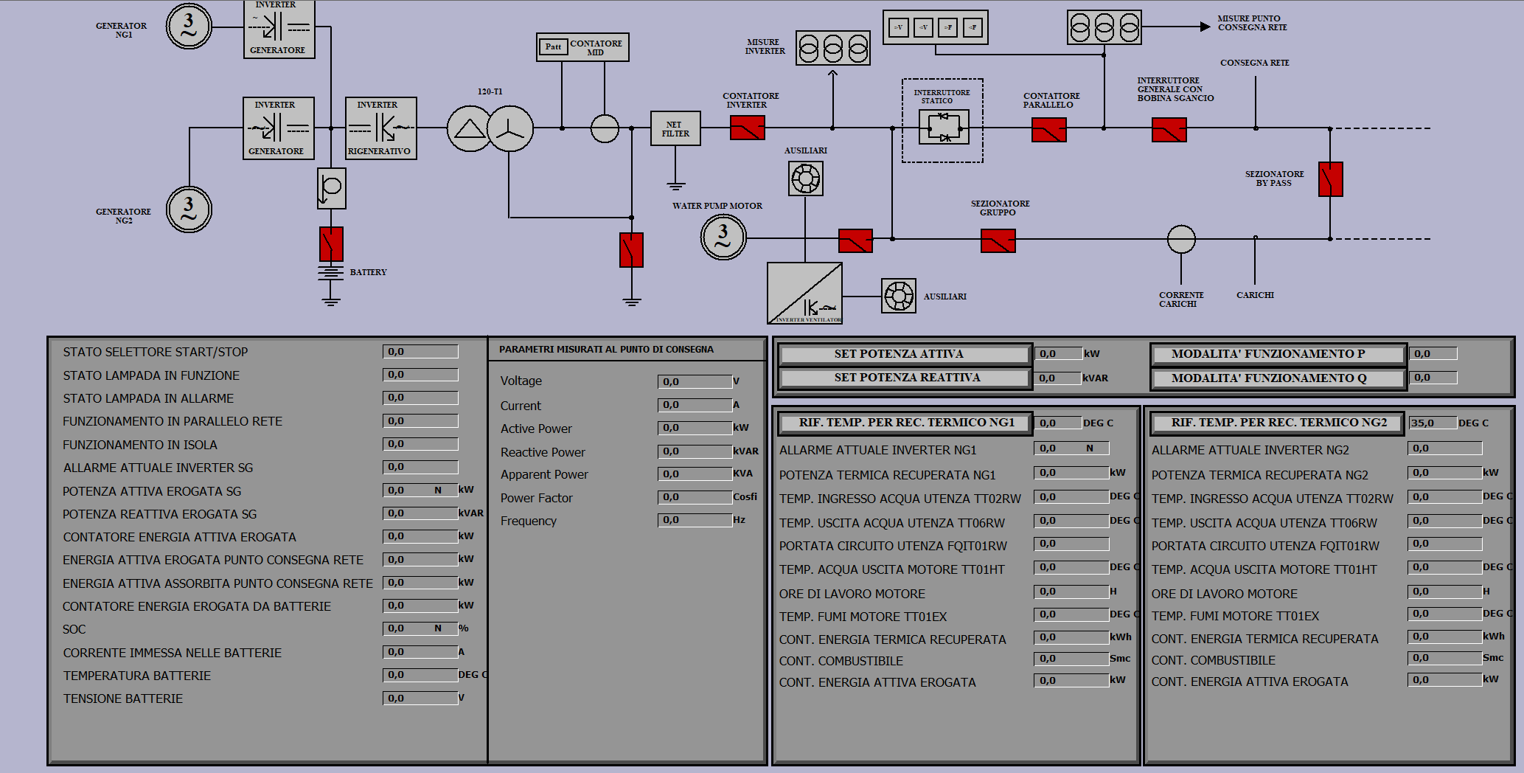
COGENERATOR’S SYNOPTIC
De Tuglie et al.
Polytechnic University of Bari

Slide 9
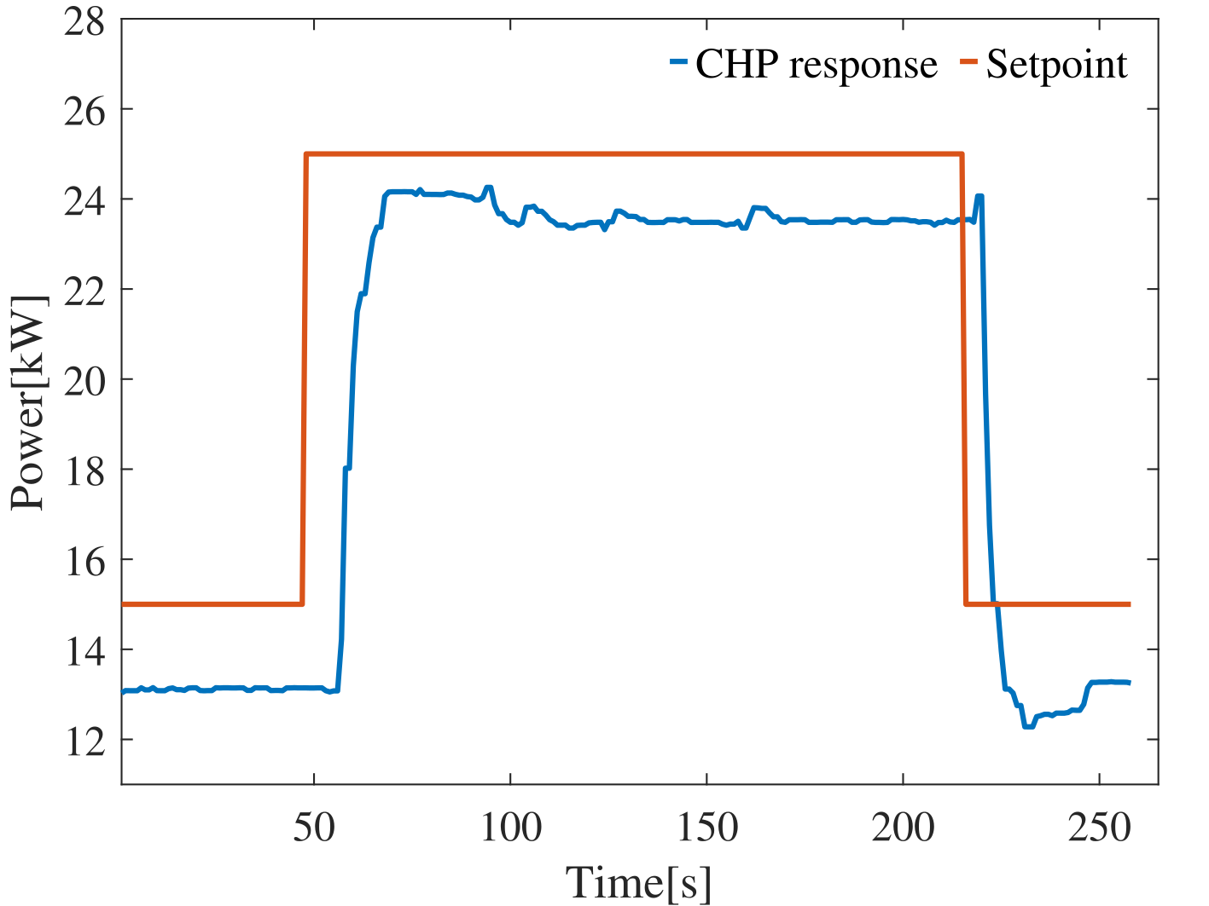
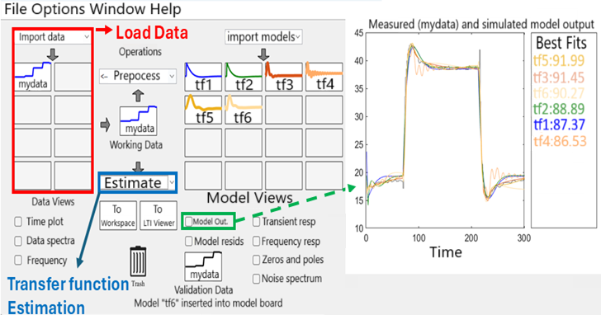
CHP TRANSFER FUNCTION IDENTIFICATION
This toolbox allows users to:
Interact with the real cogenerator and define setpoints;
Record the system’s response and upload the resulting data;
Automatically derive the transfer function from the uploaded data.
De Tuglie et al.
Polytechnic University of Bari

Slide 10
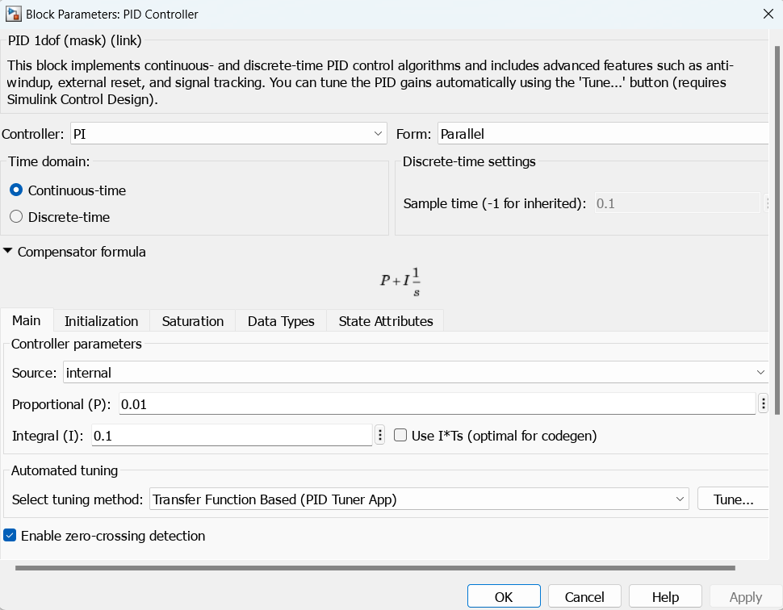
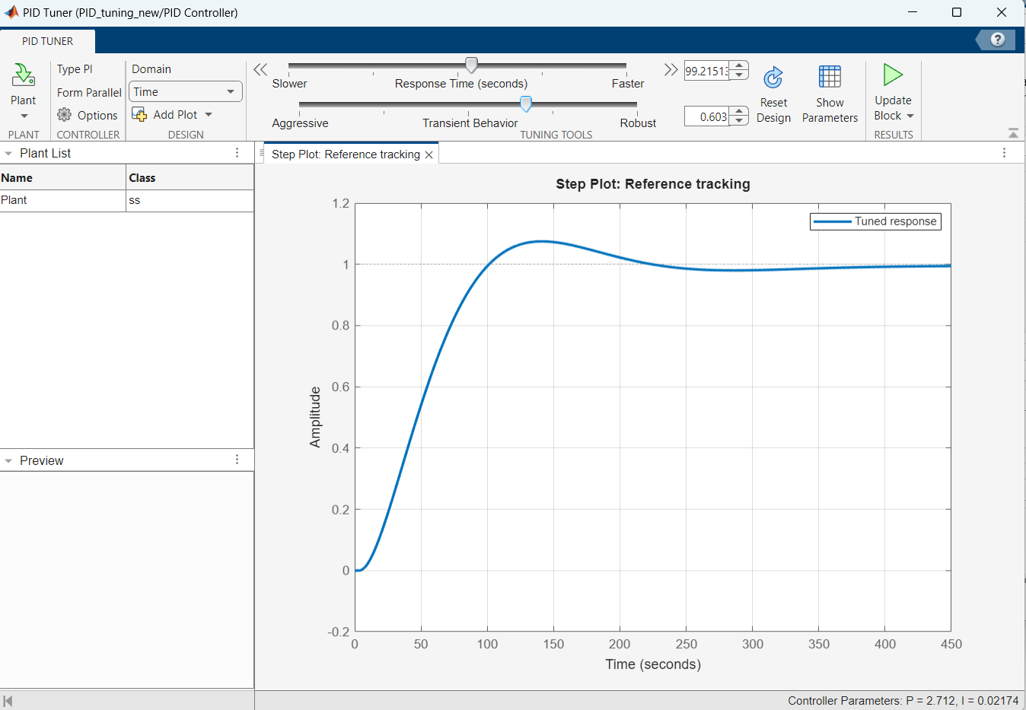
PI TUNING
Once the transfer function is obtained, it is possible to tune the PI controller using the 'Tune' function and update the PI block. This step is crucial for building the online model that enables interaction with real machines.
De Tuglie et al.
Polytechnic University of Bari

Slide 11
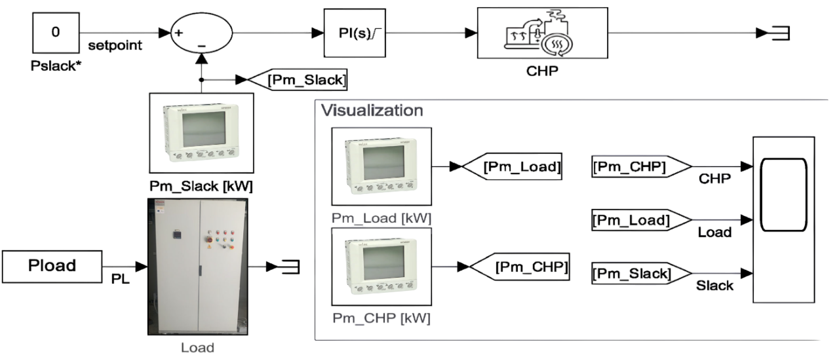
REAL TIME CONTROL
The simulated transfer function are replaced by OPC tag in order to communicate with the real machine
The actual process signals are read in real time via OPC
The model continues to operate as a real time controller, directly interfacing with the hardware
De Tuglie et al.
Polytechnic University of Bari

Slide 12
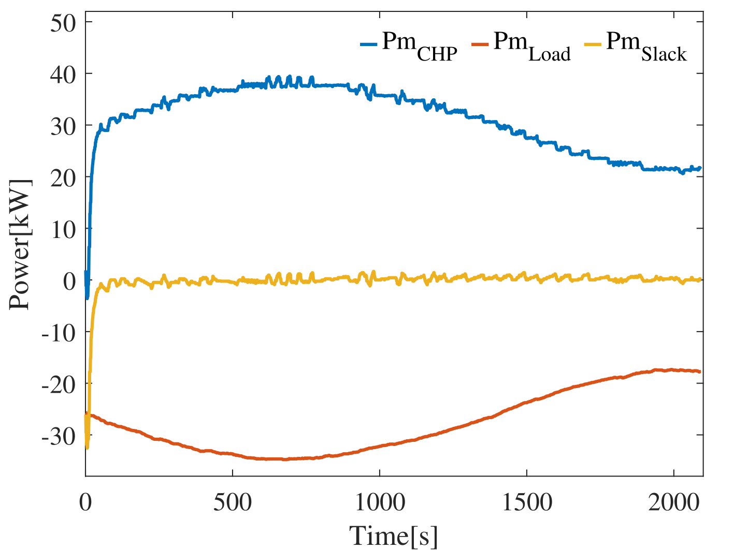
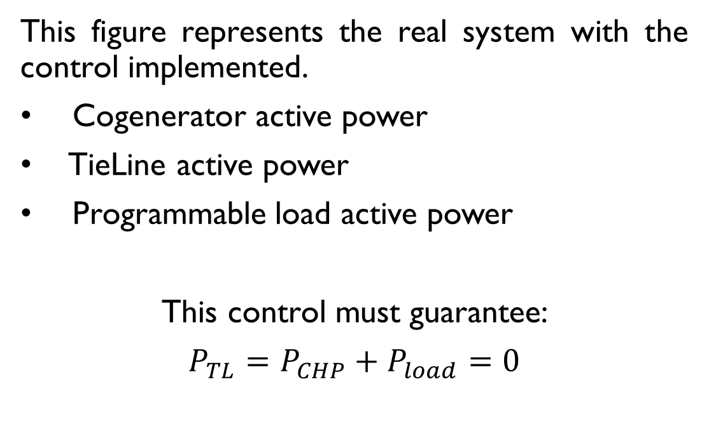
REsults
This figure represents the real system with the control implemented.
Cogenerator active power
TieLine active power
Programmable load active power
This control must guarantee:
$P_{TL}=P_{CHP}+P_{load}=0$
De Tuglie et al.
Polytechnic University of Bari

Slide 13
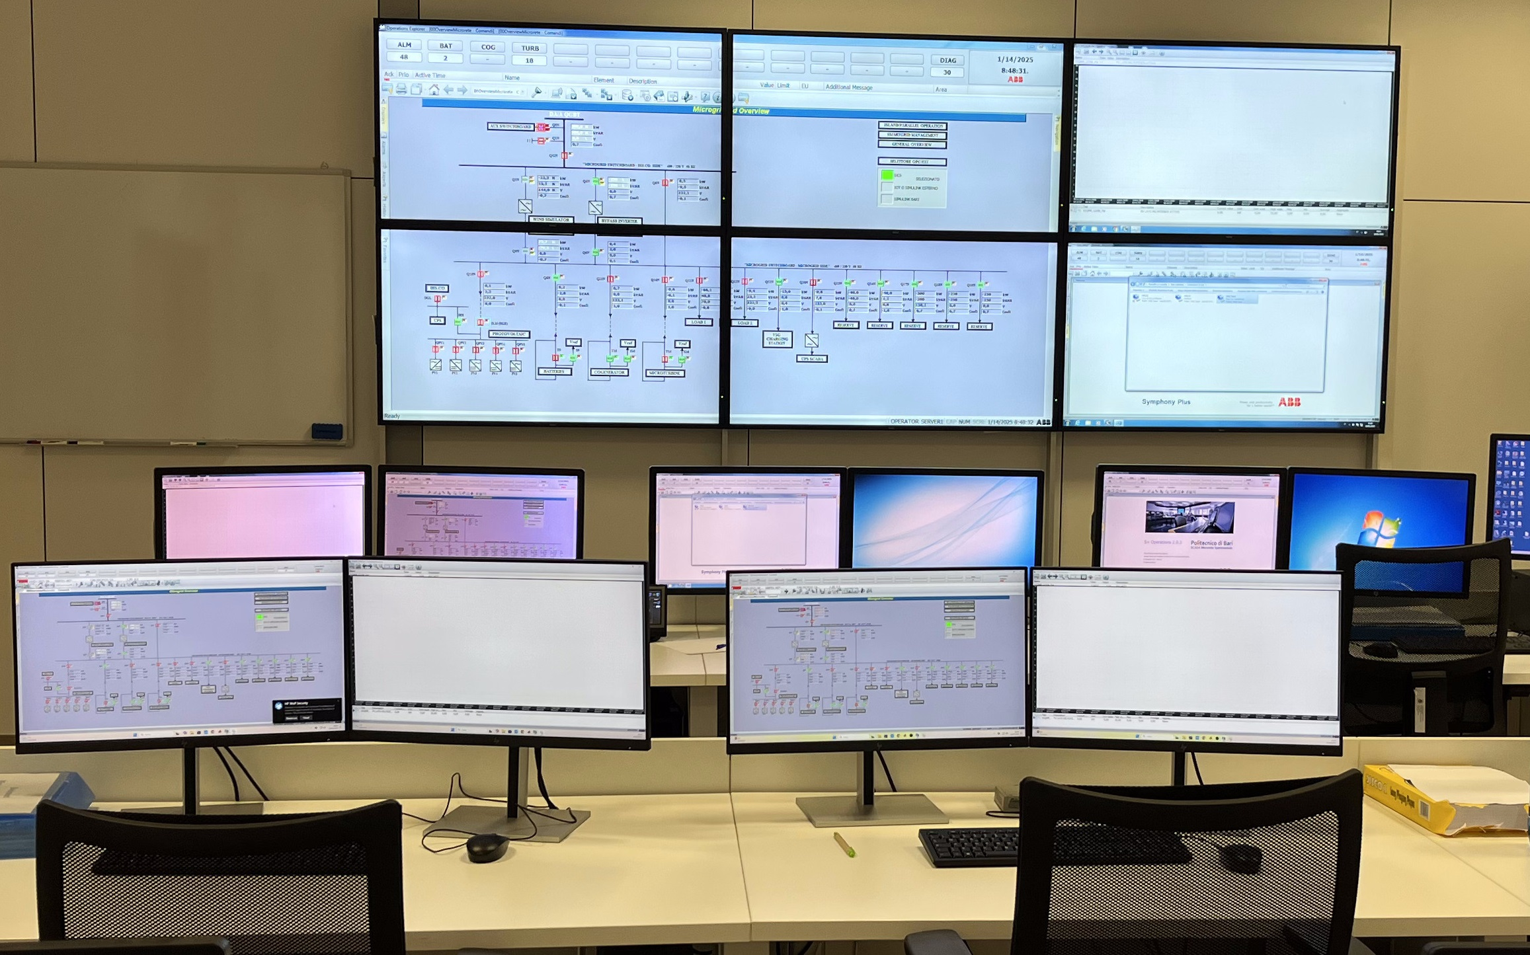
COLLABORATION VS COMPETITION IN TASK EXECUTION
The control room of the test facility
Students response per phase
CHP identification
Group | Number of students | Average execution time | Variance
Group A | 5 | 25 minutes | 10 minutes
Group B | 5 | 15 minutes | 10 minutes
Group C | 4 | 20 minutes | 10 minutes
Group D | 2 | 20 minutes | 10 minutes
PI Tuning
Group A | 5 | 30 minutes | 15 minutes
Group B | 5 | 20 minutes | 15 minutes
Group C | 4 | 25 minutes | 15 minutes
Group D | 2 | 20 minutes | 10 minutes
Real time Control
Group A | 5 | 25 minutes | 20 minutes
Group B | 5 | 15 minutes | 10 minutes
Group C | 4 | 25 minutes | 20 minutes
Group D | 2 | 15 minutes | 10 minutes
Students were divided into groups to analyze how collaboration and competition affect task execution, focusing on completion time and coordination;
Results showed that larger groups completed task faster but with greater variability, indicating uneven partecipation and task distribution;
Smaller or well coordinated groups were more consistent, though generally slower, highlighting the importance of balanced teamwork for efficiency
De Tuglie et al.
Polytechnic University of Bari

Slide 14
CONCLUSION & LEARNING OPPORTUNITIES
Seamless Integration Experience: Students and researchers learn to transfer control logic from MATLAB/Simulink to SCADA using OPC, simplifying the management of complex energy systems.
Real Time Microgrid Control: Practical application in the PrInCE Microgrid allows learners to manage a cogenerator for demand balancing and reduced grid reliance.
Collaborative Learning & Innovation: The platform fosters teamwork, competition, and innovation, preparing students with industry relevant, real world automation and energy management skills.
De Tuglie et al.
Polytechnic University of Bari

Slide 15
THANKS FOR YOUR ATTENTION!

