Slide 1
The Role of Generative Artificial Intelligence in Higher Education: Applications and Ethical Implications
Jun 2025
Dr. Sorabh Bajaj
Director, Center for Digital Learning
Ms. Sheba Philip George
Consultant, Center for Digital Learning

Slide 2
Introduction
GenAI is capable of autonomously generating original content.
It is transforming knowledge delivery, consumption, and production in higher education.

Slide 3
Paper objectives:
Explore current uses of GenAI
Examine ethical implications
Propose a framework for adaptive learning

Slide 4
GenAI Applications in Higher Education
A
GenAI in Assignments
R
GenAI in Research
T
GenAI in Teaching

Slide 5
GenAI Applications in Higher Education
A
GenAI in Assignments
High
R
GenAI in Research
T
GenAI in Teaching
Need for Governance
Low
Low
High
Acceptance

Slide 6
GenAI Applications in Higher Education
A
GenAI in Assignments
High
R
GenAI in Research
T
A
Planning
T
GenAI in Teaching
Grading & Evaluation
Self assessment
A
A
R
A
Polishing and Editing
Need for Governance
R
Application and Review
T
Content Creation
T
Learning Support
A
R
Research
T
Classroom Use
Data Analysis
R
Low
Low
High
Acceptance

Slide 7
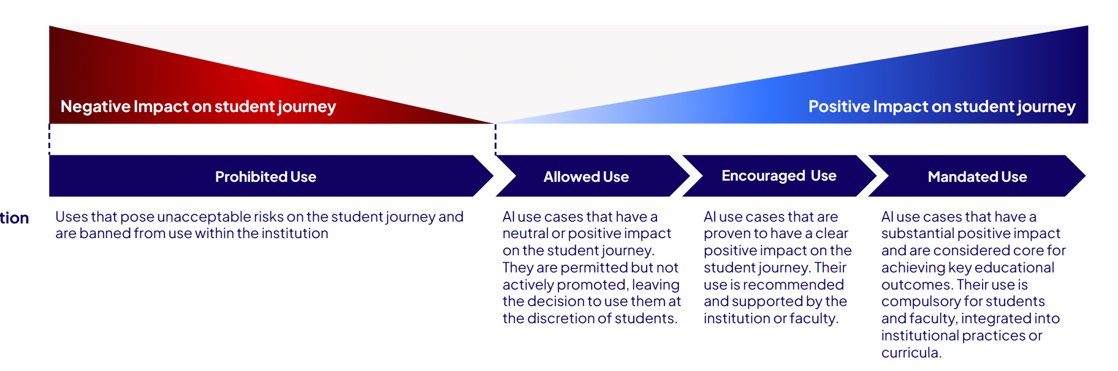
GenAI’s iMPACT: Higher Education
Source:Digital Education Council. (2024). AI use in higher education: Current practices and future directions

Slide 8
GenAI Applications in Higher Education
A
GenAI in Assignments
High
R
GenAI in Research
T
A
Planning
T
GenAI in Teaching
Grading & Evaluation
Self assessment
A
A
R
A
Polishing and Editing
Need for Governance
R
Application and Review
T
Content Creation
T
Learning Support
Source:Digital Education Council. (2024). AI use in higher education: Current practices and future directions
A
R
Research
T
Classroom Use
Data Analysis
R
Low
Low
Prohibitive
Debatable
Commonly Agreed
High
Acceptance

Slide 9
Ethical Implications of GenAI
Intellectual Property:
Challenges traditional authorship; need for clear policies.
Data Privacy:
Relies on sensitive student data; requires robust governance.
Academic Integrity:
Difficult to distinguish student vs. AI-generated work; need for new evaluation methods.
Equity and Bias:
Risk of perpetuating biases and widening resource gaps.

Slide 10
Benefits for Teaching, Learning, and Research
Personalized Learning Pathways:
Tailors content to individual styles, pacing, competencies.
Administrative Efficiency:
Automates grading, attendance, communications.
Enhanced Research Productivity:
Manages datasets, drafts academic writing.
Inclusive Education:
Generates content in multiple formats (audio, simplified text, translations).

Slide 11
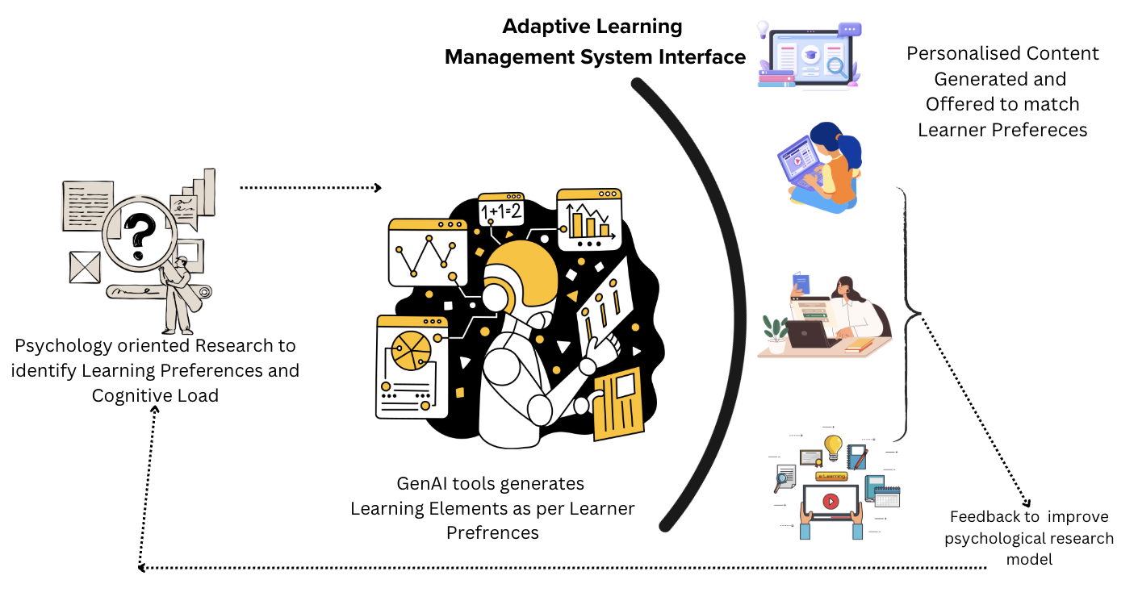
Conceptual Framework for Adaptive Learning Management Systems (ALMS)
Integrates:
GenAI tools
Psychological research on learning preferences
Digital learning platforms
Goal: Deliver customized learning experiences tailored to individual needs.

Slide 12
Psychological Research in ALMS
Learners have diverse preferences and cognitive styles.
Use psychometric assessments and profiling to identify:
Working memory
Processing speed
Attention span
Enables meaningful personalization, avoiding “one-size-fits-all” approaches.

Slide 13
Cognitive Load Theory in ALMS
Managing mental effort is crucial.
Test learning elements (videos, texts, simulations) for:
Intrinsic load
Extraneous load
Germane load
Optimizes content format and complexity for each learner

Slide 14
GenAI-Driven Personalization
GenAI dynamically generates:
Videos tailored to pace and prior knowledge
Reading materials adapted in complexity and length
Interactive activities with adaptive feedback
Ensures optimal engagement and retention.

Slide 15
ALMS Design and Implementation
Cyclical Process:
Assessment: Identify learner profiles
Generation: AI creates custom content
Delivery: Curated via digital platform
Feedback: Continuous refinement based on learner data
Enables flexible, evolving educational experiences.

Slide 16
Future Research Directions
Cognitive load experiments across diverse learners
AI bias mitigation frameworks
Longitudinal studies on learning outcomes
Models for effective faculty-AI collaboration

Slide 17
Thank You
Reach me at: sorabh.bajaj@flame.edu.in

