Slide 1
Teaching and Learning Ideas for Mathematics: The Case of a Greek Game
Eleni Tsami
University of Piraeus – Greece
Dimitris Anastasopoulos
University of Ioannina – Greece
The Learning Ideas Conference 2025, New York.

Slide 2
INTRODUCTION
Distance game – based teaching is not familiar to Greek Schools (teachers and students). This survey is an innovation for the Greek Education and makes a teaching proposal in this field.
The proposal is for children 6-12 years old.
The teaching proposal is based on the students books of the primary school.
The game – based teaching guides children to learn with fun and solve problems.

Slide 3
KIDEDU – Play Create Learn (1)
A project named “KIDEDU” (Play Create Learn) designed and implemented by a research team of the University of Piraeus.
The proposed object is the creation of 3D animation interactive game through which children aged 6-12 years will learn “Everyday Arithmetic“ and “Planet Earth” in a very innovative way without the use of books, notebooks, pencils and blackboards but only with the use of digital technology presented simply to attract children to learn indirectly through guided exploratory learning while spending their time happily.

Slide 4
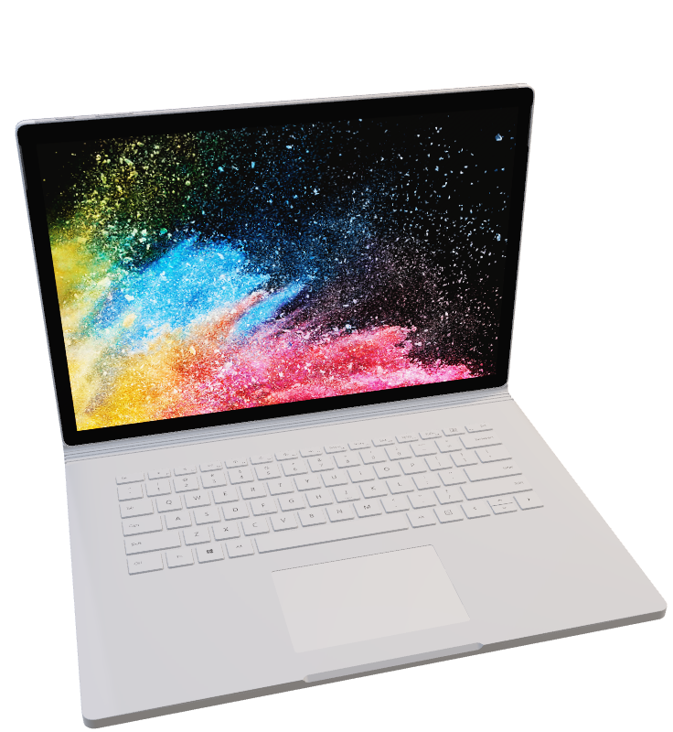
KIDEDU – Play Create Learn (2)
During the game, basic knowledge will be narrated and transferred, where this is necessary by children, so that the voice that is heard is popular and does not refer to the voice of a teacher but to the voice of a friend - their classmate.

Slide 5
THE SUBJECT
The hero is a small child of about 7 years. He lives with his family in a house.
He is starting an adventure trip to a fantastic castle and through this trip he passes through different environments such as:
Children’s bedroom, Bathroom, Kitchen/living room, Garage, Neighbourhood, Forest, Stable/Farm, Castle grounds, Geopark and Hall of the castle.

Slide 6
DIGITAL ENVIRONMENTS
1. Bedroom | 2. Bathroom
3. Kitchen/Lining Room | 4. Garage
5. Neighborhood | 6. Forest
7. Farm | 8. Castle (outside)
9. Geopark | 10. Castle (insight)

Slide 7
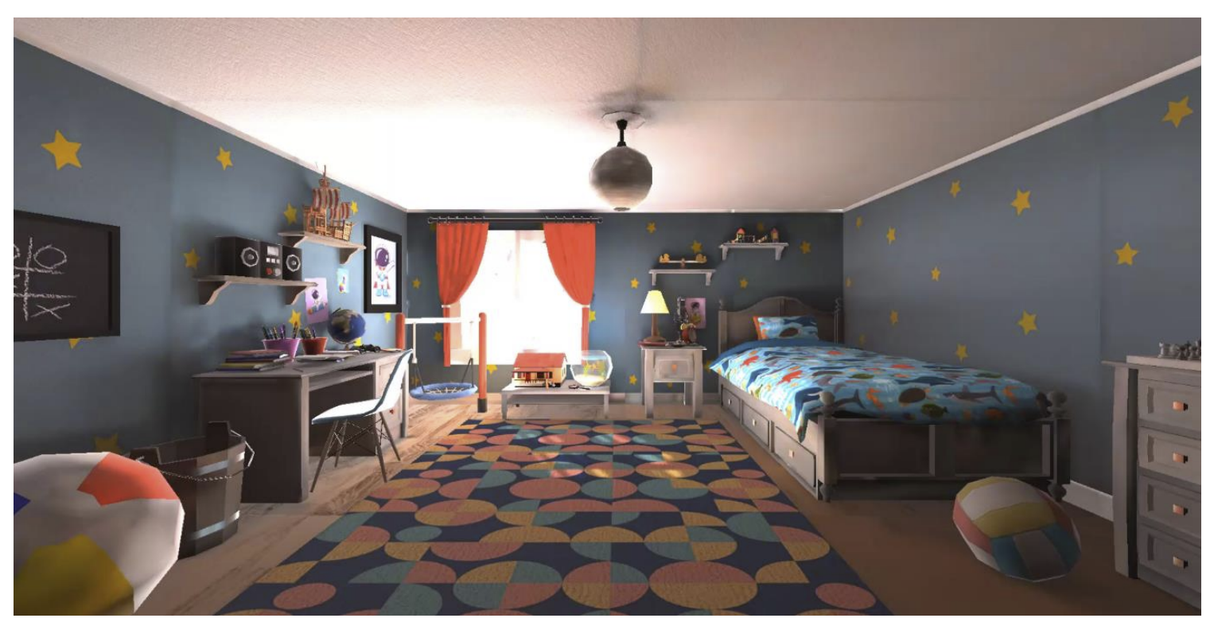
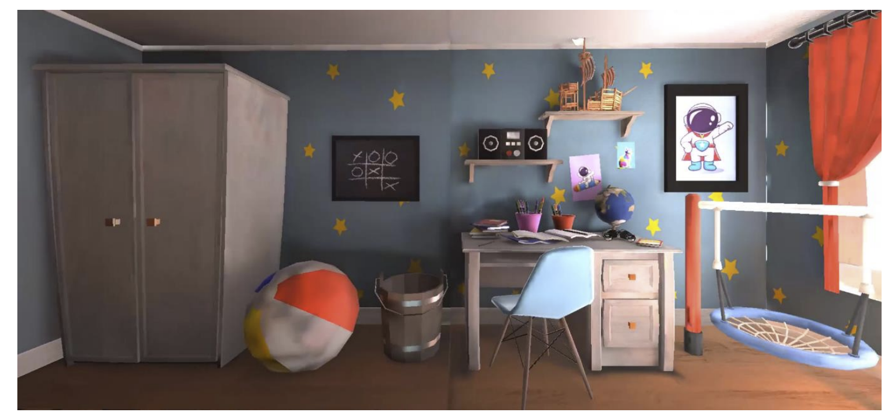
Bedroom
.

Slide 8
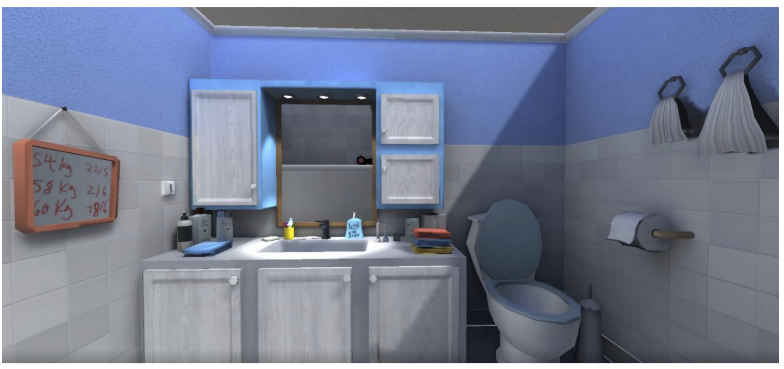
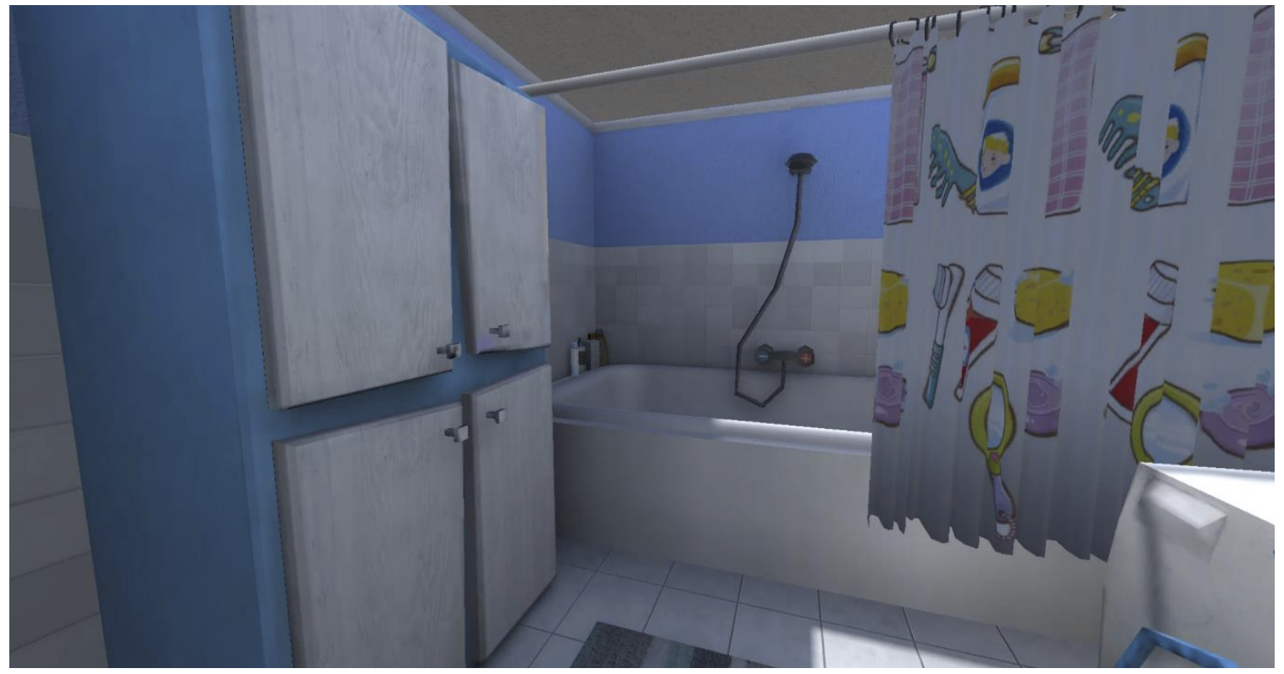
Bathroom

Slide 9
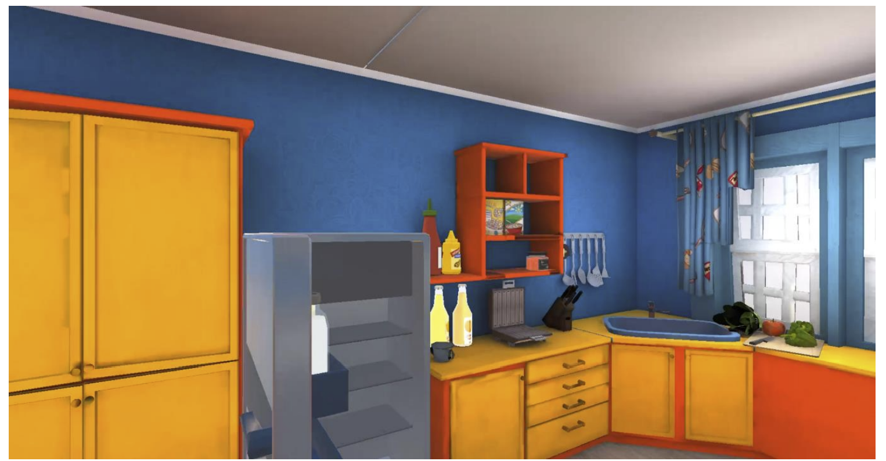
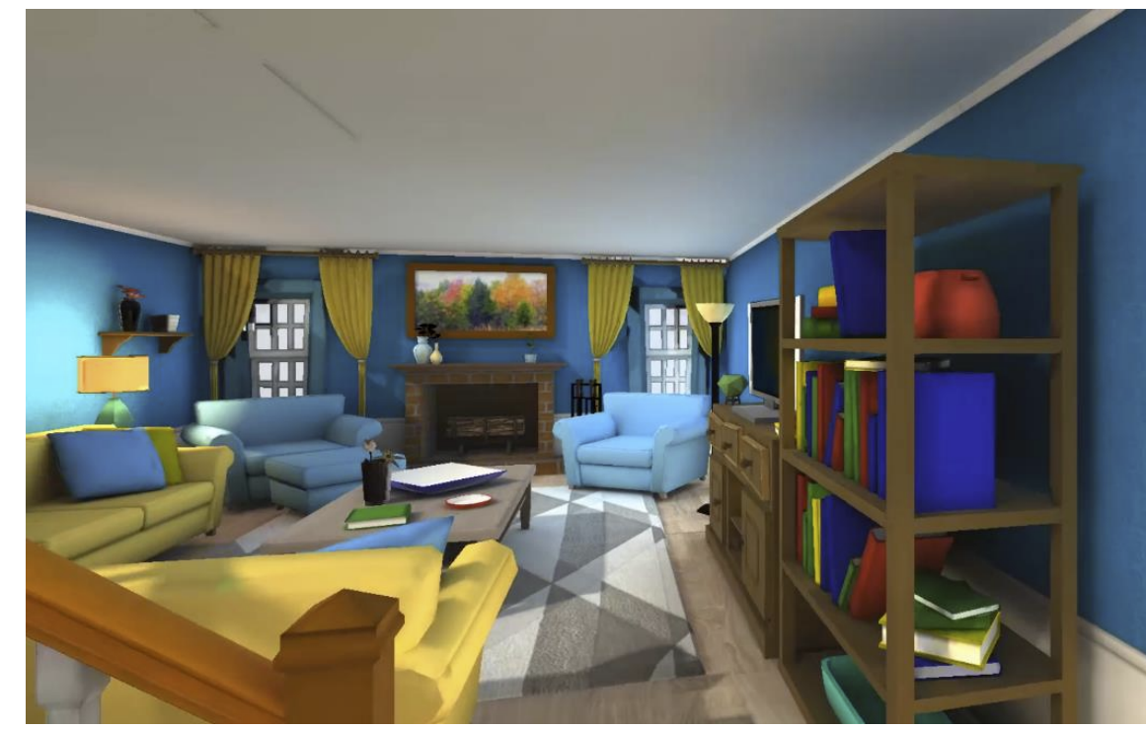
Kitchen/Living Room

Slide 10
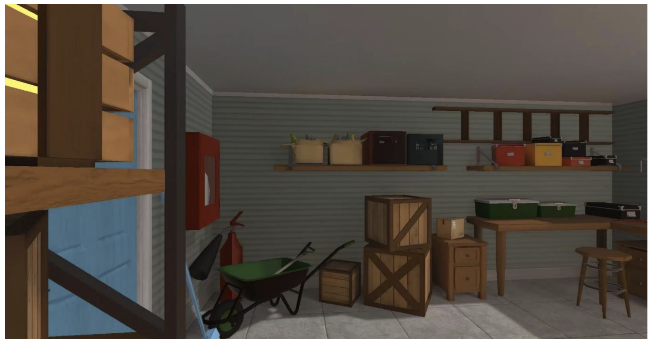
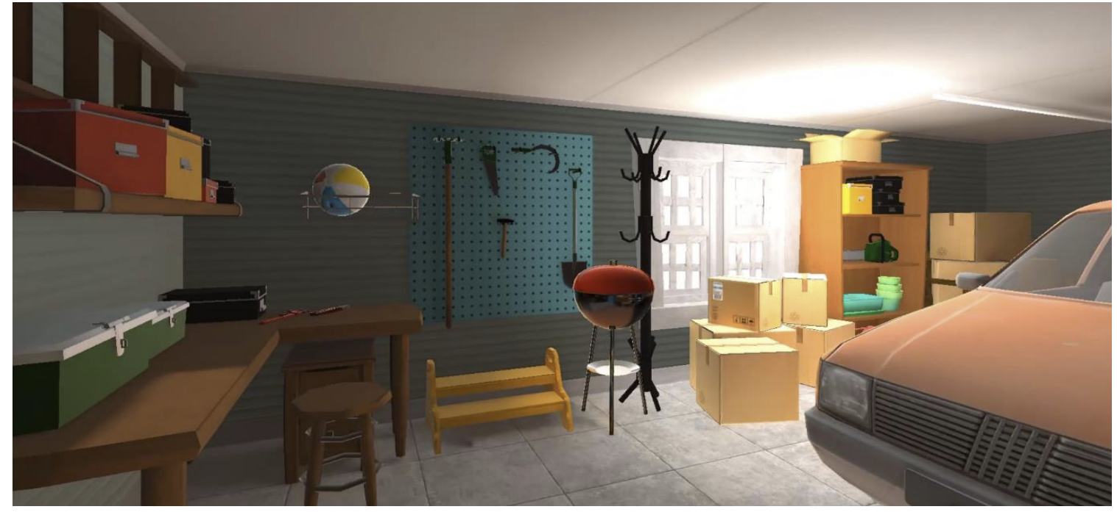
Garage

Slide 11
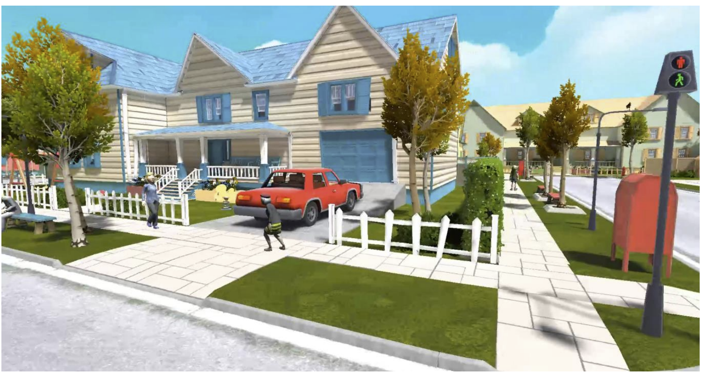
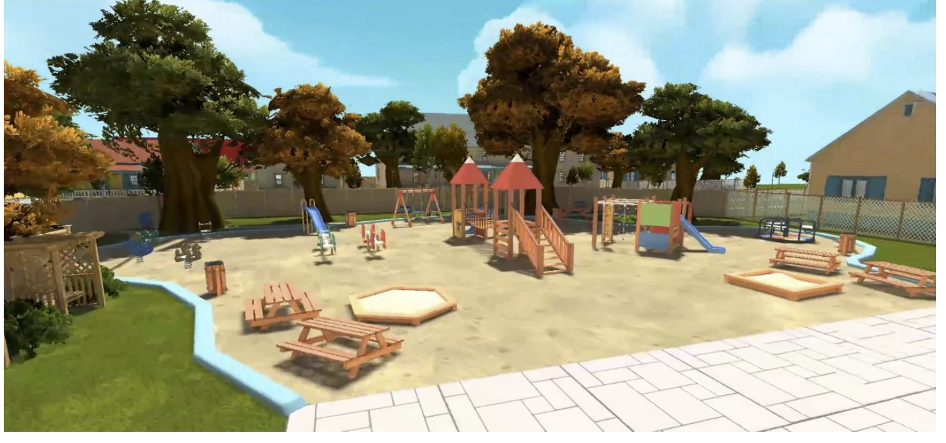
Neighborhood

Slide 12
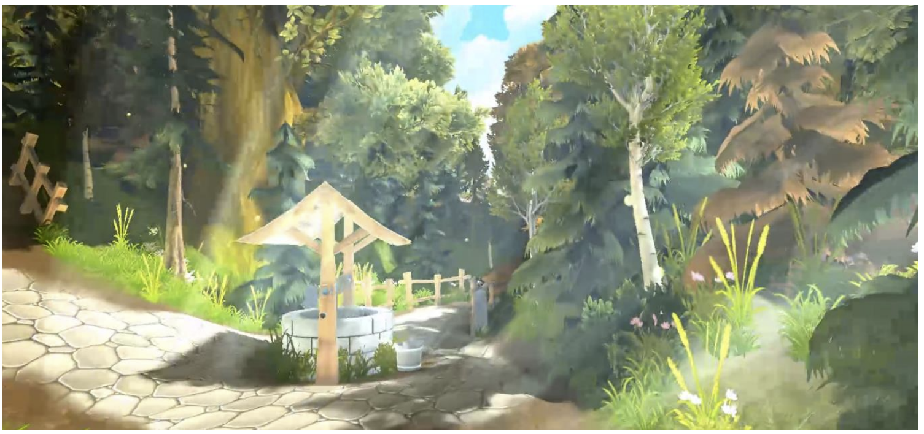
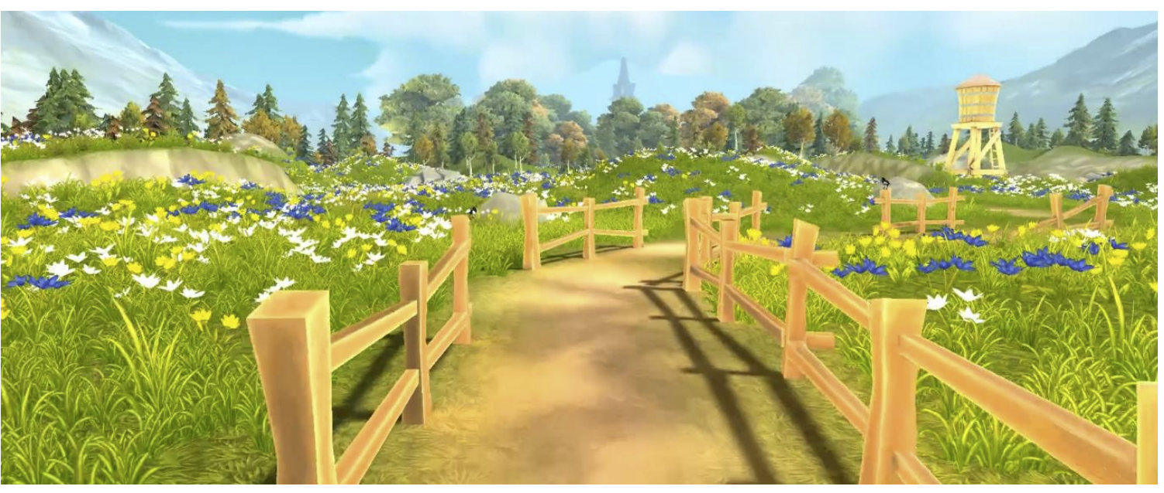
Forest
.

Slide 13
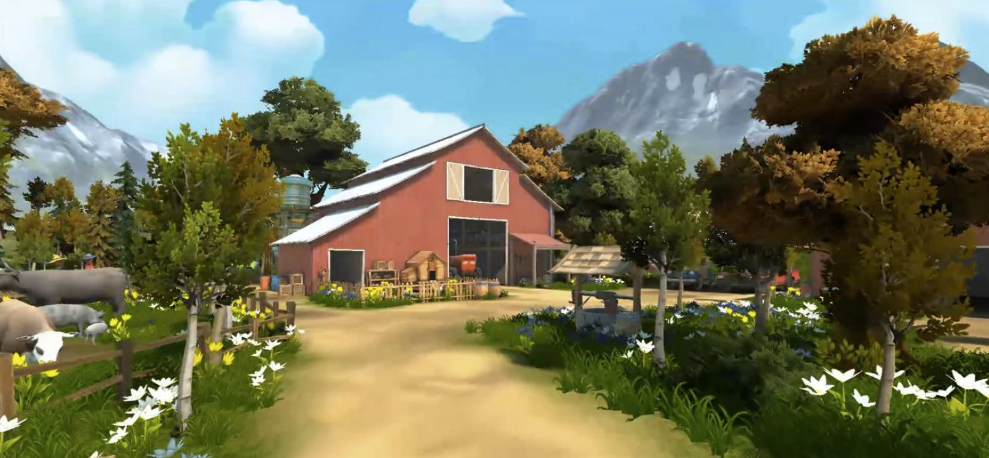
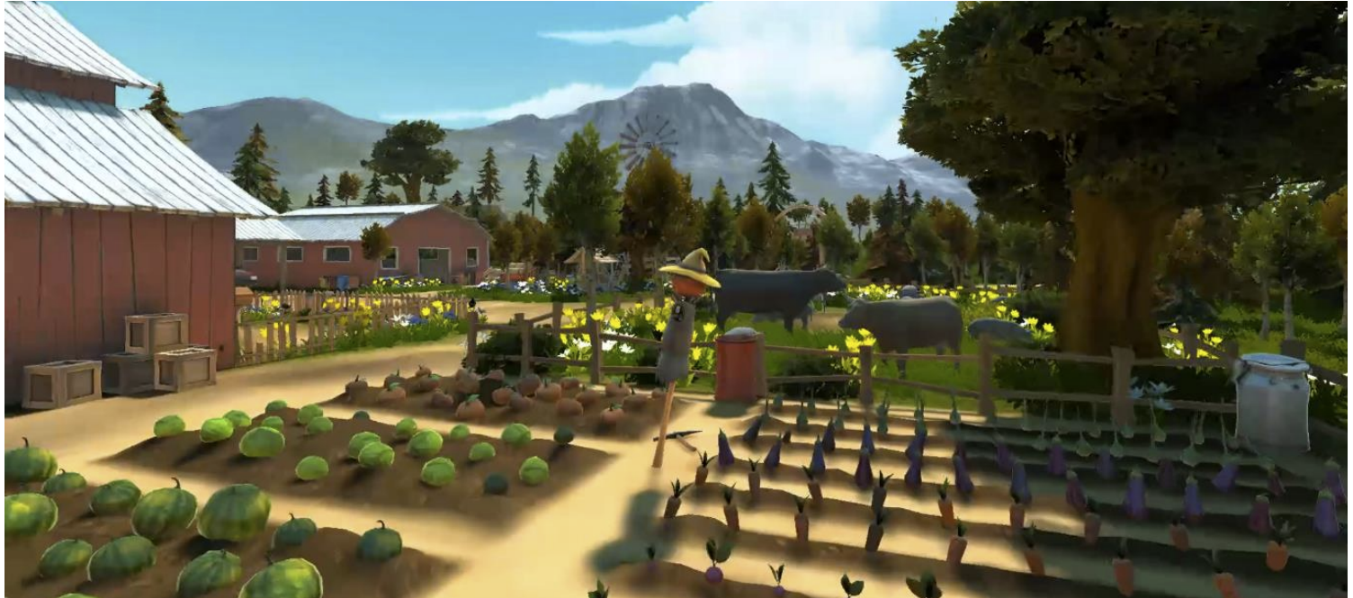
Farm

Slide 14
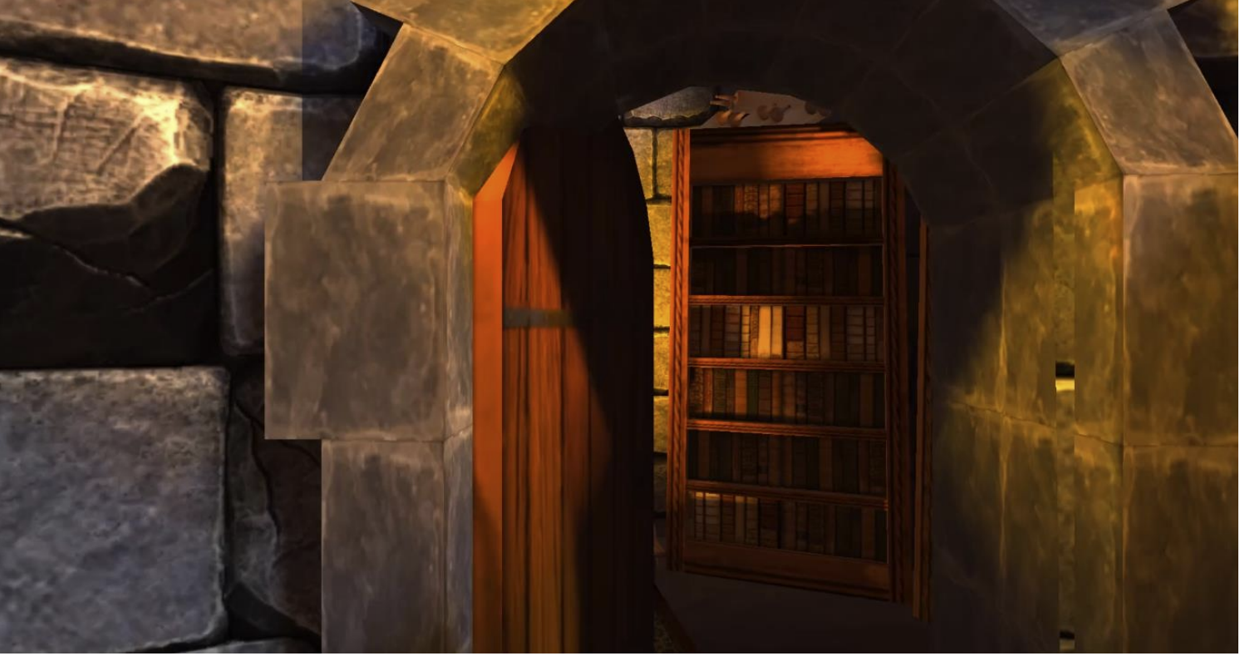
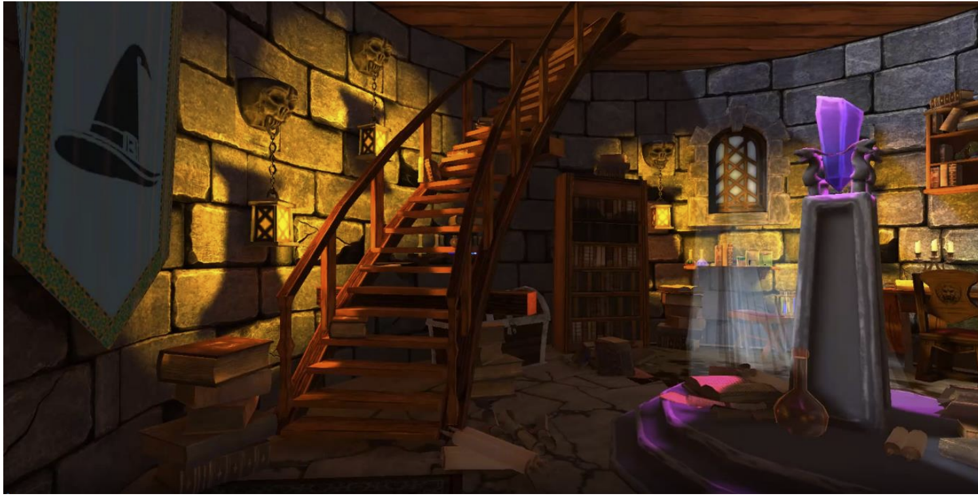
Castle

Slide 15
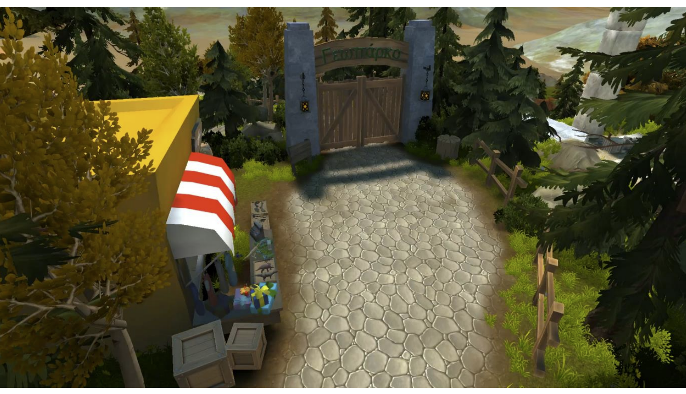
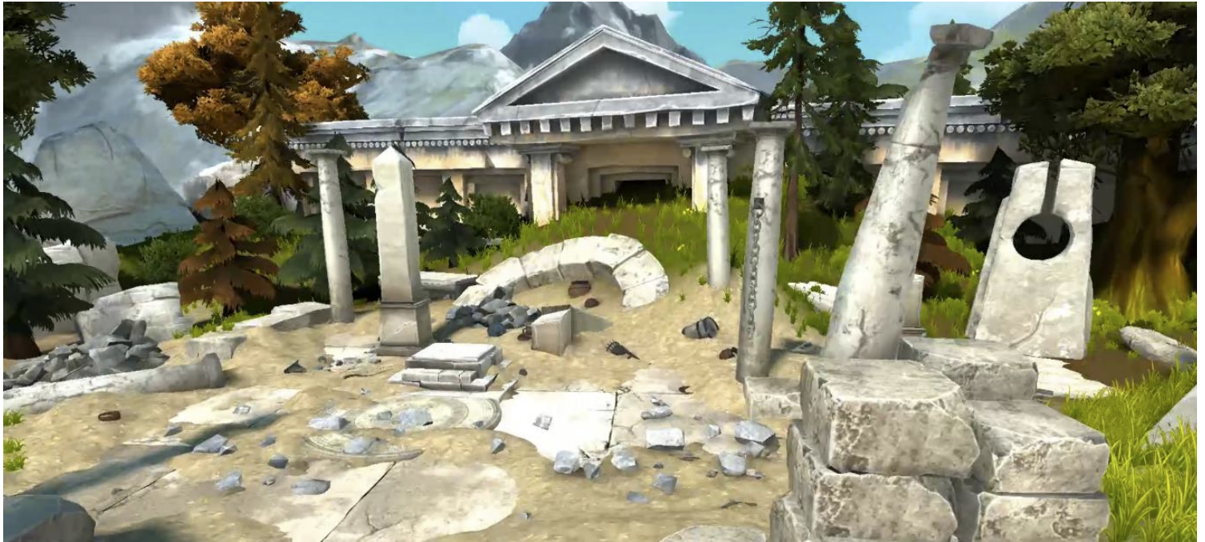
Geopark - 1

Slide 16
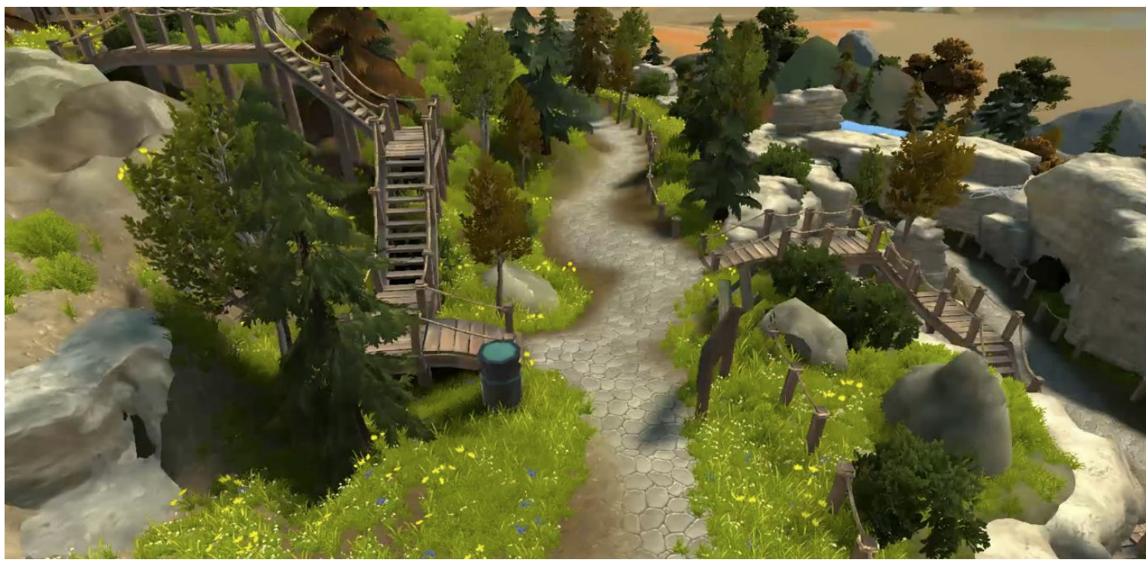
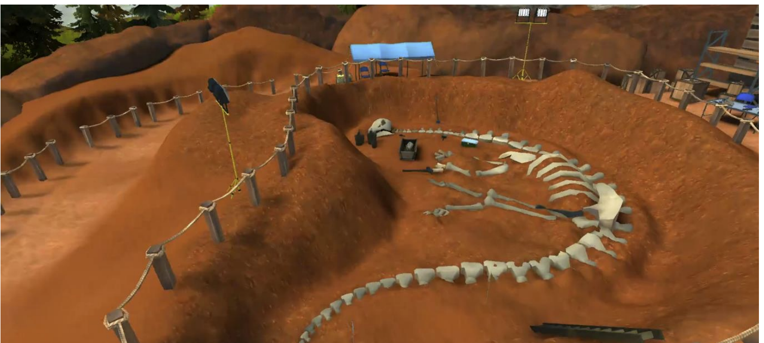
Geopark - 2

Slide 17
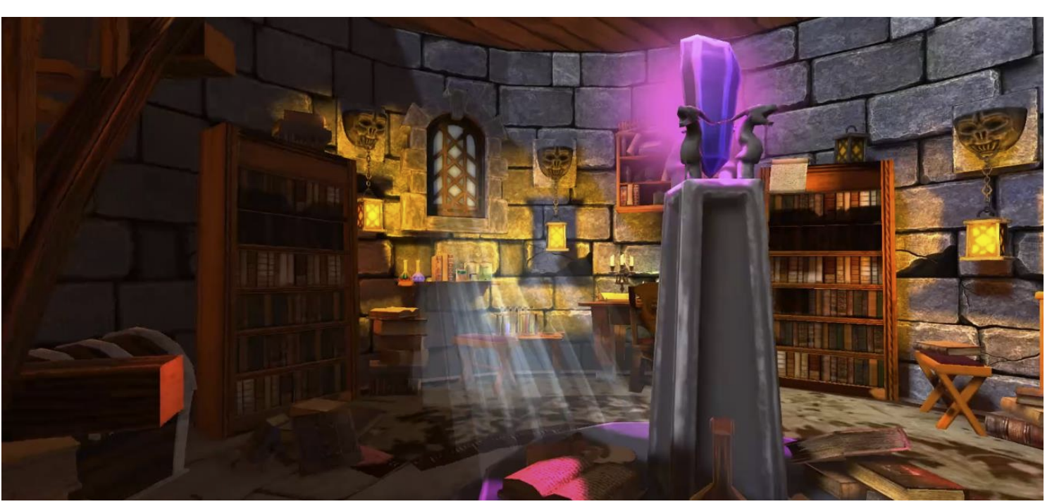
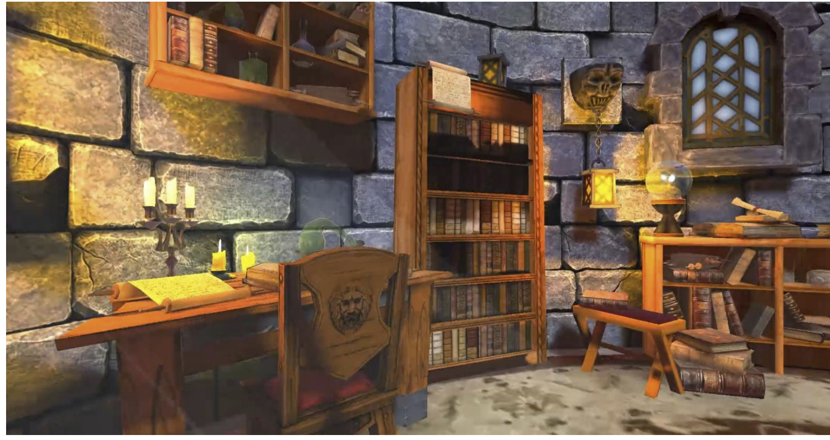
Castle

Slide 18
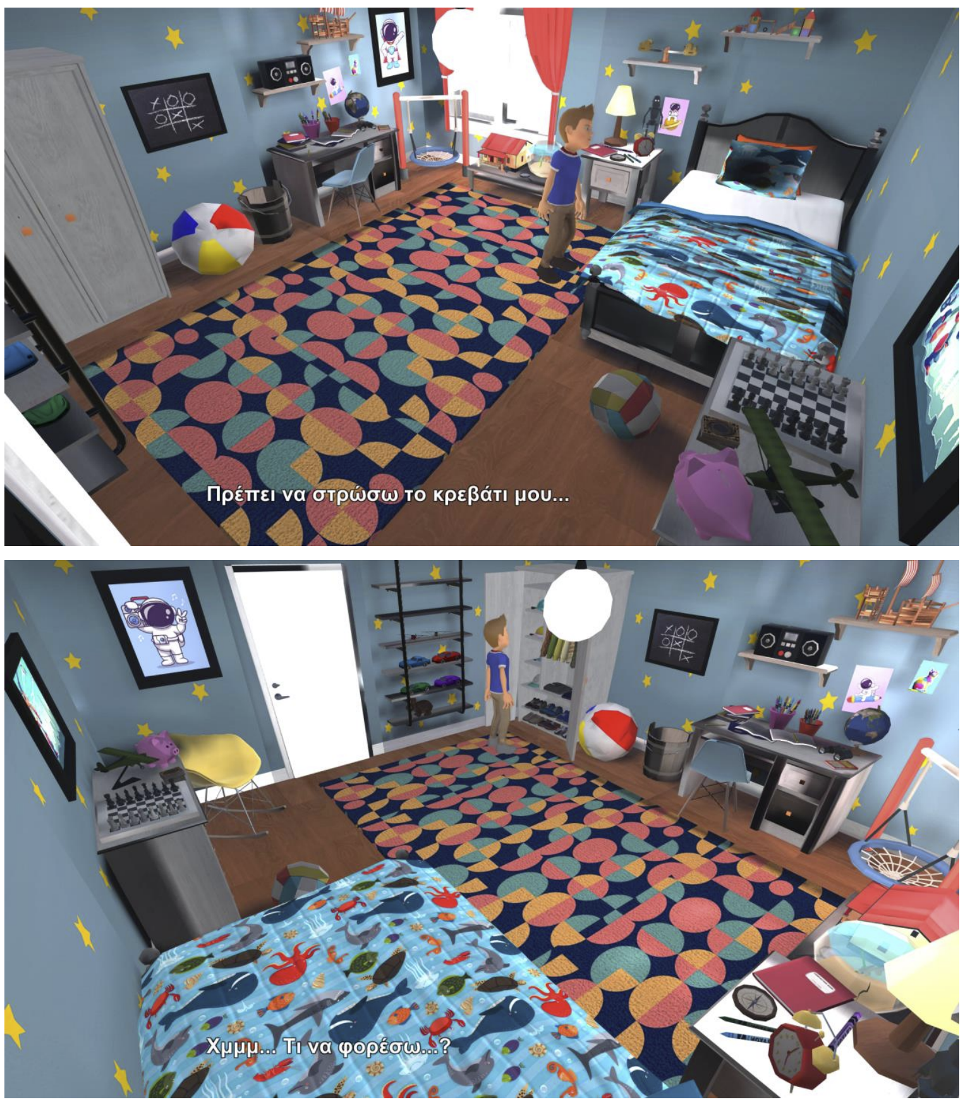
NAVIGATION AND
USER INTERACTION WITH
OBJECTS IN
THE GAME
Bedroom

Slide 19
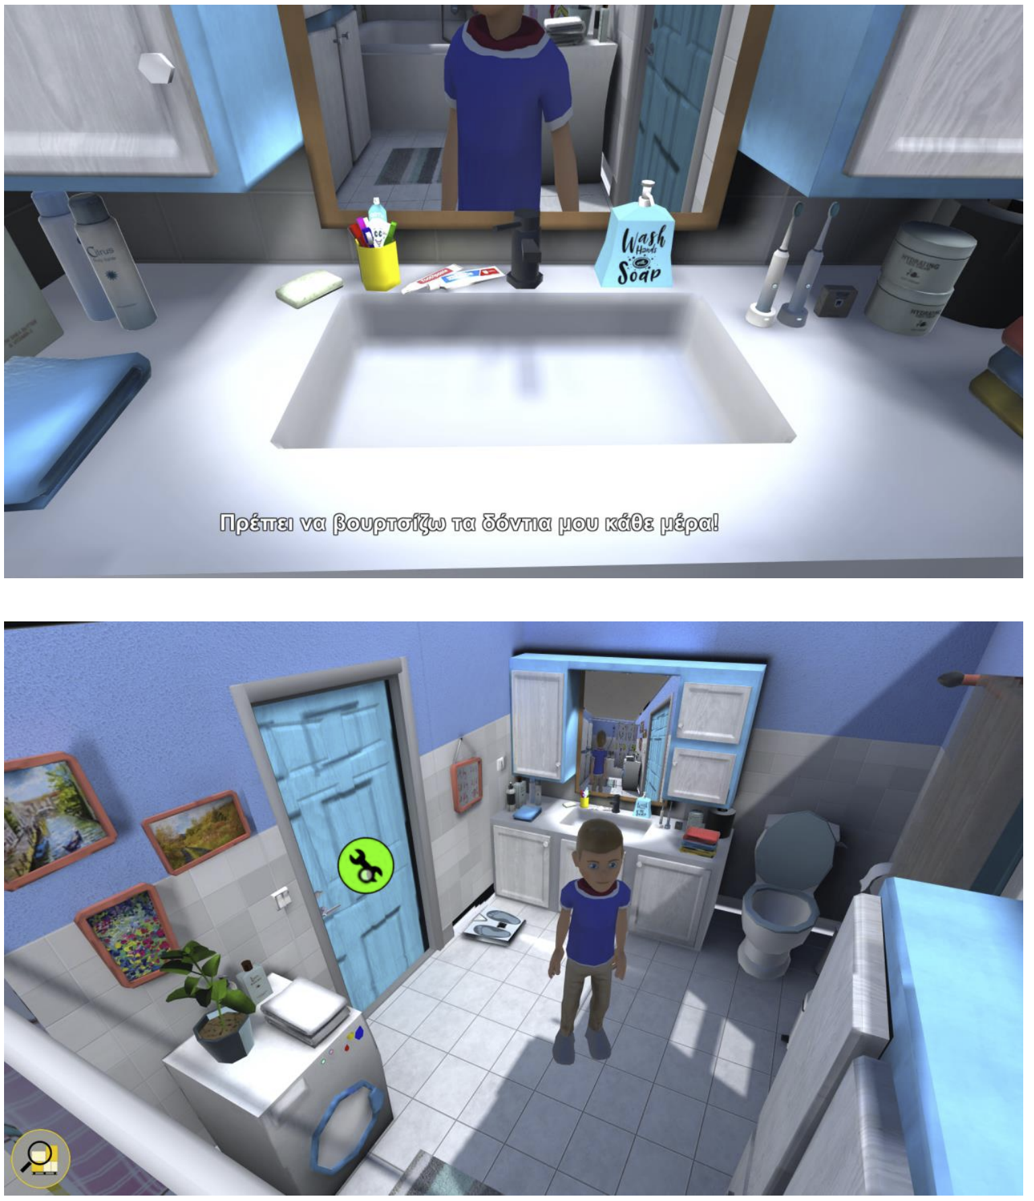
NAVIGATION AND
USER INTERACTION
WITH OBJECTS IN
THE GAME
Bathroom

Slide 20
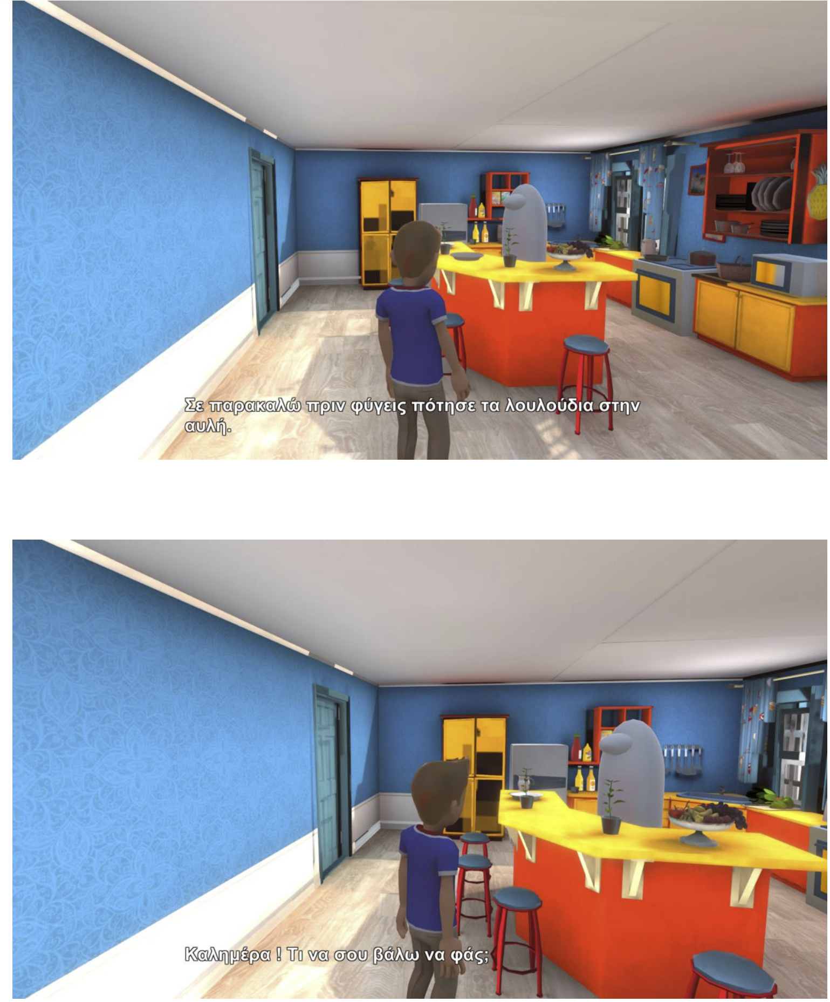
NAVIGATION AND
USER INTERACTION
WITH OBJECTS IN
THE GAME
Kitchen

Slide 21
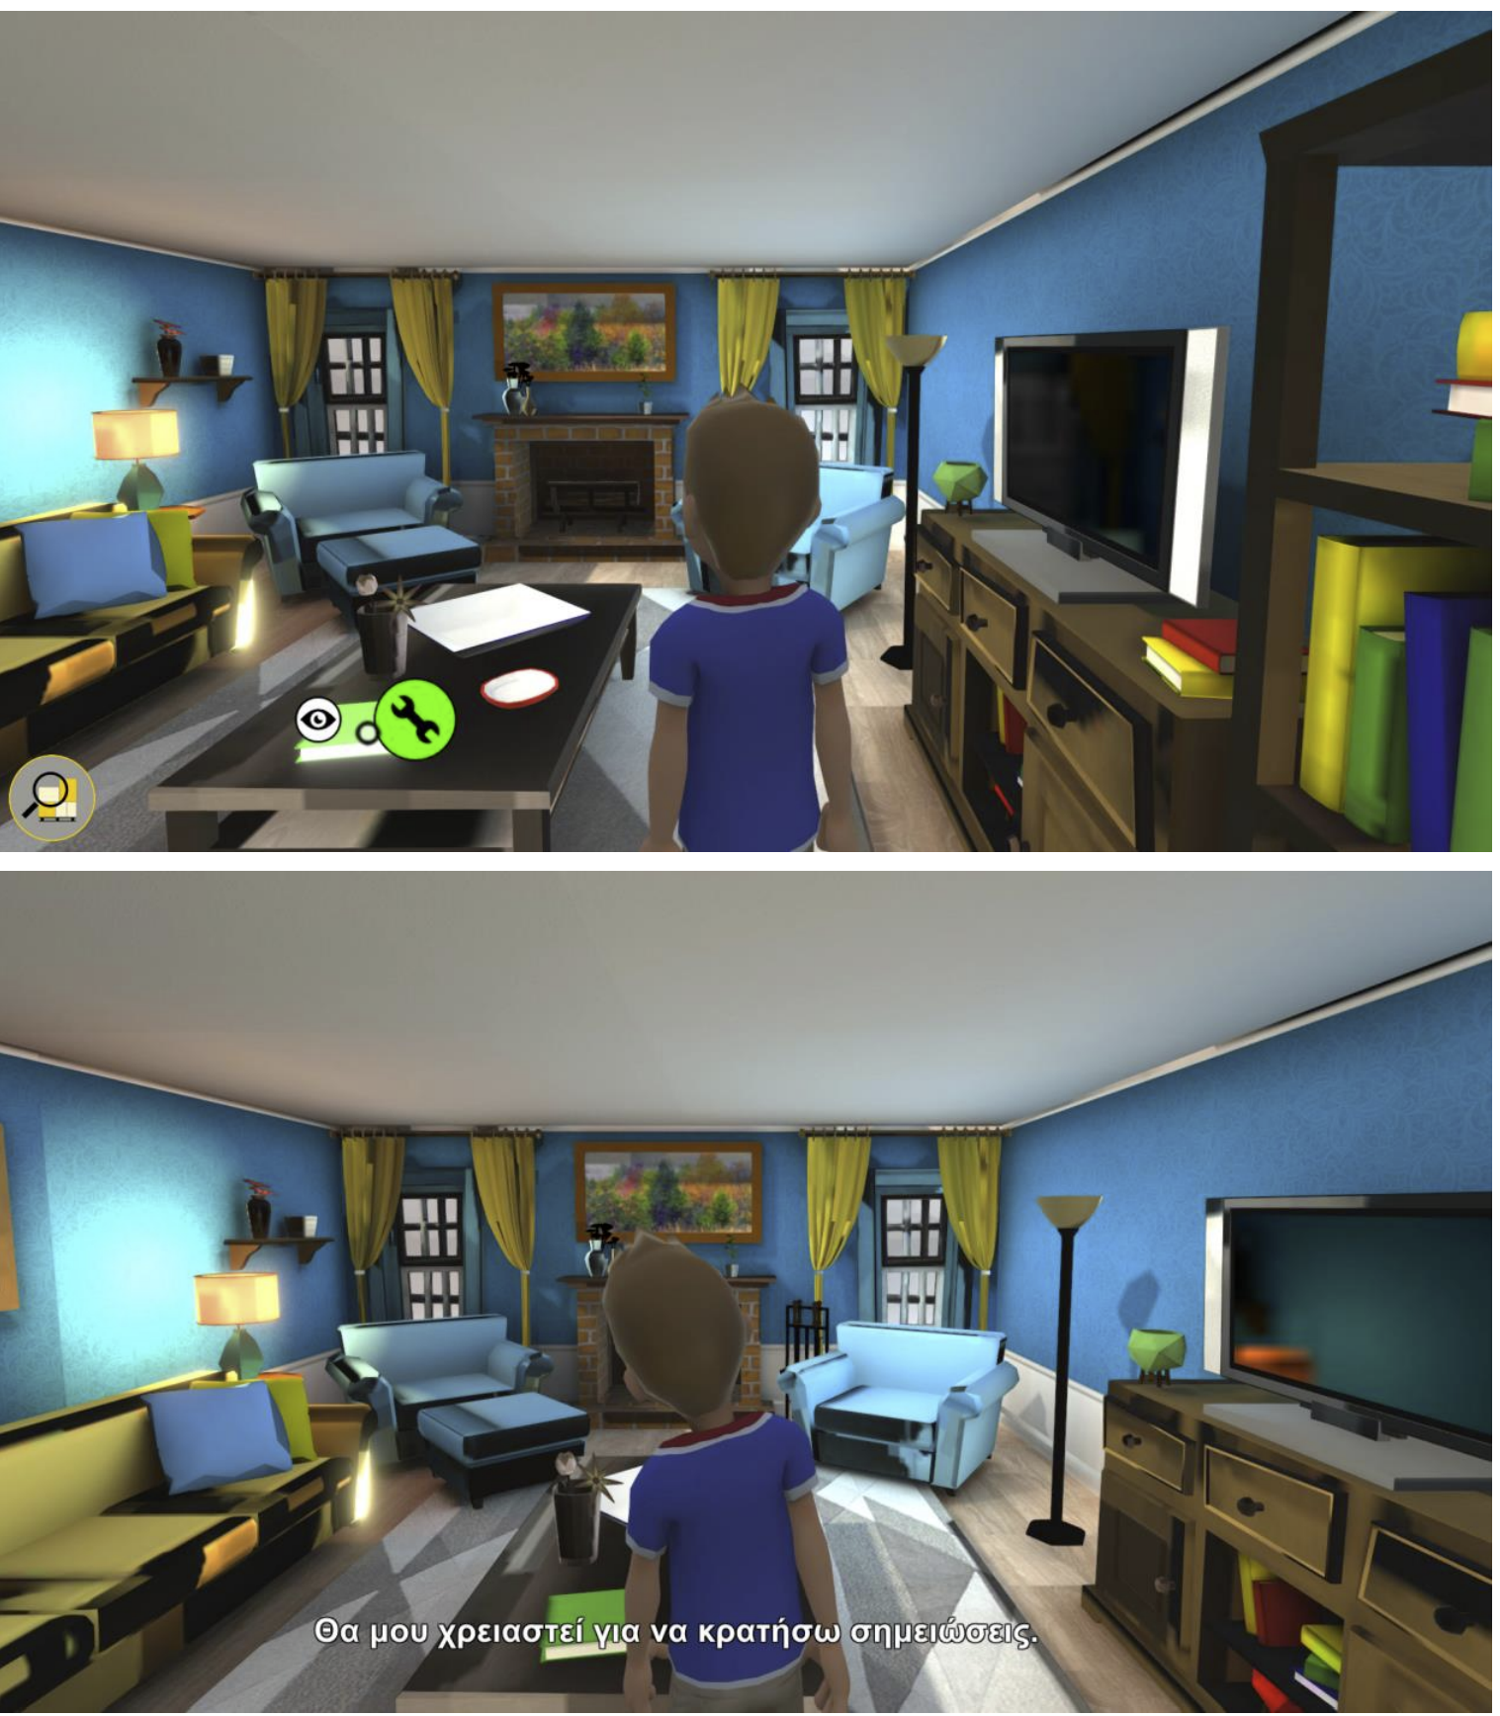
NAVIGATION AND
USER INTERACTION WITH
OBJECTS IN
THE GAME
Living room

Slide 22
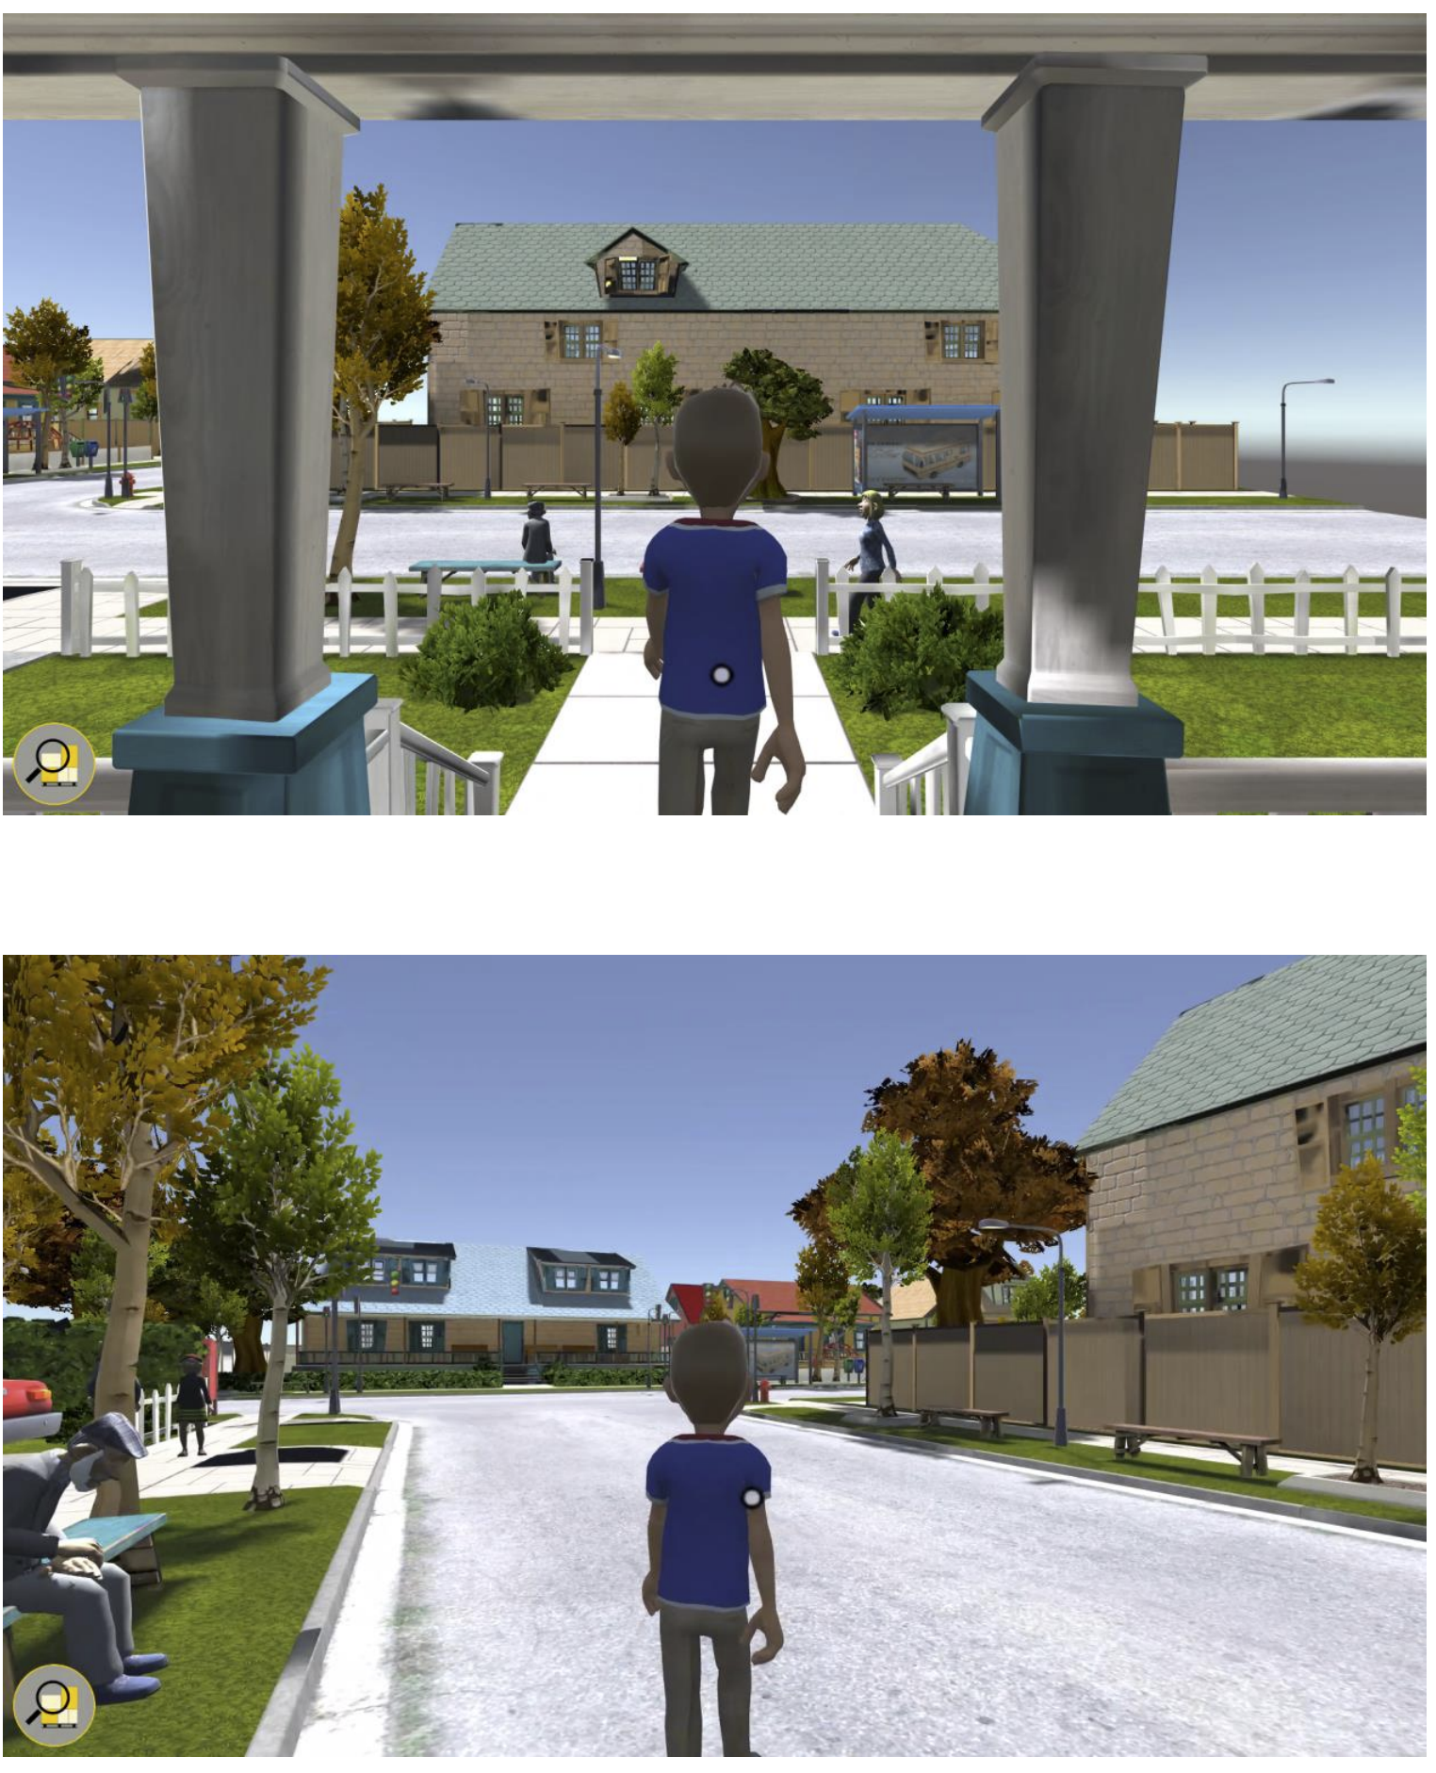
NAVIGATION AND
USER INTERACTION
WITH
OBJECTS IN
THE GAME
Neighborhood

Slide 23

Thank you so much

