Slide 1


How AI-Powered Grading Boosts Completion through Faster, High-Quality Feedback at Scale
Robert Urbaniak
Product Management
Alexandra Urban
Learning Science Research
Xiaonan Sun
Data Science

Slide 2

Quick poll through a raise of hands
Have you experienced peer review in an online course before?
→ YES / NO
If so, how was your experience with the feedback quality and timeliness?
→ GOOD / FAIR / LOTS OF ISSUES
Coursera
Proprietary & Confidential

Slide 3

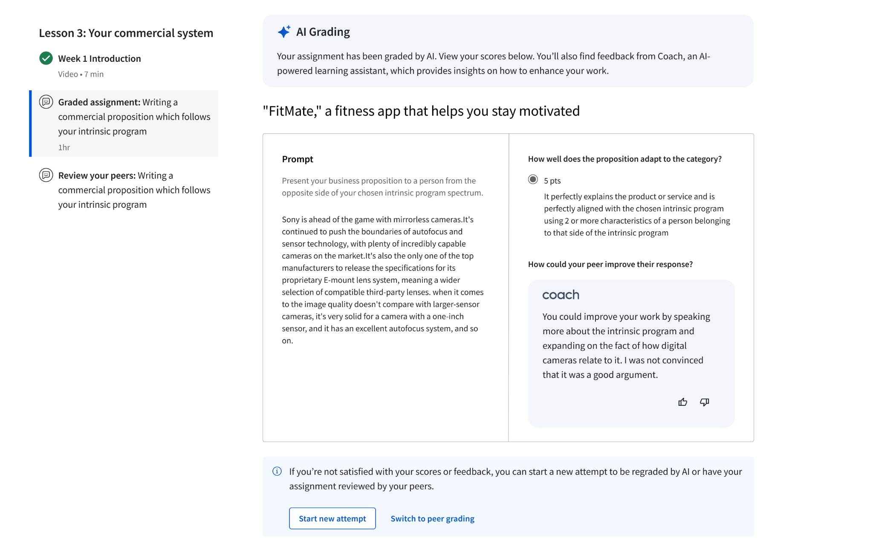
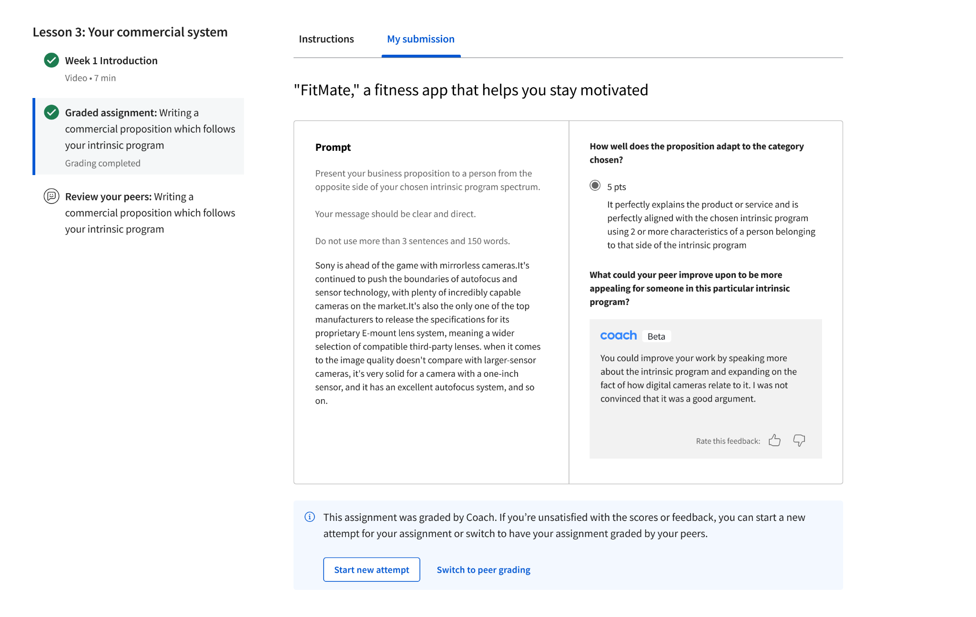
AI Grading in Peer Reviews
Leverages GenAI to improve grading efficiency and feedback quality in peer review assignments
✔
Enhances the learning experience by providing learners with faster grades and more constructive feedback
Increases academic rigor by ensuring more consistent grading using established rubrics
Reduces the level of support required to resolve issues with peer grading
✔
✔
Coursera
Proprietary & Confidential

Slide 4
In 2024, we tested AI Grading in Peer Reviews with…
🧑🏿‍🏫
🧑🏽‍🏫
🧑🏼‍🏫
✍
📄
Paid Consumer and Enterprise Learners A/B test for 50% of learners
300,000+ Submissions Graded by AI within the 90 days of our experiment
2,600+ Assignments* Rich text assignments, across domains, courses & partners
*All Assignments were in English and public sessions, while excluding all degree or pathway content as well as learners in the UK and Europe.
Coursera
Proprietary & Confidential

Slide 5

Monitoring quality and success throughout test
Learners received AI grades in 1 minute of submission, compared to 15 hours with human graders.
Feedback thumbs up rate: 90% of learners expressed ‌satisfaction of those who responded to the thumbs-up or -down rating with the AI feedback from Coach alongside their peer review grade.
Learners switching back: Only 7% of learners switched back to full human grading. Notably, a majority of these learners (84%) did not receive a passing grade from the AI.
Coursera
Proprietary & Confidential

Slide 6
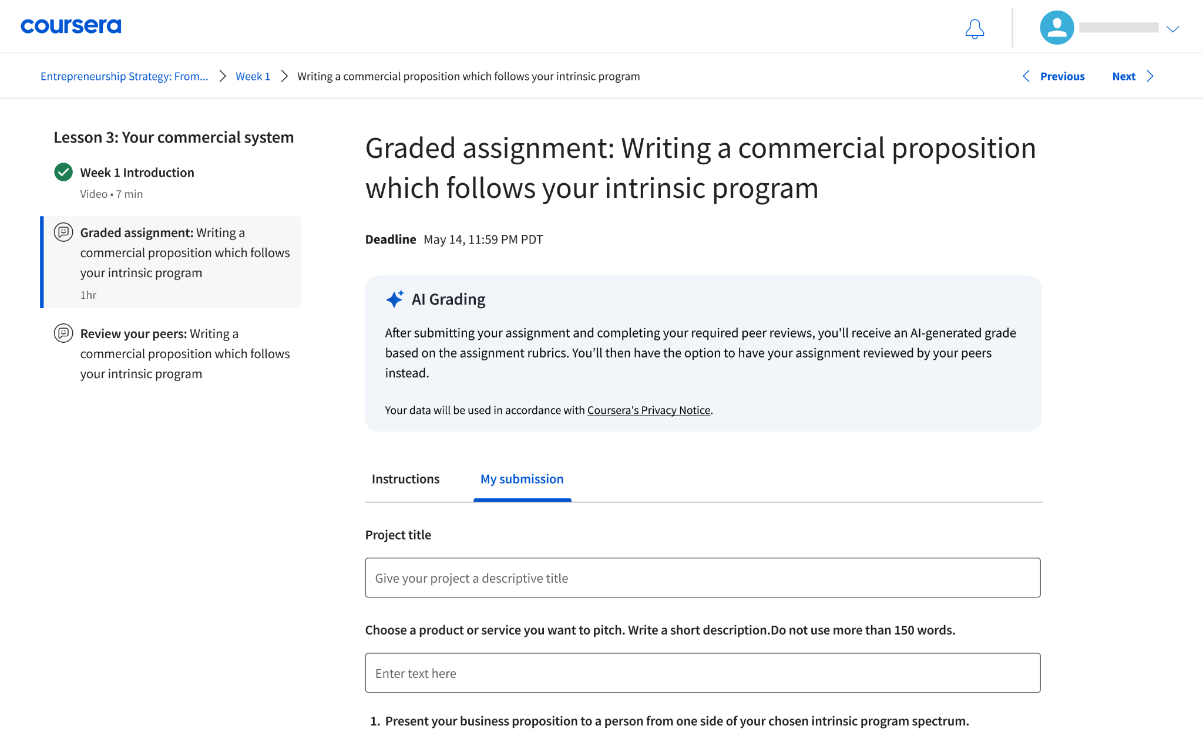
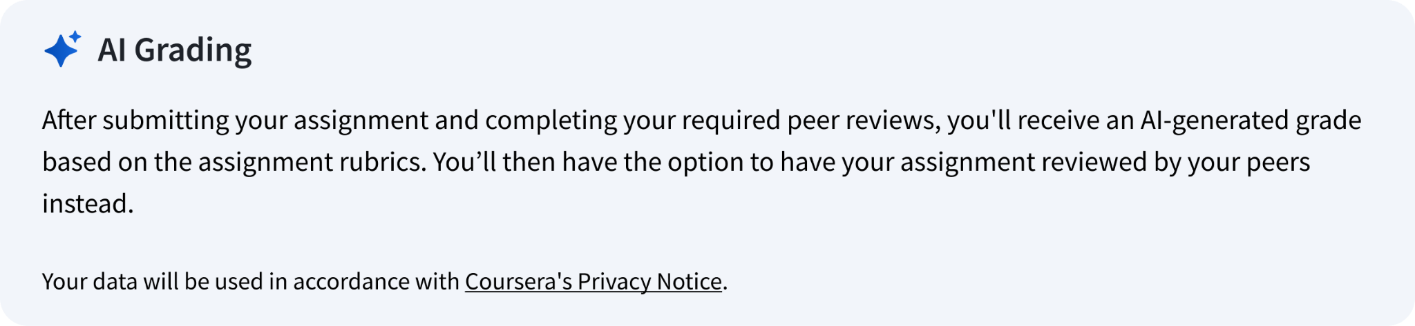
Learners submit their assignments
Learners are informed in advance that their assignments will be graded by AI once submitted.
Coursera
Proprietary & Confidential

Slide 7
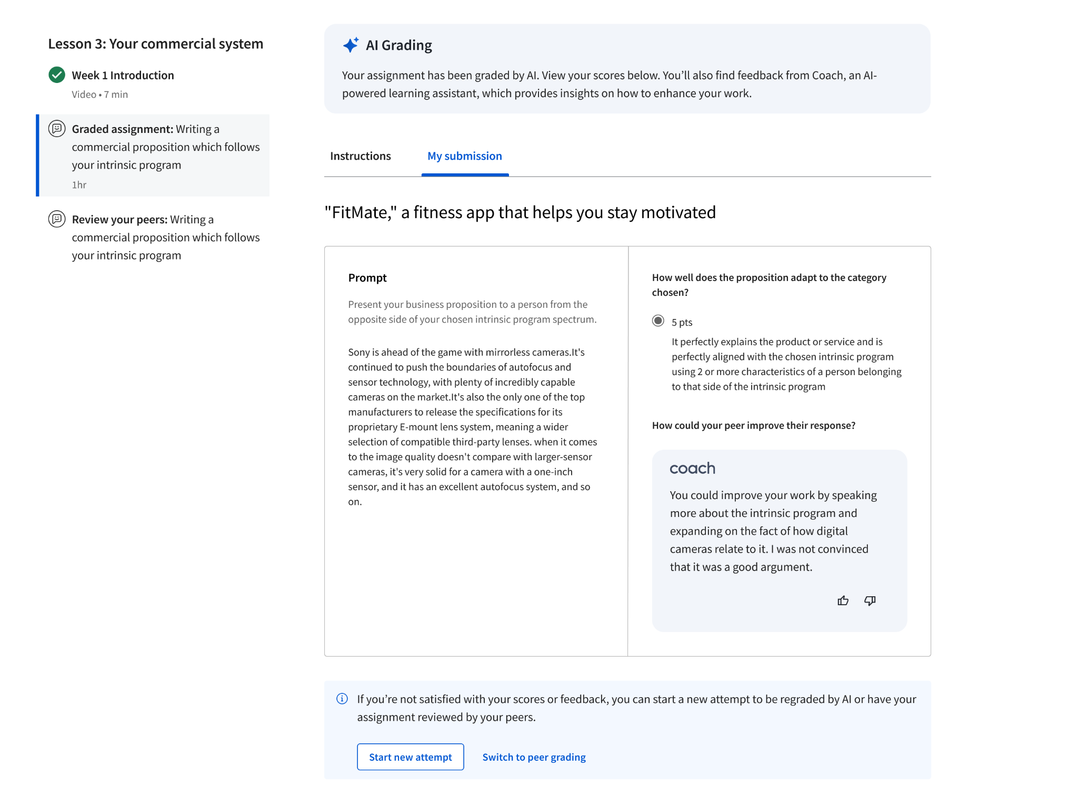
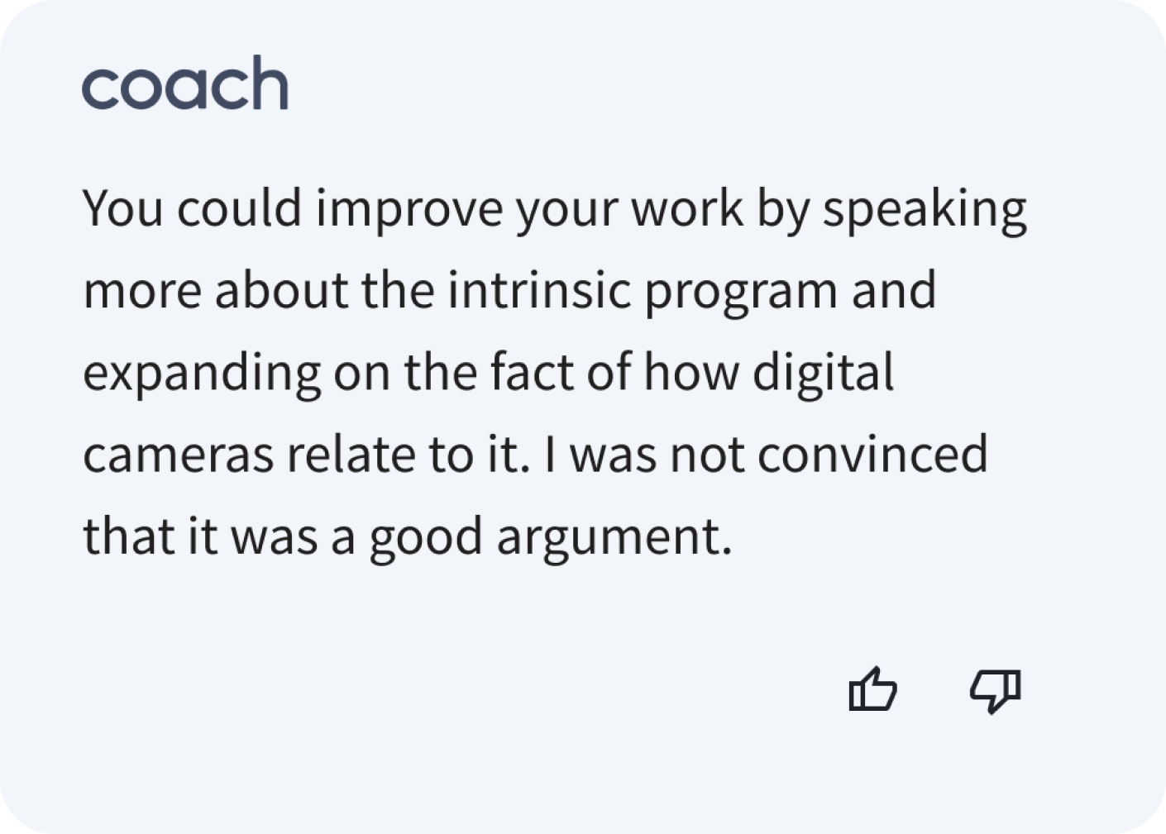
Learners get grades and feedback instantly
Once learners complete the requisite peer reviews, they’ll receive their grades and clear, constructive feedback instantly
Coursera
Proprietary & Confidential

Slide 8

Impact on learning metrics during this test
More feedback: Learners received an average of 45x more feedback in the AI grading group using a prompt adhering to online pedagogical best practices.
Increased practice: Learners assessed by AI are submitting more attempts, on average, for their peer review assignment.
Greater progress: Course completions increased by 16.7% within a day of peer review impression.
Coursera
Proprietary & Confidential

Slide 9

Signals of increased rigor
Across all assignments and learners, AI grades in peer review were 3% lower, on average, than those given by peer graders.
The first-attempt pass rate for AI-graded assignments was 72% compared to 88% for human-graded peer review assignments.
The AI grading system is less likely to award perfect scores (100%) and more likely to give 0% when the submission fails to meet any rubric criteria.
Coursera
Proprietary & Confidential

Slide 10

Let’s learn from one another
Think individually: "What is one opportunity or concern you have with using AI for grading assessments and providing feedback?"
Pair up and discuss thoughts with a partner
Share out: let’s hear from a few of you!
Coursera
Proprietary & Confidential

Slide 11
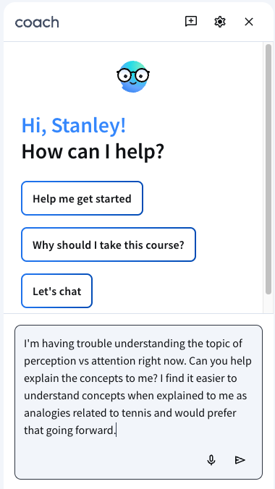
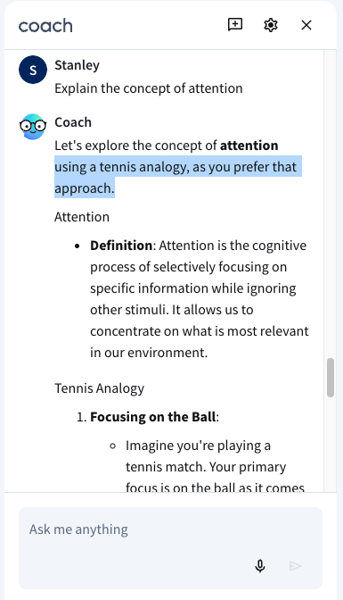
What’s ahead
More submission types
Additional modalities of feedback
Increased personalization
Continued investment in accuracy, quality, and utility of the output
Coursera
Proprietary & Confidential

Slide 12
Questions?
Thank you!

