Slide 1
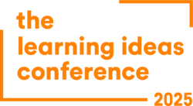
Transformative Learning in the Age of Gen AI
Educators’ Perspectives on a Learning Paradigm Shift
Dr. Mara Alagic & Dr. JaeHwan Byun
Wichita State University
Wichita, KS. USA

Slide 2
Table of Contents
Introduction
Background and purpose of the study
Research questions and theoretical framing
AI and Education
What is AI?
Traditional AI vs. Generative AI (GenAI)
Transformative Learning Theory and GenAI
Learning Paradigms
Definition and components of paradigms
Historical paradigm shifts in education
Behaviorism, Cognitivism, Constructivism, and Connectivism
GenAI and Existing Learning Paradigms
GenAI through the lens of Behaviorism
GenAI through the lens of Cognitivism
GenAI through the lens of Constructivism
Educators’ Perspectives
Thematic findings from educators’ experiences
Reflections on paradigm shifts and teaching practices
Summary and Conclusion
Key insights
Remaining questions
Implications for future research and practice

Slide 3
Introduction:
Background of the study
Educators are actively exploring how GenAI affects their teaching roles, student engagement, and learning processes.
The emergence of Generative Artificial Intelligence (GenAI), such as ChatGPT, has rapidly effected educational practices and discourse.

Slide 4
Introduction:
Purpose of the Study
How educators are processing and responding to GenAI, examined through Transformative Learning Theory
The purpose of the study was to explore the disruptive and transformative potential of GenAI in educational contexts.
We investigated how GenAI is influencing both educators’ professional activities and understanding of changes.
Consequently, we had opportunity to cogitate on learning paradigms in the context of ongoing changes induced by use of Gen AI in educational contexts.
Two
dimensions
Whether GenAI represents a disruption or shift in educational learning paradigms

Slide 5

Introduction:
Research Questions
How are educators adopting and adapting GenAI technologies in their practice?
Are their experiences with GenAI indicative of a learning paradigm shift, or merely a disruption?
How does GenAI align with, extend, or challenge existing paradigms—Behaviorism, Cognitivism, and Constructivism? Or, Could Integration of GenAI lead to the emergence of a new learning paradigm?

Slide 6
AI and Education

Slide 7
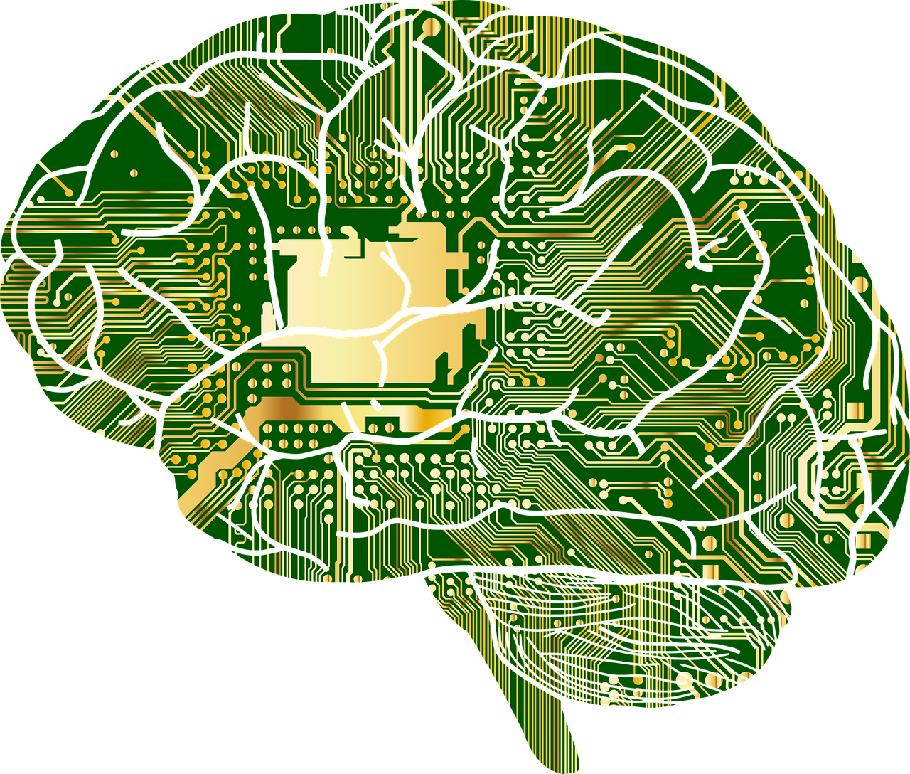
AI and Education:
What is AI?
AI refers to the simulation of human intelligence processes by machines using algorithms.
It includes capabilities like learning from data, “reasoning”, and “decision-making.”
Subfields range from expert systems and machine learning to natural language processing and robotics.
Key goals of AI:
  Automate tasks
  Adapt based on performance
  Exhibit intelligent behavior comparable to human reasoning
“AI enables machines to recognize images, understand speech, and even engage in dialogue.”

Slide 8

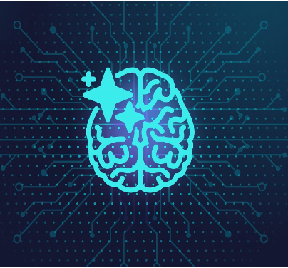
AI and Education:
What is AI?
Traditional AI
  Analytical/Predictable
  Rule-based and deterministic
  Follows predefined logic
  Limited adaptability
  Example: expert systems
Generative AI
  Probabilistic, powered by deep learning
  Generates new content from learned data
  Open-ended, “creative”, context-responsive
  Example: ChatGPT, DALL·E, Midjourney
GenAI uses large language models and neural networks to produce original text, images, or media.
Unlike symbolic AI, GenAI can simulate dialogue, reflect user input, and support creative tasks in real time.

Slide 9
AI and Education:
Transformative Learning Theory (TLT) and GenAI
Transformative Learning Theory in the Context of GenAI
  TLT (Mezirow, 1991) explains how adults revise their worldviews in response to disorienting experiences.
Five phases of transformation:
Integration of New Perspectives
Planning & Action
Dialogue
(PSPT)
Critical Reflection
Disorienting Dilemma

Slide 10
AI and Education:
Transformative Learning Theory (TLT) and GenAI
Critical Reflection
Findings from this study:
  250 of discussion entries
  Most educators were in the Critical Reflection stage.
  Some showed movement toward Planning and Action.
  Participants demonstrated both optimism and caution, emphasizing:
    Ethical use of GenAI
    Student-centered learning
  Need for more research and support
Movement Toward Planning
and Action
Optimism and Caution
Ethical Use of GenAI
Student-Centered Learning
Need for More Research and
Support
“Educators are in the stage of transformation, navigating GenAI’s promise and its ethical tensions.”

Slide 11
Learning Paradigms

Slide 12
About Paradigms and Paradigm Shifts
A paradigm is a framework of assumptions, concepts, and practices that shape how a field understands and explores reality.
Coined by Thomas Kuhn (1962): paradigms guide inquiry until anomalies lead to paradigm shifts.
In education, paradigm shifts occur when new theories challenge dominant views of how learning occurs.
Learning paradigms affect:
  How knowledge is defined and transmitted
  How the identities of learners and teachers are conceptualized
  How teaching and assessment are designed

Slide 13
Learning Paradigms:
Core Dimensions of Learning Paradigms
Epistemology – What is knowledge, and how is it acquired?
Ontology – Who is the learner? What is their role in the learning environment?
Methodology – How is learning facilitated or structured?
Three Dimensions of Learning Paradigms
These dimensions shape whether a learning environment is teacher-centered to learner-centered, passive to active, individual to social.

Slide 14

Learning Paradigms:
Historical Shifts in Learning Paradigms
Behaviorism
(early 20th century):
Learning = observable behavior change
Reinforcement, repetition, conditioning
Cognitivism
(mid–20th century):
Learning = mental information processing
Emphasis on memory, attention, schema
Constructivism
(late 20th century):
Learning = active meaning-making
Based on experience, context, social interaction
Connectivism
(early 21st century)
Learning = making and nurturing connections
Learners are nodes in a network
  Advances in psychology and neuroscience
  Rise of internet technology in education
  New social expectations for learning

Slide 15
GenAI and
Existing Learning Paradigms

Slide 16

GenAI Through the Lens of Behaviorism (1)
Behaviorism emphasizes learning as a response to external stimuli, shaped through reinforcement and repetition.
GenAI applications that align:
  Language apps giving instant feedback and rewards (e.g., Duolingo with GenAI backend)
  AI systems that adjust difficulty based on correct/incorrect responses
Behaviorism

Slide 17
GenAI Through the Lens of Behaviorism (2)
GenAI can optimize:
  Procedural learning (e.g., drills, math practice)
  Habit formation through gamified interfaces
Limitations:
  Emphasis on surface behavior, not deep understanding
  Less suited for critical thinking or contextual meaning-making
Behaviorism

Slide 18
GenAI Through the Lens of Cognitivism (1)
Cognitivism views learning as an internal process involving memory, reasoning, and organization of information.
GenAI supports cognitive learning through:
  AI-powered tutors that scaffold understanding by identifying misconceptions
  Interactive dashboards that visualize learning progress
  Prompts that encourage metacognitive strategies (e.g., summarizing, reflecting)
Cognitivism

Slide 19
GenAI Through the Lens of Cognitivism (2)
Benefits:
  Promotes self-regulated learning
  Encourages deep mental processing via step-by-step guidance
Considerations:
  Learners must still develop awareness of how to guide GenAI effectively
Cognitivism

Slide 20
GenAI Through the Lens of Constructivism (1)
Constructivism sees learning as an active
process of building meaning through experience, social interaction, and reflection.
GenAI can act as a co-learner or dialogic partner:
  Simulates real-world problems for
  project-based learning
  Generates ideas, debates, or prompts for inquiry-based tasks
  Adapts responses based on learners’ context, interests, or prior knowledge
Constructivism

Slide 21
GenAI Through the Lens of Constructivism (2)
Examples:
  Students using GenAI to explore complex
  social or ethical issues
  AI-generated simulations that support
  scenario-based learning
Strengths:
  Encourages creativity,
  perspective-taking, collaboration
Challenge:
  Requires careful facilitation to avoid
  over-reliance or passive use
Constructivism

Slide 22
Educators’ Perspectives

Slide 23

Educators’ Perspectives: Dual Mindset
Participants expressed a complex mix of curiosity,
enthusiasm, and caution.
Key tensions in their responses:
  Optimism vs. Concern over academic integrity
  and ethics
  Embracing potential vs. fear of dependency
  Creative opportunities vs. diminished student
  effort
GenAI seen both as a powerful assistant and a threat to traditional skills
Examples of tools used: ChatGPT, Grammarly, Canva AI, generative design apps
“I don’t think teachers will ever be replaced by AI, but our roles will change.” – EB, participant

Slide 24
Educators’ Perspectives:
Shifting Roles & Practices in AI Mediated Landscapes
Educators described transformations that align with paradigm-level shifts:
  From “knowledge deliverer” to mentor and facilitator
  Focus on critical thinking, creativity, personalization
GenAI supports:
  Adaptive learning paths and tailored lesson plans
  Immediate feedback and real-time scaffolding
Equity concerns raised:
  Access to technology
  Digital literacy gaps among educators and students
GenAI contributes to rethinking how knowledge is constructed and who constructs it

Slide 25
Educators’ Perspectives:
Implications and Future Considerations
Key questions emerging:
How do we prepare future teachers to use GenAI ethically and effectively?
What guidelines are needed to maintain academic integrity and fairness?
How can we ensure access and inclusion for all learners?
Ongoing need for:
Professional development
Collaborative exploration of best practices
A sustained conversation about what counts as learning
“GenAI continues the shift away from teachers as the sole presenters of knowledge.” – AB, participant

Slide 26
Summary & Conclusion

Slide 27
Key Insights from the Study
Implementation of GenAI is reshaping how educators reflect, plan, and teach.
Educators are in the midst of transformative learning, particularly at the stages of critical reflection and planning/action.
Integrating GenAI in education:
  Extends and challenges aspects of existing paradigms (Behaviorism, Cognitivism, Constructivism)
  Introduces new dynamics in epistemology, ontology, and methodology
Educators recognize both opportunities and risks:
  Creative support vs. academic shortcuts
  Personalization vs. equity gaps
  Evolving roles vs. uncertain responsibilities

Slide 28
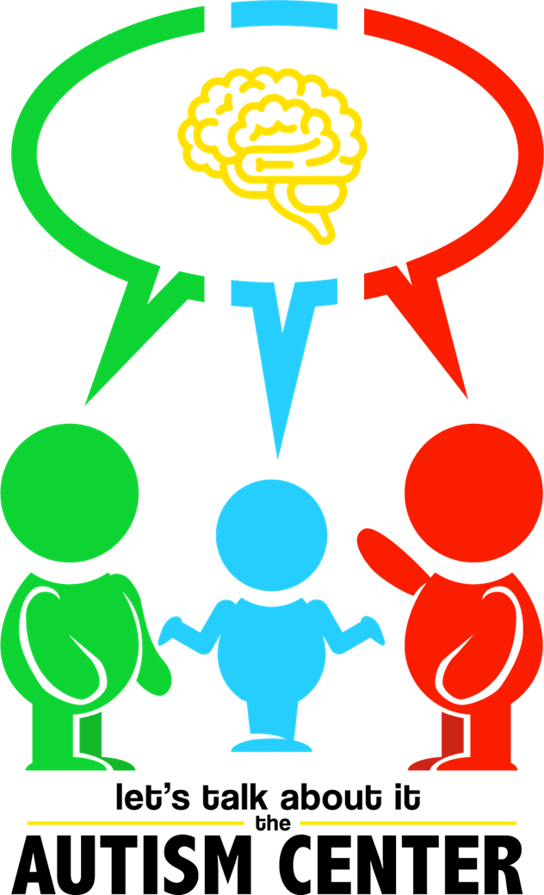
Let’s Talk!
The study points a critical juncture:
Could GenAI be an enhancement of existing paradigms, or could it evolve into its own distinct paradigm?
Three critical questions to continue examining:
  Epistemology: How is GenAI reshaping what knowledge is and how it’s created?
  Ontology: How is the identity of the learner (and teacher) fundamentally changing?
  Methodology: How are GenAI-mediated practices distinct from previous models?

Slide 29
“Transformative learning begins with disorientation.
GenAI may be that disorientation — and the direction of transformation depends on how we respond.”
mara.Alagic@wichita.edu
jaehwan.byun@Wichita.edu

